Slide 1


Slide 2

SPAM CLASSIFICATION
USING SVM
Presented by :
NISHTHA GOEL :2K12/CO/080
PALAK JAIN : 2K12/CO/083
VRINDA BHATIA: 2K12/CO/145

Slide 4
WHAT IS MACHINE LEARNING?
It is field of study that gives computers the ability to learn without being explicitly programmed.
Mathematically, a computer program is said to learn from experience E with respect to some task T and some performance measure P, if its performance on T, as measured by P, improves with experience E.

Slide 5
TYPES OF MACHINE LEARNING ALGORITHMS
There are two types of machine learning algorithms:
1.SUPERVISED LEARNING : Supervised learning is the machine learning task of inferring a function from labeled training data. The training data consist of a set of training examples. There are
two types of supervised learning algorithms:
-Classification
-Regression
2.UNSUPERVISED LEARNING: In machine learning, the problem of unsupervised learning is that of trying to find hidden structure in unlabeled data. Since the examples given to the learner are unlabeled, there is no error or reward signal to evaluate a potential solution. This distinguishes unsupervised learning from supervised learning.

Slide 6
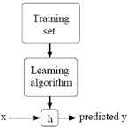
SUPERVISED ALGORITHM-TYPES
REGRESSION- In this type, there are continuous valued outputs against a given labelled data set. We feed our training set to the learning algorithm, apply a ‘HYPOTHESIS’ function to the inputs, which gives some outputs, which we call the predicted output. This is depicted by the following diagram :

Slide 7
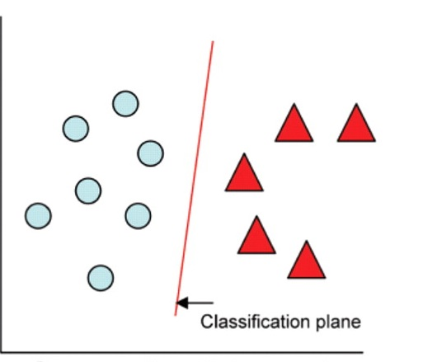
….continued
CLASSIFICATION- In this type, we identify to which of a set of categories a new observation belongs, on the basis of a training set of data containing observations (or instances) whose category membership is known.

Slide 8
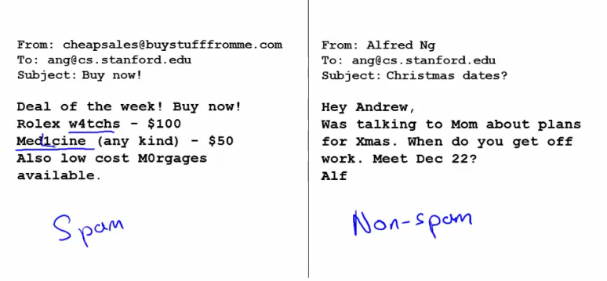
EXAMPLES
SUPERVISED LEARNING- SPAM CLASSIFICATION
In this example, we classify the emails into spam
or non-spam. This is a classification supervised problem ,
with two classes.

Slide 9
…continued
UNSUPERVISED LEARNING – COCKTAIL PARTY PROBLEM
Consider a party, room full of people, all sitting around,
all talking at the same time and suppose there are
two overlapping voices ,it is almost hard to hear the other person
clearly. So put two microphones in the room at different places.
Since these microphones are at two different distances from the
speakers, each microphone records a different combination of these
two speaker voices.

Slide 10
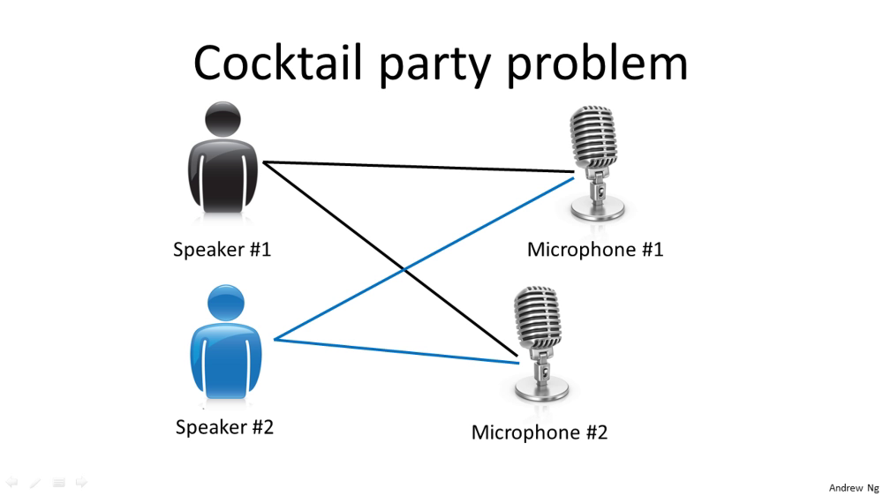

OUTPUT 1 :
OUTPUT 2 :

Slide 11
SUPPORT VECTOR MACHINE(SVM)
Support vector machines are supervised learning models with associated learning algorithms that analyze data and recognize patterns, used for classification and regression analysis.
Given a set of training examples each marked as belonging to one of two categories, an SVM training algorithm builds a model that assigns new examples into one category or the other, making it a non-probabilistic binary linear classifier.
An SVM model is a representation of the examples as points in space, mapped so that the examples of the separate categories are divided by a clear gap that is as wide as possible.

Slide 12
COST FUNCTION FOR SVM
We have to choose our parameters(θ) such that our hypothesis is close to ‘y’ for our training example(x,y).
So we introduce a ‘Cost Function’ which we have to minimize.
This minimal value of the cost function will give the optimal
value of θ.
The cost function for an SVM is similar to that of logistic
regression.

Slide 13
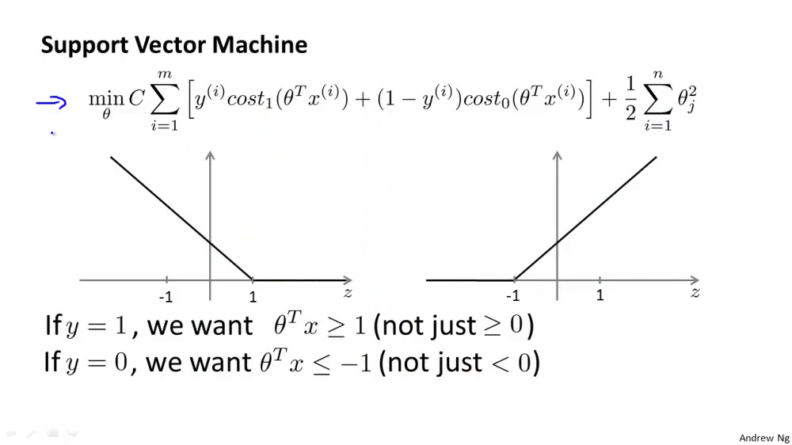
SVM HYPOTHESIS AND COST FUNCTION
H_{θ}(x)= 1 if θ^{T}x>=0
= 0 otherwise

Slide 14
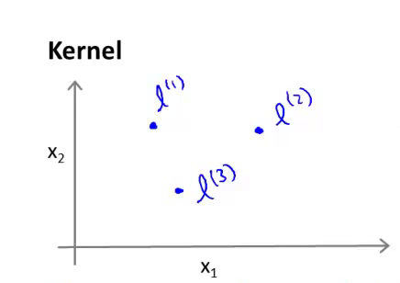
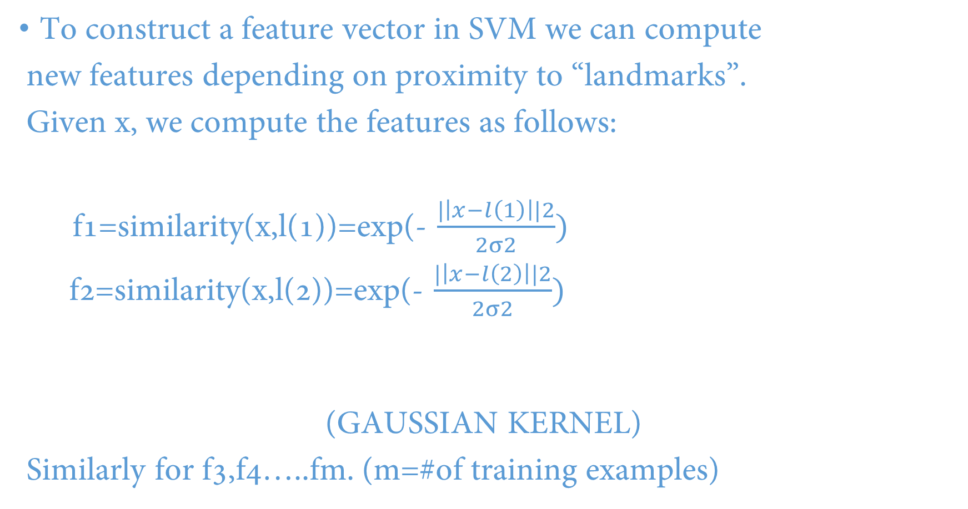
SVM KERNELS
To construct a feature vector in SVM we can compute
new features depending on proximity to “landmarks”.
Given x, we compute the features as follows:
f1=similarity(x,l(1))=exp(- $\frac{|\left|x−l\left(1\right)\right||2}{2σ2})$
f2=similarity(x,l(2))=exp(- $\frac{|\left|x−l\left(2\right)\right||2}{2σ2})$
(GAUSSIAN KERNEL)
Similarly for f3,f4…..fm. (m=#of training examples)

Slide 15
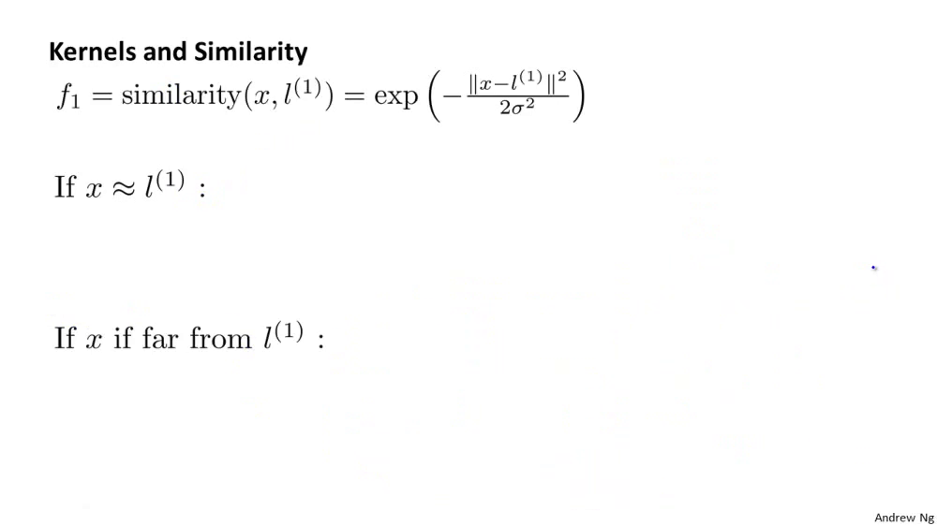
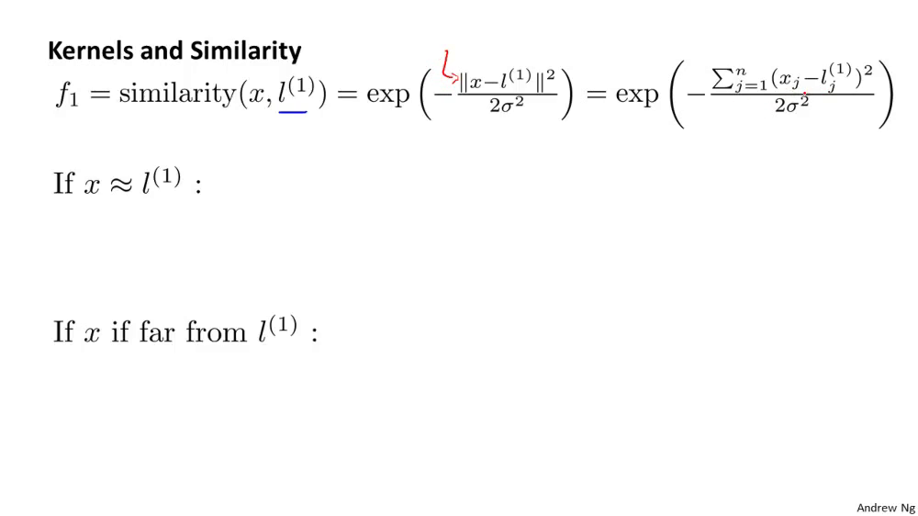
….continued
If x is near to l^{(1),}then f₁ is nearly equal to 1.
f₁=exp(-0/2σ²)=1
On the contrary, if x is far from l^{(1),} f₁ will be approximately 0.
f₁=exp(-(large number)²/2σ²)=0

Slide 16
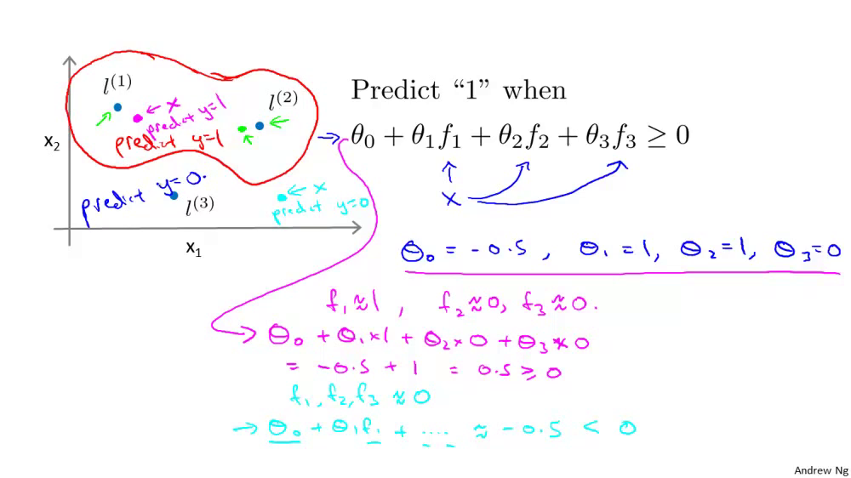

Slide 17
HOW TO CHOOSE THE LANDMARKS?
Given (x¹,y¹),(x²,y²),………(x^{m},y^{m})
choose landmarks l¹=x¹,l²=x²,…..,l^{m}=x^{m}
for training example (x^{i},y^{i}) :
calculate f₁(i),f₂(i),…..,f_{m}(i) as described in the previous slide.
Now we compute the feature vector
f=[f₀,f₁,f₂…………………….f_{m}]^{T} (f₀=1)

Slide 18
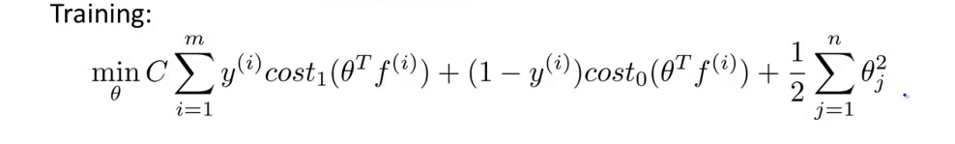
HYPOTHESIS and COST FUNCTION
Given x and feature vector f (dimension of mX1)
predict ‘y=1’, if θ^{T}f>=0
and y=0 ,otherwise
Cost Function:

Slide 19
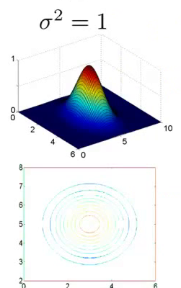
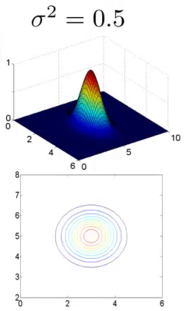
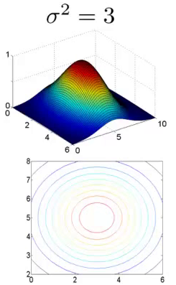
SVM PARAMETERS
Choosing constant ‘σ²’ in Gaussian Kernel:
- if ‘σ²’ is large,features fi vary smoothly.
- if ‘σ²’is small,features vary less smoothly.

Slide 20
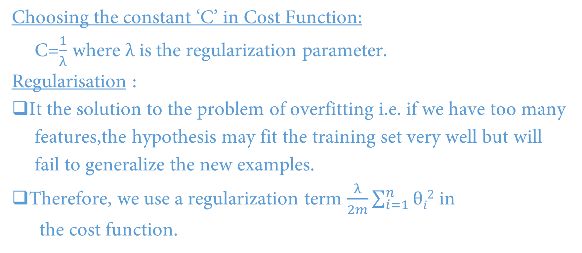
….continued
Choosing the constant ‘C’ in Cost Function:
C=$\frac{1}{λ}$ where $λ$ is the regularization parameter.
Regularisation :
It the solution to the problem of overfitting i.e. if we have too many
features,the hypothesis may fit the training set very well but will
fail to generalize the new examples.
Therefore, we use a regularization term $\frac{λ}{2m}\sum_{i=1}^{n}{θi2}$ in
the cost function.

Slide 21

SPAM CLASSIFICATION USING SVM

Slide 22
INTRODUCTION
Many email services today provide spam filters that are able to classify emails into spam and non-spam email with high accuracy.
We’ll build such a classifier using Support Vector Machine.
We will be training a classifier to classify whether a given email, x, is spam (y = 1) or non-spam (y = 0). In particular,we need to convert each email into a feature vector xԑ R^{n}

Slide 23
PREPROCESSING EMAILS
While many emails would contain similar types of entities (e.g.,numbers, other URLs, or other email addresses), the specific entities (e.g.,the specific URL or specific dollar amount) will be different in almost every email.
Therefore, one method often employed in processing emails is to “normalize" these values, so that all URLs are treated the same, all numbers are treated the same, etc.
For example, we could replace each URL in the email with the unique string “httpaddr" to indicate that a URL was present.
This has the effect of letting the spam classifier make a classification decision based on whether any URL was present, rather than whether a specific URL was present.

Slide 24
....continued
Normalization is done in the following steps:
Lower-casing: The entire email is converted into lower case, so that captialization is ignored (e.g., IndIcaTE is treated the same as Indicate).
Stripping HTML: All HTML tags are removed from the emails.Many emails often come with HTML formatting; we remove all the
HTML tags, so that only the content remains.
All URLs are replaced with the text \httpaddr".
Normalizing Email Addresses: All email addresses are replaced with the text \emailaddr".
Normalizing Numbers: All numbers are replaced with the text\number".
Normalizing Dollars: All dollar signs ($) are replaced with the text\dollar".
Word Stemming: Words are reduced to their stemmed form. For ex-ample, “discount",”discounts", \discounted" and \discounting" are all replaced with \discount". Sometimes, the Stemmer actually strips of additional characters from the end, so \include", “includes", “included",and “including" are all replaced with \includ".
Removal of non-words: Non-words and punctuation have been re-moved. All white spaces (tabs, newlines, spaces) have all been trimmed to a single space character.

Slide 25
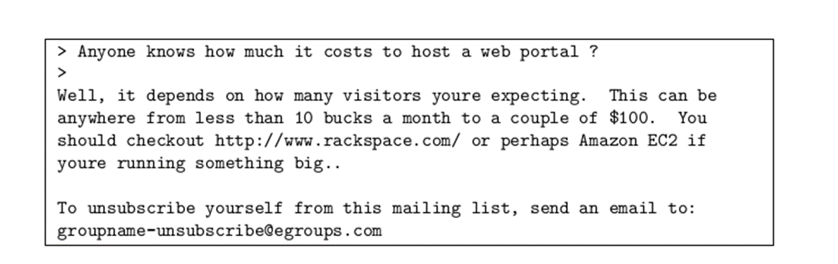
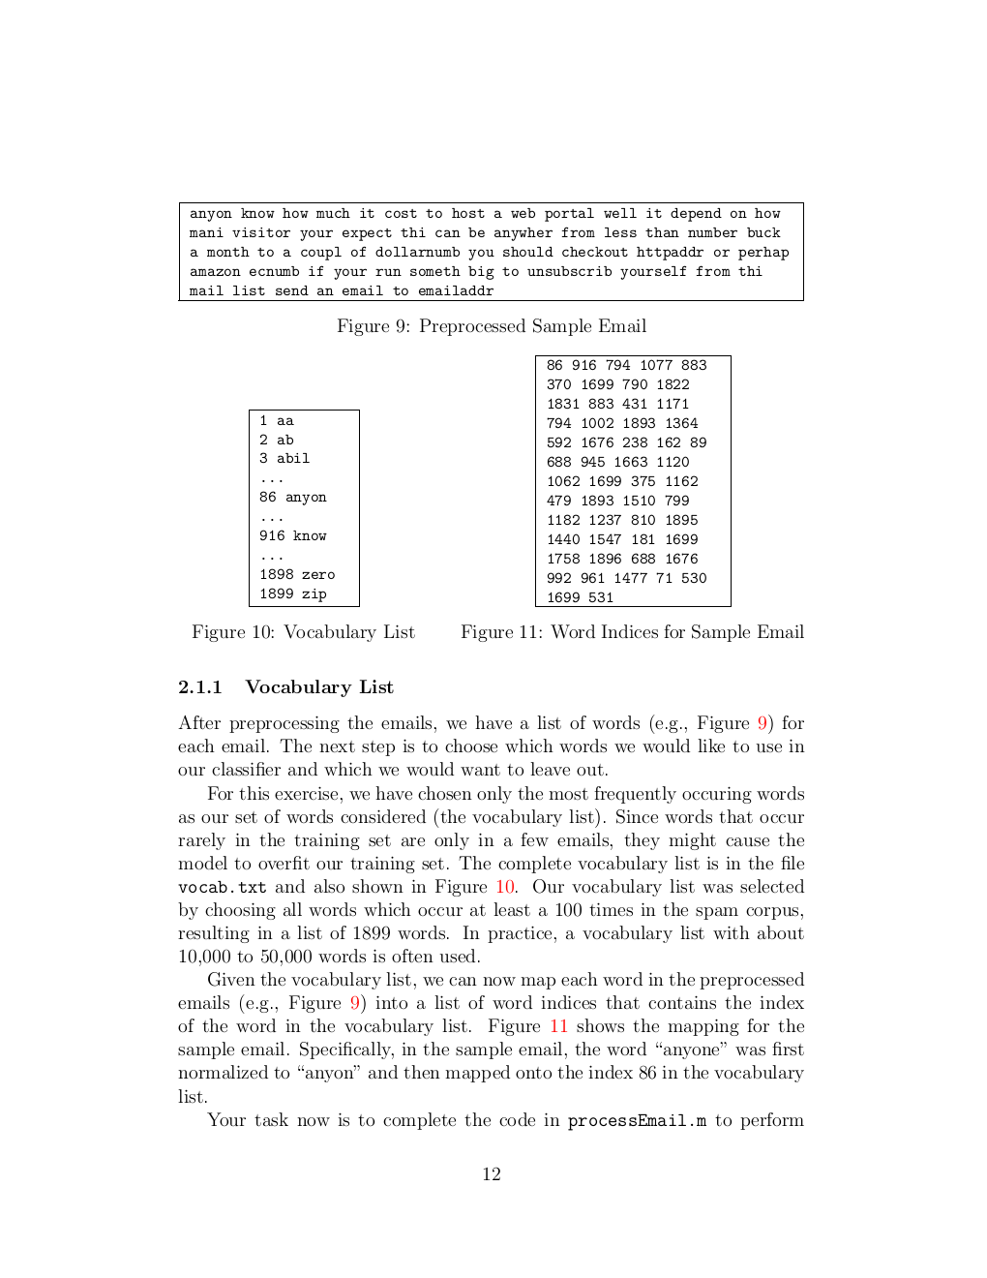
SAMPLE EMAIL
NORMALIZED EMAIL

Slide 26
VOCABULARY LIST
After preprocessing the emails, we have a list of words for each email. The next step is to choose which words we would like to use in our classifier and which we would want to leave out.
For this, we have chosen only the most frequently occuring words as our set of words considered (the vocabulary list). Since words that occur rarely in the training set are only in a few emails, they might cause the model to overfit our training set.
Our vocabulary list was selected by choosing all words which occur at least a 100 times in the spam corpus, resulting in a list of 1899 words.

Slide 27
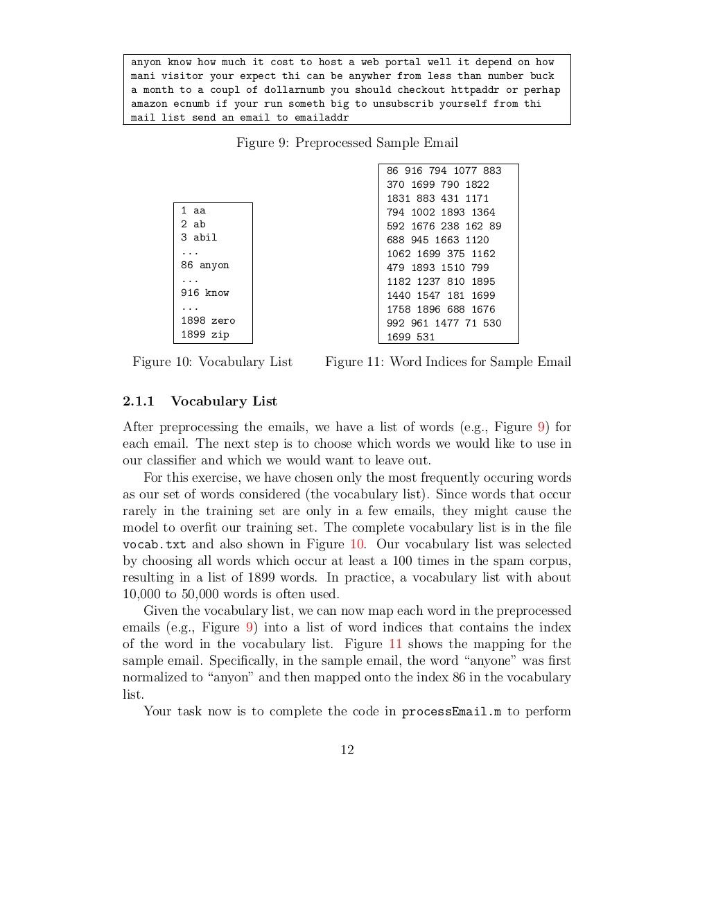
….continued
Given the vocabulary list, we can now map each word in the preprocessed emails into a list of word indices that contains the index of the word in the vocabulary list.
For example, in the sample email,the word “anyone“ was first normalized to “anyone" and then mapped onto the index 86 in the vocabulary list.
Word Indices for Sample Email

Slide 28
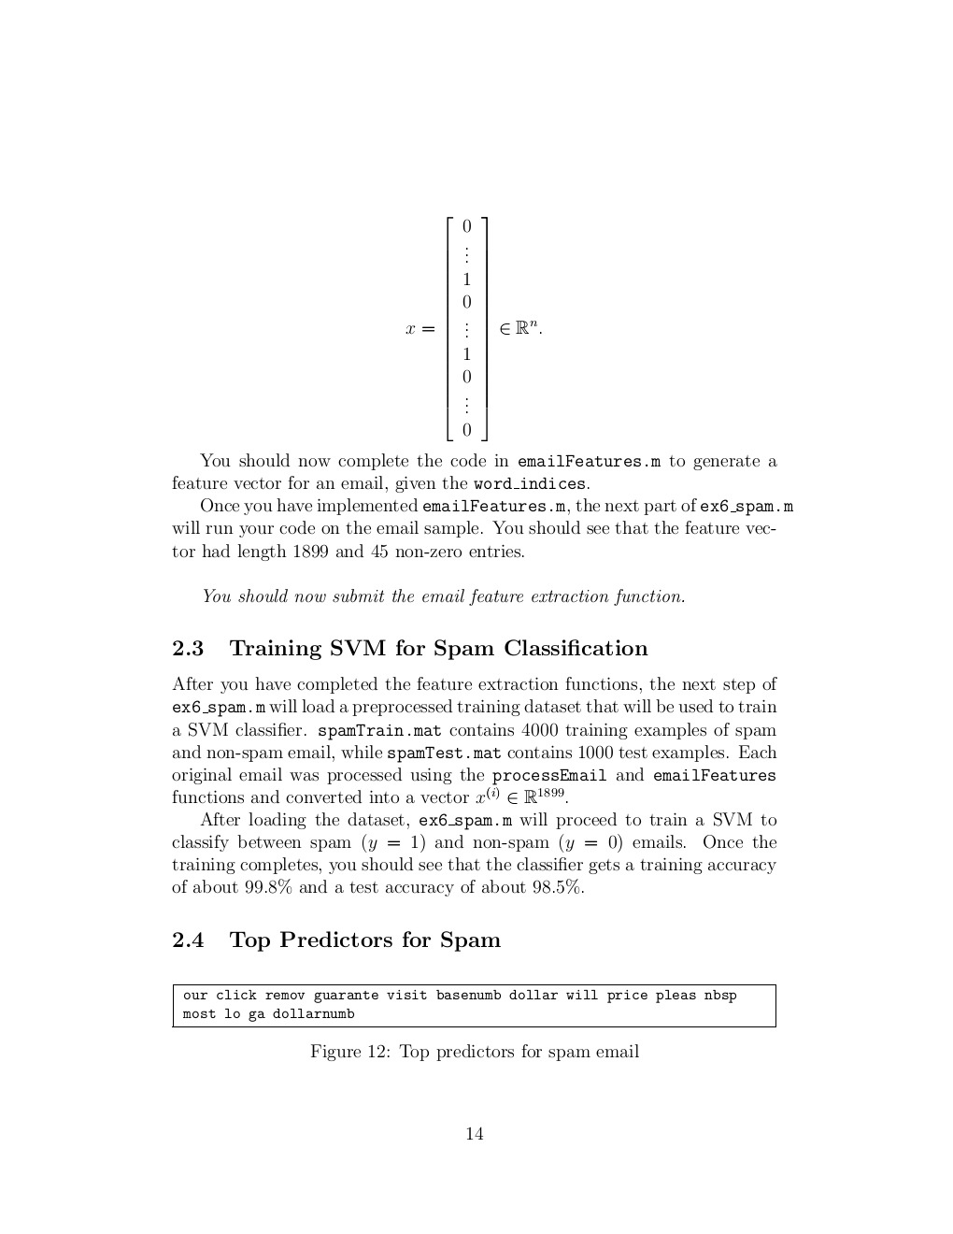
FEATURE EXTRACTION
We will now implement the feature extraction that converts each email into a vector in R^{n}
For this exercise, we will be using n = number of words in vocabulary list.
Specifically, the feature x_{i} ԑ{0,1}for an email corresponds to whether the i-th word in the dictionary occurs in the email.
That is, x_{i}= 1 if the i-th word is in the email and x_{i}= 0 if the i-th word is not present in the email.So,for a typical e-mail,feature vector will look like:

Slide 29
Train Linear SVM for Spam Classification
Now,we will load a preprocessed training dataset that will be used to train a SVM classifier.
spamTrain.mat contains 4000 training examples of spam and non-spam email, while spamTest.mat contains 1000 test examples.
Each original email was processed using the processEmail and emailFeatures functions and converted into a vector x^{(i)}ԑ R¹⁸⁹⁹.
After loading the dataset, we will proceed to train a SVM to classify between spam (y = 1) and non-spam (y = 0) emails.

Slide 30
%% ============= Part 1: Email Preprocessing ==============%
fprintf('\nPreprocessing sample email (emailSample1.txt)\n');
% Extract Features
file_contents = readFile('emailSample1.txt');
word_indices = processEmail(file_contents);
% Print Stats
fprintf('Word Indices: \n');
fprintf(' %d', word_indices);
fprintf('\n\n');
fprintf('Program paused. Press enter to continue.\n');
pause;

Slide 31
%% ================ Part 2: Feature Extraction ====================
fprintf('\nExtracting features from sample email (emailSample1.txt)\n');
% Extract Features
file_contents = readFile('emailSample1.txt');
word_indices = processEmail(file_contents);
features = emailFeatures(word_indices);
% Print Stats
fprintf('Length of feature vector: %d\n', length(features));
fprintf('Number of non-zero entries: %d\n', sum(features > 0));
fprintf('Program paused. Press enter to continue.\n');
pause;

Slide 32
%% = ==Part 3: Train Linear SVM for Spam Classification ==
% Load the Spam Email dataset
load('spamTrain.mat');
fprintf('\nTraining Linear SVM (Spam Classification)\n')
fprintf('(this may take 1 to 2 minutes) ...\n')
C = 0.1;
model = svmTrain(X, y, C, @linearKernel);

Slide 33
%% ========= Part 4: Try Your Own Emails =========
filename = 'spamSample1.txt';
% Read and predict
file_contents = readFile(filename);
word_indices = processEmail(file_contents);
x = emailFeatures(word_indices);
p = svmPredict(model, x);
fprintf('\nProcessed %s\n\nSpam Classification: %d\n', filename, p);
fprintf('(1 indicates spam, 0 indicates not spam)\n\n');

