Slide 1
Project Presentation of CO-OP Project at Industry (Module-2) (22CS421)
On
Privacy-Preserving Machine Learning using Federated Learning
Vrinda Puri
Roll No.: 2210992549
Supervised By
Dr. Simarjit Kaur
Department of Computer Science and Engineering,
Chitkara University, Punjab

Slide 2
Outline / Agenda
Introduction & Background
Federated Learning Architecture
Privacy-Preserving Techniques
Proposed System: PFed-HE
Experimental Results
Industry Applications
Technical Challenges
Conclusion & Future Scope
References
2

Slide 3
Introduction
Machine learning is widely deployed in healthcare, finance, e-commerce & mobile apps
High accuracy requires large volumes of sensitive user data
Centralized ML: all data aggregated on a single server
Creates data breach risks, single point of failure
Violates GDPR, HIPAA, PCI-DSS regulations
Federated Learning (FL) – McMahan et al., 2017
Train a shared global model without sharing raw data
Clients share gradient updates, not private data
Goal: Analyse FL as a privacy-preserving ML framework and propose PFed-HE

Slide 4
Background: Centralized vs Federated Learning
Centralized ML – Traditional Paradigm
All data transported and stored at a central server
Vulnerable to breaches; non-compliant with privacy laws
Federated Learning – Distributed Paradigm
Clients perform local training on private data
Only model updates (gradients) are sent to server
Raw data never leaves the client device
Three types of FL
Horizontal FL: same features, different samples
Vertical FL: different features, overlapping samples
Federated Transfer Learning: minimal overlap
4

Slide 5
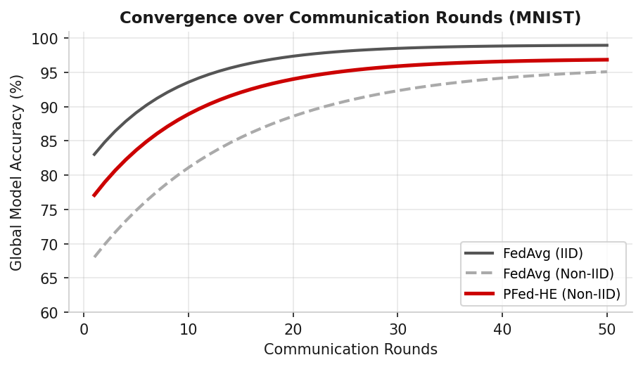
Federated Learning Architecture & FedAvg
System Components
N dispersed clients with private datasets D_k
Central aggregation server coordinating training rounds
Communication protocol for parameter exchange
FedAvg Training Protocol (per round t)
1. Server selects subset S_t of clients
2. Each client downloads global model w_t
3. Client trains locally for E epochs
4. Updated weights w_k^(t+1) sent to server
5. Server aggregates: w_{t+1} = Σ (n_k/n) · w_k^(t+1)
5

Slide 6
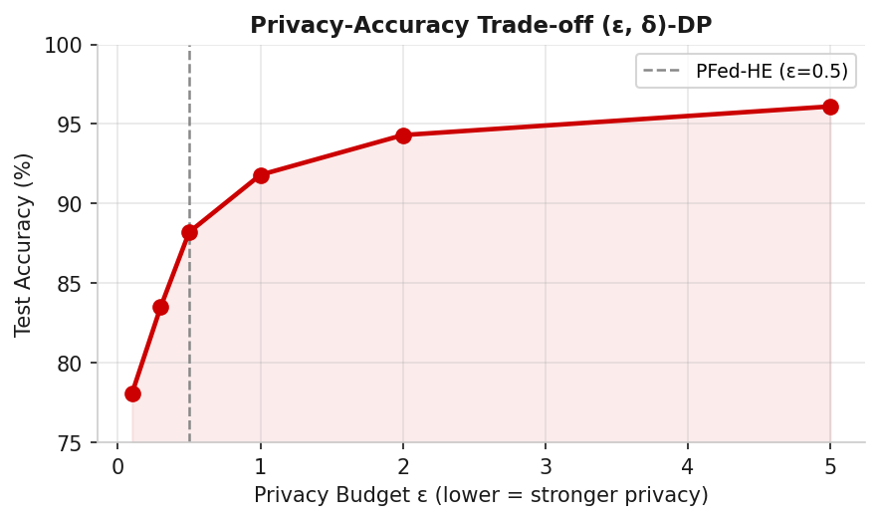
Privacy-Preserving Techniques
Differential Privacy (DP)
Add calibrated Gaussian/Laplace noise to model updates
(ε, δ)-DP: smaller ε = stronger privacy, lower accuracy
Homomorphic Encryption (HE)
Compute on encrypted gradients without decryption
CKKS scheme: efficient approximate arithmetic over real vectors
FHE: unrestricted ops; PHE: only addition or multiplication
Secure Multi-Party Computation (SMPC)
Shamir's secret sharing splits updates into n shares
Server learns only the aggregate,
6

Slide 7
Proposed System: PFed-HE Overview
Privacy-Preserving Federated Learning with Homomorphic Encryption
Six integrated components:
① Optimized CKKS HE for gradient protection
② Differential Privacy (ε = 0.5) as secondary privacy layer
③ Client-side encryption module in training loop
④ Decentralized aggregation over encrypted ciphertexts
⑤ Dynamic key management with Diffie-Hellman rotation
⑥ Batch-parallelized HE operations (CRT slot packing)
Targets: sensitive cross-silo FL (healthcare, finance, IoT)
7

Slide 8
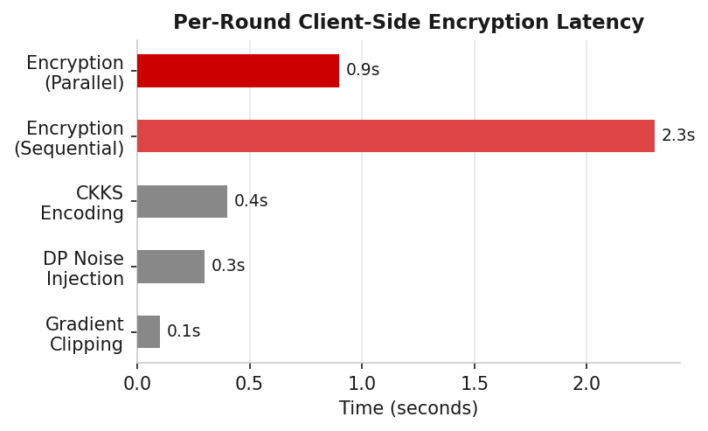
PFed-HE: Client Encryption & Aggregation
Client-Side Encryption Steps
Step 1: Gradient clipping to sensitivity bound S
Step 2: Add Gaussian noise N(0, σ²I) for (ε, δ)-DP
Step 3: Encode into CKKS plaintext slots
Step 4: Encrypt → send ciphertext c_k to server
Server Encrypted Aggregation
Homomorphic weighted sum: c_agg = Σ (n_k/n) ⊙ c_k
Decrypt only the final aggregate using shared session key
Dynamic Key Management
Diffie-Hellman key negotiation at start of each round
8

Slide 9
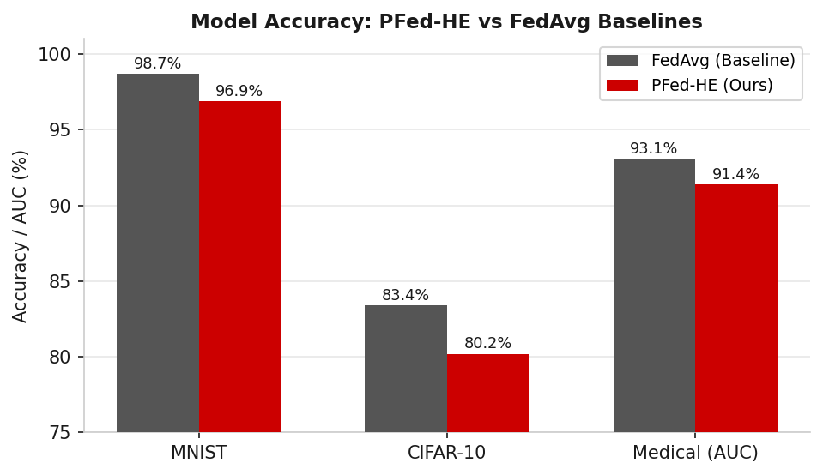
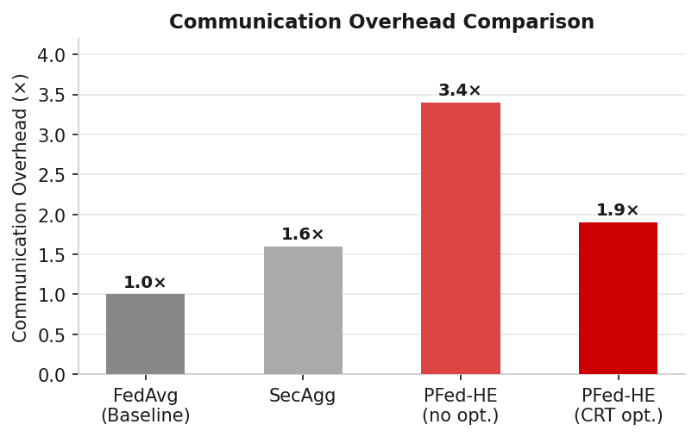
Experimental Setup & Results
Baselines: FedAvg, DP-FedAvg (ε=1.0), SecAgg
Datasets: MNIST, CIFAR-10, Medical Chest X-Ray (Non-IID, α=0.5, 100 clients)
Results Summary
MNIST: PFed-HE 96.9% vs FedAvg 98.7% (gap: 1.8%)
CIFAR-10: PFed-HE 80.2% vs FedAvg 83.4% (gap: 3.2%)
Medical AUC: 91.4% vs 93.1% (non-private) – clinically acceptable
PFed-HE provides ε = 0.5 (stronger than DP-FedAvg at ε = 1.0)
Communication Overhead
Without batch optimization: 3.4× overhead
With CRT slot packing: reduced to 1.9×
Encryption time: 2.3s → 0.9s with parallel processing
9

Slide 10
Industry Applications
Healthcare
Multi-hospital model training without sharing patient records
Brain tumor segmentation, COVID-19 X-ray, diabetic retinopathy
Finance
Cross-bank fraud detection on combined transaction data
SecureBoost: vertical FL for credit risk modelling
Mobile & Edge Computing
Google Gboard: next-word prediction for billions of users
On-device voice recognition without uploading audio
IoT & Smart Cities
Smart grid energy management, predictive maintenance
Connected vehicles: traffic prediction without GPS traces
10

Slide 11
Technical & Security Challenges
Communication Overhead
Deep models have millions of parameters to transmit per round
Mitigation: gradient compression, quantization, top-k sparsification
Non-IID Data Heterogeneity
Client drift from divergent local objectives → slow convergence
Solutions: FedProx, SCAFFOLD, personalized FL
Gradient Leakage Attacks
DLG attack can reconstruct training samples from gradients
Defence: DP, gradient compression, secure aggregation
Poisoning & Byzantine Attacks
Malicious clients inject crafted updates (backdoor triggers)
Defences: Krum, Trimmed Mean, FLTrust – still imperfect
11

Slide 12
Conclusion & Future Scope
Conclusions
FL enables collaborative ML without sharing raw data
PFed-HE combines HE + DP + dynamic key mgmt for end-to-end privacy
Achieves competitive accuracy with formal (ε=0.5)-DP guarantees
Communication overhead reduced to 1.9× with batch optimization
Future Research Directions
Personalized FL with formal convergence guarantees
Blockchain-based audit trails for model update accountability
Quantum-secure cryptographic primitives for HE/SMPC
Federated Reinforcement Learning (robotics, autonomous driving)
FL + LLMs via LoRA for privacy-preserving fine-tuning at scale
12

Slide 13
References
[1] McMahan et al. – FedAvg. AISTATS, 2017
[2] Li et al. – FL: Challenges, Methods. IEEE Signal Process., 2020
[3] Yang et al. – Federated Machine Learning. ACM TIST, 2019
[4] Kairouz et al. – Advances and Open Problems in FL. Found. Trends ML, 2021
[5] Bagdasaryan et al. – How to Backdoor FL. AISTATS, 2020
[6] Bonawitz et al. – Practical Secure Aggregation. CCS, 2017
[7] Geyer et al. – Client-Level DP for FL. arXiv:1712.07557, 2017
[8] Dwork & Roth – Algorithmic Foundations of DP. Found. Trends TCS, 2014
[9] Cheon et al. – CKKS Homomorphic Encryption. ASIACRYPT, 2017
[10] Rieke et al. – Future of Digital Health with FL. npj Digital Med., 2020
[11] Lim et al. – FL in Mobile Edge Networks. IEEE Commun. Surv., 2020
13

Slide 14
Thank You
14

