Slide 1

Team members:
1.Roshini S [711715104050]
2.Vrinda raj.V.P [711715104075]
Faculty Guide : Mrs.Jayashree.r [AP/CSE]
Industry Guide : Mrs.Yukthika [Developer / KGFSL]
Department of CSE, KGiSL Institute of Technology, Coimbatore

Slide 2
Abstract
The E-Charging Operators (equivalent of today’s petrol pump operators) need a Big Data approach to ensure their customers (end-users) satisfaction and optimum utilization of the e-Charging stations.
The operator may have fast or slow charging infrastructure with their own payment terms and timings.
Based on a data-centric approach the operator can offer dynamic pricing at stipulated times and manage the peak demand accordingly.
Department of CSE, KGiSL Institute of Technology, Coimbatore

Slide 3
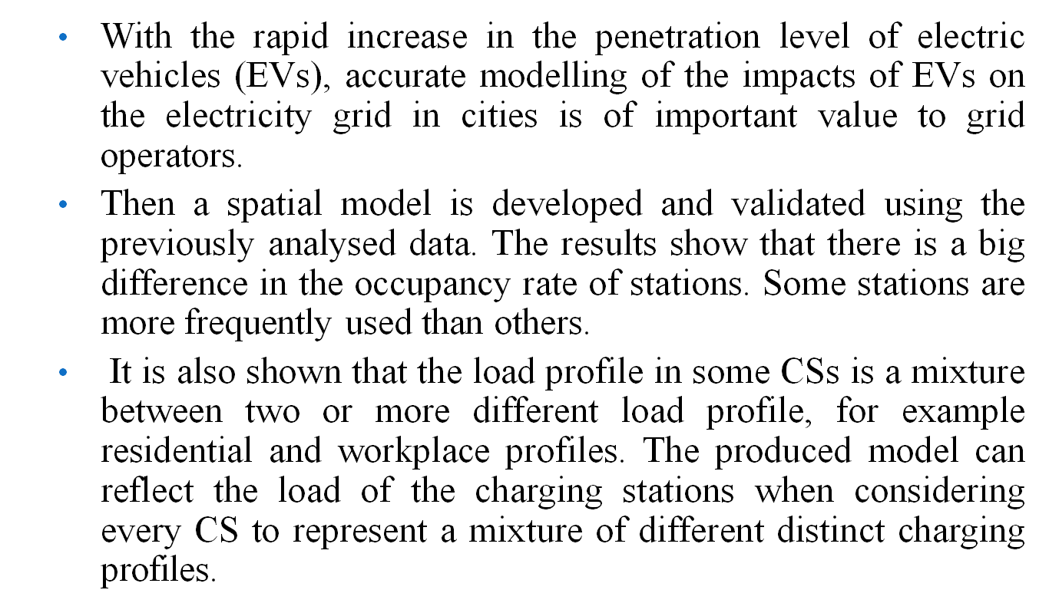
Area Introduction-Existing system
Department of CSE, KGiSL Institute of Technology, Coimbatore

Slide 4
Proposed System
A battery swapping (or switching) station is a place at which a vehicle's discharged battery or battery pack can be immediately swapped for a fully charged one, eliminating the delay involved in waiting for the vehicle's battery to charge.
Some electric vehicles have onboard converters that can plug into a standard electrical outlet or a high-capacity appliance outlet. Others either require or can use a charging station that provides electrical conversion, monitoring, or safety functionality.
These stations are also needed when traveling, and many support faster charging at higher voltages and currents than are available from residential EVSEs.
Department of CSE, KGiSL Institute of Technology, Coimbatore

Slide 5
Literature Review
Drawbacks:
One of most significant issues around electric vehicles (EVs) is “range anxiety”, which describes the fear felt by drivers while driving an electric car that the battery will run out of power before reaching the destination or a charging station.
The number of electrical vehicles continues to increase but EV charging infrastructure remains underdeveloped and insufficient.
Department of CSE, KGiSL Institute of Technology, Coimbatore

Slide 6
References
https://www.nttdata.com/global/en/success-stories/2018/february/open-charging-station-controller-for-future-mobility-society#
https://wise-paas.advantech.com/en-us/embedded/resource-library/4cc199e6-0d4c-4d53-b0f5-5243b096f94a
https://en.wikipedia.org/wiki/Charging_station#Overview
https://www.researchgate.net/publication/320663372_Data_from_electric_vehicle_charging_stations_Analysis_and_model_development

Slide 7
Module Splitup
Module 1:
1.Data set
2.Data cleaning
Module 2:
1.K-means
Module 3:
1.Linear regression
2.Decision tree
Module 4:
1. prediction score and accuracy.
Department of CSE, KGiSL Institute of Technology, Coimbatore

Slide 8
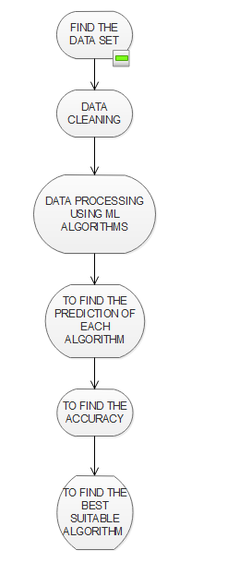
USECASE

Slide 9
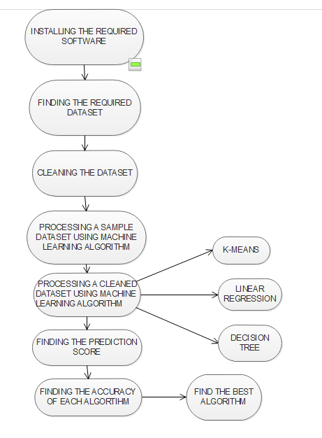
USECASE

Slide 10
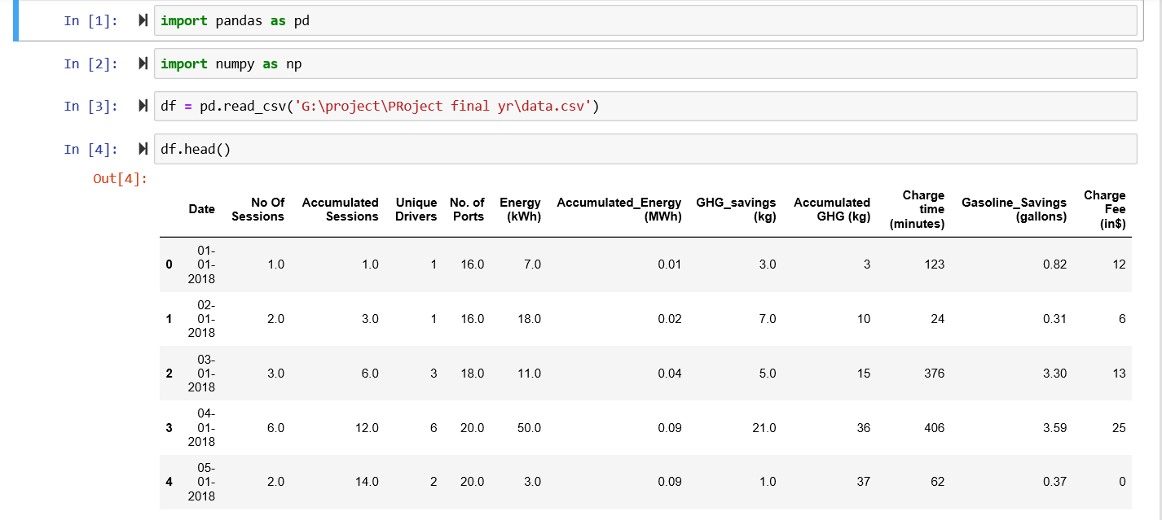
SCREENSHOTS OF MODULE UNDER PROGRESS

Slide 11
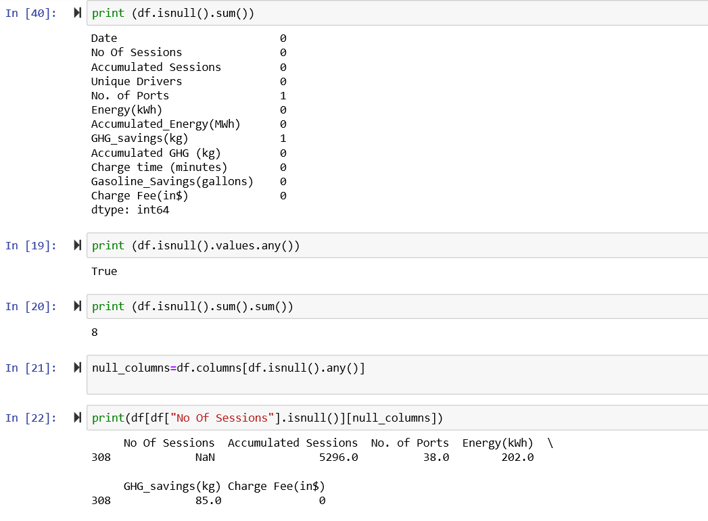
SCREENSHOTS OF MODULE UNDER PROGRESS

Slide 12
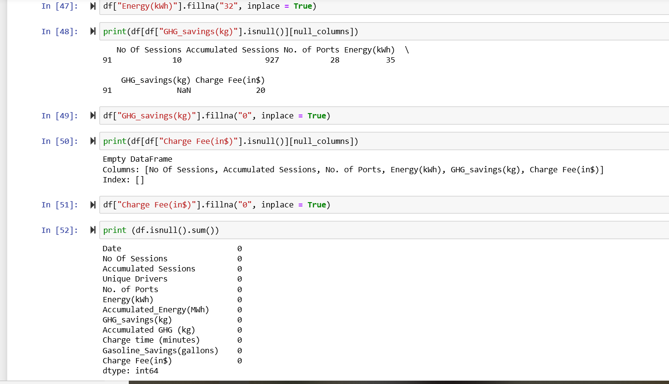
SCREENSHOTS OF MODULE UNDER PROGRESS

Slide 13
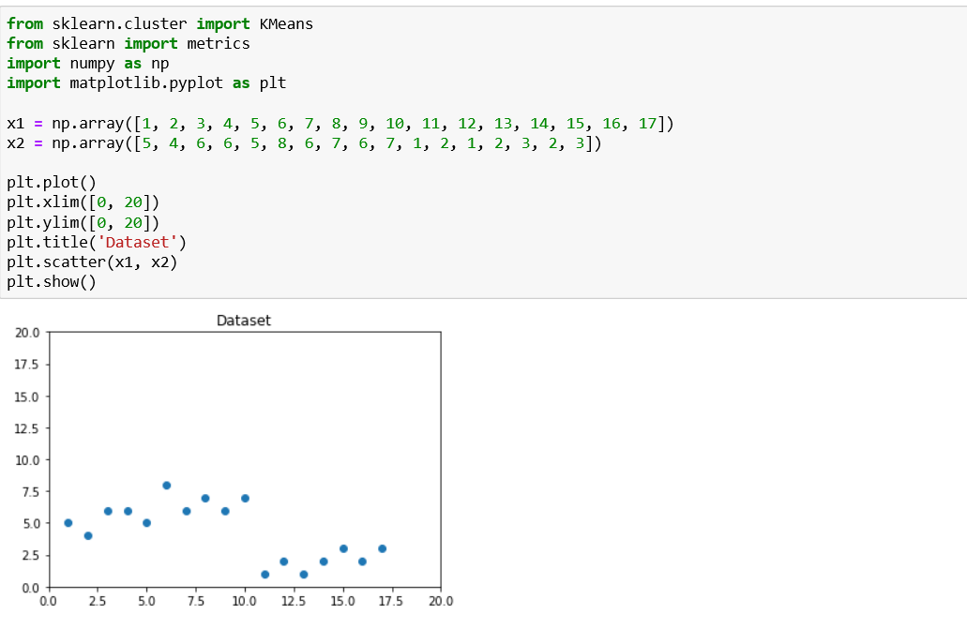
SCREENSHOTS OF MODULE UNDER PROGRESS

Slide 14

The need for an algorithm that will prove efficient every time is the reason that gave rise to the comparative study of machine learning algorithms in e-charging station.

