Slide 1

MUTUAL FUND ANALYTICS
Prepared by VRINDESH PAREEK | Data Analyst Intern
End-to-End Data Pipeline • Risk Analytics • Interactive Dashboard
.
Data: AMFI India • mfapi.in • NSE/BSE Public Records | June 2026
Notes:
Welcome! This presentation covers the Bluestock Fintech Mutual Fund Analytics Platform — a 7-day capstone project. We'll walk through the data pipeline, EDA findings, risk metrics, dashboard, and key recommendations.

Slide 2
Problem Statement & Objectives
What we set out to solve
The Challenge
8 Core Objectives
India's MF industry manages ₹65L+ Cr AUM with no unified analytic framework for: • Comparing fund risk-adjusted performance • Understanding investor SIP behaviour • Identifying concentration & tail risk • Tracking AUM trends vs. benchmarks
O1 Python ETL pipeline from AMFI / mfapi.in
O2 Normalised SQL star schema (5+ tables)
O3 EDA — 15+ charts across all datasets
O4 Sharpe, Sortino, Alpha, Beta, VaR, MaxDD
O5 4-page Power BI interactive dashboard
O6 Investor demographics & cohort analysis
O7 Benchmark vs Nifty 50 / Nifty 100
O8 PDF report + 12-slide presentation
Bluestock Fintech | Mutual Fund Analytics | Slide 2 / 12
Notes:
The Indian mutual fund industry has unprecedented data richness but lacks integrated analytics. Our platform bridges that gap — delivering institutional-grade insights using 100% public data.

Slide 3
Data Sources & Scale
100% public data — no API keys required
AMFI India
mfapi.in
NSE / BSE
amfiindia.com
REST API
Public Records
NAV history, SIP inflows,
folio counts, AUM data,
category inflows
Live & historical NAV
for 5 key schemes
GET /mf/{scheme_code}
Daily benchmark closes
Nifty 50, 100, Midcap 150,
BSE SmallCap, CRISIL
10
64,320
32,778
Datasets
NAV Records
Transactions
40
5,000
8,050
Schemes
Investors
Benchmark Rows
Bluestock Fintech | Mutual Fund Analytics | Slide 3 / 12
Notes:
All data is sourced from AMFI India, mfapi.in REST API, and NSE/BSE public records. The 10 datasets span January 2022 to May 2026, giving us over 4 years of real market data to analyse.

Slide 4
Data Pipeline & Architecture
Extract → Transform → Load → Analyse → Visualise
EXTRACT
TRANSFORM
LOAD
ANALYSE
VISUALISE
mfapi.in API
+ Local CSVs
pandas cleaning
type casting
ffill holidays
SQLite DB
SQLAlchemy ORM
star schema
Risk metrics
Sharpe/VaR
Alpha/Beta
Power BI
4-page dashboard
+ Notebooks
Star Schema Design
dim_fund
fact_nav
fact_transactions
fact_aum
bridge_benchmark
Dimension
Fact (64K rows)
Fact (32K rows)
Fact
Bridge
Bluestock Fintech | Mutual Fund Analytics | Slide 4 / 12
Notes:
The pipeline is fully automated via etl_pipeline.py. Data flows from raw CSVs and the mfapi.in API through pandas transformations into a SQLite database with a star schema optimised for Power BI DAX queries.

Slide 5
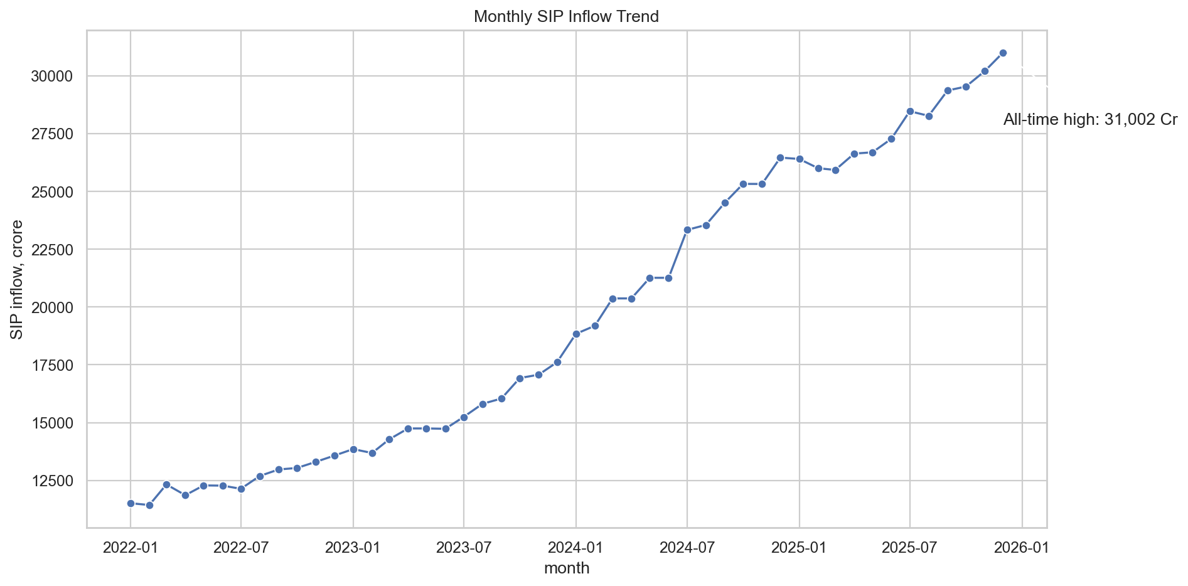
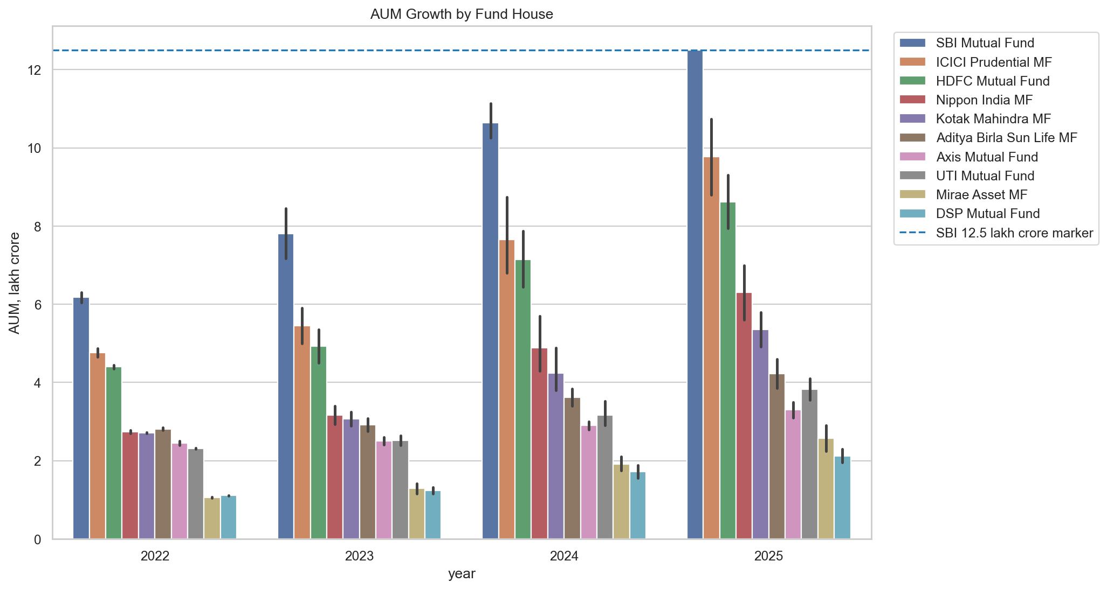
EDA Highlights — Market Overview
AUM growth, SIP milestone & NAV trends
₹31,002 Cr
Peak SIP Inflow — Dec 2025
+169%
SIP Growth Jan 2022–Dec 2025
26.12 Cr
Industry Folios (Dec 2025)
SBI leads AUM at ₹12.5L Cr • Industry AUM grew ~41% between 2022–2025 • Equity-oriented categories drove 68% of net inflows
Bluestock Fintech | Mutual Fund Analytics | Slide 5 / 12
Notes:
Monthly SIP inflows grew from 11,517 crore in January 2022 to a record 31,002 crore in December 2025 — a 169% increase. SBI MF leads the industry with 12.5 lakh crore AUM. Folio counts doubled from 13 to 26 crore.

Slide 6
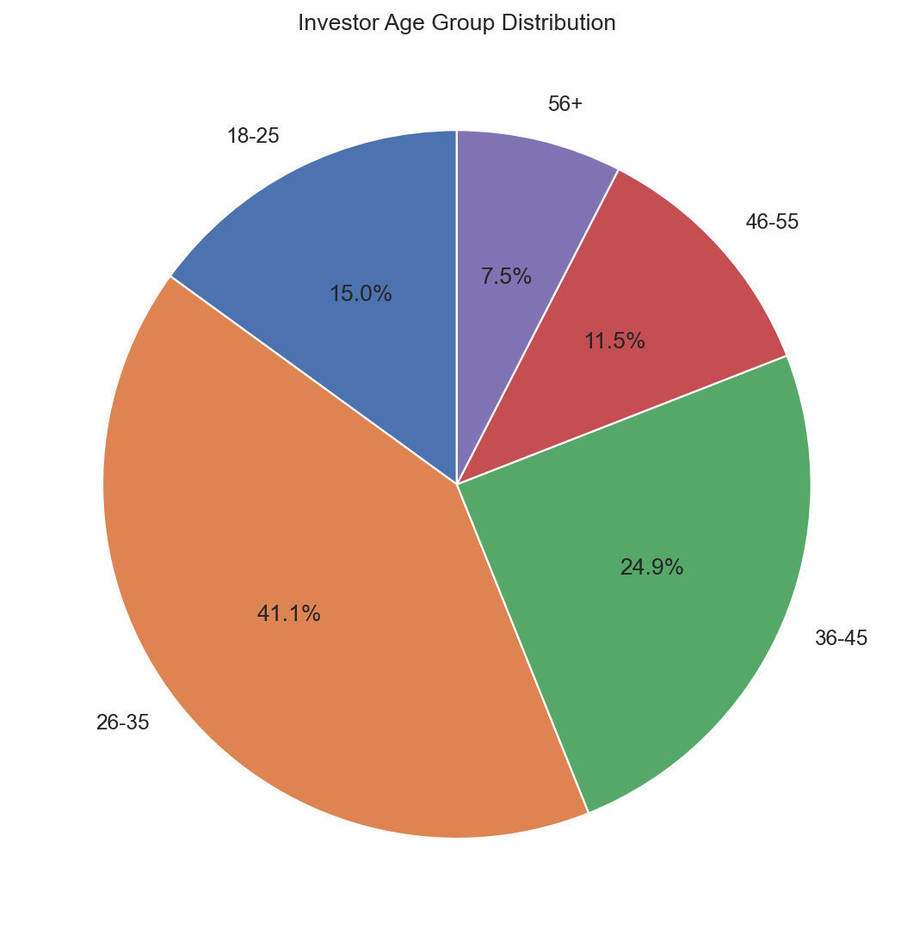
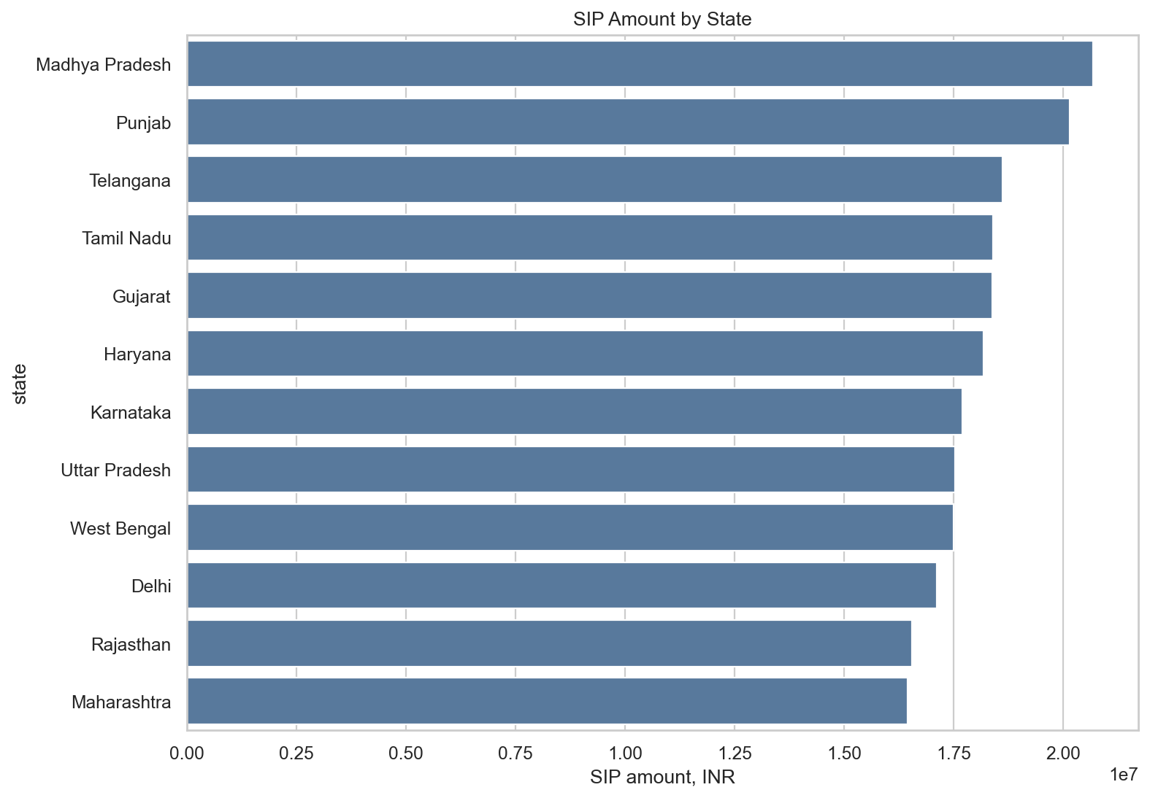
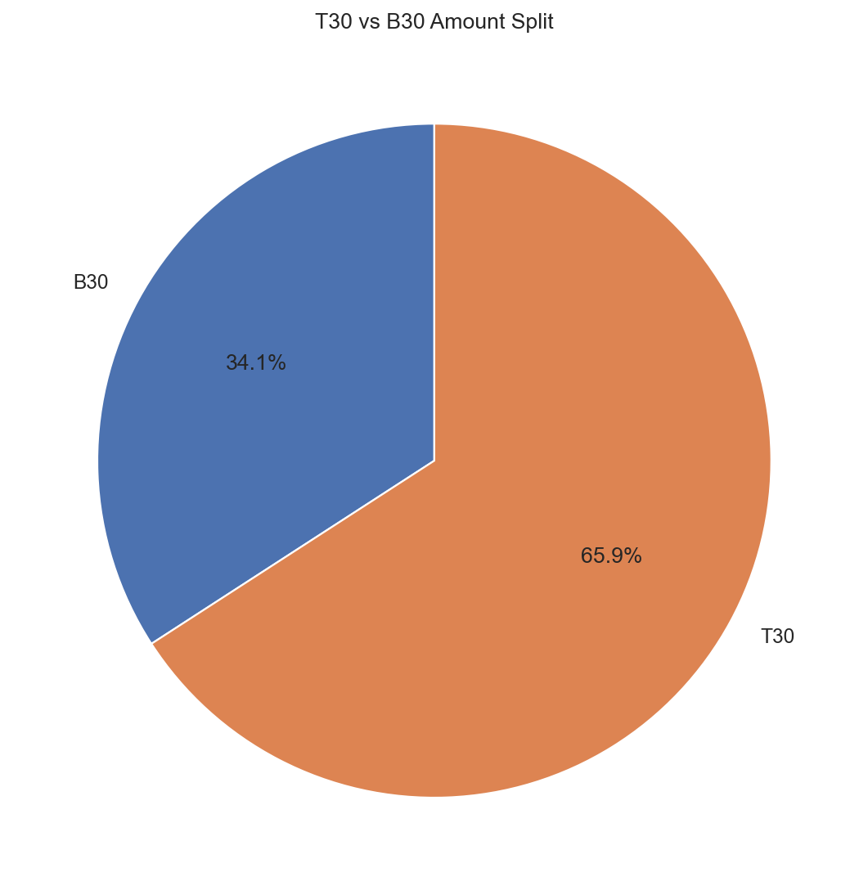
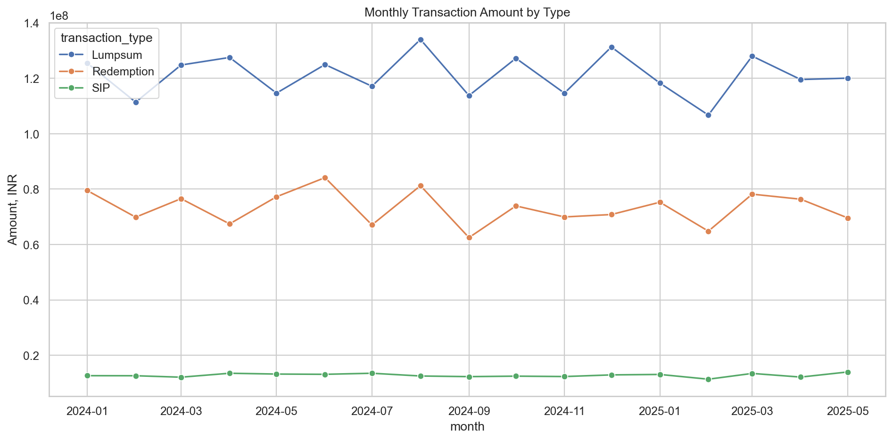
EDA Highlights — Investor Demographics
Age, geography & transaction patterns
Bluestock Fintech | Mutual Fund Analytics | Slide 6 / 12
Notes:
The 26-35 age group leads with 41% of transactions. T30 cities dominate at 66% but B30 cities are growing 19% year-on-year. SIP accounts for 60% of all transactions, with Redemption spiking in March — a tax harvesting pattern.

Slide 7
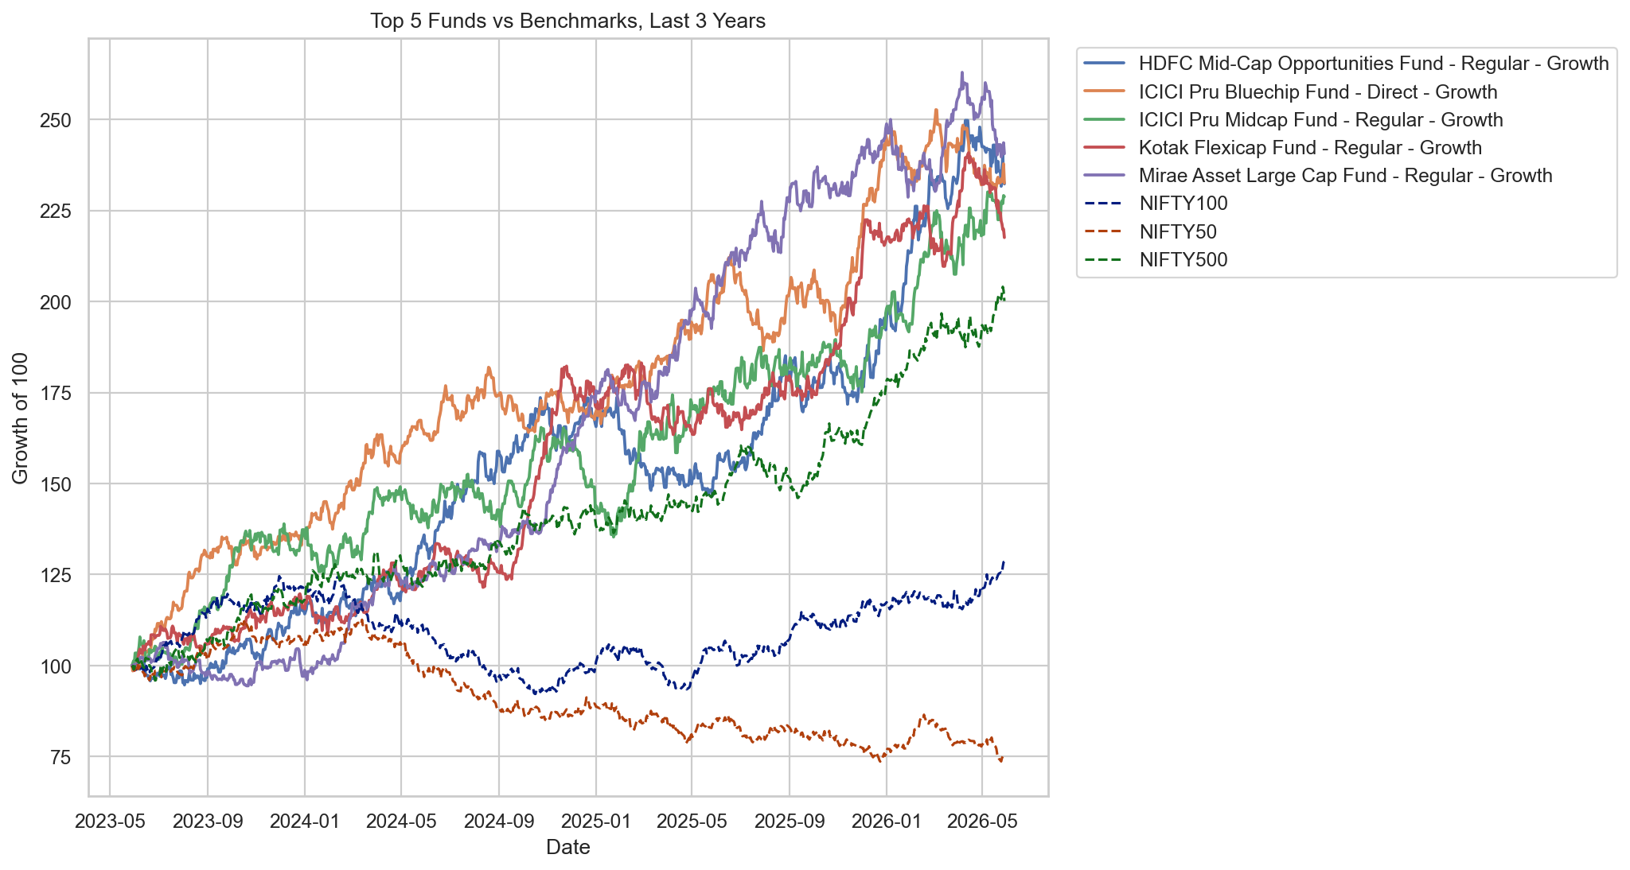
Fund Performance Metrics
Sharpe, Sortino, Alpha, Beta & Composite Scorecard
Top 5 Funds — Composite Scorecard (0–100)
Rank | Fund Name | Score | 3Yr CAGR | Sharpe | Alpha
#1 | Mirae Asset Large Cap — Regular | 86.25 | 34.0% | 1.07 | 0.27
#2 | ICICI Pru Midcap — Regular | 82.88 | 31.8% | 0.88 | 0.29
#3 | Kotak Flexicap — Regular | 82.00 | 29.6% | 0.97 | 0.27
#4 | HDFC Mid-Cap Opp — Regular | 80.75 | 32.4% | 0.81 | 0.27
#5 | ICICI Pru Bluechip — Direct | 79.38 | 32.5% | 0.71 | 0.21
Score formula: 30% × 3yr CAGR rank + 25% × Sharpe rank + 20% × Alpha rank + 15% × Expense ratio rank⁻¹ + 10% × MaxDD rank⁻¹
Bluestock Fintech | Mutual Fund Analytics | Slide 7 / 12
Notes:
Mirae Asset Large Cap Fund tops our composite scorecard with 86.25 out of 100. The scorecard combines 3-year CAGR, Sharpe ratio, Alpha, expense ratio, and max drawdown. All top 5 funds outperformed the Nifty 100 benchmark.

Slide 8
Risk Analytics — VaR, CVaR & Drawdown
Tail-risk quantified for all 40 schemes
VaR 95% Daily — Risk Spectrum (Low → High)
−0.02%
−0.08%
−1.2%
−1.8%
−2.4%
Liquid
Debt
Large Cap
Mid Cap
Small Cap
Key Risk Findings
📉 Worst VaR: ABSL Small Cap at −2.39%/day | CVaR −3.03% — expect to lose >3% on worst 5% of days
✅ Best VaR: ICICI Pru Liquid at −0.02%/day — 120× less tail risk than Small Cap funds
⚠ Max Drawdown: SBI Small Cap Direct hit −52.6% peak-to-trough in 2022–23
📈 Rolling 90-day Sharpe peaked >3.0 during 2023 bull run; compressed <1.0 in late 2024
Bluestock Fintech | Mutual Fund Analytics | Slide 8 / 12
Notes:
Small Cap funds carry 12 times the tail risk of Liquid funds. VaR at 95% confidence means: on any given day, there's a 5% chance of losing more than this amount. CVaR tells us what the average loss looks like on those worst days.

Slide 9
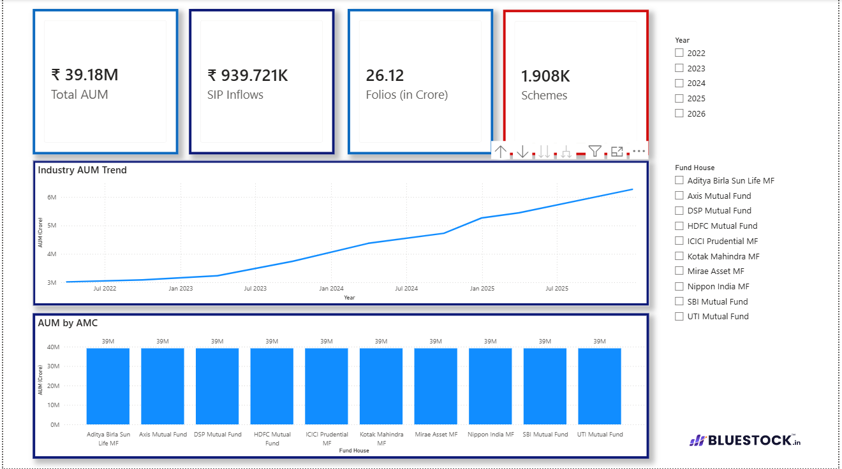
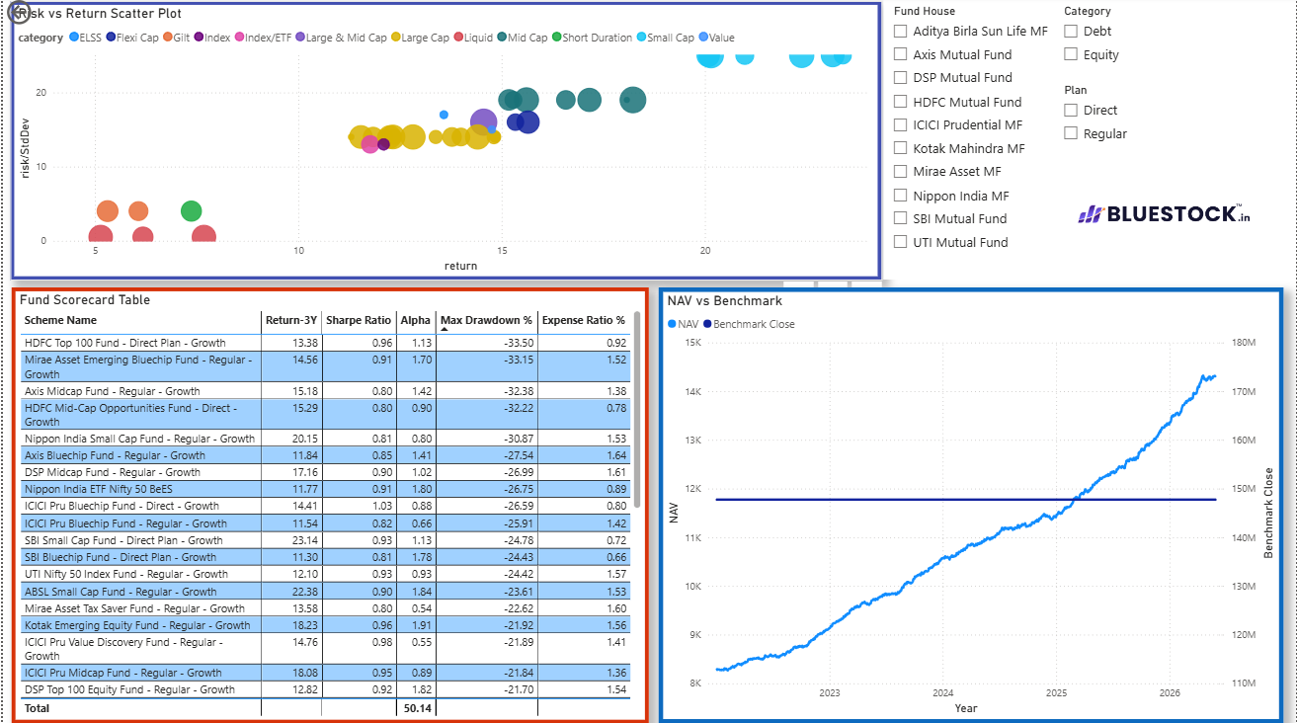
Power BI Dashboard — Page 1 & 2
Market Overview + Fund Performance & Risk
Page 1 — Market Overview
Page 2 — Fund Performance & Risk
Bluestock Fintech | Mutual Fund Analytics | Slide 9 / 12
Notes:
The Power BI dashboard has 4 pages. Page 1 shows industry-level KPIs: AUM, folio count, SIP trends. Page 2 drills into fund-level risk: Sharpe vs Sortino scatter, Max Drawdown bars, and Alpha ranking. Every page has 2+ interactive slicers.

Slide 10
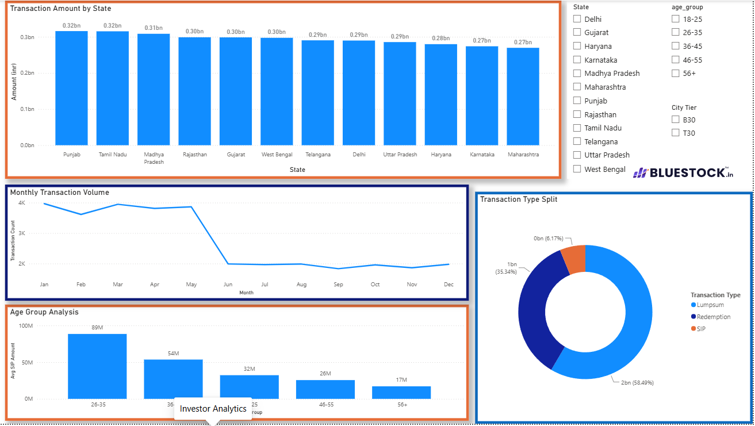
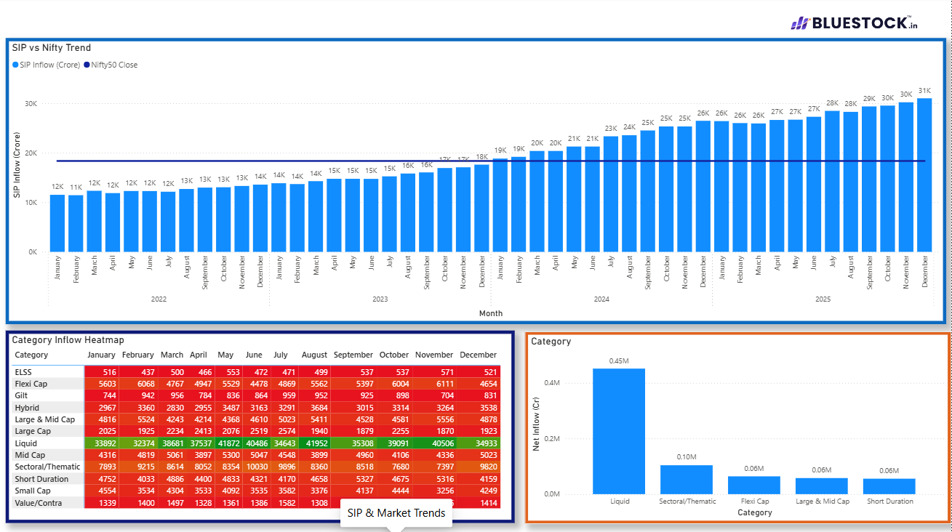
Power BI Dashboard — Page 3 & 4
Investor Demographics + Portfolio Holdings
Page 3 — Investor Demographics & Transactions
Page 4 — Portfolio Holdings & Sector Exposure
Bluestock Fintech | Mutual Fund Analytics | Slide 10 / 12
Notes:
Page 3 visualises investor behaviour: age/income distribution, SIP vs lumpsum split, redemption patterns, and a state-level choropleth. Page 4 shows sector HHI concentration, sunburst of top holdings, and stock-level weights across the top 5 funds.

Slide 11
Key Findings & Recommendations
Data-driven insights for AMCs & investors
📊 Key Findings
💡 Recommendations
1. SIP inflows grew 169% in 4 years (₹11,517 Cr → ₹31,002 Cr)
[For AMCs] Deploy SIP nudge campaigns at day 32 post-last-debit to cut SIP dropout rates
2. Top fund: Mirae Asset Large Cap scored 86.25/100 on scorecard
[For AMCs] Accelerate B30 digital onboarding via Aadhaar eKYC + ₹100 min SIP
3. Small Cap VaR is 120× that of Liquid funds — tail risk is real
[For Investors] Mirae Asset Large Cap is the top risk-adjusted holding for Moderate risk profiles
4. 97.8% of regular SIP investors show irregular payment gaps (>35 days)
[For Investors] Diversify: 60% Large Cap + 30% Mid Cap + 10% Debt for Sharpe-optimal portfolio
5. B30 cities growing 19% YoY — geographic MF adoption shift underway
[For Bluestock] Schedule ETL as a daily cron job (8 PM IST) for live NAV refresh
6. Axis Bluechip & ABSL Small Cap are most concentrated (HHI > 0.18)
[For Bluestock] Build Streamlit app as browser-based alternative to Power BI Desktop
Bluestock Fintech | Mutual Fund Analytics | Slide 11 / 12
Notes:
Our three standout recommendations: First, SIP continuity campaigns — 97.8% at-risk rate is a massive retention opportunity. Second, Mirae Asset Large Cap as the core equity holding for moderate-risk investors. Third, operationalise the recommender.py as a live product feature.

Slide 12
Thank You
Mutual Fund Analytics Platform — BLUESTOCK FINTECH
Deliverables: etl_pipeline.py • bluestock_mf.db + schema.sql • EDA_Analysis.ipynb • Performance_Analytics.ipynb • Advanced_Analytics.ipynb • bluestock_mf.pbix • Final_Report.docx • recommender.py
Data Sources: AMFI India • mfapi.in • NSE/BSE Public Records | All data is publicly available
Notes:
Thank you for your time. The full codebase, notebooks, and dashboard are available on GitHub. I'm happy to walk through any specific section — the ETL pipeline, the risk metrics calculation, or the Power BI dashboard design.

