Slide 1
Public Health Trend Analysis
Life Expectancy Prediction
Machine Learning Project
Case Study No. 56

Slide 2
Problem Statement
A public-health organization wants to analyze historical observations and identify meaningful patterns useful for planning.
Our Goal: Build a robust machine learning regression system to predict life expectancy based on global health and socio-economic data.

Slide 3
Dataset Overview
- Source: WHO Life Expectancy Data
- Scope: 193 Countries (2000-2015)
- Size: 2938 records, 22 features
- Target Variable: Life Expectancy (Years)
- Features: Adult Mortality, GDP, BMI, Schooling, etc.

Slide 4
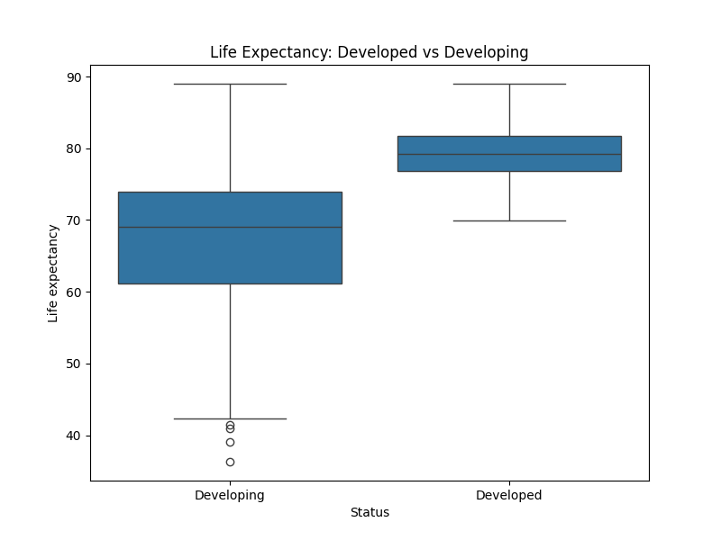
Exploratory Data Analysis

Slide 5
Machine Learning Methodology
- Preprocessing: Median Imputation (Numeric), Mode Imputation (Categorical)
- Scaling: StandardScaler
- Encoding: One-Hot Encoding for 'Status'
- Train/Test Split: 80% / 20%
- Models: Linear Regression, Decision Tree, Random Forest

Slide 6
Model Comparison & Best Model
Models Evaluated:
- Linear Regression (R²: 0.819, RMSE: 3.951)
- Decision Tree Regressor (R²: 0.916, RMSE: 2.700)
- Random Forest Regressor (R²: 0.967, RMSE: 1.680)
Best Model: Random Forest Regressor
- Explains 96.7% of variance.
- Lowest prediction error (RMSE: 1.68).

Slide 7
Conclusion & Future Scope
- Findings: Socio-economic factors like Schooling and Income composition strongly correlate with life expectancy.
- Future Scope: Use more recent data, attempt time-series forecasting, and explore deep learning algorithms.
- Application: An interactive Streamlit dashboard was created to demonstrate live predictions.

