Slide 1
Deadlocks

Slide 2
Deadlocks
System Model
Deadlock Characterization
Methods for Handling Deadlocks
Deadlock Prevention
Deadlock Avoidance
Deadlock Detection
Recovery from Deadlock

Slide 3
Chapter Objectives
To develop a description of deadlocks, which prevent sets of concurrent processes from completing their tasks
To present a number of different methods for preventing, avoiding, or detecting deadlocks in a computer system

Slide 4
The Deadlock Problem
A deadlock consists of a set of blocked processes, each holding a resource and waiting to acquire a resource held by another process in the set
Example #1
  A system has 2 disk drives
  P₁ and P₂ each hold one disk drive and each needs the other one
Example #2
  Semaphores A and B, initialized to 1
        P₀ P₁
        wait (A); wait(B)‏
        wait (B); wait(A)‏

Slide 5
Bridge Crossing Example
Traffic only in one direction
The resource is a one-lane bridge
If a deadlock occurs, it can be resolved if one car backs up (preempt resources and rollback)‏
Several cars may have to be backed up if a deadlock occurs
Starvation is possible

Slide 6
System Model
Resource types R₁, R₂, . . ., R_{m}
    CPU cycles, memory space, I/O devices
Each resource type R_{i} has 1 or more instances
Each process utilizes a resource as follows:
  request
  use
  release

Slide 7
Deadlock Characterization

Slide 8
Deadlock Characterization
Deadlock can arise if four conditions hold simultaneously.
Mutual exclusion: only one process at a time can use a resource
Hold and wait: a process holding at least one resource is waiting to acquire additional resources held by other processes
No preemption: a resource can be released only voluntarily by the process holding it after that process has completed its task
Circular wait: there exists a set {P₀, P₁, …, P₀} of waiting processes such that P₀ is waiting for a resource that is held by P₁, P₁ is waiting for a resource that is held by
P₂, …, P_{n–1} is waiting for a resource that is held by
P_{n}, and P_{n} is waiting for a resource that is held by P₀

Slide 9

Resource-Allocation Graph
A set of vertices V and a set of edges E.
V is partitioned into two types:
  P = {P₁, P₂, …, P_{n}}, the set consisting of all
  the processes in the system
  R = {R₁, R₂, …, R_{m}}, the set consisting of all
  resource types in the system
request edge – directed edge P₁ → R_{j}
assignment edge – directed edge R_{j} → P_{i}

Slide 10
Resource-Allocation Graph (Cont.)‏
Process
Resource Type with 4 instances
P_{i} requests instance of R_{j}
P_{i} is holding an instance of R_{j}
P_{i}
R_{j}
P_{i}
R_{j}

Slide 11

Resource Allocation Graph With A Deadlock
Before P₃ requested an instance of R₂
After P₃ requested an instance of R₂

Slide 12

Graph With A Cycle But No Deadlock
Process P₄ may release its instance of resource type R₂. That
resource can then be allocated to P3, thereby breaking the cycle.

Slide 13
Relationship of cycles to deadlocks
If a resource allocation graph contains no cycles ⇒ no deadlock
If a resource allocation graph contains a cycle and if only one instance exists per resource type ⇒ deadlock
If a resource allocation graph contains a cycle and and if several instances exists per resource type ⇒ possibility of deadlock

Slide 14
Methods for Handling Deadlocks

Slide 15
Methods for Handling Deadlocks
Prevention
  Ensure that the system will never enter a deadlock state
Avoidance
  Ensure that the system will never enter an unsafe state
Detection
  Allow the system to enter a deadlock state and then recover
Do Nothing
  Ignore the problem and let the user or system administrator respond to the problem; used by most operating systems, including Windows and UNIX

Slide 16
Deadlock Prevention

Slide 17
Deadlock Prevention
To prevent deadlock, we can restrain the ways that a request can be made
Mutual Exclusion – The mutual-exclusion condition must hold for non-sharable resources
Hold and Wait – we must guarantee that whenever a process requests a resource, it does not hold any other resources
  Require a process to request and be allocated all its resources before it begins execution, or allow a process to request resources only when the process has none
  Result: Low resource utilization; starvation possible

Slide 18
Deadlock Prevention (Cont.)‏
No Preemption –
  If a process that is holding some resources requests another resource that cannot be immediately allocated to it, then all resources currently being held are released
  Preempted resources are added to the list of resources for which the process is waiting
  A process will be restarted only when it can regain its old resources, as well as the new ones that it is requesting
Circular Wait – impose a total ordering of all resource types, and require that each process requests resources in an increasing order of enumeration. For example:
F(tape drive) = 1
F(disk drive) = 5
F(printer) = 12

Slide 19
Deadlock Avoidance

Slide 20
Deadlock Avoidance
Requires that the system has some additional a priori information
available.
Simplest and most useful model requires that each process declare the maximum number of resources of each type that it may need
The deadlock-avoidance algorithm dynamically examines the resource-allocation state to ensure that there can never be a circular-wait condition
A resource-allocation state is defined by the number of available and allocated resources, and the maximum demands of the processes

Slide 21
Safe State
When a process requests an available resource, the system must decide if immediate allocation leaves the system in a safe state
A system is in a safe state only if there exists a safe sequence
A sequence of processes <P₁, P₂, …, P_{n}> is a safe sequence for the current allocation state if, for each P_{i}, the resource requests that P_{i} can still make, can be satisfied by currently available resources plus resources held by all P_{j}, with j < i.
That is:
  If the P_{i} resource needs are not immediately available, then P_{i} can wait until all P_{j} have finished
  When P_{j} is finished, P_{i} can obtain needed resources, execute, return allocated resources, and terminate
  When P_{i} terminates, P_{i +1} can obtain its needed resources, and so on

Slide 22
Safe State (continued)‏
If a system is in safe state ⇒ no deadlocks
If a system is in unsafe state ⇒ possibility of deadlock
Avoidance ⇒ ensure that a system will never enter an unsafe state

Slide 23

Safe, Unsafe , Deadlock State

Slide 24
Avoidance algorithms
For a single instance of a resource type, use a resource-allocation graph
For multiple instances of a resource type, use the banker’s algorithm

Slide 25
Resource-Allocation Graph Scheme
Introduce a new kind of edge called a claim edge
Claim edge P_{i} R_{j} indicates that process P_{j} may request resource R_{j}; which is represented by a dashed line
A claim edge converts to a request edge when a process requests a resource
A request edge converts to an assignment edge when the resource is allocated to the process
When a resource is released by a process, an assignment edge reconverts to a claim edge
Resources must be claimed a priori in the system

Slide 26

Resource-Allocation Graph with
Claim Edges
Assignment
edge
Request
edge
Claim
edge
Claim
edge

Slide 27

Unsafe State In Resource-Allocation Graph
Assignment
edge
Request
edge
Assignment
edge
Claim
edge

Slide 28
Resource-Allocation Graph Algorithm
Suppose that process P_{i} requests a resource R_{j}
The request can be granted only if converting the request edge to an assignment edge does not result in the formation of a cycle in the resource allocation graph

Slide 29
Banker’s Algorithm
Used when there exists multiple instances of a resource type
Each process must a priori claim maximum use
When a process requests a resource, it may have to wait
When a process gets all its resources, it must return them in a finite amount of time

Slide 30
Data Structures for the Banker’s Algorithm
Let n = number of processes, and m = number of resources types.
Available: Vector of length m. If available [j] = k, there are k instances of resource type R_{j} available.
Max: n x m matrix. If Max [i,j] = k, then process P_{i} may request at most k instances of resource type R_{j}.
Allocation: n x m matrix. If Allocation[i,j] = k then P_{i} is currently allocated k instances of R_{j.}
Need: n x m matrix. If Need[i,j] = k, then P_{i} may need k more instances of R_{j} to complete its task.
    Need [i,j] = Max[i,j] – Allocation [i,j]

Slide 31
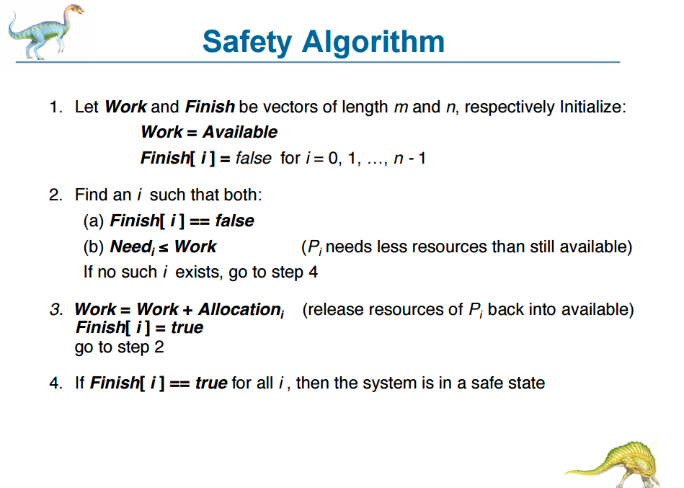

Slide 32
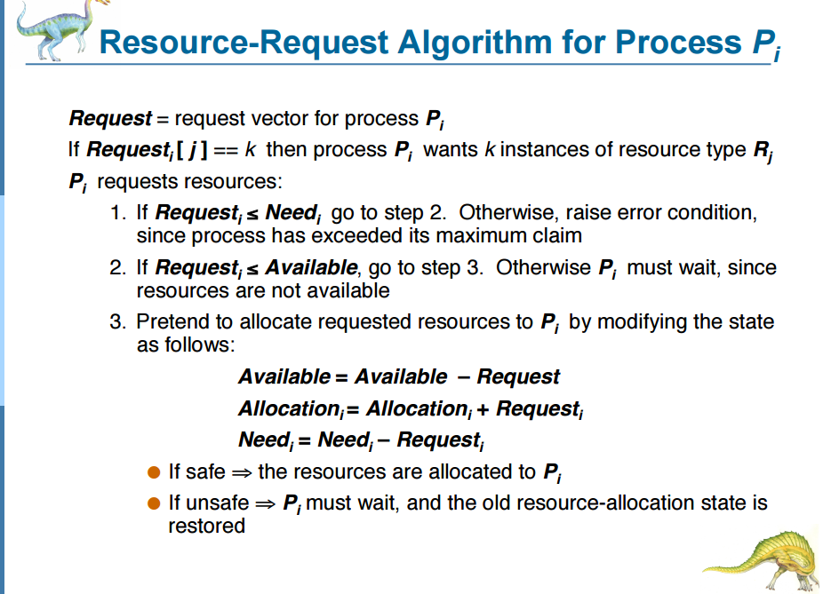

Slide 33
Deadlock Detection

Slide 34
Deadlock Detection
For deadlock detection, the system must provide
  An algorithm that examines the state of the system to detect whether a deadlock has occurred
  And an algorithm to recover from the deadlock
A detection-and-recovery scheme requires various kinds of overhead
  Run-time costs of maintaining necessary information and executing the detection algorithm
  Potential losses inherent in recovering from a deadlock

Slide 35
Single Instance of Each Resource Type
Requires the creation and maintenance of a wait-for graph
  Consists of a variant of the resource-allocation graph
  The graph is obtained by removing the resource nodes from a resource-allocation graph and collapsing the appropriate edges
  Consequently; all nodes are processes
  P_{i} → P_{j} if P_{i} is waiting for P_{j}.
Periodically invoke an algorithm that searches for a cycle in the graph
  If there is a cycle, there exists a deadlock
  An algorithm to detect a cycle in a graph requires an order of n² operations, where n is the number of vertices in the graph

Slide 36

Resource-Allocation Graph and Wait-for Graph
Resource-Allocation Graph
Corresponding wait-for graph

Slide 37
Multiple Instances of a Resource Type
Required data structures:
Available: A vector of length m indicates the number of available resources of each type.
Allocation: An n x m matrix defines the number of resources of each type currently allocated to each process.
Request: An n x m matrix indicates the current request of each process. If Request [i_{j}] = k, then process P_{i} is requesting k more instances of resource type. R_{j}.

Slide 38
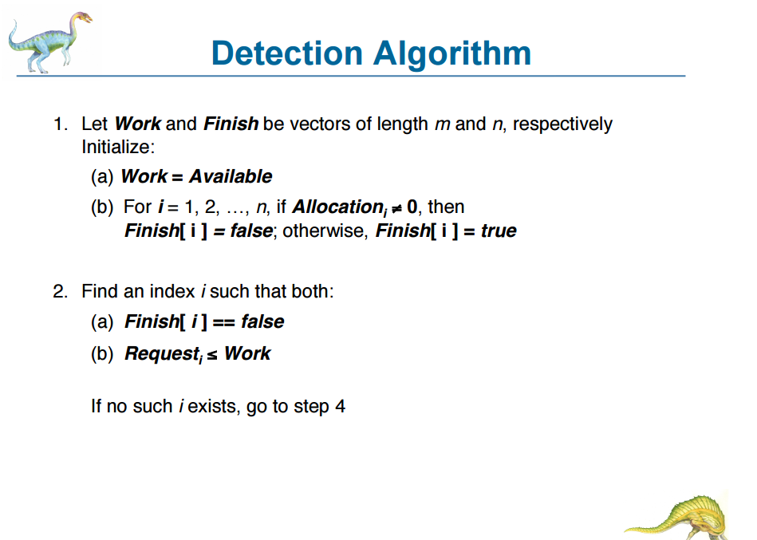

Slide 39
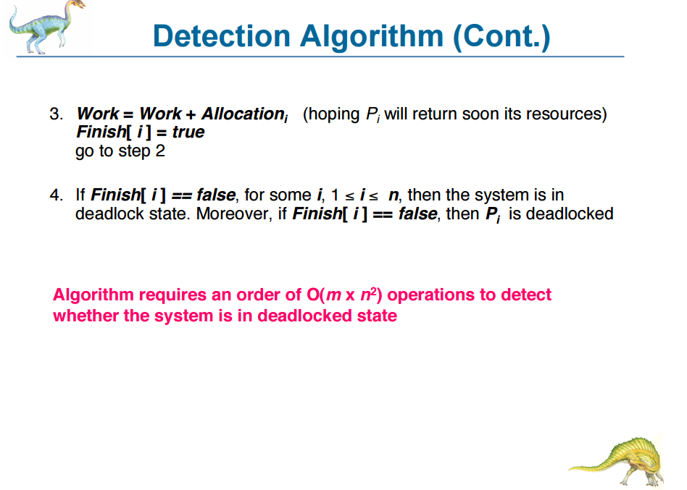

Slide 40
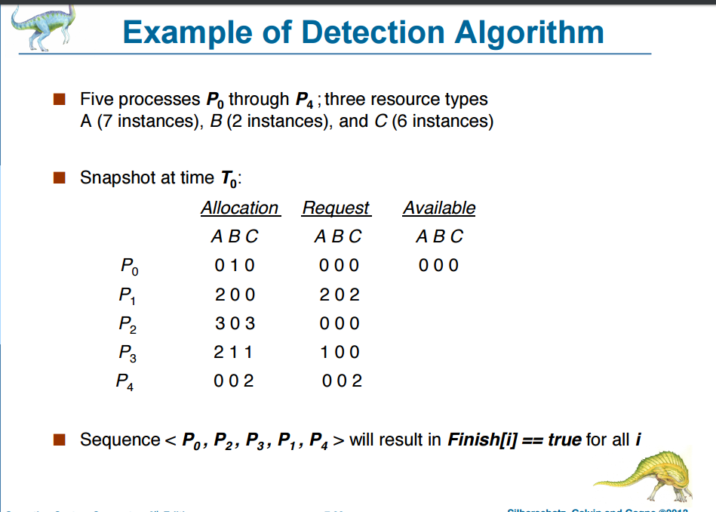

Slide 41
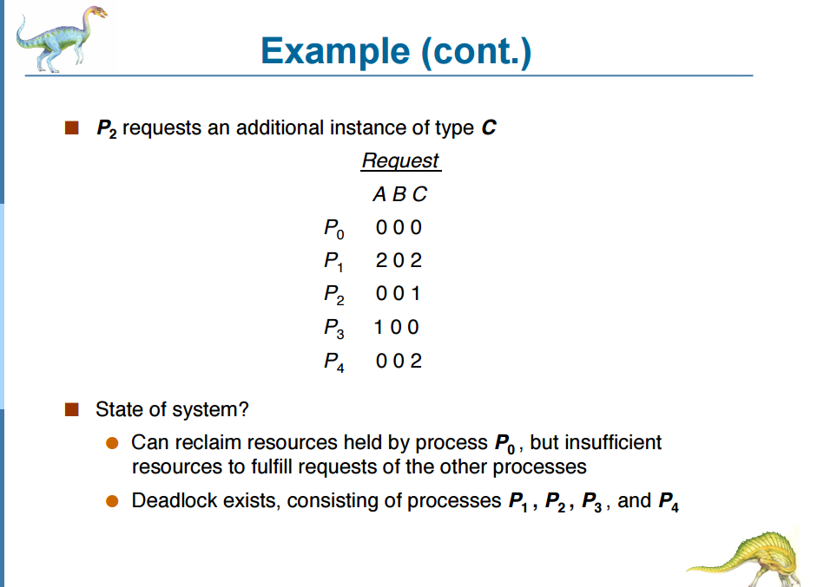

Slide 42
Detection-Algorithm Usage
When, and how often, to invoke the detection algorithm depends on:
  How often is a deadlock likely to occur?
  How many processes will be affected by deadlock when it happens?
If the detection algorithm is invoked arbitrarily, there may be many cycles in the resource graph and so we would not be able to tell which one of the many deadlocked processes “caused” the deadlock
If the detection algorithm is invoked for every resource request, such an action will incur a considerable overhead in computation time
A less expensive alternative is to invoke the algorithm when CPU utilization drops below 40%, for example
  This is based on the observation that a deadlock eventually cripples system throughput and causes CPU utilization to drop

Slide 43
Recovery From Deadlock

Slide 44
Recovery from Deadlock
Two Approaches
  Process termination
  Resource preemption

Slide 45
Recovery from Deadlock: Process Termination
Abort all deadlocked processes
  This approach will break the deadlock, but at great expense
Abort one process at a time until the deadlock cycle is eliminated
  This approach incurs considerable overhead, since, after each process is aborted, a deadlock-detection algorithm must be re-invoked to determine whether any processes are still deadlocked
Many factors may affect which process is chosen for termination
  What is the priority of the process?
  How long has the process run so far and how much longer will the process need to run before completing its task?
  How many and what type of resources has the process used?
  How many more resources does the process need in order to finish its task?
  How many processes will need to be terminated?
  Is the process interactive or batch?

Slide 46
Recovery from Deadlock: Resource Preemption
With this approach, we successively preempt some resources from processes and give these resources to other processes until the deadlock cycle is broken
When preemption is required to deal with deadlocks, then three issues need to be addressed:
  Selecting a victim – Which resources and which processes are to be preempted?
  Rollback – If we preempt a resource from a process, what should be done with that process?
  Starvation – How do we ensure that starvation will not occur? That is, how can we guarantee that resources will not always be preempted from the same process?

Slide 47
Summary
Four necessary conditions must hold in the system for a deadlock to occur
  Mutual exclusion
  Hold and wait
  No preemption
  Circular wait
Four principal methods for dealing with deadlocks
  Use some protocol to (1) prevent or (2) avoid deadlocks, ensuring that the system will never enter a deadlock state
  Allow the system to enter a deadlock state, (3) detect it, and then recover
    Recover by process termination or resource preemption
  (4) Do nothing; ignore the problem altogether and pretend that deadlocks never occur in the system (used by Windows and Unix)‏
To prevent deadlocks, we can ensure that at least one of the four necessary conditions never holds

