Slide 1

Forage
Data Science Virtual Experience Programme
Notes:
幸运日素材 淘宝店：https://shop145643496.taobao.com

Slide 2
Task 1
Web Scraping
Data Cleaning & Analysis

Slide 3
Web Scraping
Performed web scraping to extract 2000 reviews from this website.

Slide 4
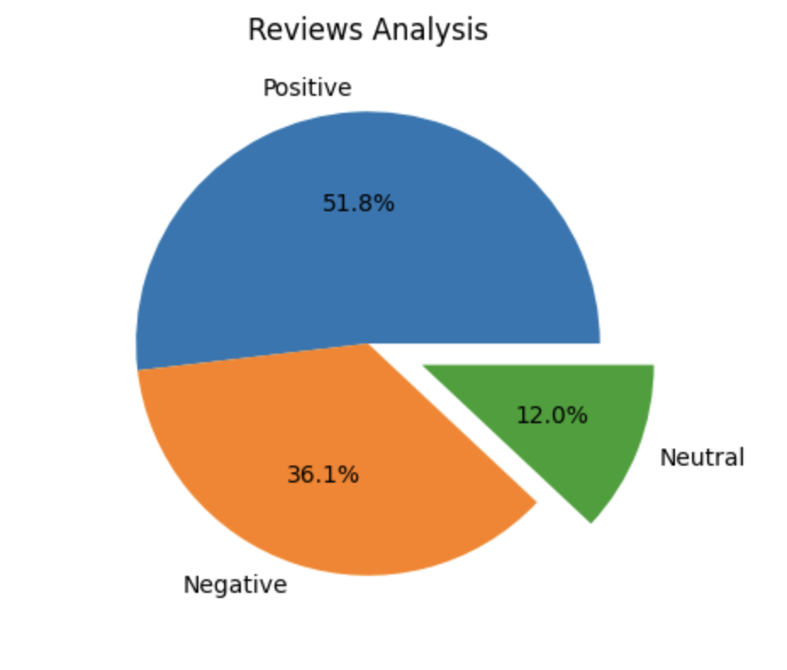
Data Cleaning & Analysis
Analyze customer reviews using sentiment analysis to sort positive and negative reviews. Following observations were made:
Total Reviews | 2000
Positive Reviews | 1037
Negative Reviews | 723
Neutral Reviews | 240

Slide 5
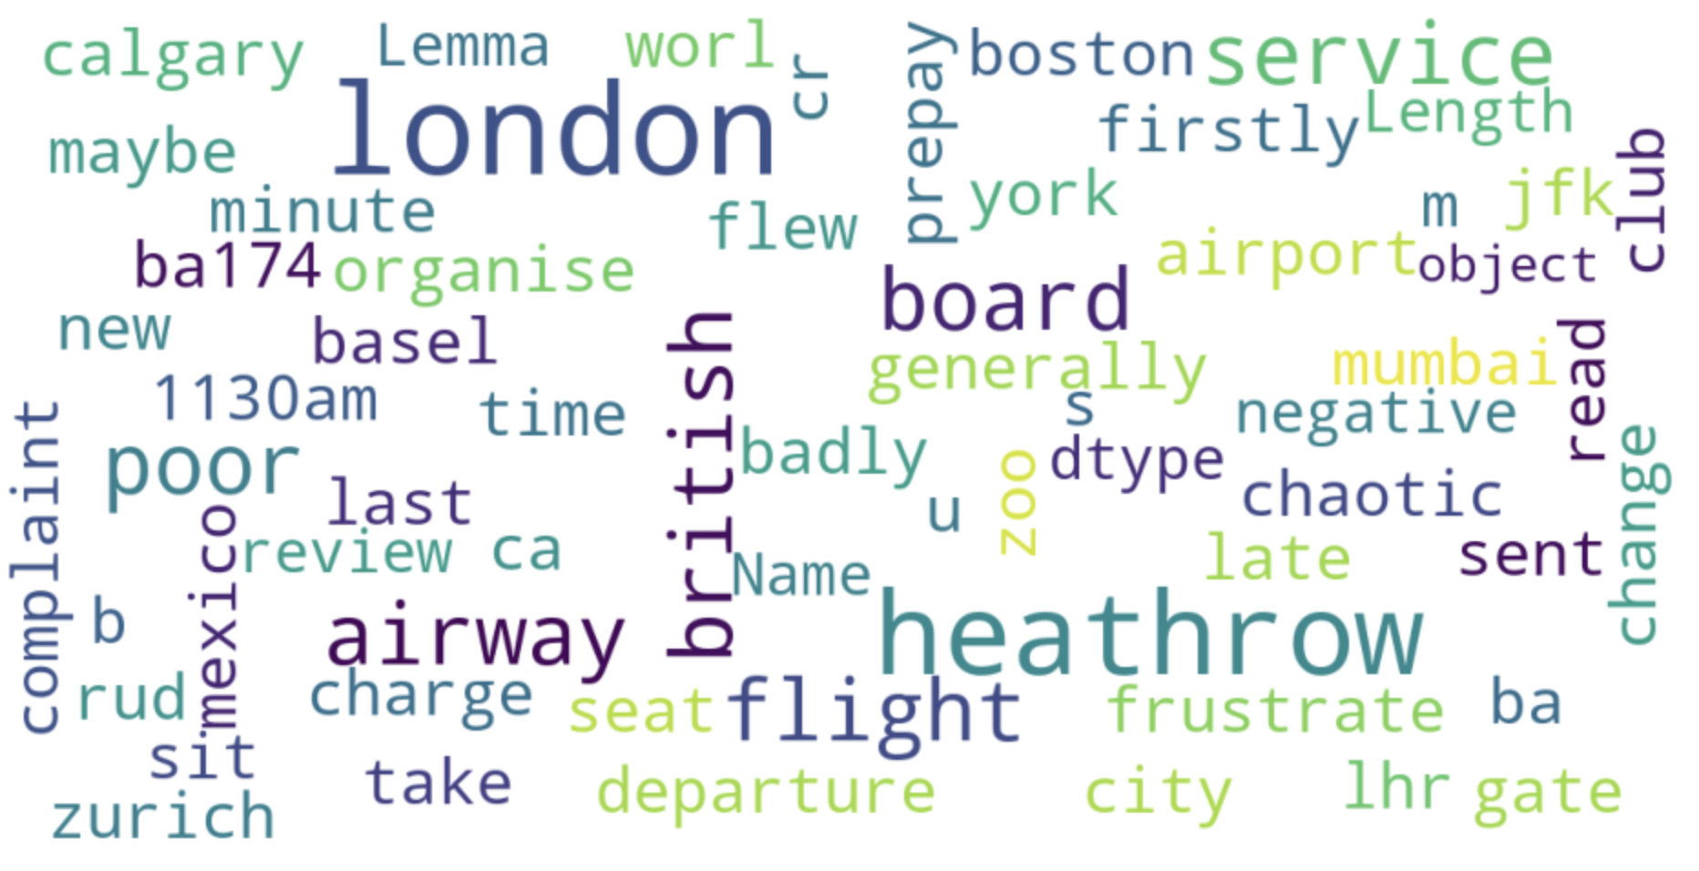
Word cloud of keywords used in Reviews

