Slide 1

Forage
Data Science Virtual Experience Programme
Notes:
幸运日素材 淘宝店：https://shop145643496.taobao.com

Slide 2
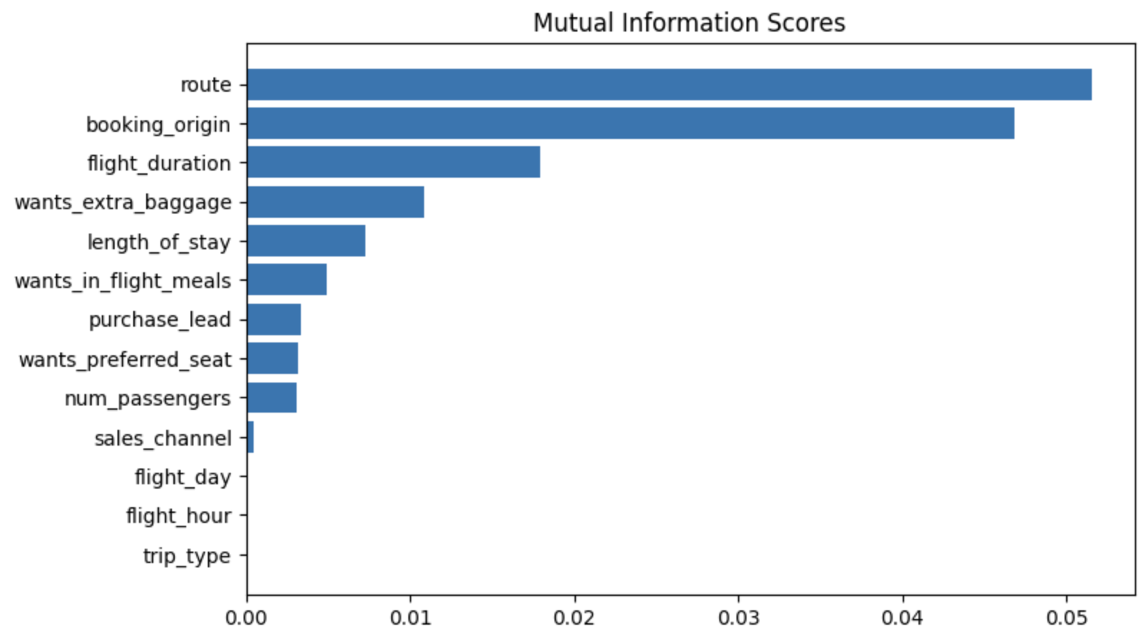
Task 2
Performed Exploratory Data Analysis
Target Model Prediction using Machine Learning
Cross- Validation for maximum accuracy

Slide 3
Exploratory Data Analysis
Performed exploratory data analysis to to better understand what we have and the statistical properties of the dataset.
Checked if there are any null values in the dataset.
Changed the datatypes of the columns
Plotted mutual information score

Slide 4
Target Model Prediction Using Machine Learning
Used the following models to prediction:
Random forest classifier with top 6 features
Random forest classifier with all features
XGB classifier with all features
Finalizing random forest model with all features as final model, as it has good accuracy and highest auc score.
Produced following metrics on Validation dataset:
ACCURACY: 85.37
AUC score: 0.5678474780954598

