Slide 1




SCIENTIFIC CALCULATOR USING PYTHON (TKINTER)
INTERNSHIP: NEXT HIKE PVT. LTD.
By Ankit

Slide 2


To design a scientific calculator that performs
both basic and advanced mathematical
operations with a user-friendly interface.
OBJECTIVE

Slide 3




TECHNOLOGIES USED
  Python
  Tkinter (GUI library)
  Math module

Slide 4


FEATURES
GENERAL OVERVIEW
  Arithmetic and scientific calculations
  Trigonometric, logarithmic, and exponential functions
  Constants π and e
  Modern dark theme UI
  Error handling & safe execution

Slide 5

GUI LAYOUT
  Entry display at top
  6×6 grid of uniform buttons
  Last row for π and e
  Smooth dark interface

Slide 6


WORKING
1. User enters input via buttons.
2. Expression stored in global variable.
3. Safe evaluation via eval().
4. Output displayed instantly.

Slide 7

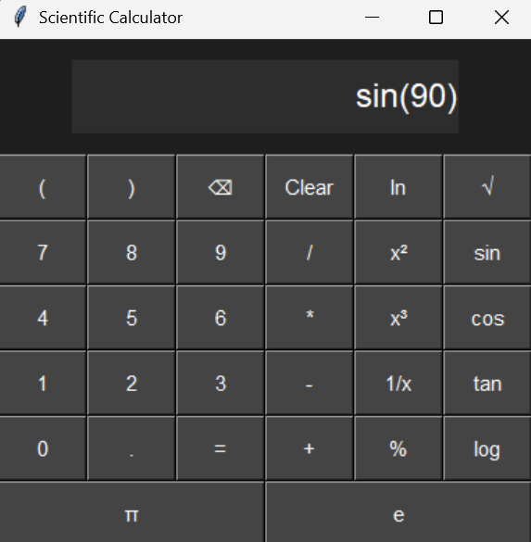
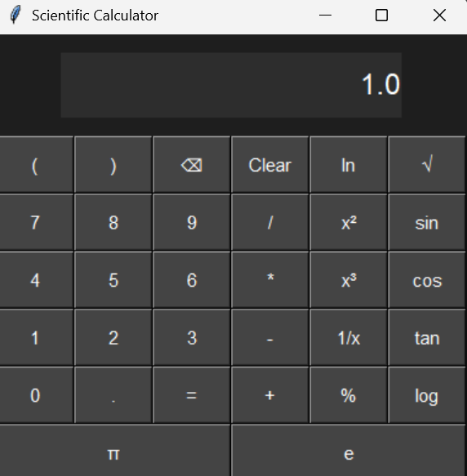
OUTPUT SCREENSHOTS

Slide 8
CONCLUSION
The project enhances understanding of GUI development and mathematical computations using Python.
It is efficient, accurate, and user-friendly.

Slide 9

THANK YOU
By Ankit

