Slide 1
Haskell

Slide 2
GHC and HUGS
Haskell 98 is the current version of Haskell
GHC (Glasgow Haskell Compiler, version 7.4.1) is the version of Haskell I am using
  GHCi is the REPL
  Just enter ghci at the command line
HUGS is also a popular version
  As far as the language is concerned, there are no differences between the two that concern us.

Slide 3
Using Haskell
You can do arithmetic at the prompt:
  GHCi> 2 + 2
  4
You can call functions at the prompt:
  GHCi> sqrt 10
  3.16228
You can load definitions from a file:
  GHCi> :load "~\\Desktop\\myHaskellPrograms\\h.hs"
You can reload definitions from the same file
  GHCi> :reload
You can define variables directly in GHCi with let
  let double x = 2 * x

Slide 4
Lexical issues
Haskell is case-sensitive
  Variables begin with a lowercase letter
  Type names begin with an uppercase letter
Haskell uses indentation for grouping, not braces
  Braces and semicolons can be used, but it’s not common
  Tabs can really obscure the indentation; set your text editor to replace tabs with spaces
There are two types of comments:
  -- (two hyphens) to end of line
  {- multi-line {- these may be nested -} -}

Slide 5
Semantics
The best way to think of a Haskell program is as a single mathematical expression
  In Haskell you do not have a sequence of “statements”, each of which makes some changes in the state of the program
  Instead you evaluate an expression, which can call functions
Haskell is a functional programming language

Slide 6
Rules for functions
Functions should be free of side effects
  A function should not do any input/output
  A function should not change any state (any external data)
Functions should be deterministic: Given the same inputs, a function should produce the same outputs, every time
If a function is side-effect free and deterministic, it has referential transparency—all calls to the function could be replaced in the program text by the result of the function
But this disallows random numbers, getting the date and time, input and output, etc.—don’t we need those things?

Slide 7
Functional Programming (FP)
In FP,
  Functions are first-class objects. That is, they are values, just like other objects are values, and can be treated as such
    Functions can be assigned to variables,
    Functions can be passed as parameters to higher-order functions,
    Functions can be returned as results of functions
    Functions can be manipulated to create new functions
    There are function literals
One author suggests that the most important characteristic of a functional language is that it be single assignment
  Everything else (?) follows from this

Slide 8
Types
Haskell is strongly typed…
…but type declarations are seldom needed
Primitive types: Int, Float, Char, Bool
Lists: [2, 3, 5, 7, 11]
  All list elements must be the same type
Tuples: (1, 5, True, 'a')
  Tuple elements may be different types

Slide 9
Bool Operators
Bool values are True and False
“And” is infix &&
“Or” is infix ||
“Not” is prefix not
Functions have types
  “Not” is type Bool -> Bool
  “And” and “Or” are type Bool -> Bool -> Bool

Slide 10
Arithmetic on Integers
+ - * / ^ are infix operators
  Add, subtract, and multiply are type (Num a) => a -> a -> a
  Divide is type (Fractional a) => a -> a -> a
  Exponentiation is type (Num a, Integral b) => a -> b -> a
even and odd are prefix operators
  They have type (Integral a) => a -> Bool
div, quot, gcd, lcm are also prefix
  They have type (Integral a) => a -> a -> a

Slide 11
Floating-Point Arithmetic
+ - * / ^ are infix operators, with the types specified previously
sin, cos, tan, log, exp, sqrt, log, log10
  Prefix, type (Floating a) => a -> a
pi
  Type Float
truncate
  Type (RealFrac a, Integral b) => a -> b

Slide 12
Operations on Chars
These operations require import Data.Char
ord is Char -> Int
chr is Int -> Char
isPrint, isSpace, isAscii, isControl, isUpper, isLower, isAlpha, isDigit, isAlphaNum are all
Char-> Bool
A string is just a list of Char, that is, [Char]
  "abc" == ['a', 'b', 'c']

Slide 13
Polymorphic Functions
== /=
  Equality and inequality tests are type (Eq a) => a -> a -> Bool
< <= >= >
  Other comparisons are type (Ord a) => a -> a -> Bool
  show will convert almost anything to a string
Any operator can be used as infix or prefix
  (+) 2 2 is the same as 2 + 2
  100 `mod` 7 is the same as mod 100 7

Slide 14
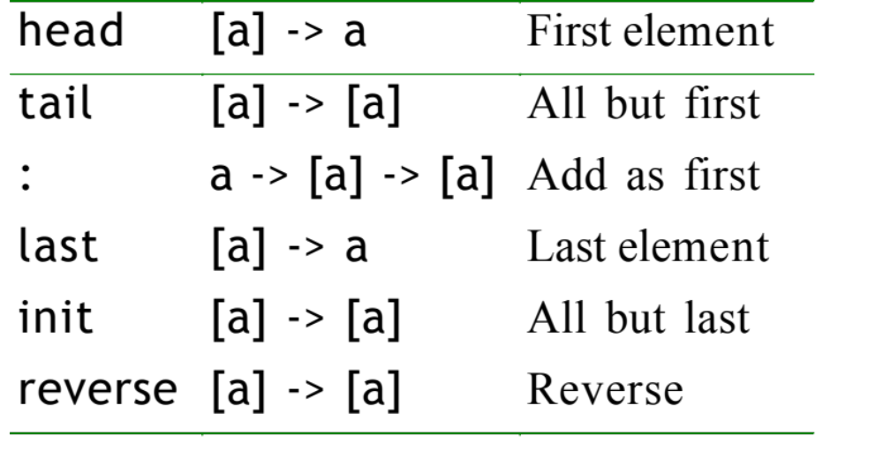
Operations on Lists I

Slide 15
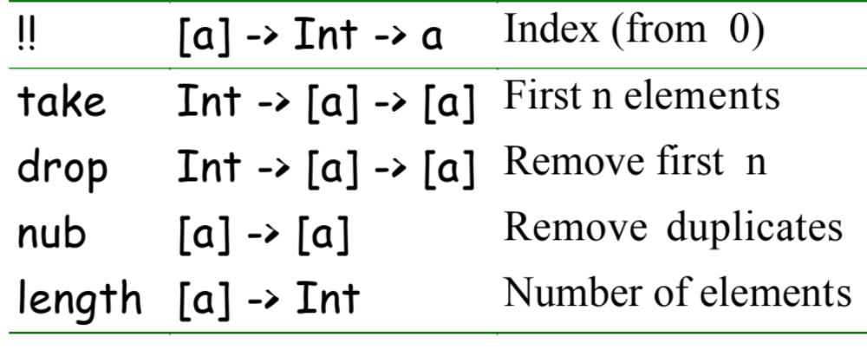
Operations on Lists II

Slide 16
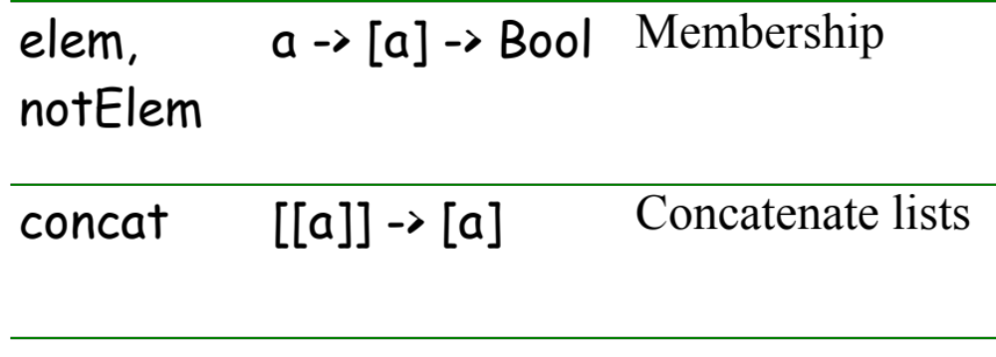
Operations on Lists III

Slide 17
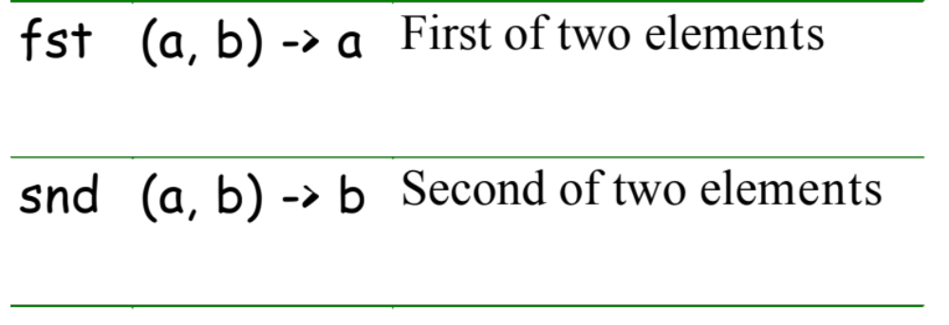
Operations on Tuples
…and nothing else, really.

Slide 18
Lazy Evaluation
No value is ever computed until it is needed
Lazy evaluation allows infinite lists
Arithmetic over infinite lists is supported
Some operations must be avoided

Slide 19
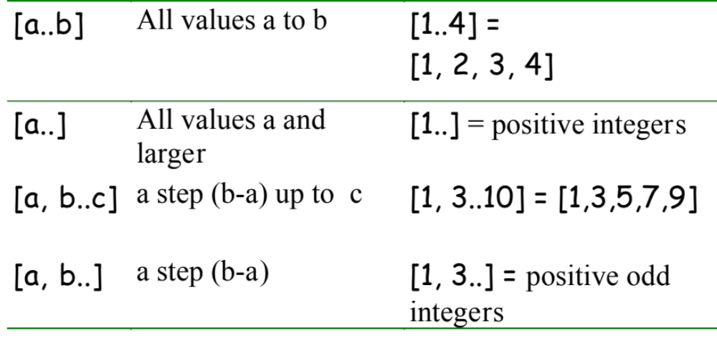
Finite and Infinite Lists

Slide 20
List Comprehensions I
[ expression_using_x | x <- list ]
  read: <expression> where x is in <list>
  x <- list is called a “generator”
Example: [ x * x | x <- [1..] ]
  This is the list of squares of positive integers
take 5 [x*x | x <- [1..]]
  [1,4,9,16,25]

Slide 21
List Comprehensions II
[ expression_using_x_and_y | x <- list, y <- list]
take 10 [x*y | x <- [2..], y <- [2..]]
  [4,6,8,10,12,14,16,18,20,22]
take 10 [x * y | x <- [1..], y <- [1..]]
  [1,2,3,4,5,6,7,8,9,10]
take 5 [(x,y) | x <- [1,2], y <- "abc"]
  [(1,'a'),(1,'b'),(1,'c'),(2,'a'),(2,'b')]

Slide 22
List Comprehensions III
[ expression_using_x | generator_for_x, test_on_x]
take 5 [x*x | x <- [1..], even x]
  [4,16,36,64,100]

Slide 23
List Comprehensions IV
[x+y | x <- [1..5], even x, y <- [1..5], odd y]
  [3,5,7,5,7,9]
[x+y | x <- [1..5], y <- [1..5], even x, odd y]
  [3,5,7,5,7,9]
[x+y | y <- [1..5], x <- [1..5], even x, odd y]
  [3,5,5,7,7,9]

Slide 24
Simple Functions
Functions are defined using =
  avg x y = (x + y) / 2
:type or :t tells you the type
  :t avg
  (Fractional a) => a -> a -> a

Slide 25
Anonymous Functions
Anonymous functions are used often in Haskell, usually enclosed in parentheses
\x y -> (x + y) / 2
  the \ is pronounced “lambda”
    It’s just a convenient way to type λ
  the x and y are the formal parameters
Functions are first-class objects and can be assigned
  avg = \x y -> (x + y) / 2

Slide 26
Currying
Technique named after Haskell Curry
Functions have only one argument
Currying absorbs an argument into a function
f a b = (f a) b, where (f a) is a curried function
(avg 6) 8
  7.0

Slide 27
Currying example
  “And”, &&, has the type Bool -> Bool -> Bool
  x && y can be written as (&&) x y
  If x is True,
  (&&)x is a function that returns the value of y
  If x is False,
  (&&)x is a function that returns False
    It accepts y as a parameter, but doesn’t use its value

Slide 28
Slicing
negative = (< 0)
Main> negative 5
False
Main> negative (-3)
True
Main> :type negative
negative :: Integer -> Bool
Main>

Slide 29
Factorial I
fact n =
if n == 0 then 1
else n * fact (n - 1)
This is an extremely conventional definition.

Slide 30
Factorial II
fact n
| n == 0 = 1
| otherwise = n * fact (n - 1)
Each | indicates a “guard.”
Notice where the equal signs are.

Slide 31
Factorial III
fact n = case n of
0 -> 1
n -> n * fact (n - 1)
This is essentially the same as the last definition.

Slide 32
Factorial IV
You can introduce new variables with
let declarations in expression
fact n
| n == 0 = 1
| otherwise = let m = n - 1 in n * fact m

Slide 33
Factorial V
You can also introduce new variables with
expression where declarations
fact n
| n == 0 = 1
| otherwise = n * fact m
where m = n - 1

Slide 34
The End

