Slide 1
Haskell
Dealing with impurity

Slide 2
Purity
Haskell is a “pure” functional programming language
  Functions have no side effects
    Input/output is a side effect
  Given the same parameters, a function will always return the same result
    This doesn’t work for a function that does input
  There are other needs that can’t be met in a pure fashion
    Obtaining the date and time
    Getting a random number
Haskell “quarantines” these impure actions so as not to contaminate the rest of the code

Slide 3
Laziness
All values in Haskell are “lazy”—they are not computed until they are needed
Laziness does not work well for I/O
Consider [ print "x" ; print "y" ]
  If these values are computed only when needed,
    x might be printed before y
    y might be printed before x
    Neither might be printed
Similar observations hold for input
Most functional languages will temporarily enter an “imperative world” to perform I/O operations
  This approach works for simple cases but is fraught with problems
Haskell enforces a strict separation between the “functional world” and the “imperative world”
  This separation is done by the use of monads

Slide 4
main
Haskell programs usually have a main method
  The type of main is IO ()
  IO () is an I/O action
  The () is the unit; it is an empty tuple, of type () and value ()
The body of the main method is one I/O action
  When main is executed, the I/O action is performed
  The do expression groups a series of I/O actions into a single I/O action
    Think of do as like a compound statement, {...;...;...}, in Java
    The body of the main function is usually a do expression

Slide 5
main is not a pure function
In a typical Haskell program, all I/O is under control of the main function
  “Impure” functions such as main can call pure functions
  “Impure” functions can call other impure functions
  Pure functions cannot call “impure” functions
Thus, main, along with perhaps a small coterie of impure helper functions, is in the “imperative world,” but can make use of the “functional world”
  This turns out to be a good design for programs in other languages, such as Java

Slide 6
getLine and putStrLn
getLine reads in a line of text from the user
  The type of getLine is IO String
  This is an I/O action that contains, “in quarantine,” a String
  The <- operator removes a value from quarantine
  line <- getLine gets the contained String “out of quarantine” and puts it in the (normal, immutable) variable line
putStr string displays text to the user
putStrLn string displays a complete line of text to the user
  The type of these functions is IO ()

Slide 7
Bind
GHCi> :t getLine
getLine :: IO String
GHCi> :t putStrLn
putStrLn :: String -> IO ()
putStrLn prints a String, but getLine returns an IO String
What we might like to do is take the String out of the IO String, but that is “unsafe”—it brings impurity into the world of pure functions
You can think of the IO monad as a kind of “quarantine”
What we need is an operator to go into the IO world of getLine, take its String, and pass it to putStrLn, without leaving “quarantine”
That operator is “bind”, >>=
The type of >>= is: Monad m => m a -> (a -> m b) -> m b
do is syntactic sugar for a sequence of bind operations

Slide 8
return
return doesn’t mean what it means in any other language!
return is a function that quarantines its argument, and returns that argument in an “isolation cell”
  This “isolation cell” is called a monad
  Inside do, the operator <- can be used to get a value out of a monad
Prelude> :t return "hello"
return "hello" :: (Monad m) => m [Char]
Prelude> foo <- return "hello"
Prelude> foo
"hello"
One use of return is to provide an “empty value” in a do

Slide 9
More I/O actions
putChar takes a character and returns an I/O action that will print it out to the terminal
getChar is an I/O action that reads a character from the input
print is putStrLn . show

Slide 10
Example program using I/O
import Data.Char
main = do
putStrLn "Type something in: "
line <- getLine
if null line
then return ()
else do
putStrLn $ "You said: " ++ map toUpper line
main
In Haskell, the if is an expression and must return a value; hence it requires both a then and an else
The do requires a sequence of I/O actions
return () is an IO action and returns a value, so it’s okay to use

Slide 11
Why purity matters
Pure functions are like immutable values--safe and reliable
  No dependency on state, so...
    A function that works once will work always
    Functions may be computed in any order
    Lazy evaluation becomes possible
Laziness and side effects are incompatible
  Suppose “print” were a function
  Consider a list of print functions...
  ...when are the print functions evaluated?
Input changes the state of the computation
  But pure functions have no dependency on state, so computations cannot depend on state

Slide 12
The Blind Men and the Elephant
It was six men of Indostan
To learning much inclined,
Who went to see the Elephant
(Though all of them were blind),
That each by observation
Might satisfy his mind.
The First approached the Elephant,
And happening to fall
Against his broad and sturdy side,
At once began to bawl:
"God bless me! but the Elephant
Is very like a WALL!"
The Second, feeling of the tusk,
Cried, "Ho, what have we here,
So very round and smooth and sharp?
To me 'tis mighty clear
This wonder of an Elephant
Is very like a SPEAR!"
The Third approached the animal,
And happening to take
The squirming trunk within his hands,
Thus boldly up and spake:
"I see," quoth he, "the Elephant
Is very like a SNAKE!"

Slide 13
by John Godfrey Saxe (1816-1887)
The Fourth reached out an eager hand,
And felt about the knee
"What most this wondrous beast is like
Is mighty plain," quoth he:
"'Tis clear enough the Elephant
Is very like a TREE!"
The Fifth, who chanced to touch the ear,
Said: "E'en the blindest man
Can tell what this resembles most;
Deny the fact who can,
This marvel of an Elephant
Is very like a FAN!"
The Sixth no sooner had begun
About the beast to grope,
Than seizing on the swinging tail
That fell within his scope,
"I see," quoth he, "the Elephant
Is very like a ROPE!"
And so these men of Indostan
Disputed loud and long,
Each in his own opinion
Exceeding stiff and strong,
Though each was partly in the right,
And all were in the wrong!

Slide 14
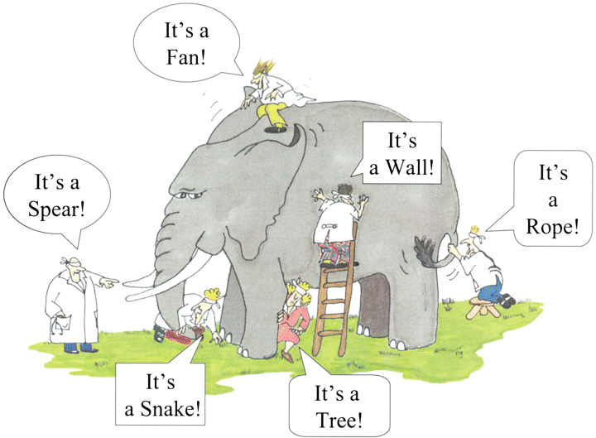
So, what’s a monad?

Slide 15
How to learn about monads
Be very confused
Read lots of explanations on the web by people who have finally understood how simple monads really are
Remain confused
Program in Haskell for a while
See the light
Realize that all the explanations you had read were wrong
Write a tutorial on the web explaining how monads are actually very simple

Slide 16

Dealing with state
To have state and pure functions, the old state of the world must be passed in as a parameter, and the new state of the world returned as a result
A monad is a way of automatically maintaining state
IO a can be thought of as a function whose type is
World -> (a, World)

Slide 17
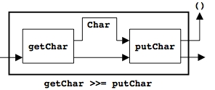
The “bind” operator, >>=
We will want to take the “state of the world” resulting from one function, and pass it into the next function
Suppose we want to read a character and then print it
Types:
  getChar :: IO Char
  putChar :: Char -> IO ()
The result of getChar isn’t something that can be given to putChar
  The IO Char “contains” a Char that has to be extracted to be given to putChar
  (>>=) :: IO a -> (a -> IO b) -> IO b
Hence,
  Prelude> getChar >>= putChar
  a
  aPrelude>

Slide 18
The “then” operator, >>
The second argument to >>= is a function (such as putChar)
  This is what we need for passing along a result
  It is convenient to have another function that doesn’t demand a function as its second argument
The “then” operator simply throws away its contents
  (>>) :: IO a -> IO b -> IO b
  Prelude> putChar 'a' >> putChar 'b' >> putChar '\n'
  ab
  Prelude>

Slide 19

The return function
Finally, it is helpful to be able to create a monad container for arbitrary values
return :: a -> IO a
The action (return v) is an action that does no I/O, and immediately returns v without having any side effects
getTwoChars :: IO (Char,Char)
getTwoChars = getChar >>= \ c1 ->
getChar >>= \ c2 ->
return (c1,c2)

Slide 20
do notation
From the last slide:
  getTwoChars :: IO (Char,Char)
  getTwoChars = getChar >>= \ c1 ->
  getChar >>= \ c2 ->
  return (c1,c2)
That’s pretty hard to read
The do provides “syntactic sugar”
  get2Chars :: IO (Char,Char)
  get2Chars = do
  c1 <- getChar
  c2 <- getChar
  return (c1,c2)
  The do also allows the let form (but without in)

Slide 21
Building control structures
An infinite loop:
  forever :: IO () -> IO ()
  forever a = a >> forever a
Repeating a fixed number of times:
  repeatN :: Int -> IO a -> IO ()
  repeatN 0 a = return ()
  repeatN n a = a >> repeatN (n-1) a
A “for loop” for I/O actions:
  for :: [a] -> (a -> IO ()) -> IO ()
  for [] fa = return ()
  for (n:ns) fa = fa n >> for ns fa
  printNums = for [1..10] print

Slide 22
Formal definition of a monad
A monad consists of three things:
  A type constructor M
  A bind operation, (>>=) :: (Monad m) => m a -> (a -> m b) -> m b
  A return operation, return :: (Monad m) => a -> m a
And the operations must obey some simple rules:
  return x >>= f = f x
    return just sends its result to the next function
  m >>= return = m
    Returning the result of an action is equivalent to just doing the action
  do {x <- m1; y <- m2; m3} =
  do {y <- do {x <- m1; m2} m3}
    >>= is associative

Slide 23
when
Earlier, we had this function:
  main = do
  putStrLn "Type something in: "
  line <- getLine
  if null line
  then return ()
  else do
  putStrLn $ "You said: " ++ map toUpper line
  main
The return () seems like an unnecessary annoyance, so let’s get rid of it
  when :: (Monad m) => Bool -> m () -> m ()
  when True m = m
  when False m = return ()
  main = do
  putStrLn "Type something in: "
  line <- getLine
  when (not (null line)) $ do
  putStrLn $ "You said: " ++ map toUpper line
  main

Slide 24
sequence
sequence takes a list of I/O actions and produces a list of results
sequence :: [IO a] -> IO [a]
  main = do
  rs <- sequence [getLine, getLine, getLine]
  print rs
  is equivalent to
  main = do
  a <- getLine
  b <- getLine
  c <- getLine
  print [a,b,c]

Slide 25
File I/O
A first example:
  import System.IO
  main = do
  handle <- openFile "myFile.txt" ReadMode
  contents <- hGetContents handle
  putStr contents
  hClose handle
Where:
  openFile :: FilePath -> IOMode -> IO Handle
  type FilePath = String
  data IOMode = ReadMode | WriteMode | AppendMode | ReadWriteMode
  getContents :: IO String -- reads from stdIn
  hGetContents :: Handle -> IO String
    This is a lazy method
  hClose :: Handle -> IO ()

Slide 26
More file I/O
withFile is like openFile, but it takes care of closing the file afterward
The “h” methods work with a specific file, given by the file “handle”
  hGetLine :: Handle -> IO String
  hPutStr :: Handle -> String -> IO ()
  hPutStrLn :: Handle -> String -> IO ()
  hGetChar :: Handle -> IO Char
readFile and writeFile read and write the entire thing

Slide 27
Doing I/O
There are two ways you can have code that does I/O:
  Run from the REPL, GHCi
    In the REPL you can call any defined method, including main
  Write a program with a main method
    You can interpret the program, or compile and run it
    The program will run from the main method
    The main method encapsulates all the I/O
    “Normal” methods can be called from main to do the work

Slide 28
References
The monad explanations are based on a great article, “Tackling the Awkward Squad,” by Simon Peyton Jones
  http://research.microsoft.com/en-us/um/people/simonpj/papers/marktoberdorf/
  The pictures are copied from this article
Some examples are taken, with minor revisions, from “Learn You a Haskell for Great Good”

Slide 29
The End

