Slide 1
AUTONOMOUS SECURITY GUARD ROBOT
Group 15
Team Members
Rohit Vijayaraghavan
MCG Karthik
Ayush Sanghvi
Sahil Bareja

Slide 2
Introduction
Problem Statement-A robot that should monitor and report status of his guarding area to detect gas leaks and perform face recognition
The security features we have implemented are
1-Face recognition module(on PC)
2- Gas detection module(on SPARKV)

Slide 3
Task Specification
Sr. No | Task | Date of Completion | Done by
1 | Hardware Procurement | 1 December 2011 | Rohit & Karthik
2 | Smoke Detector Interfaced with SparkV | 18th April 2012 | Ayush and Sahil
3 | Code for Implementing Autonomous nature | 15th Febuary 2012 | Ayush and Sahil
4 | Software Code in MATLAB for Face Recog. | 3rd April 2012 | Karthik and Rohit
5 | Testing and Debugging | 21st April | Karthik and Rohit
6 | Documentation |  | Sahil Bareja

Slide 4
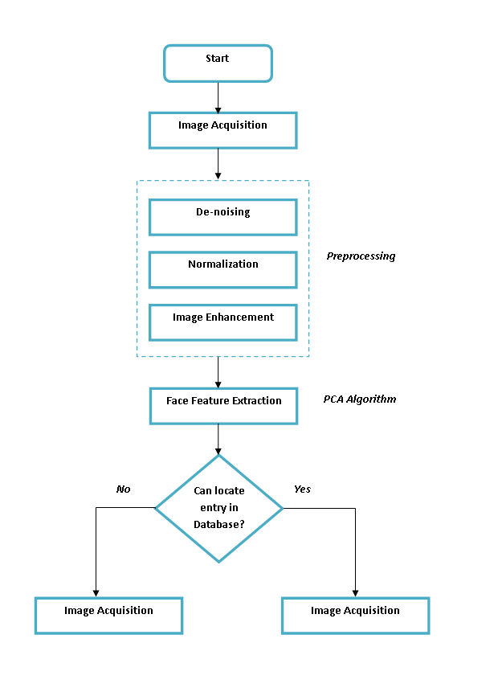
Flowchart

Slide 5
Module1-Face Recognition
Types of face recognition
Eigenfaces: the idea
Eigenvectors ,Eigenvalues and covariance
Learning Eigenfaces from training sets of faces
Recognition and reconstruction
Results
Problems Faced
Future Modifications Required

Slide 6
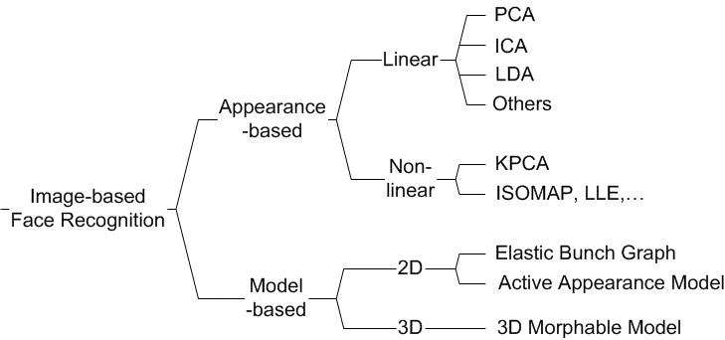

Slide 7
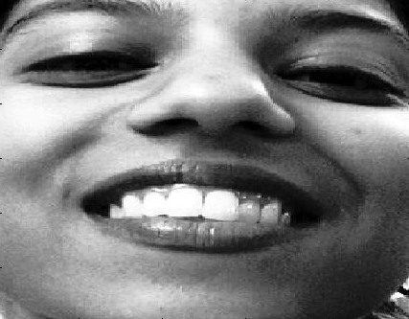
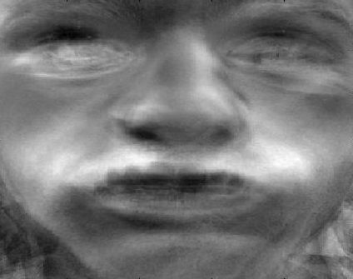
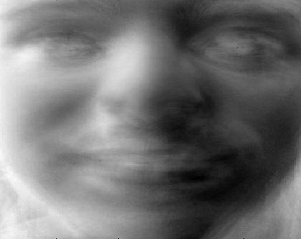
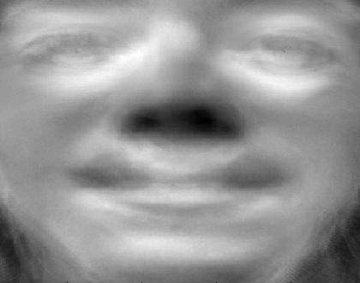
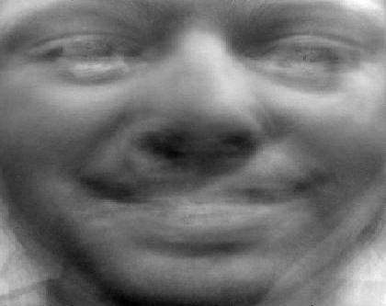
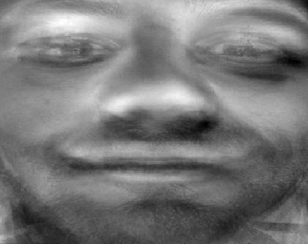
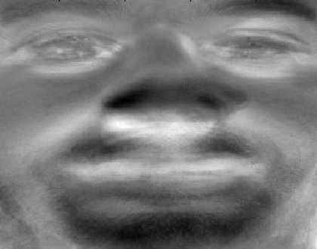
Eigenfaces: the idea
Think of a face as being a weighted combination of some “component” or “basis” faces
These basis faces are called eigenfaces
-8029 2900 1751 1445 4238 6193
…

Slide 8
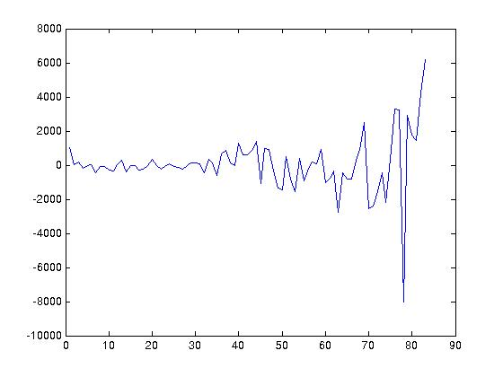
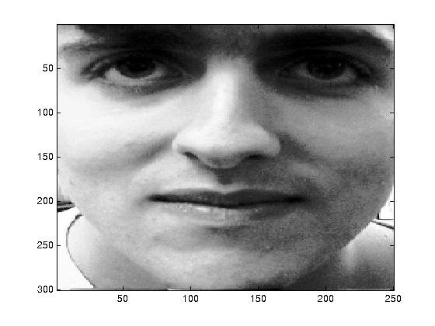
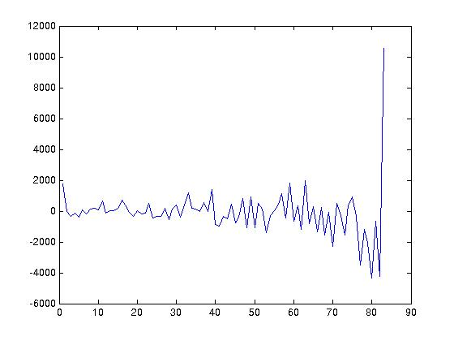
Eigenfaces: representing faces
These basis faces can be differently weighted to represent any face
So we can use different vectors of weights to represent different faces
-8029 -1183 2900 -2088 1751 -4336 1445 -669 4238 -4221 6193 10549

Slide 9
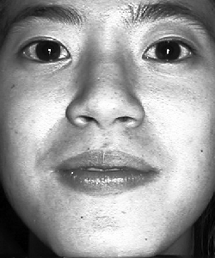
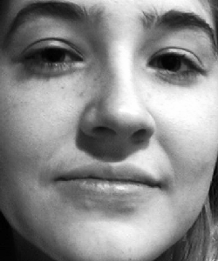
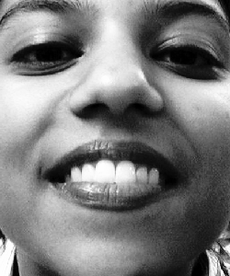
Learning Eigenfaces
Q: How do we pick the set of basis faces?
A: We take a set of real training faces
Then we find (learn) a set of basis faces which best represent the differences between them
We’ll use a statistical criterion for measuring this notion of “best representation of the differences between the training faces”
We can then store each face as a set of weights for those basis faces
…

Slide 10

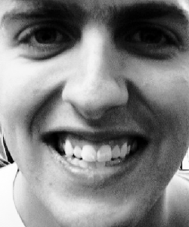
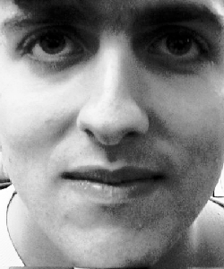
Using Eigenfaces: recognition & reconstruction
We can use the eigenfaces in two ways
1: we can store and then reconstruct a face from a set of weights
2: we can recognise a new picture of a familiar face

Slide 11
Learning Eigenfaces
How do we learn them?
We use a method called Principle Components Analysis (PCA)
To understand this we will need to understand
  What an eigenvector is
  What covariance is
But first we will look at what is happening in PCA qualitatively

Slide 12
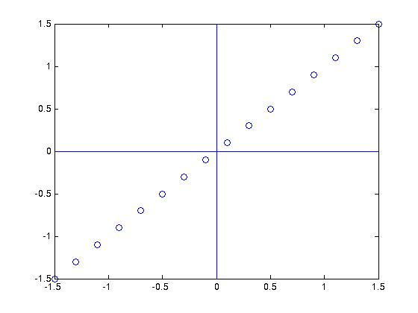
Subspaces
Imagine that our face is simply a (high dimensional) vector of pixels
We can think more easily about 2d vectors
Here we have data in two dimensions
But we only really need one dimension to represent it

Slide 13
Finding Subspaces
Suppose we take a line through the space
And then take the projection of each point onto that line
This could represent our data in “one” dimension

Slide 14
Finding Subspaces
Some lines will represent the data in this way well, some badly
This is because the projection onto some lines separates the data well, and the projection onto some lines separates it badly

Slide 15

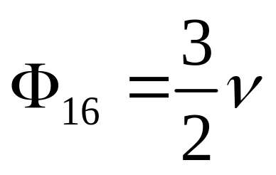
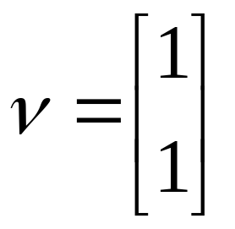
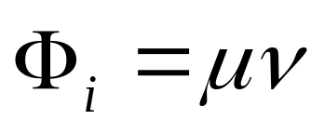
Finding Subspaces
Rather than a line we can perform roughly the same trick with a vector
Now we have to scale the vector to obtain any point on the line

Slide 16
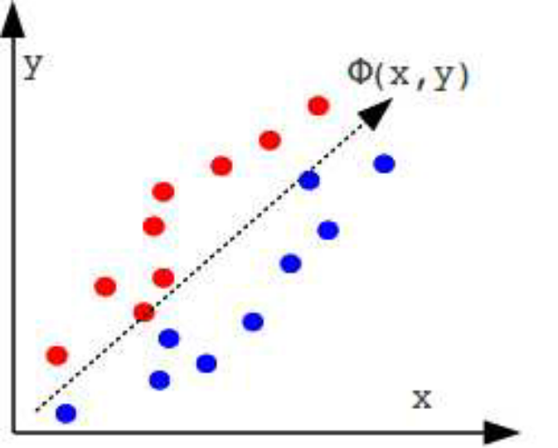
PCA Algorithm
Template matching approach
A general method to identify the linear directions in which a set of vectors are best represented
A dimensional reduction
First principal component is the linear combination of the original dimensions that has the highest variability.
High energy compaction technique.
Mathematical concepts required for PCA- standard deviation, covariance, eigenvectors and eigenvalues.

Slide 17




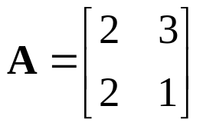
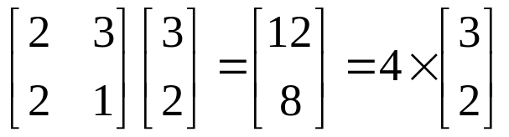
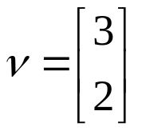

Eigenvectors
An eigenvector is a vector that obeys the following rule:
Where is a matrix and is a scalar (called the eigenvalue)
e.g.
so for this eigenvector of this matrix the eigenvalue is 4

Slide 18
Eigenvectors
We can think of matrices as performing transformations on vectors (e.g rotations, reflections)
We can think of the eigenvectors of a matrix as being special vectors (for that matrix) that are scaled by that matrix
Different matrices have different eigenvectors
Only square matrices have eigenvectors
Not all square matrices have eigenvectors
An n by n matrix has at most n distinct eigenvectors
All the distinct eigenvectors of a matrix are orthogonal (ie perpendicular)

Slide 19
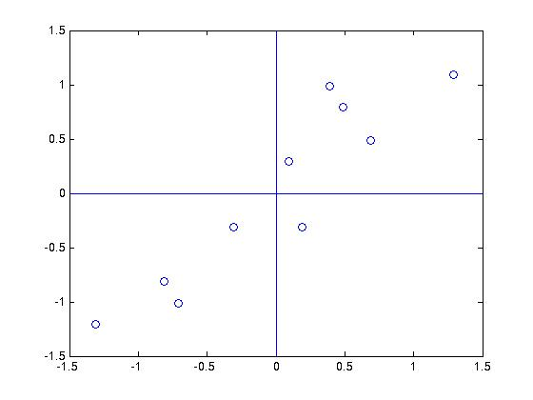


Covariance
Which single vector can be used to separate these points as much as possible?
This vector turns out to be a vector expressing the direction of the correlation
Here I have two variables and
They co-vary (y tends to change in roughly the same direction as x)

Slide 20
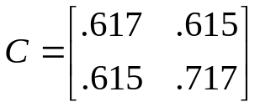
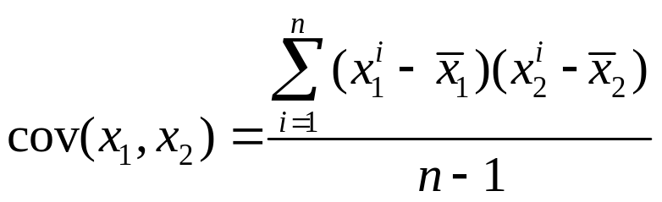
Covariance
The covariances can be expressed as a matrix
The diagonal elements are the variances e.g. Var(x₁)
The covariance of two variables is:

Slide 21
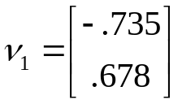
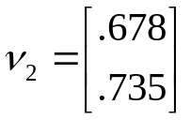


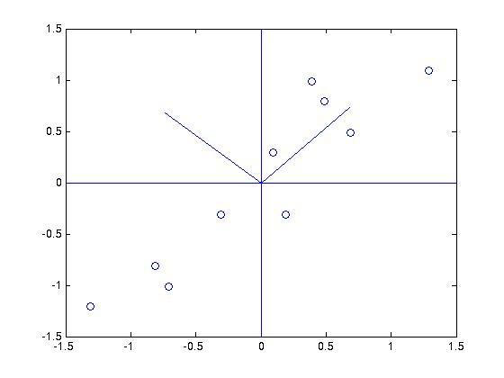
Eigenvectors of the covariance matrix
The covariance matrix has eigenvectors
covariance matrix
eigenvectors
eigenvalues
Eigenvectors with larger eigenvectors correspond to
directions in which the data varies more
Finding the eigenvectors and eigenvalues of the
covariance matrix for a set of data is termed
principle components analysis

Slide 22
Expressing points using eigenvectors
Suppose you think of your eigenvectors as specifying a new vector space
i.e. I can reference any point in terms of those eigenvectors
A point’s position in this new coordinate system is what we earlier referred to as its “weight vector”
For many data sets you can cope with fewer dimensions in the new space than in the old space

Slide 23
Eigenfaces
All we are doing in the face case is treating the face as a point in a high-dimensional space, and then treating the training set of face pictures as our set of points
To train:
  We calculate the covariance matrix of the faces
  We then find the eigenvectors of that covariance matrix
These eigenvectors are the eigenfaces or basis faces
Eigenfaces with bigger eigenvalues will explain more of the variation in the set of faces, i.e. will be more distinguishing

Slide 24
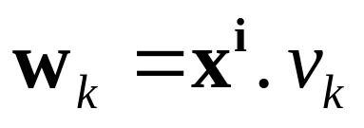


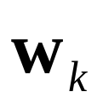
Eigenfaces: image space to face space
When we see an image of a face we can transform it to face space
There are k=1…n eigenfaces
The i^{th} face in image space is a vector
The corresponding weight is
We calculate the corresponding weight for every eigenface

Slide 25
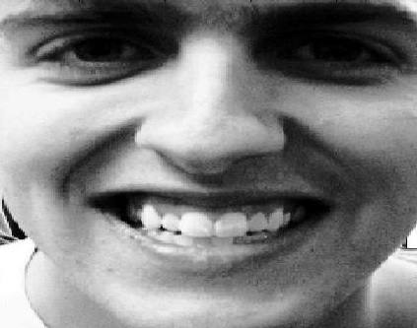
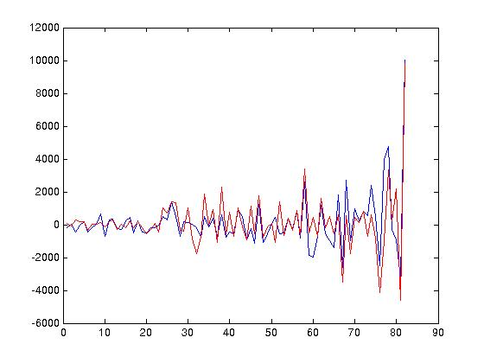
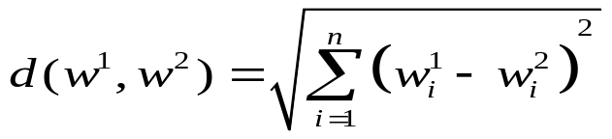
Recognition in face space
Recognition is now simple. We find the Euclidean distance d between our face and all the other stored faces in face space:
The closest face in face space is the chosen match

Slide 26
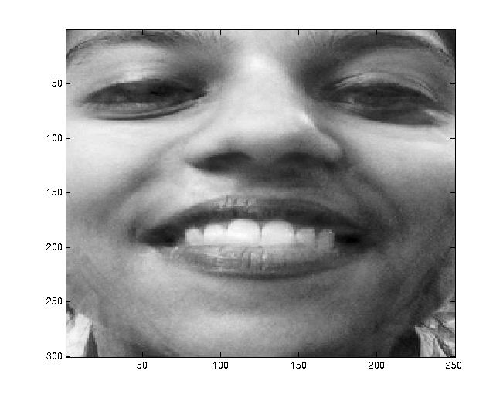

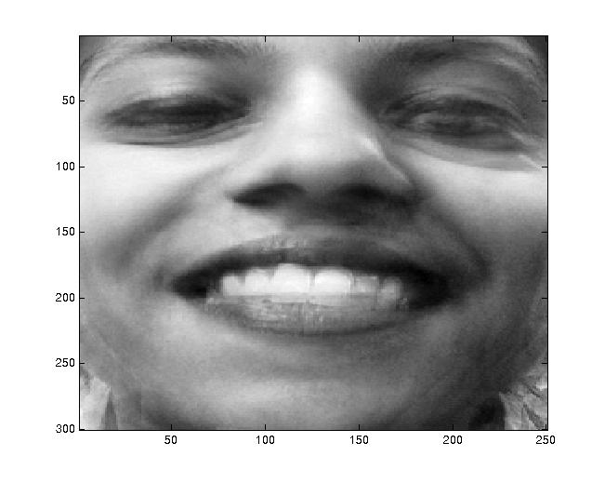
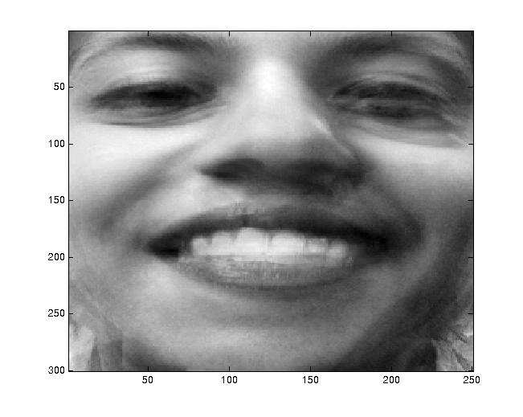
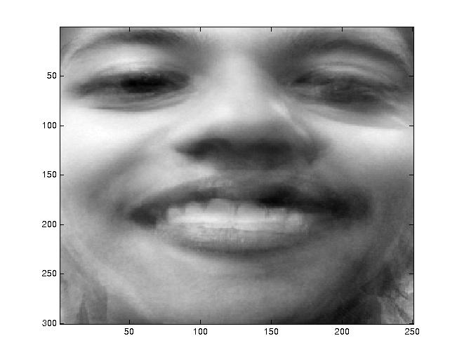
Reconstruction
The more eigenfaces you have the better the reconstruction, but you can have high quality reconstruction even with a small number of eigenfaces
82 70 50
30 20 10

Slide 27
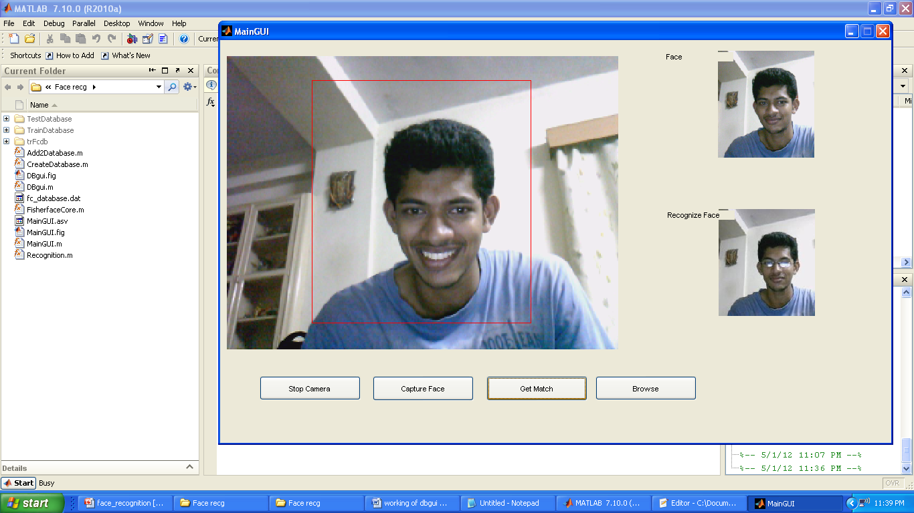


Slide 28
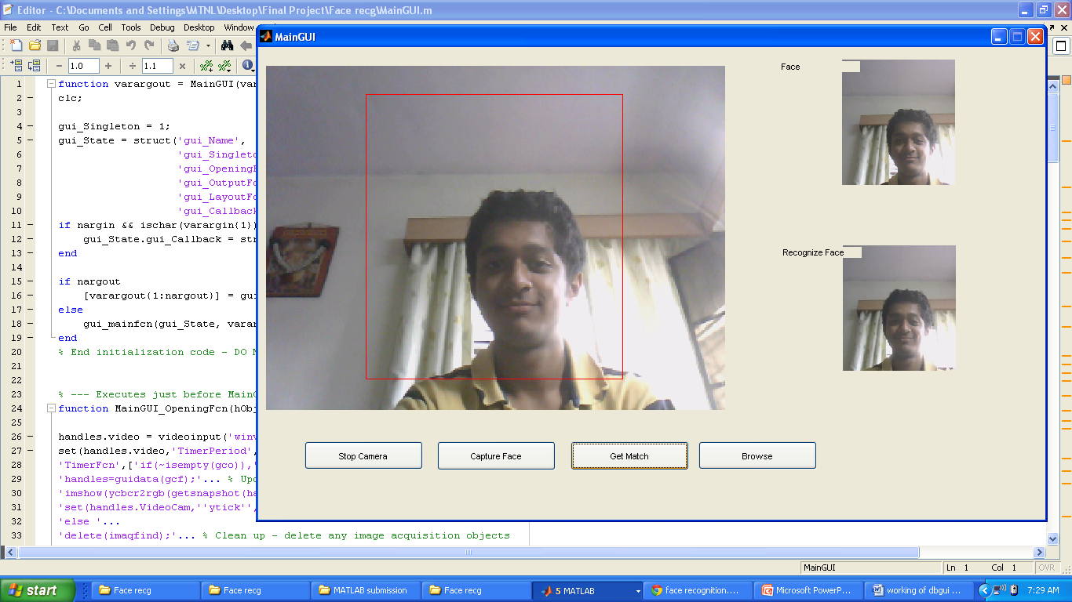

Slide 29
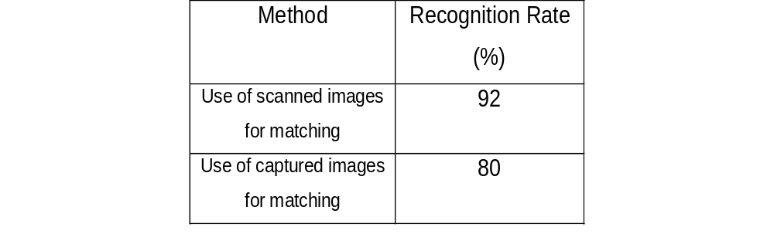
RESULTS
Recognition rates

Slide 30
Problems Faced
Illumination-varying light conditions
Timer Call-back delay issue while dealing with GUI
Pose- varying positions for different images. The recognition rate is not satisfactory for pose variations exceeding 30 degrees

Slide 31
Module 2-Hardware

Slide 32
Circuit Diagram
Vcc
GND
Atmega 16
IR Proximity Sensor left
A0 PC.3
Buzzer
IR Proximity Sensor center
A1
IR Proximity Sensor right
A2 PC.1
Gas Sensor Module

Slide 33
Working
Start
X=left
Y=Center
Z=right
PC.2=Gas Module o/p
PC.3=Buzzer out=0
Flowchart for obstacle Detection
and Gas detection
X Or Y Or
Z> Threshold
N
PC.2
Y
0
Turn
PC.3=1
Straight
Stop

Slide 34
Future Enhancements
GSM Module to transmit presence of intruder
Further enhancements in code to increase re-usability
Further sensor and detector additions to enhance usability
Dividing images into smaller sub images and then applying PCA
Evaluated under the conditions of further varying expression, illumination and pose using standard face databases

Slide 35


