Slide 1

Notes:
slide 1

Slide 2
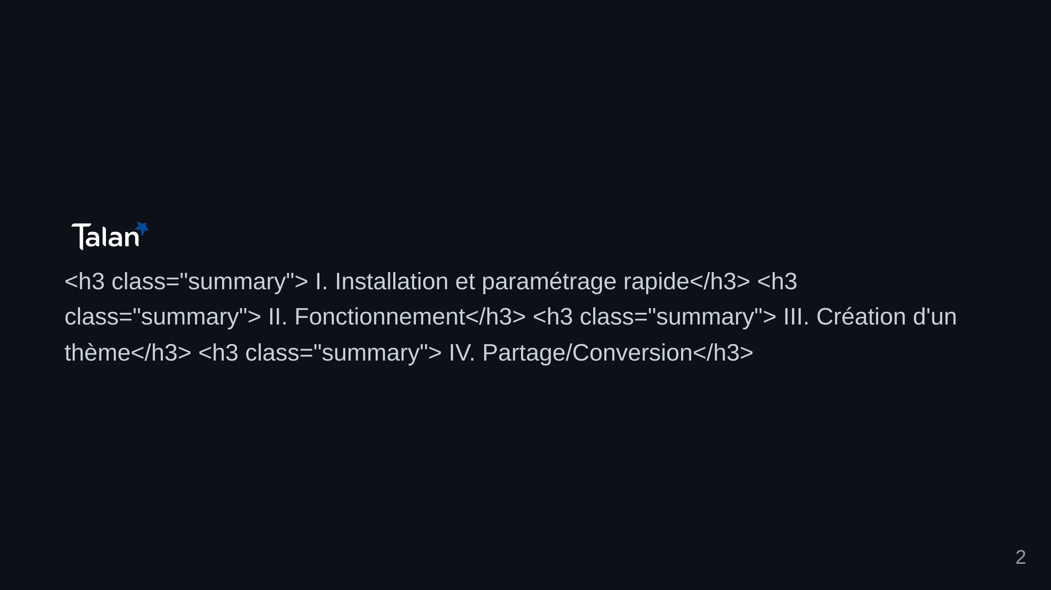
Notes:
slide 2

Slide 3
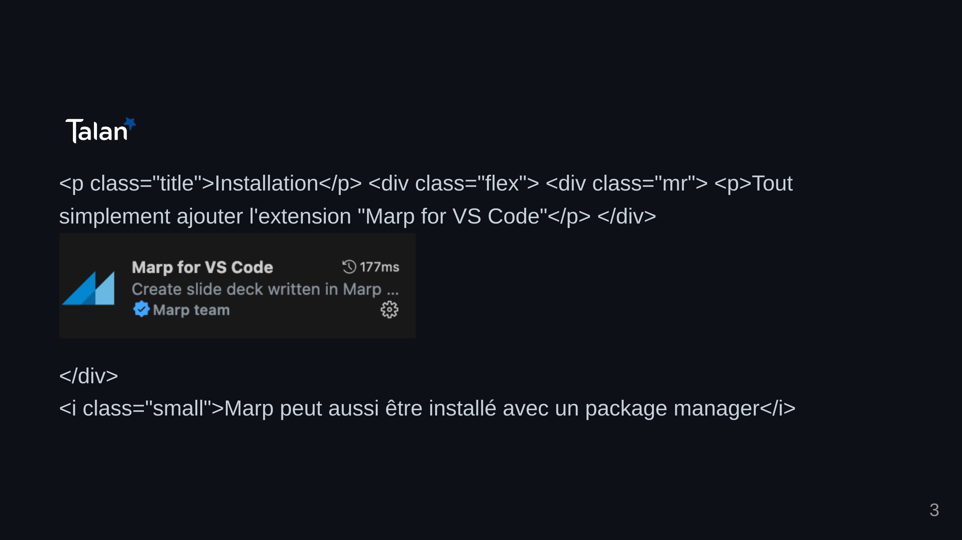
Notes:
slide 3

Slide 4
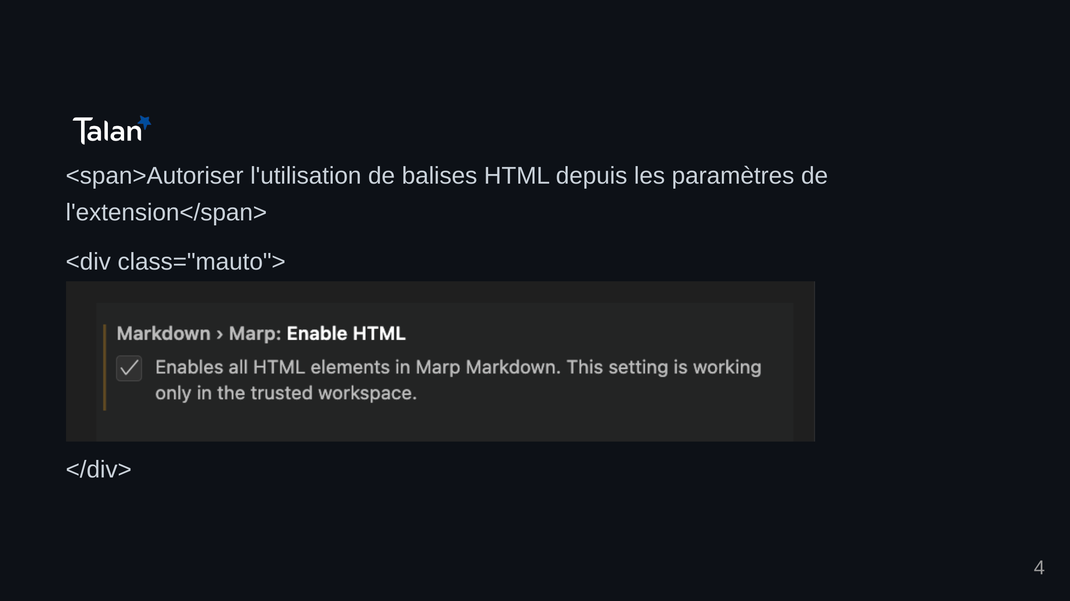
Notes:
slide 4

Slide 5
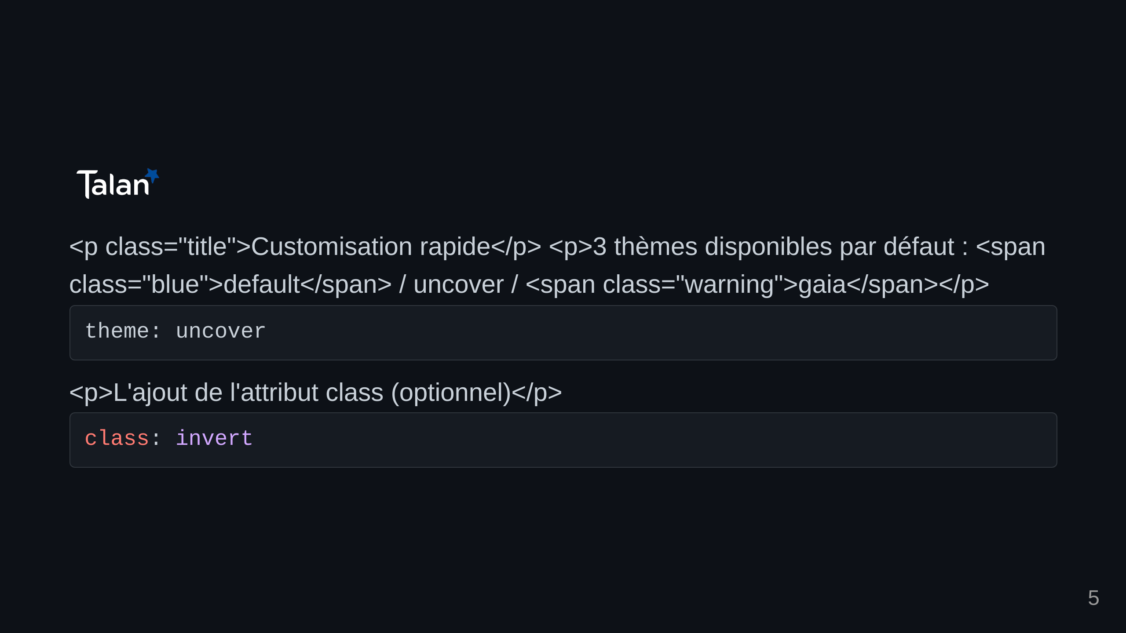
Notes:
slide 5

Slide 6
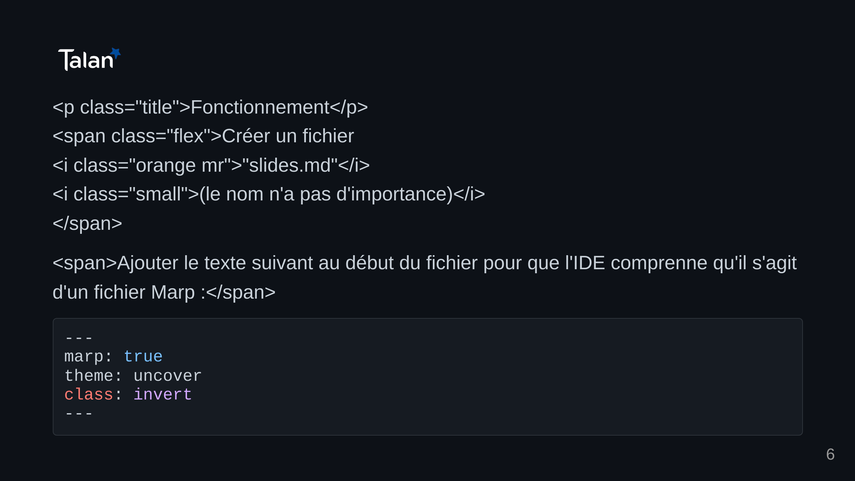
Notes:
slide 6

Slide 7
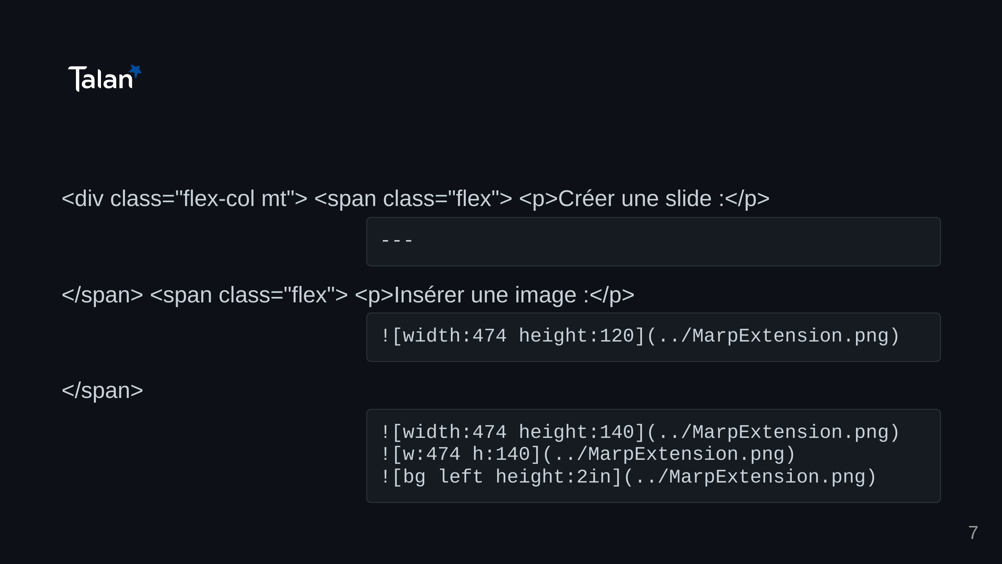
Notes:
slide 7

Slide 8
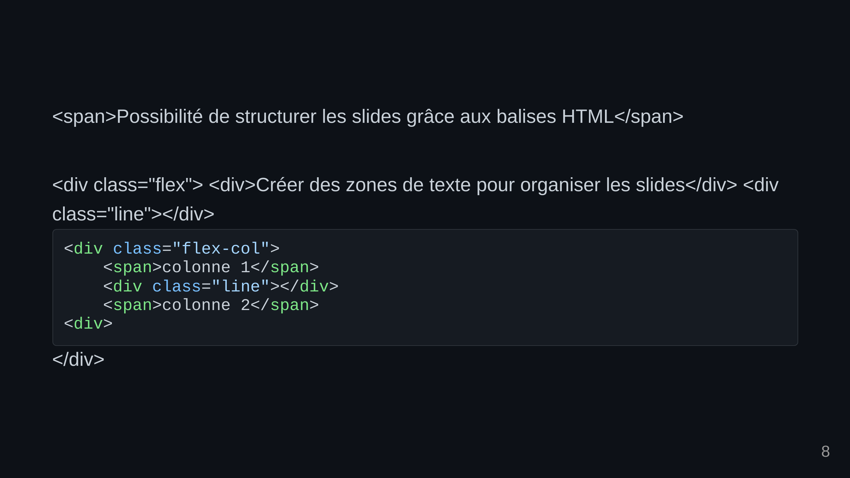
Notes:
slide 9

Slide 9
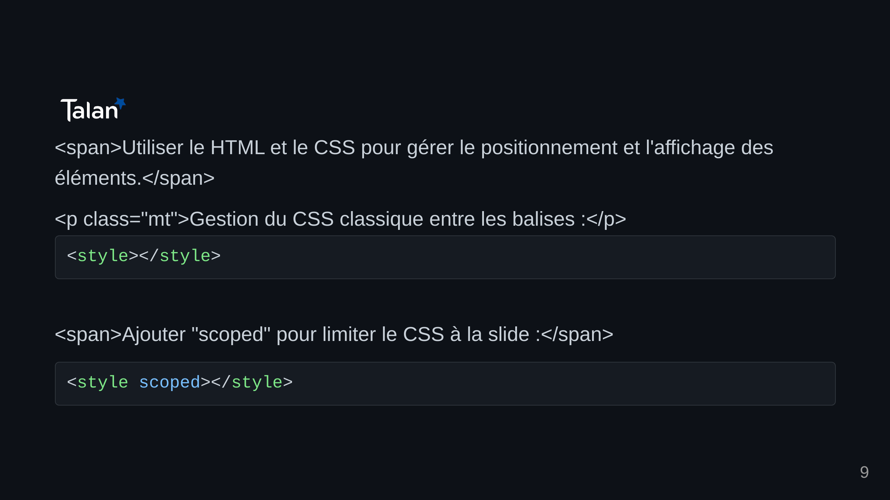
Notes:
slide 8

Slide 10
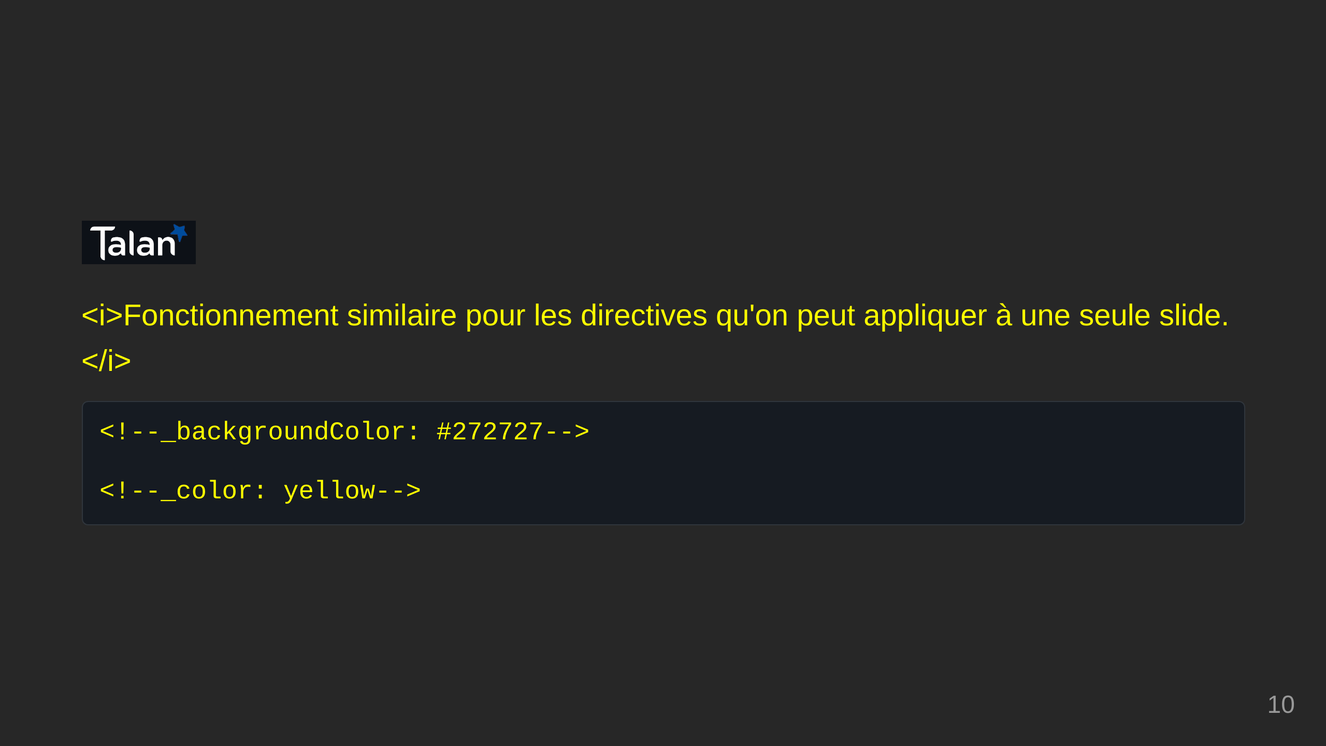
Notes:
slide 10

Slide 11
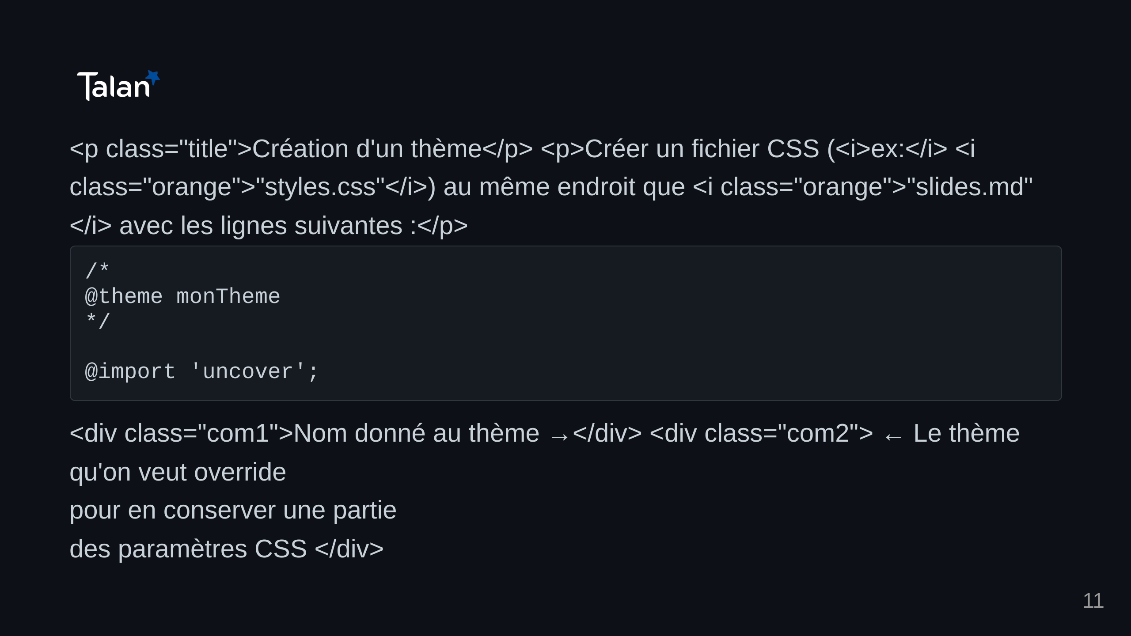
Notes:
slide 11

Slide 12
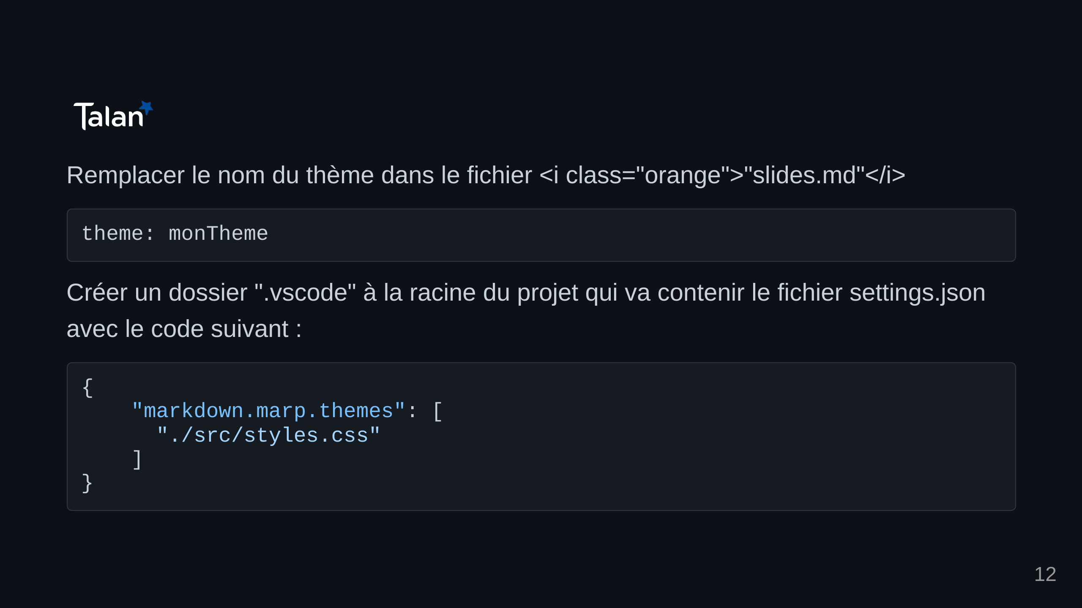
Notes:
slide 12

Slide 13
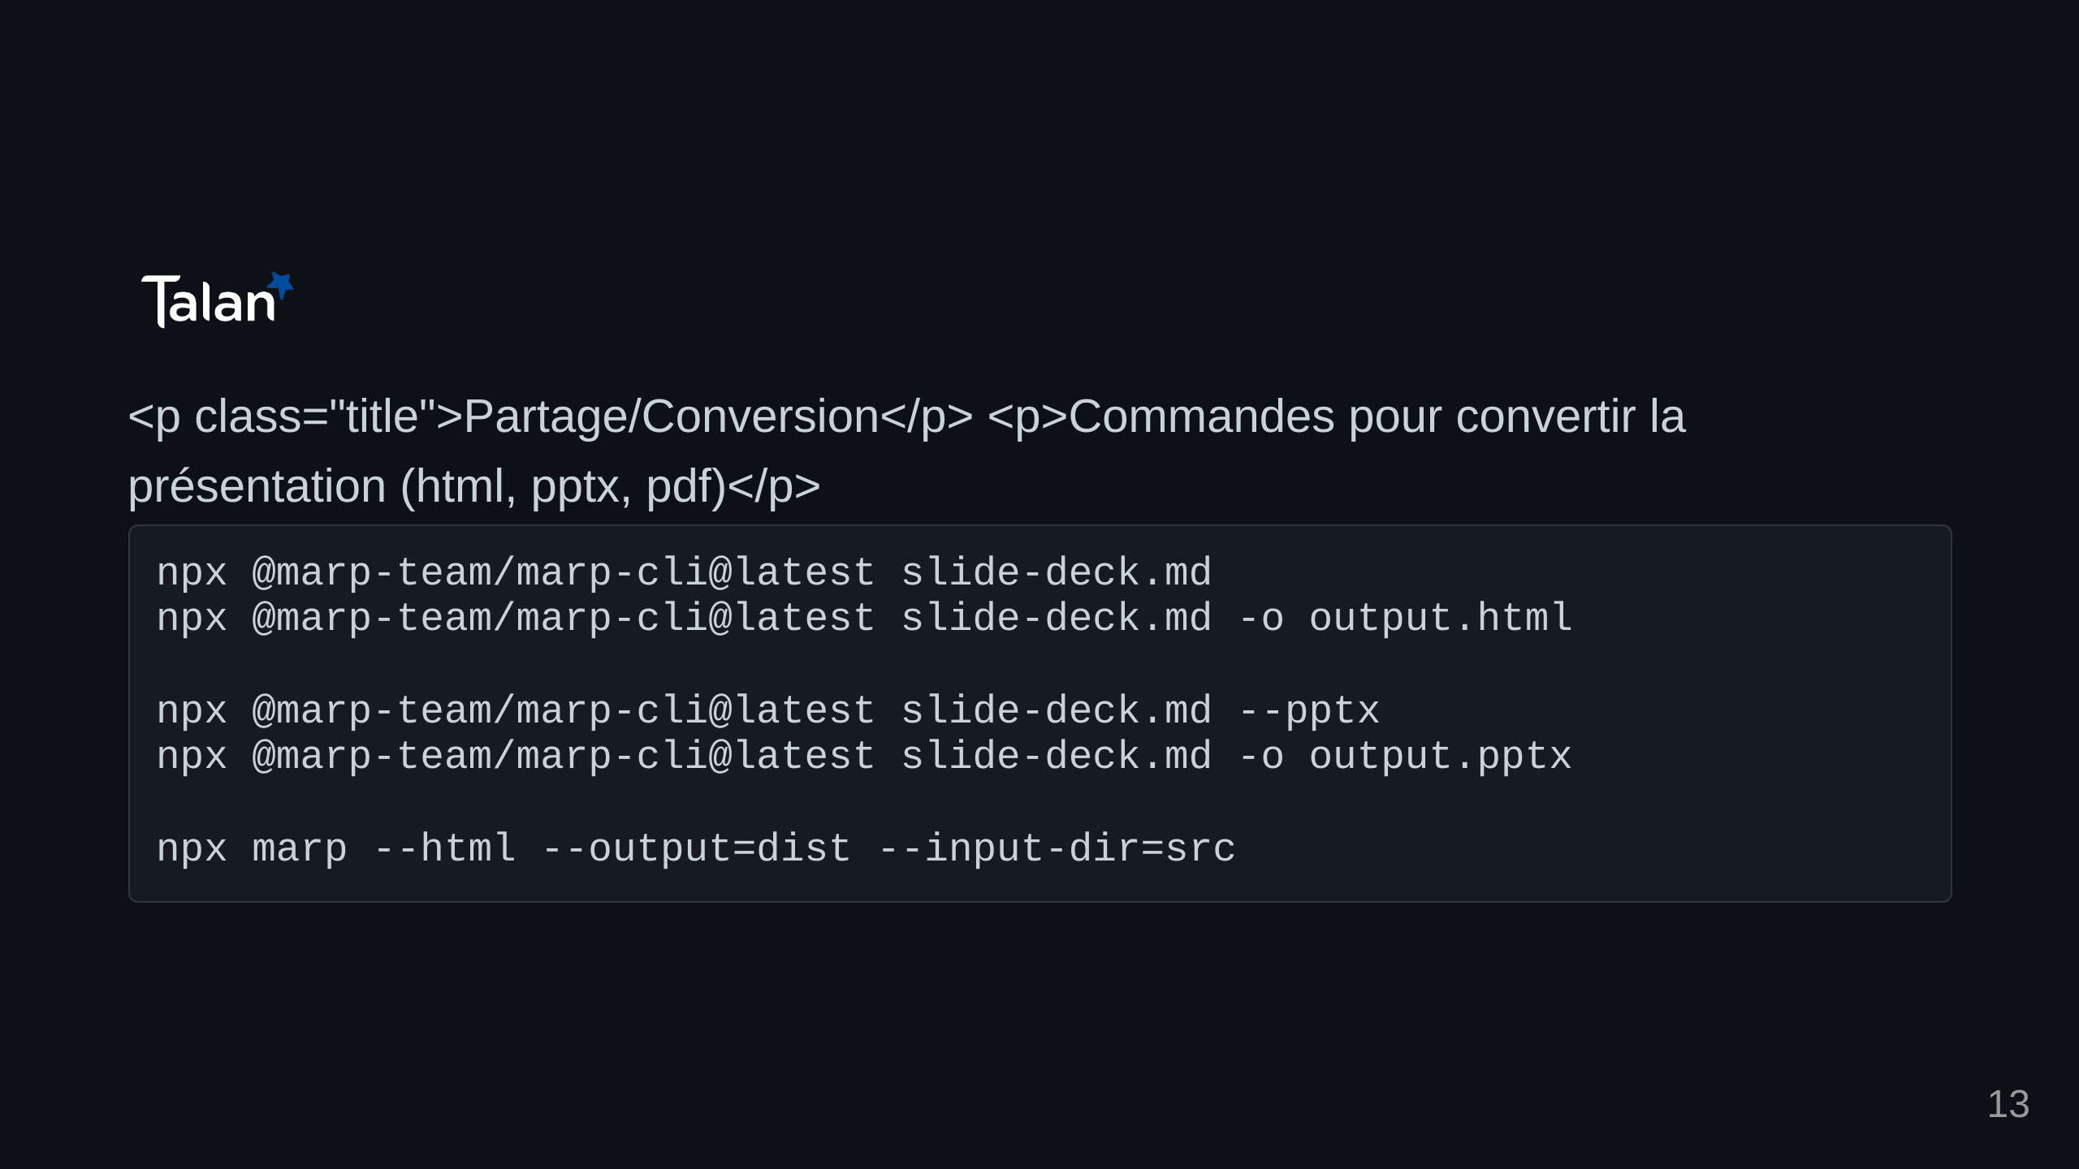
Notes:
slide 13

Slide 14
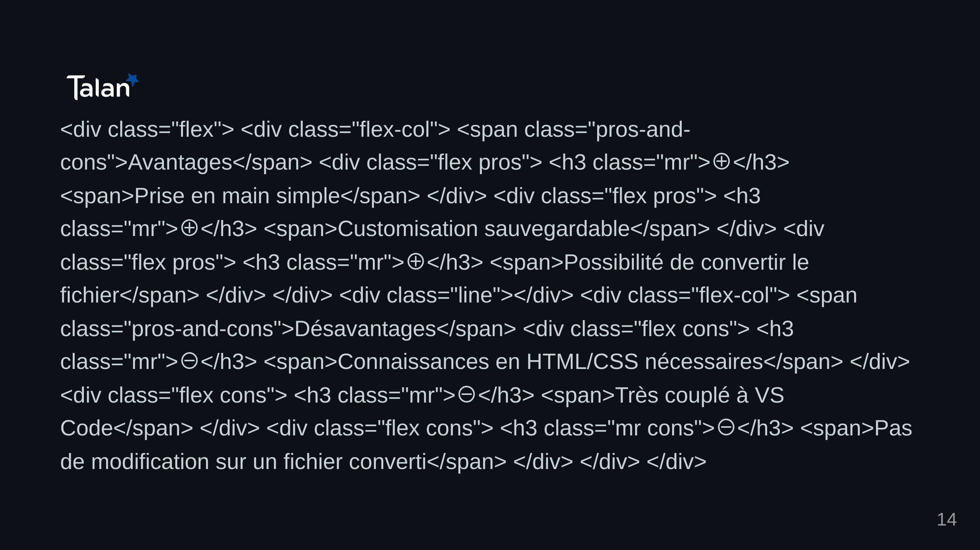
Notes:
slide 14

Slide 15

Notes:
slide 15

