Slide 1
VCM — Tiny Voice Command Model
"Hello Jarvis" wake gate · CRNN command classifier · real actions on a Raspberry Pi 4
AI 231 · MEx 2 — real-world VCM demo
Raspberry Pi 4 (4 GB) · ReSpeaker 2-Mics HAT · USB speaker (only two devices)
Standalone: no cloud models · no LLM · no ASR — pure VCM, commands 1–10

Slide 2
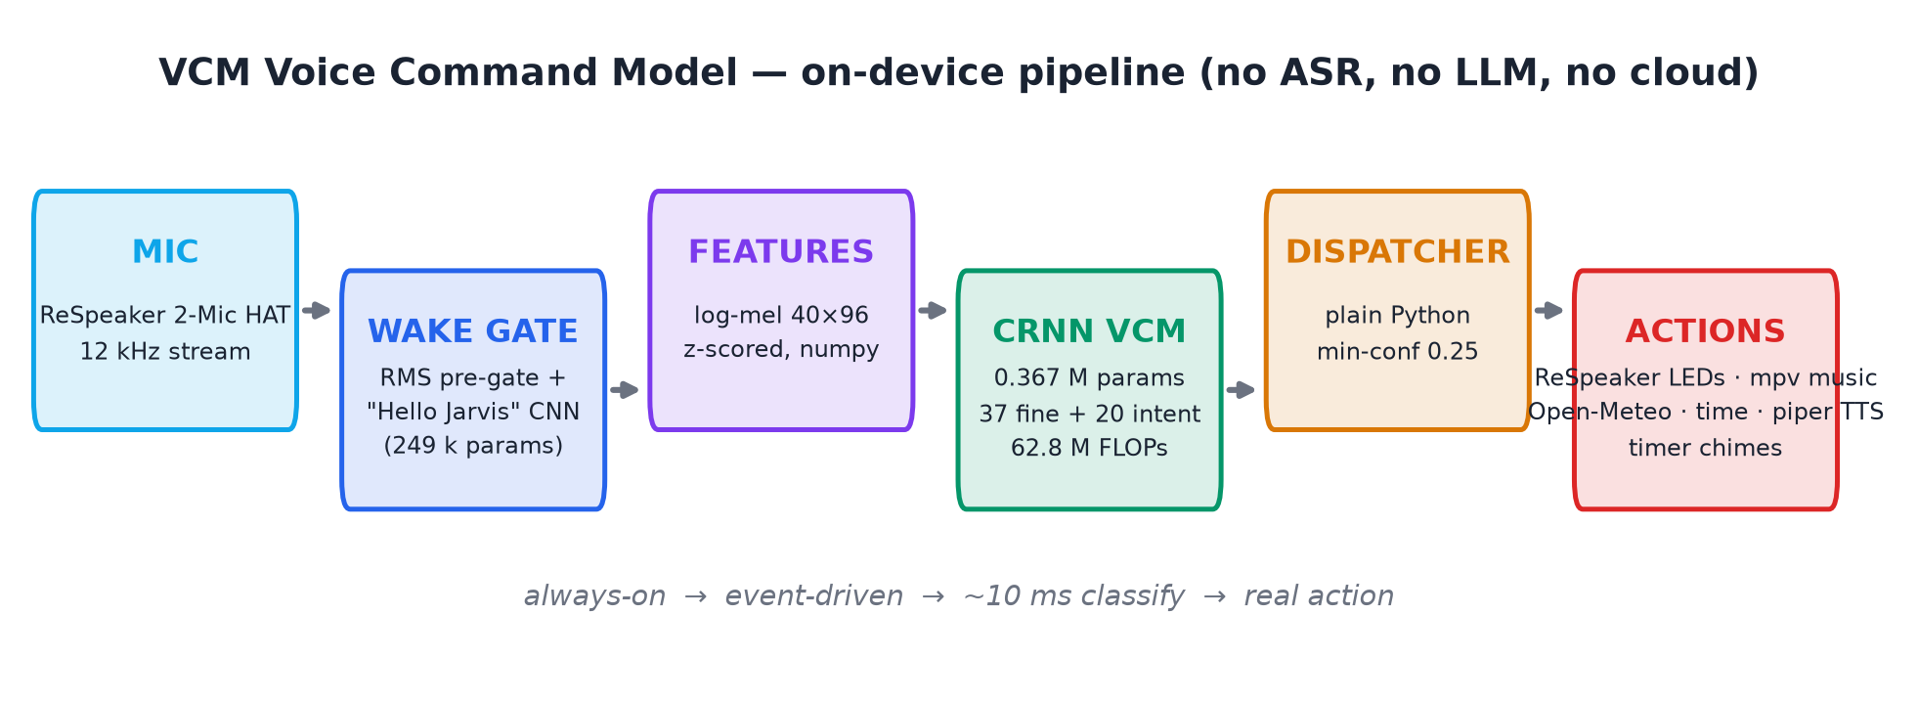
What this project is
A tiny, standalone voice assistant — everything on-device
• Listens continuously for "Hello Jarvis" (249 k-param CNN gate) — LEDs blink cyan on wake
• Classifies the command with a 0.367 M-param CRNN → 37 fine labels / 20 intents — no transcription
• Executes real actions: ReSpeaker LEDs (the lights), mp3 music, per-slot timer chimes, weather, time — plus spoken Piper-TTS answers (the "Jarvis" voice)
• LEDs: blink = listening · steady green = executing · off = done / not recognized

Slide 3
Meeting the professor's constraints
tiny · real-time on RPi · standalone · no LLM · no ASR
0.367 M
parameters (command model)
62.78 M
FLOPs / inference
~1.6 MB
ONNX size
9.36 ms
Pi 4 latency (measured)
Constraint | How it is met
Standalone / no cloud models | Wake CNN + CRNN run locally via onnxruntime; network only for one action (keyless Open-Meteo weather) — never a model call
No LLM | Fixed 37-label classifier; spoken answers are template sentences, not generated text
No full ASR | Audio → log-mel → intent/fine label directly; no audio→text stage
Real-time on RPi 4/5 | 62.78 M FLOPs → 9.36 ms p95 measured on a Pi 4 CPU — under 1% of the 1 s frame budget
Genuinely tiny | 0.367 M params (~1.6 MB ONNX) + 0.249 M-param wake gate; <120 MB RSS idle

Slide 4
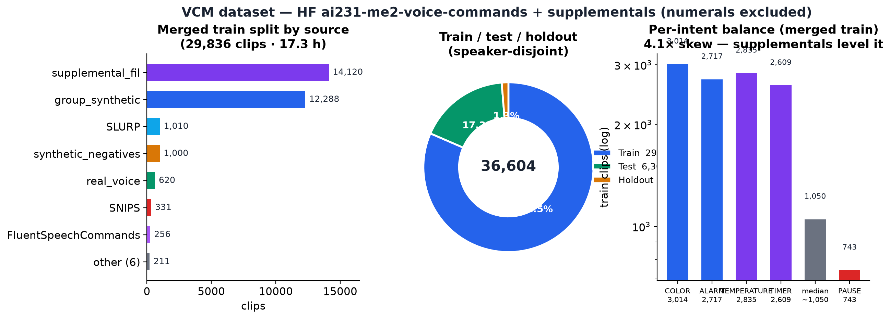
Dataset — 36,604 clips · 37 fine / 20 intents
HF ai231-me2-voice-commands + supplementals · speaker-disjoint
Train 29,836 / Test 6,305 / Holdout 463 (21.0 h) — speaker-disjoint. Supplemental merge (synth by voice_split + fil50 persona bank + 1,250 synthetic negatives) levels the skew: COLOR 3,014 → PAUSE 743 (4.1×). Numerals excluded.

Slide 5
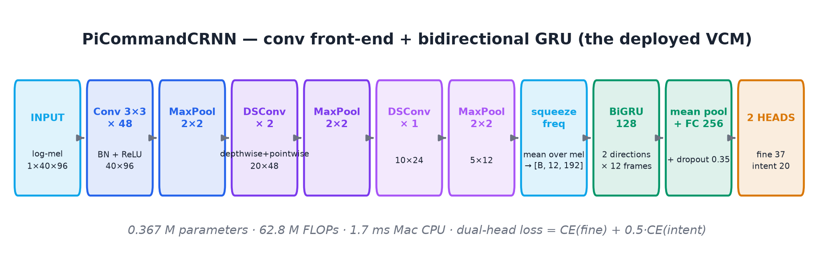
Model — PiCommandCRNN (deployed)
depthwise-separable CNN trunk → BiGRU, dual head: 37 fine + 20 intent
• Loss = CE(fine) + 0.5·CE(intent) — fine head carries the slot, intent head the action group
• Recipe: AdamW wd 1e-4 · lr 1e-3 cosine · batch 128 · label smoothing 0.05 · dropout 0.35 · seed 42 · 60 epochs on Apple MPS
• The trunk pools 40×96 → 5×12 before the BiGRU: temporal modelling costs 12 steps × 192 dims — 62.78 M FLOPs

Slide 6
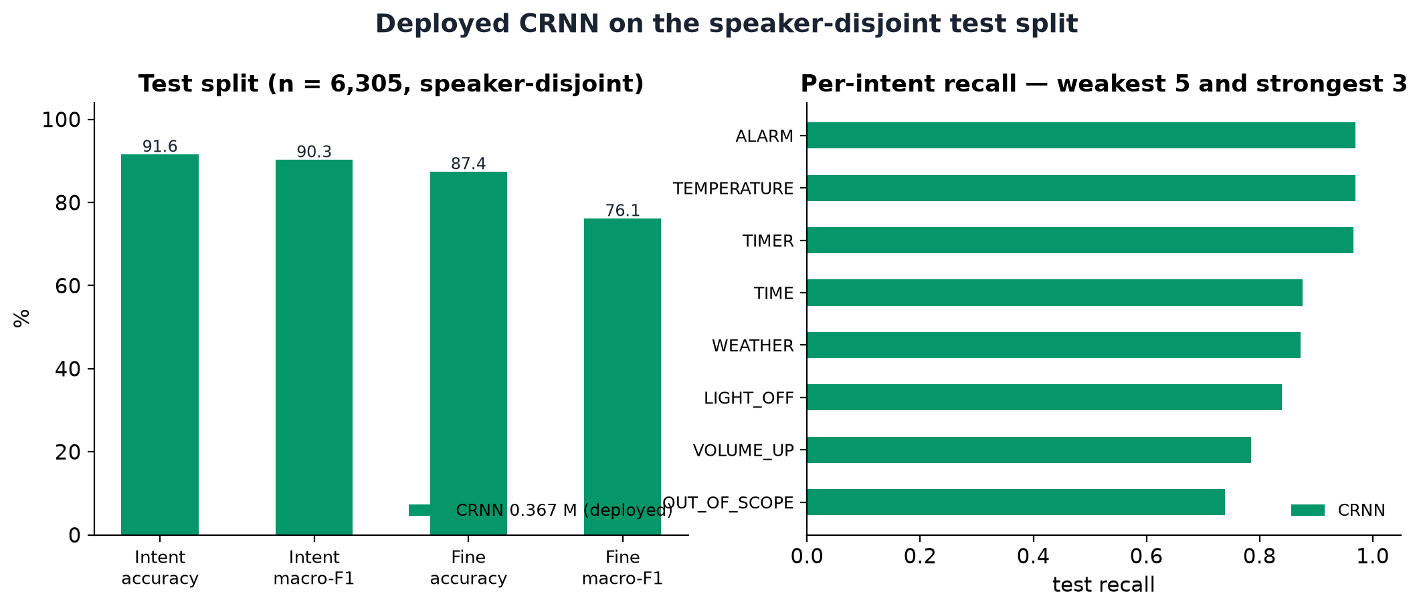
Results — deployed CRNN (test n = 6,305)
one model, speaker-disjoint evaluation
Metric | Value
Intent acc | 91.6 %
Intent mF1 | 90.3 %
Fine acc | 87.4 %
Holdout intent | 88.6 %
• speaker-disjoint test + holdout — no clip seen twice
• OOS recall 0.739 · FAR_oos 0.261 @ min_conf 0.25
• real-voice OOS remains the honest weak point

Slide 7
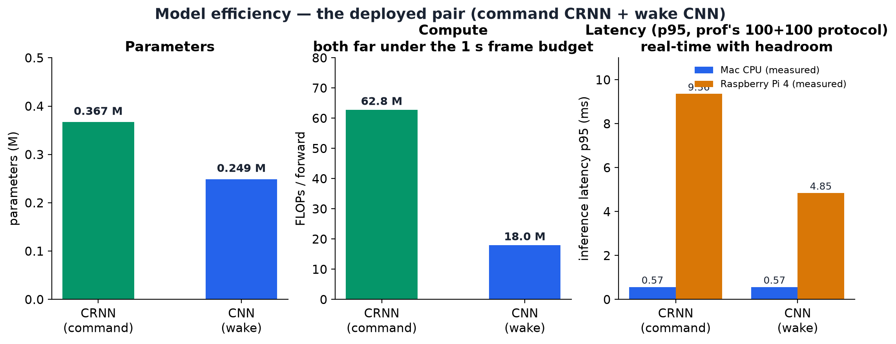
Efficiency — why it is tiny
62.78 M FLOPs · real-time headroom
• Total resident model footprint (command + wake): ~2.6 MB weights; whole assistant < 120 MB RSS idle
• Always-on cost ≈ 0: RMS pre-gate discards silence; wake CNN scores only while the voiced latch is open
• ONNX Runtime CPU is the only ML dependency on the Pi — no PyTorch, no librosa

Slide 8
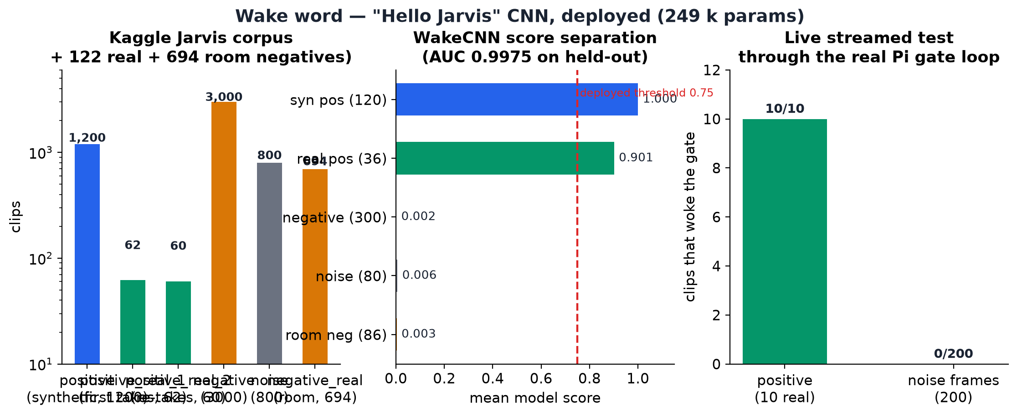
Wake word — "Hello Jarvis" from scratch
Kaggle jarvis-wake-word-dataset + 122 real recordings + 694 real-room negatives · 5,816 clips
Deployed wake model (1200 synthetic + 122 real positives, 694 real-room negatives, source-disjoint split): AUC 0.9975 · real-room negative max 0.065 vs threshold 0.99 · live on the Pi: retrained weights 9/10 spoken attempts fired · 0 false fires (Oct 16, evidence/logs_live_20261016.log); original weights 10/10 real clips fired (scores 0.994–0.999) · 0 false fires on 200 noise frames (Oct 15).

Slide 9
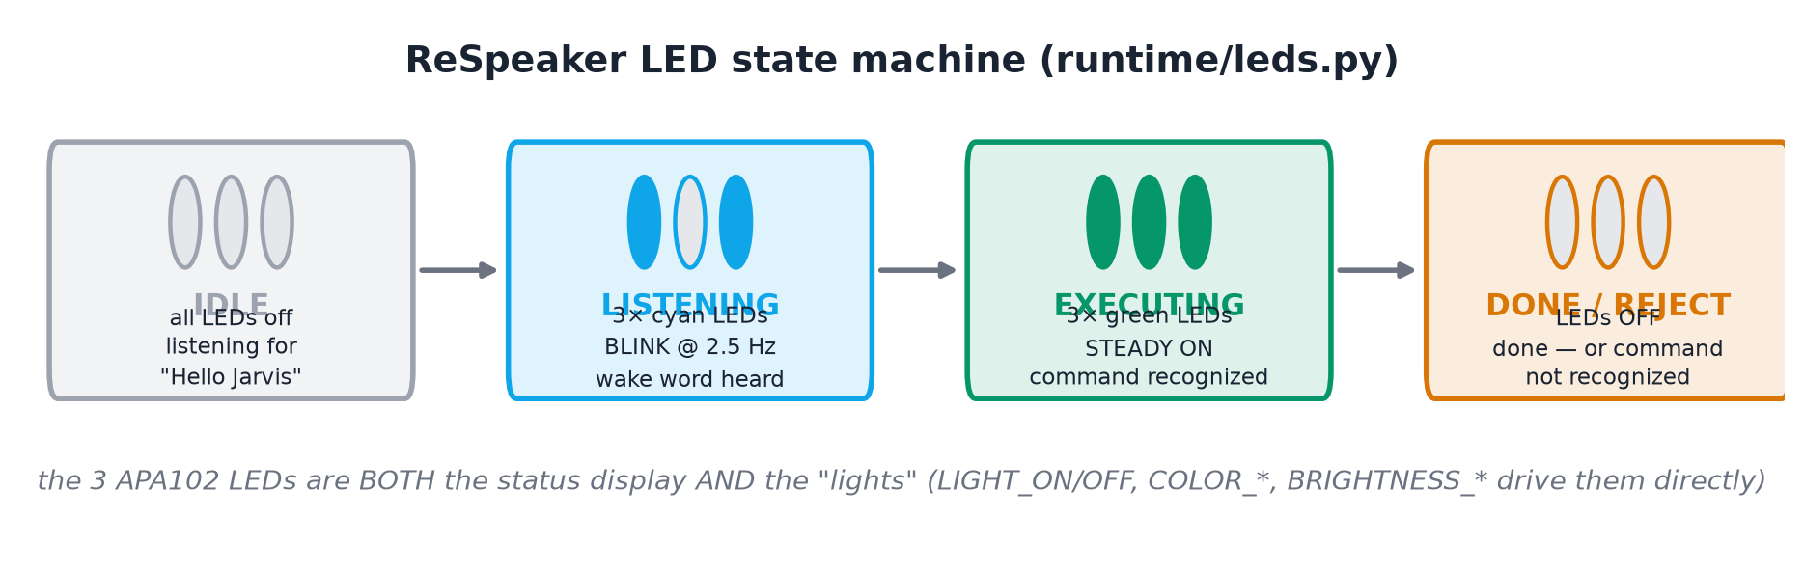
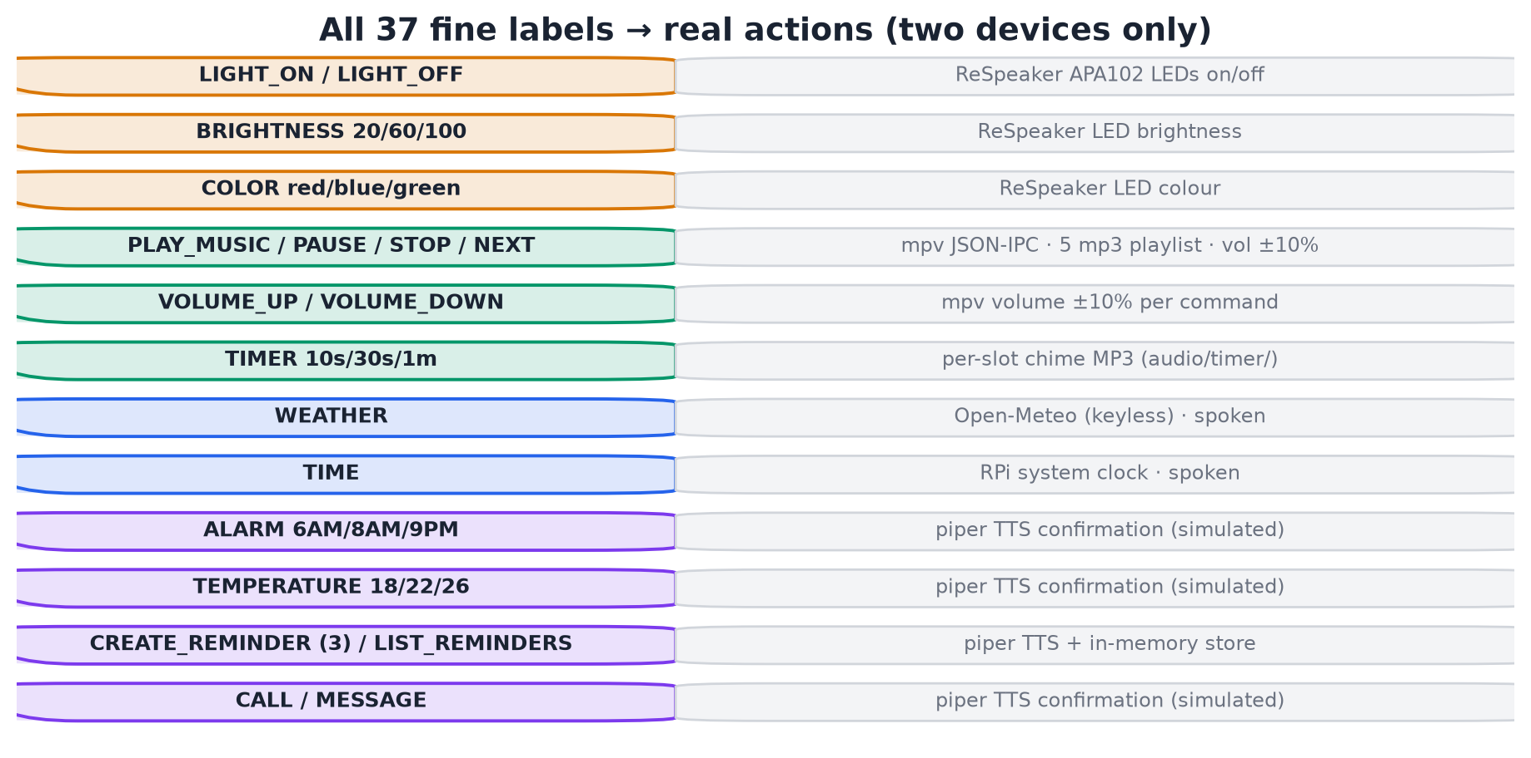
Runtime & demo — the 8 build items, verified on hardware
LED language + all 37 labels dispatched

Slide 10
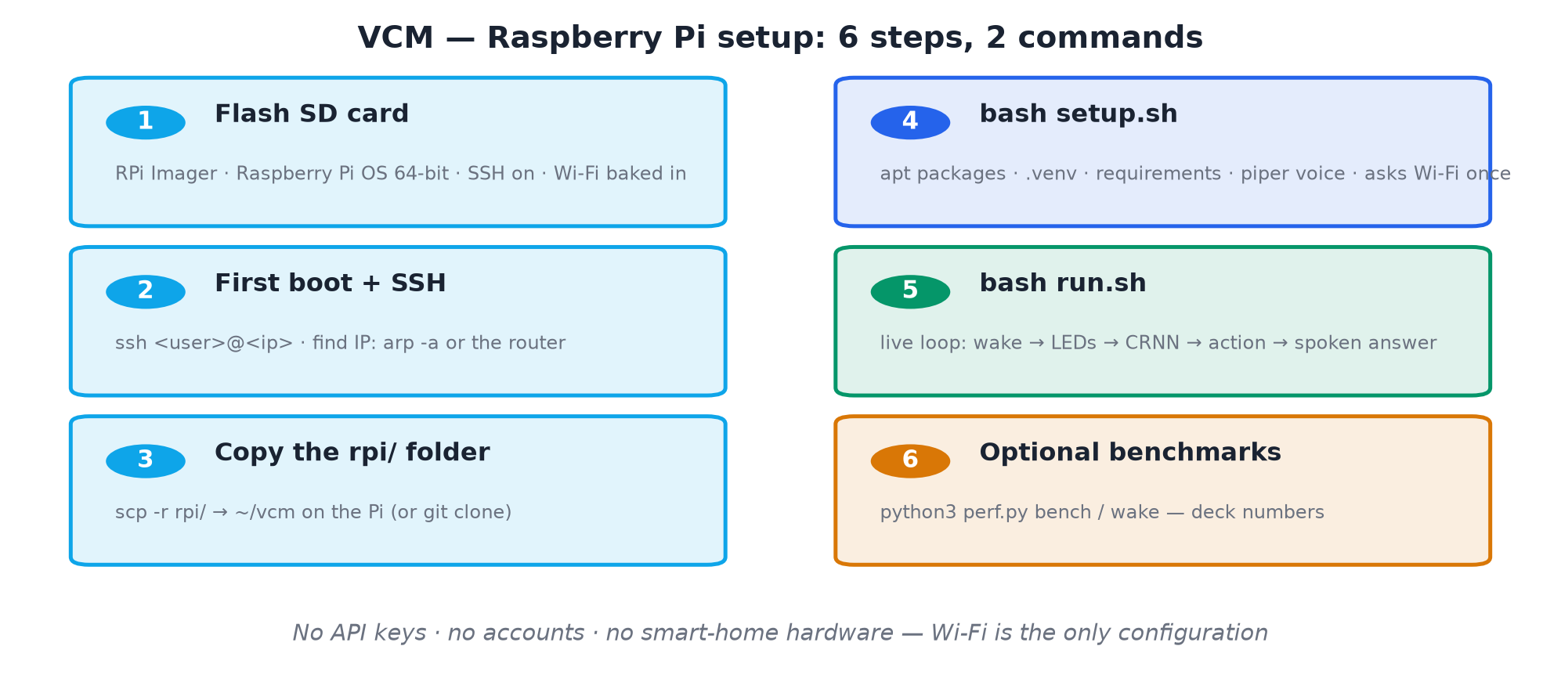
How to set up on the RPi
one-time install (left) → per-demo-day routine (right)
Full command-by-command guide: report section 08_rpi_setup.md — Wi-Fi switching, SPI/LEDs, config, troubleshooting.

Slide 11
Verification on hardware — and honest limits
Raspberry Pi 4 · ReSpeaker 2-Mics HAT · USB speaker
Component | Test | Result
Mic | ReSpeaker capture (hw rejects 12 kHz → 16 k + decimate) | ✅ verified
Wake gate | 10 real clips streamed through the gate | ✅ 9/10 fire · 0 false fires on 200 noise frames
LEDs | blink → steady → off cycle | ✅ APA102 GPIO bitbang
Lights | ReSpeaker LEDs on/off/brightness/colour (no bulb) | ✅ dispatcher wired
Music | play/stop/next (ffplay fallback) | ✅ audible
TTS answers | Piper en_GB-alan: TIME/WEATHER real; ALARM/TEMP/REMINDERS simulated | ✅ spoken end-to-end
Full loop | mic → wake → classify → dispatch → LEDs → spoken answer | ✅ end-to-end
• Honest limit: real-voice OOS clips still mis-accepted (synthetic negatives taught kinds, not the domain); min_conf 0.25 fails safe
• Wake model trained on TTS data → live-mic threshold tuning recommended before the demo

Slide 12
Deliverable checklist
Requirement | Status
Build a dataset to train VCMs (collective) | ✅ HF dataset + supplementals · 36,604 clips / 21.0 h
Build and train a VCM (individual) | ✅ CRNN 0.367 M (the deployed model)
Design a benchmark for validating VCMs | ✅ speaker-disjoint splits · intent + fine + macro-F1 + per-intent recall
Validate the performance of your VCM | ✅ CRNN test 91.6 % intent · holdout 88.6 % · OOS/FAR analysis
Build a real-world demo on RPi4/5 | ✅ full loop verified on hardware (two devices only)
VCM must be tiny, real-time on RPi4/5 | ✅ 0.367 M params · 62.78 M FLOPs · 9.36 ms p95 measured on Pi 4
Standalone — no cloud models | ✅ all inference on-device
No LLM, no ASR — pure VCM, commands 1–10 | ✅ 37-label classifier + dispatcher + TTS answers
Run it: bash run.sh · spoken answers in the Jarvis voice (Piper en_GB-alan)

