Slide 1
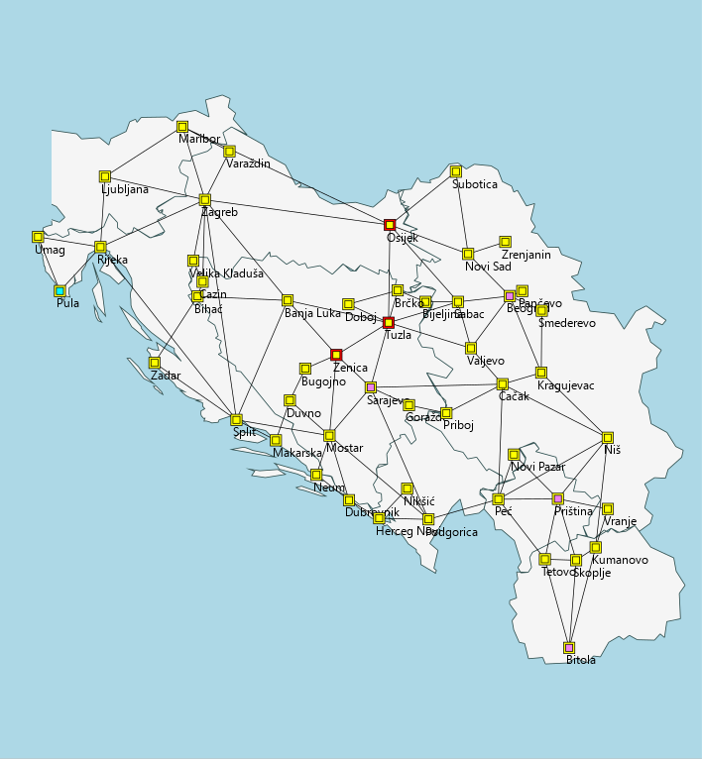
Obiđi Jugu
Interactive Traveling
Salesman Problem
Editable cities, connections
and required destinations
Goal: a minimum-cost route
with weighted cities
Hadžić, Rodin and Sivro
C++ / natID
OBIĐI JUGU 1/3
Notes:
TIME: 0:00–0:25
Obiđi Jugu lets users create and solve a Traveling Salesman Problem on a network of cities in the former Yugoslavia. Users choose required destinations and edit connections and weights. We can interpret city weights as congestion factors, so the shortest distance does not necessarily produce the lowest cost.
Image source: user-provided Docs/screenshots/main-application-view.png.

Slide 2
Algorithms and comparison
Route search
Automatic benchmark
Nearest Neighbor + 2-opt
Up to 10 required cities
Exact TSP: proven optimum
Simulated Annealing
More than 10 required cities
Genetic Algorithm
NN + 2-opt: heuristic reference
Exact TSP
Δ = route cost − benchmark cost
OBIĐI JUGU 2/3
Notes:
TIME: 0:25–1:00
We implemented Nearest Neighbor with optional 2-opt improvement, Simulated Annealing, a Genetic Algorithm and Exact TSP. Each result is automatically compared with a benchmark. For up to ten required cities, we compute the exact optimum. For larger problems, we use NN with 2-opt, which does not guarantee optimality. Delta shows the cost difference. A negative delta against the heuristic benchmark means we found a better route.
Required cities are Start and Goal cities, not every city on the map. The cost calculation preserves city weights. Exact TSP is also a standalone option without this automatic size limit.

Slide 3
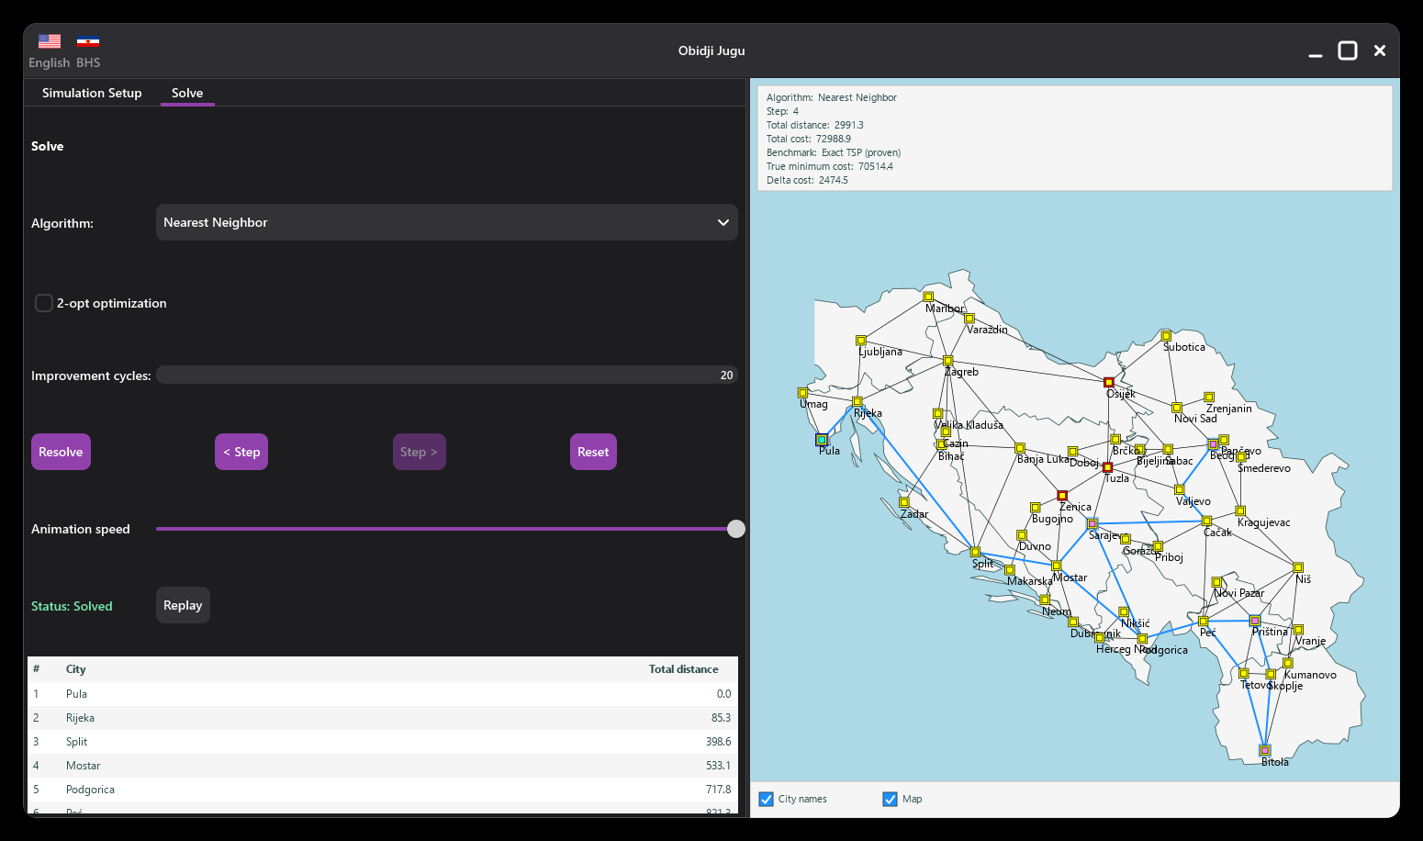
Interactivity and performance
Editing and route review
City table, Replay and translations
Optional map and city labels
Non-blocking computation
Solver runs in a background thread
Users can cancel computation
Smoother window resizing
Static map bitmap cache
Temporarily simplified rendering
Live demonstration
OBIĐI JUGU 3/3
Notes:
TIME: 1:00–1:30
We edit the problem through the city table and controls, then review the result in the route table or through Replay. Users can hide city labels and the map. The solver runs in a background thread, so the application stays interactive and computation can be cancelled. During resizing, we use a bitmap cache and simplified rendering. Now we will demonstrate the workflow.
DEMO 1:30–3:45
0–25 seconds: Select a city, change its weight or status and click Update.
25–55 seconds: Run NN on a prepared problem with up to 10 required cities. Show the cost, Exact benchmark and delta.
55–80 seconds: Enable 2-opt, click Resolve and compare. Do not promise improvement unless the prepared instance produces it.
80–100 seconds: Show Replay and cumulative distance in the route table.
100–115 seconds: Toggle city labels and the map, then move the splitter.
115–135 seconds: Run Exact TSP on a larger prepared problem. Show that the UI stays responsive and cancel with Reset. Do not claim it can never finish.
CONCLUSION: The application combines problem editing, different search strategies and clear result comparison in a responsive interface.
Allow 15 seconds of buffer time.
Image source: user-provided Docs/screenshots/completed-solution.png.

