Slide 1
Queue

Slide 2
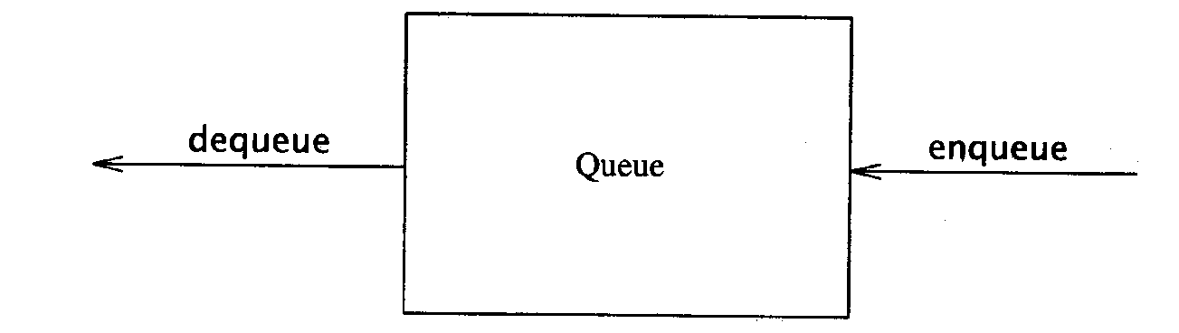
Queue
Like a stack, a queue is also a list. However, with a queue, insertion is done at one end, while deletion is performed at the other end.
Accessing the elements of queues follows a First In, First Out (FIFO) order.
  Like customers standing in a check-out line in a store, the first customer in is the first customer served.
Basic operations:
  enqueue: insert an element at the rear of the list
  dequeue: delete the element at the front of the list

Slide 3
The Queue Operations
A queue is like a line of people waiting for a bank teller. The queue has a front and a rear ends.
New people must enter the queue at the rear. To insert an element in queue is called enqueue operation.
People must leave from the queue at the front. To insert an element in queue is called dequeue operation.
$ $
Front
Rear
Notes:
Don’t ask me why the C++ STL used the name push. It only confuses matters with a stack. In any case, when a new item enters a queue, it does so at the rear.

Slide 4
Enqueue and Dequeue
Primary queue operations: Enqueue and Dequeue
Like check-out lines in a store, a queue has a front and a rear.
Enqueue
  Insert an element at the rear of the queue
Dequeue
  Remove an element from the front of the queue
Implementation of Queue: Just as stacks can be implemented as arrays or linked lists, so with queues.
Remove
(Dequeue)
Insert
(Enqueue)
front
rear

Slide 5
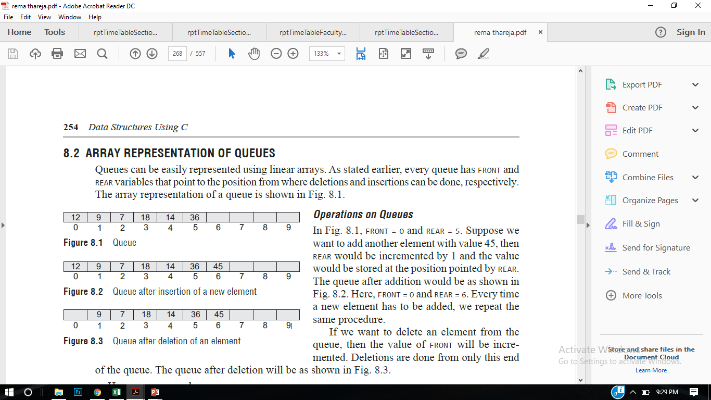
Queue Implementation
Queues can be implemented in two ways:-
Arrays
Linked List
Way I: Queues can be easily represented using linear arrays.
In an array of size 6 , FRONT = 0 and REAR = 5.
Suppose we want to add another element with value 45, then REAR would be incremented by 1 and the value would be stored at the position pointed by REAR.
FRONT = 0 and REAR = 6
If we want to delete an element from the queue, then the value of FRONT will be incremented.
3
6

Slide 6
Queue Operations #include<iostream> #define MAX 10 using namespace std; int queue[MAX]; int front = -1, rear =-1; void insert_element(int value); int delete_element(); int peek(); void display(); int main() { int option, val; char choice='Y'; while(choice=='Y') { cout<<endl<<" ***** MAIN MENU *****"; cout<<endl<<" 1. Insert an element"; cout<<endl<< "2. Delete an element"; cout<<endl<< "3. Peek"; cout<<endl<<" 4. Display the queue"; cout<<endl<<" Enter your option : "; cin>>option; | switch(option) { case 1: cout<<"enter the value to insert"; cin>>val; insert_element(val); break; case 2: val = delete_element(); if (val != -1) cout<<"\n The number deleted is :"<< val<<endl; break; case 3: val = peek(); if (val != -1) cout<<"\n The first value in queue is : "<< val<<endl; break; case 4: display(); break; } cout<<"Enter choice"; cin>>choice; } return 0; }

Slide 7
Queue Operations void insert_element(int value) // Enqueue { if(rear == MAX-1) cout<<"\n OVERFLOW"; else if(front == -1 && rear == -1) front = rear = 0; else rear++; queue[rear] = value; } int delete_element() // Dequeue { int val; if(front == -1) { cout<<"\n UNDERFLOW"; return -1; } else { val = queue[front]; front++; return val; }} | int peek() // To find the first element { if(front==-1 ) { cout<<"\n QUEUE IS EMPTY"; return -1; } else { return queue[front]; } } void display() // To show the data of queueu { int i; cout<<"\n"; if(front == -1 ) cout<<"\n QUEUE IS EMPTY"; else { for(i = front; i <= rear; i++) cout<<"\t "<< queue[i]; } }

Slide 8
Queue Implementation with Linked List
Way II: Queues can be easily represented using single linked list.
In case of an array, In a linked queue, every element has two parts, one that stores the data and another that stores the address of the next element. The START pointer of the linked list is used as FRONT. Here, we will also use another pointer called REAR, which will store the address of the last element in the queue.
3
6

Slide 9
Queue Operations #include<iostream> #include<stdlib.h> using namespace std; struct queue { int data; struct queue *next; }; struct queue *temp,*front,*rear; void enqueue(int value); void dequeue(); void display(); int main() { int option, val; char choice='Y'; while(choice=='Y') { cout<<endl<<" ***** MAIN MENU *****"; cout<<endl<<" 1. Insert an element"; cout<<endl<< "2. Delete an element"; cout<<endl<<" Enter your option : "; cin>>option; | switch(option) { case 1: cout<<"enter the value to insert"; cin>>val; enqueue(val); break; case 2: dequeue(); break; case 3: display(); break; } cout<<"Enter choice"; cin>>choice; } return 0; }

Slide 10
void enqueue(int value) { temp=new queue(); temp->data =value; if(front ==NULL && rear ==NULL) // empty queue { front = rear = temp; } else { rear->next =temp; } } void dequeue() { temp = front; if(front == NULL) { cout<<“underflow”; break; } else { front= temp->next; free(temp); }} | void display() // To show the data of queue { temp =front; cout<<"\n"; if(front == NULL ) cout<<"\n QUEUE IS EMPTY"; else { while(temp!=NULL) { cout<<temp->data; temp=temp->next; } }

Slide 11
DEQUES(Double Ended Queue)
A deque is a linear list in which elements can be added or removed at either end but not in middle( Left ,Right pointer).
There are two variation of a Deque- namely an Input Restricted and an output-Restricted deque.
An input restricted deque is a deque which allows insertions at only one end of a list but allows deletions on both the ends of the list
An output restricted Deque is a deque which allows deletions at only one end of the list but allows insertions at both the ends of the list.

Slide 12
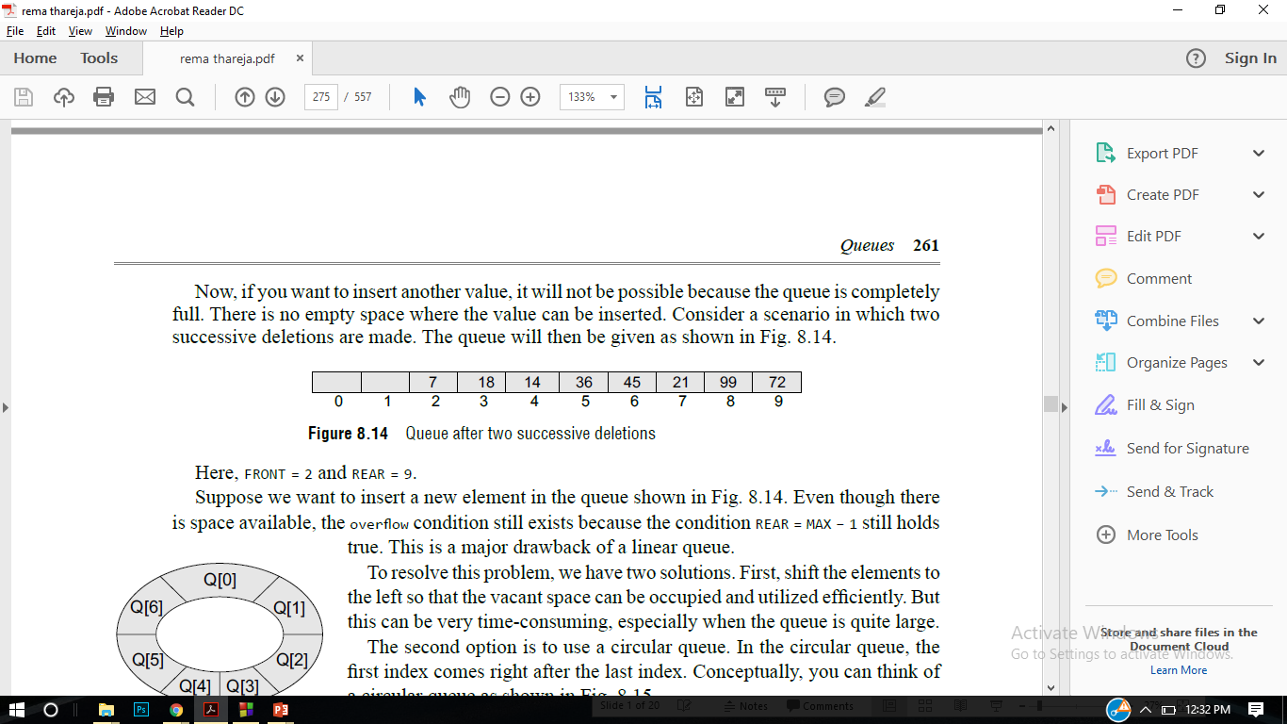
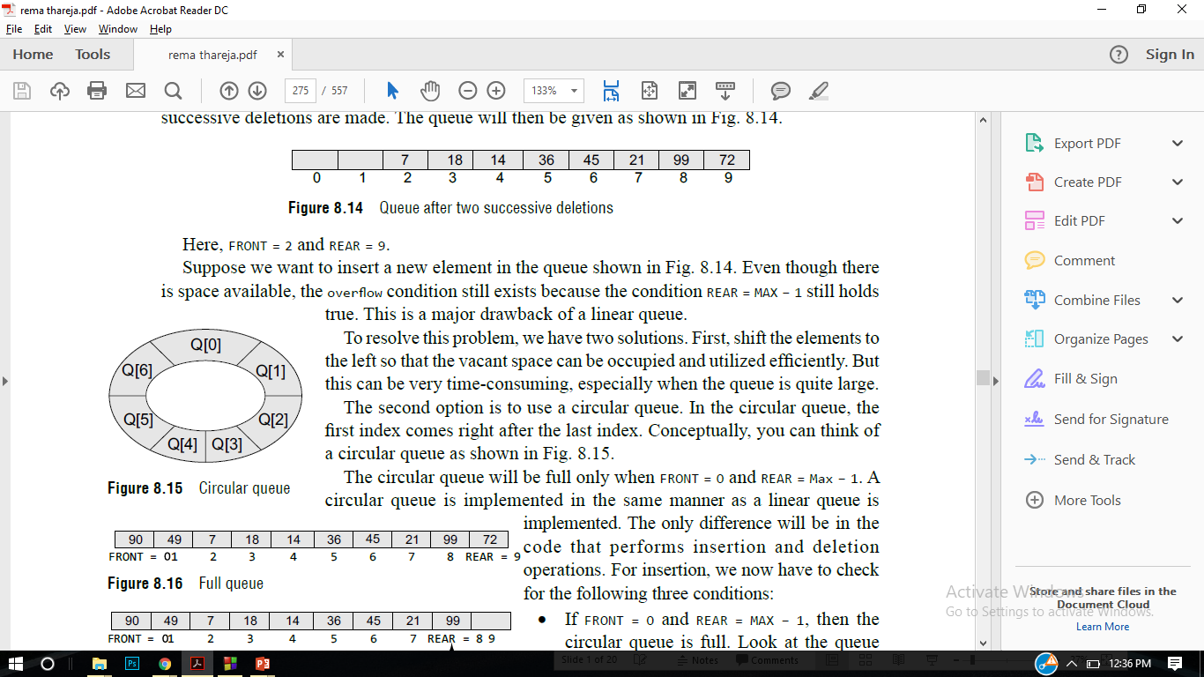
Circular Queue
If you want to insert another value, it will not be possible because the queue is completely full. There is no empty space where the value can be inserted. Consider a scenario in which two successive deletions are made.
front = 2 and REAR = 9.
Even though there is space available, the overflow condition still exists because the condition rear = MAX – 1 still holds true. This is a major drawback of a linear queue.
The second option is to use a circular queue. In the circular queue, the first index comes right after the last index.

Slide 13
Some applications of Queue:
Applied as waiting lists for a single shared resource like CPU, Disk, and Printer.
Applied as buffers on MP3 players and portable CD players.
Applied on Operating system to handle the interruption.
Applied to add a song at the end or to play from the front.

Slide 14

Ques
Ques : Write an algorithm/program to implement enqueue and dequeue operations.
Ques : How many types of queue are there ? Explain
Ques : Implement the queue using Linked List.
Notes:
A quick summary . . .

