Slide 1
Adapting Game Mechanics with Micro-Machinations
Seminar Automated Game Design
Riemer van Rozen (rozen@cwi.nl)
HvA / Create-IT applied research &
CWI / Software Analysis and Transformation (SWAT) group
Joint work with
Joris Dormans

Slide 2
Problem Statement,
Objectives and Approach
Problem
  Long design iteration times because designers lack a means of adapting game mechanics in software
Objectives
  Reduce game design iteration times
Approach
  Live adaptation of game mechanics with
  Micro-Machinations
Game
Design
Gameplay
Feedback
Game
Mechanics
Play Test
How to
adapt?
Requirements
Software
Engineering
Game
Software
Game Design
Software Engineering
Notes:
Explain a simplified iteration, point out the counter-clockwise arrows.
Explain problems in such an iteration.
Problem 1: a gap between design and software engineering: misunderstood requirements
Problem 2: missed opportunities for reuse
Problem 3: waiting for software, play testing stalls
Main problem: adjusting games is hard because game designers lack a means for efficiently defining, fine-tuning and balancing game mechanics.
Goals: We aim to speed up the game development process by reducing game design iteration times.

Slide 3
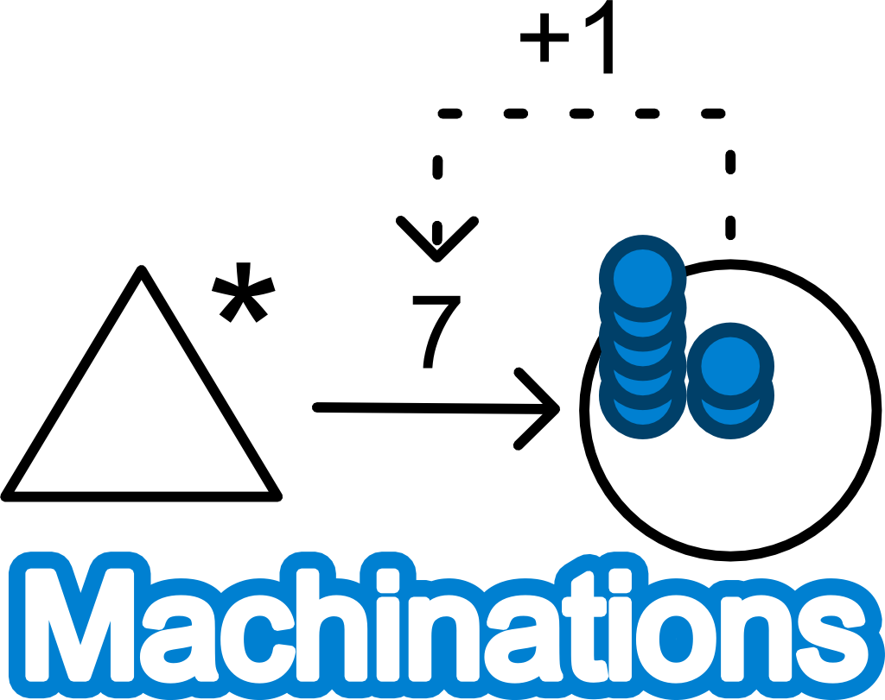
Machinations Background
Visual modeling language
for game design
Diagrams are directed graphs
Expresses game mechanics
  Depicts internal economy
  Makes feed-back loops explicit
Works by redistributing resources
between nodes along the edges
The Machinations logo contains a feed-back loop
state | 0 | 1 | 2 | 3 | 4
amount | 7 | 14 | 28 | 56 | 112
flow | 7 | 14 | 28 | 56 | 112

Slide 4
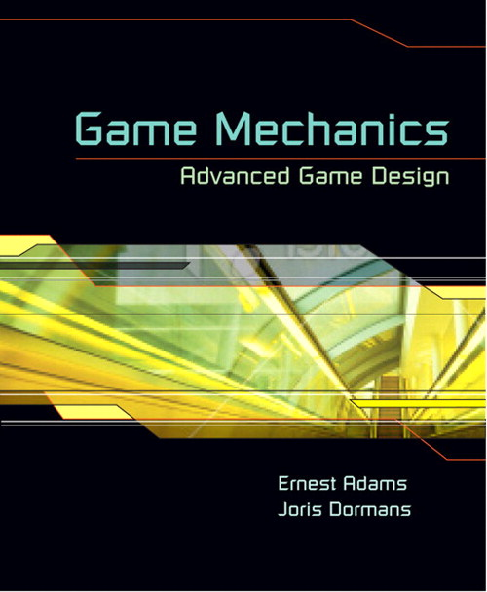
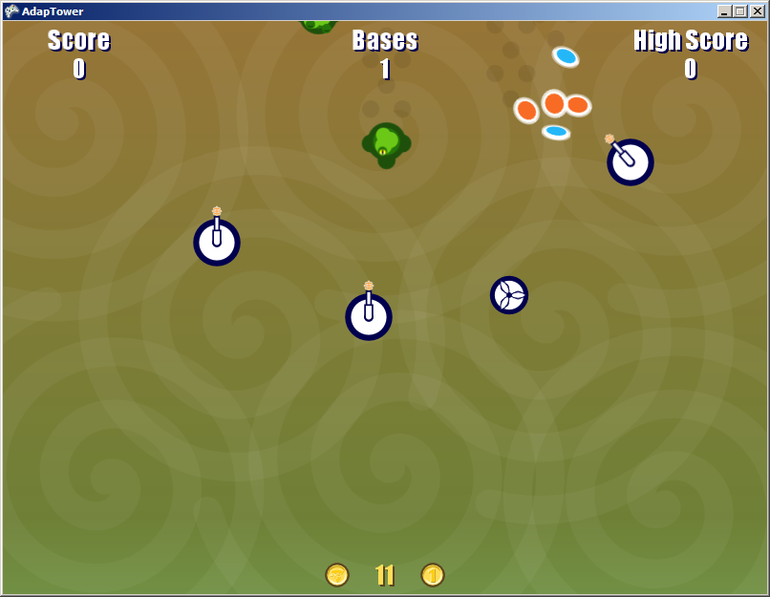
Machinations Language Evolution
Game Design Aid
  Prior work of Ernest Adams and Joris Dormans
  Helps understand how rules affect play
  Limited to game design
Analyze Micro-Machinations
  Prior work with Paul Klint
  In MM we formalized
  Machinations’ meaning and
  extended the language
  Added a textual notation
Live Adaptations
  We make MM embeddable in game
  software and modifiable at run-time
  We provide the embeddable
  MM Library and language
  extensions for modifications
  Helps experiment and play test
  for gaining immediate feedback
Ernest Adams
Joris Dormans
=
auto source s
pool p at 7
flow: s -p-> p
Modify
Modify
gameplay
Player
Designer
game software
Notes:
Eerst in hoofdlijn de evolutie
Daarna de details (+plaatjes) en wat er nu anders is / toevoegd.
1. Intended for game designers for creating, documenting, simulating and testing the effect of game rules
Results from an extensive analysis of games
3. Current work!
An approach for adapting game mechanics with Micro-Machinations
Speed-up process with live mechanics adaptations
Boost designer productivity
Improve game quality
We show that MM provides
necessary adaptability for
reducing design iteration times
increasing opportunities for quality improvements and reuse
Adaptation of game mechanics with Micro-Machinations
live mechanics modifications

Slide 5
Why Live Adaptations?
Speed-up of game design
  reduced game design iteration times
  immediate feedback in play testing
Quality and Productivity improvement opportunities
  short iterations →
  more improvements possible
  software reuse →
  lower chances for new bugs
Game
Design
Gameplay
Feedback
Mechanics
Model
Play Test
Software
Engineering
Game
Software
Notes:
Mechanics modeling is a game design discipline.
easier to adapt → reducing design iteration times
Stap requirements overgeslagen.

Slide 6





AdapTower: Workshop Teaser
Creeps spawn
into the world
Two kinds of buildings
  Towers
    kill creeps
    produce essence
  Bases
    catch essence
    produce gold
Players can spend gold
  Buy a tower for 20 gold
  Buy a base for 50 gold
Notes:
We begin with a demonstration.

Slide 7
Workshop Teaser: Demo
Notes:
Show how the game works.
play testing → problems.
All towers act the same.
Placement of bases.
During the workshop we will have a look at the internal game mechanics of the game and modify it.

Slide 8
AdapTower: Internal Mechanics
=
spawn
missed
creeps
Tower
Base
gold
creeps
essence
essence
2
=
3
=
5
=
1
=
creeps
towers
essence
bases
20
11
50
buyTower
gold
buyBase
Let’s count the number of creeps, towers
bases, essence and gold
Visual Micro-Machinations run-time state
Notes:
This diagram on the right is the run-time state of the game shown on the left.
During the workshop
Can we make AdapTower fun?
Looking to the future
What makes it worthwhile to invest in MM?
What can we learn from case studies?

Slide 9
Workshop
Goals
  Share information about Micro-Machinations
  Demonstrate interactive game adaptations
  Think about practical applications
  Discuss limitations
  Discuss future directions

Slide 10


Conclusion
Micro-Machinations Library
  Open source
  https://github.com/vrozen/MM-Lib/
Collaboration
with IC3D Media
  Loren Roosendaal
  Early quality assurance in software production
Future work
  Generalize results Micro-Machinations
  Procedural Game Mechanics and Gameplay

