Slide 1
Adapting Game Mechanics with Micro-Machinations
Seminar Automated Game Design
Riemer van Rozen (rozen@cwi.nl)
HvA / Create-IT applied research &
CWI / Software Analysis and Transformation (SWAT) group
Joint work with
Joris Dormans

Slide 2
Workshop
Goals
  Share information about Micro-Machinations
  Demonstrate interactive game adaptations
  Think about practical applications
  Discuss limitations
  Discuss future directions

Slide 3
Workshop Strategy
Steps
Problem
Objectives
Approach
Validation
Gameplay
Design
Mechanics
Modeling
Play Test
Disciplines
Artifacts
Gameplay
Goals
Mechanics
Model
Aesthetics
Feedback
Game
Software
Notes:
We will not test the mechanics without the game, Which is also possible.
Mechanics modeling is a game design discipline.
easier to adapt → reducing design iteration times
Stap requirements overgeslagen.
Speed-up of game design
reduced game design iteration times
immediate feedback in play testing
Quality and Productivity improvement opportunities
short iterations →
more improvements possible
software reuse →
lower chances for new bugs

Slide 4
AdapTower: Workshop Case
Prototype game in the
Tower Defense genre
Embeds the MM Library
  Written in C++
  ‘platform independent’
  3-clause BSD License
  github.com/vrozen/MM-Lib
Example demonstrates how MM can be used to adapt game mechanics → gameplay
gameplay
AdapTower
Play
User Interface
Player
Physics
MM Library
Modify
MM
Mechanics Model
Designer
Notes:
Case study demonstrating the approach
Written in C#
Runs on Microsoft .NET and XNA Framework
Using Phantom game by LudoMotion
Uses STL, Flex and Bison

Slide 5

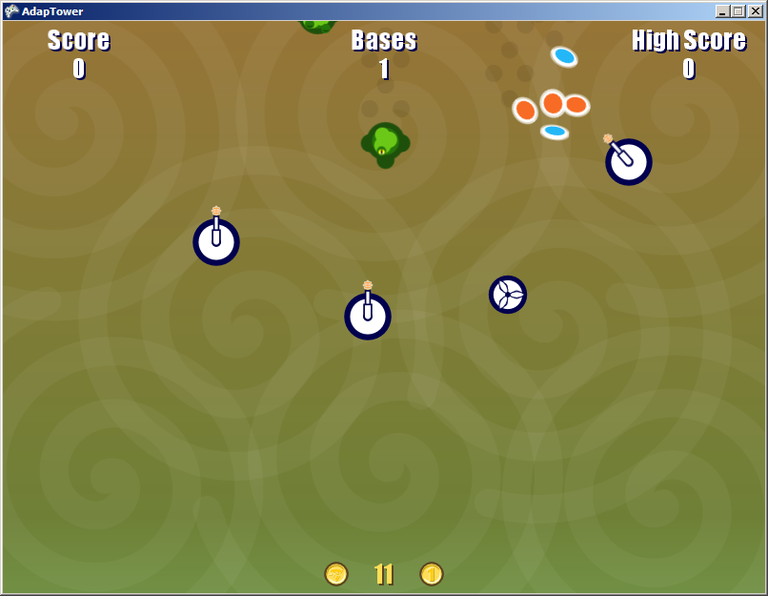




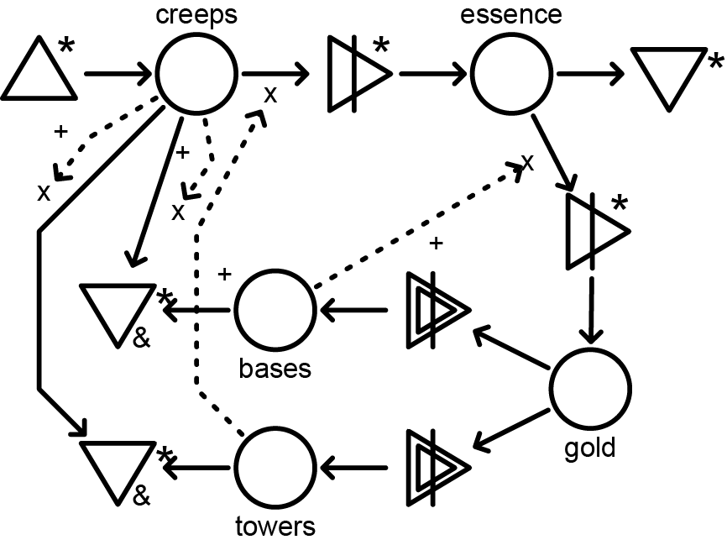
AdapTower: Gameplay Design
Creeps spawn
into the world
Two kinds of buildings
  Towers
    kill creeps
    produce essence
  Bases
    catch essence
    produce gold
Players can spend gold
  Start with 120 gold
  Buy a tower for 20 gold
  Buy a base for 50 gold
Early Game Mechanics Sketch
Notes:
Starts out as a sketch!

Slide 6
AdapTower: Mechanics Modeling
Creeps spawn
into the world
Two kinds of buildings
  Towers
    kill creeps
    produce essence
  Bases
    catch essence
    produce gold
Players can spend gold
  Start with 120 gold
  Buy a tower for 20 gold
  Buy a base for 50 gold
=
spawn
missed
creeps
Tower
Base
gold
creeps
essence
essence
0
=
0
=
0
=
0
=
creeps
towers
essence
bases
20
120
50
buyTower
gold
buyBase
Visual Micro-Machinations
Notes:
This diagram on the right is the run-time state of the game shown on the left.

Slide 7
AdapTower: Mechanics Modeling
=
spawn
missed
creeps
Tower
Base
gold
creeps
essence
essence
2
=
3
=
5
=
1
=
creeps
towers
essence
bases
20
11
50
buyTower
gold
buyBase
Let’s count the number of creeps, towers
bases, essence and gold
Visual Micro-Machinations run-time state
Notes:
This diagram on the right is the run-time state of the game shown on the left.

Slide 8
AdapTower: Play Testing
Group Assignment 1
  Play test the game together.
  Do you see
  problems with
  the gameplay?
Perceived Problems
  Players set up towers
  and bases and then
  have to wait
  Unexciting experience

Slide 9
AdapTower V2: Mechanics Modeling
Objectives
  Make positioning of towers important and speed up end-game
Group Assignment 2
  Model Mechanics modifications together.
  Add a feedback loop to Towers such that towers gain experience (xp) based on kills and provide a bonus to range, firePower and rotationSpeed
  Hint: pools and resource connections are at the top of the cheat sheet
Tower
150
1
range
self
hitByCreep
50
firePower
creeps
killCreep
20
rotationSpeed
essence
Visual Micro-Machinations of the Tower Definition
Notes:
Can you model these changes using the cheat sheet?
Possible Solution
Add a pool named xp that collects experience.
Add a resource connection from killCreep to that pool.
Add a bonus expression to range, firePower and rotationSpeed based on xp.

Slide 10
AdapTower V2: Mechanics Modeling
Possible solution
  Add pool xp
  Add a resource connection between killCreep and xp
  Modify range
  adding an expression
  Modify firePower
  adding and expression
  Modify rotationSpeed
  adding and expression
Tower
150
add 5 * xp
1
range
self
hitByCreep
50
add 2 * xp
0
firePower
creeps
xp
killCreep
20
add 2 * xp
rotationSpeed
essence
Visual Micro-Machinations of the Tower Definition
Notes:
Can you model these changes using the cheat sheet?
Possible Solution
Add a pool named xp that collects experience.
Add a resource connection from killCreep to that pool.
Add a bonus expression to range, firePower and rotationSpeed based on xp.

Slide 11
AdapTower: Play Testing
Group Assignment 3
  Play test the
  game together.
  Do you see
  problems with
  the gameplay?
Perceived Problems
  Towers easily become
  too strong
  No interesting choices
  All towers act alike
  Unexciting experience

Slide 12
AdapTower V3: Mechanics Modeling
Objectives
  Allow players to choose spending xp specializing towers in different ways
Group Assignment 4
  Adapt the mechanics model together.
  Add user upgrades for range, firePower and rotationSpeed spending xp
  Hint: use interactive nodes
Tower
150
1
range
self
hitByCreep
50
0
0
firePower
creeps
xp
xp
killCreep
20
rotationSpeed
essence
Visual Micro-Machinations of the Tower Definition

Slide 13
AdapTower V3: Mechanics Modeling
Possible solution
  Remove the xp bonus to range, firePower and rotationSpeed
  Add converters upgradeRange, upgradePower, upgradeSpeed
  Add resource connections from xp to the converters specifying the costs
    The costs increase!
  Add resource connections from the converters to the pools specifying the gain
    The gains are constant.
Tower
150
50
1
range
upgradeRange
self
range/50
+10
firePower
/10+10
hitByCreep
50
10
0
0
firePower
upgradePower
creeps
xp
xp
rotationSpeed/10 + 10
killCreep
20
10
rotationSpeed
upgradeSpeed
essence
Visual Micro-Machinations of the Tower Definition

Slide 14
AdapTower V3: Play Test
Group Assignment 5
  Play test version 3
  of the game together.
  Do you see
  problems with
  the gameplay?
Perceived problems
  None,
  it’s a perfect game!
  No wait…

Slide 15
Concluding slide: What’s next?
Free adaptations
  Do you have ideas to make the game fun?
Discuss applicability MM
  Think about practical applications
  Discuss limitations
  Discuss future directions
    Mixed-initiative model-driven game design
Questions?
Notes:
Usability concerns

Slide 16
AdapTower: Other ideas
Adding hitpoints
Adjusting the fire rate
Selling a tower
Modifying the amount of essence generated
Modifying Base

Slide 17
AdapTower: Base Mechanics
Creeps that hit a base
destroy it
When hit by essence a base produces gold
Base
1
self
essence
creeps
hitByCreep
hitByEssence
gold
Visual Micro-Machinations of the Base Definition

Slide 18
AdapTower: Base Mechanics Mod
Problem
  Players are discouraged
  from placing bases near
  the top of the screen
Adapt gameplay design
  make bases more sturdy
  reward high risk
Adapt mechanics model
  hp determines how many
  hits a base can take before
  collapsing
  When bases convert resources they heat up
  when overheated (>100) bases amplify essence instead
Base
hp==0
1
5
*
2
self
collapse
hp
hitByEssence
amplify
essence
*
heat>=100
*
0
4
creeps
hitByCreep
heat
consume
gold
heat<100

