Slide 1
VRPN Imager
Russell M. Taylor II
David Marshburn
Ryan Schubert

Slide 2
Examples
Run testimager_client
  Run testimager_server
    Show throttling
    Show discarded frames
  Run DirectX Video Server
    #define vrpn_USE_DIRECTSHOW

Slide 3
Server Data Flow Diagram
Imager(nx,ny)
AddChannel(red, units, min, max)
…
BeginFrame
Region(red)
Region(red)
Region(green)
Region(green)
…
EndFrame

Slide 4
Client Data Flow Diagram
Description(nx, ny, nz, nchannels)
BeginFrame
Region(red)
Region(red)
Region(green)
SwapBuffers
Region(green)
…
EndFrame

Slide 5
Example Client: Setup and Run
vrpn_Imager_Remote *g_imager; //< Imager client object
g_imager = new vrpn_Imager_Remote(device_name);
g_imager->register_description_handler(NULL, handle_description_message);
g_imager->register_region_handler(g_imager, handle_region_change);
g_imager->register_discarded_frames_handler(NULL, handle_discarded_frames);
g_imager->register_end_frame_handler(g_imager, handle_end_of_frame);
while (1) g_imager->mainloop();
Notes:
The things in white do most of the work, and will be described next.

Slide 6
Example Client: Description
void VRPN_CALLBACK handle_description_message(void *, const struct timeval)
{
// This method is different from other VRPN callbacks because it simply
// reports that values have been filled in on the Imager_Remote class.
// It does not report what the new values are, only the time at which
// they changed.
// Record that the dimensions are filled in. Fill in the globals needed
// to store them.
g_Xdim = g_imager->nCols();
g_Ydim = g_imager->nRows();
}

Slide 7
Example Client: Region
void VRPN_CALLBACK handle_region_change(void *userdata, const vrpn_IMAGERREGIONCB info)
{
const vrpn_Imager_Region *region=info.region;
const vrpn_Imager_Remote *imager = (const vrpn_Imager_Remote *)userdata;
// Copy pixels into the image buffer.
// Flip the image over in Y so that the image coordinates
// display correctly in OpenGL.
if (strcmp(imager->channel(region->d_chanIndex)->name, "red") == 0) {
region->decode_unscaled_region_using_base_pointer(g_image+0, 3, 3*g_Xdim, 0, g_Ydim, true);
} else if (strcmp(imager->channel(region->d_chanIndex)->name, "green") == 0) {
region->decode_unscaled_region_using_base_pointer(g_image+1, 3, 3*g_Xdim, 0, g_Ydim, true);
} else if (strcmp(imager->channel(region->d_chanIndex)->name, "blue") == 0) {
region->decode_unscaled_region_using_base_pointer(g_image+2, 3, 3*g_Xdim, 0, g_Ydim, true);
}
}

Slide 8
vrpn_Imager_Region:: decode_unscaled_region_using_base_pointer()
// Bulk read routines to copy the whole region right into user
// structures as efficiently as possible.
Bool decode_unscaled_region_using_base_pointer(
vrpn_uint8 *data, // Type and location of buffer
vrpn_uint32 colStride, // Values to skip (3 for rgb)
vrpn_uint32 rowStride, // Values to skip (3*width rgb)
vrpn_uint32 depthStride = 0, // 0 means overwrite
vrpn_uint16 nRows = 0, // Used to invert rows
bool invert_rows = false, // Invert rows?
unsigned repeat = 1 // 3 for mono → RGB buffer
) const;

Slide 9
vrpn_Imager_Channel
vrpn_Imager_Channel(void) {
  name[0] = '\0';
  units[0] = '\0';
  minVal = maxVal = 0.0;
  scale = 1;
  offset = 0;
  d_compression = NONE;
};

Slide 10
Avoiding Crashing
Wait for the description before allocating or drawing regions
  Image size not defined until then
  Channels not defined until then
  is_description_valid() can be used, or callback
Check for description changing
  Need to re-allocate buffers if new size
  New channels added, old ones modified

Slide 11
Avoiding Tearing
Also Avoiding FunkyChrome
Wait for the end of a frame before drawing
  Region buffers are per channel (one per color)
  Regions are less than the full screen

Slide 12
Avoiding Flooding
g_imager->throttle_sender(count);
Send only count more images, then stop
Accumulates (not what you want with multiple clients)
g_imager->connectionPtr()->Jane_stop_this_crazy_thing(50);
Imager doesn’t follow “The VRPN Way” and can flood
Never return from the mainloop() call, data always ready when the handlers return
Stops parsing after the packet with >= 50 total handled messages

Slide 13
Know What You’re Missing
Register discarded-frames handler
Nonzero value is known # missed
Zero value is unknown # missed
No callback is none missed

Slide 14
vrpn_Imager_Stream_Buffer
public vrpn_Auxiliary_Logger_Server
public vrpn_Imager_Server
Multi-threaded full-rate logger
Forwards “preview” as fast as possible
  Separate throttle/loss for this
  Actual lost frame counts still stored in file
Can run on different host (bass) from server

Slide 15
Reading from a File
Standard VRPN
  Open device@file://filename, not device@host
  Acquire pointer to playback control if needed

Slide 16
Region Types
uint8
uint16
u12in16 ?
f32

Slide 17
vrpn_Imager_Pose
get_origin(vrpn_float64 *xyz)
  Pixel (0,0,0) goes from half-pixel below to half-pixel above
get_dCol(vrpn_float64 *xyz)
  Vector from pixel (0,0,0) to one past last in x.
  This is the total image width
get_dRow(…)
get_dDepth(…)

Slide 18
Not Yet Implemented
Client request a subset of the image
Client request a frame rate
Client set exposure time
Binning (value and client set)
Full transcoding
Compression
ImagerPose not yet tested

Slide 19
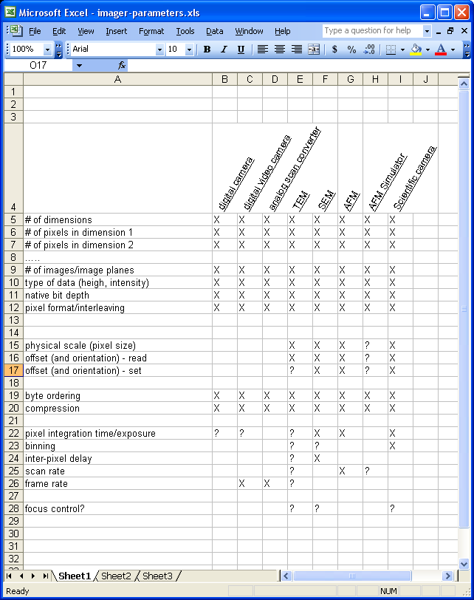
Parameters vs. Devices

