Slide 1
SBEAMS overview 10.21.04
Overview of current Affy SBEAMS pages
  Adding Array and Sample information
  Viewing and downloading Affy files
  Querying Affy expression information
Affy Help pages
Affy Analysis Pipeline
  Pre-processing and Normalization in R
  Potential analysis platforms
Future Work

Slide 2
Adding Array and Sample information
Currently the system automatically uploads the following information
  Project name, user name, sample name, array type and basic protocol information
Additional fields available for array annotation
  Protocol Deviations, Comments
Additional fields available for sample annotation
  15 additional fields
Access the data from Microarray Project Home Page
  http://db.systemsbiology.net/sbeams/cgi/Microarray/ProjectHome.cgi

Slide 3
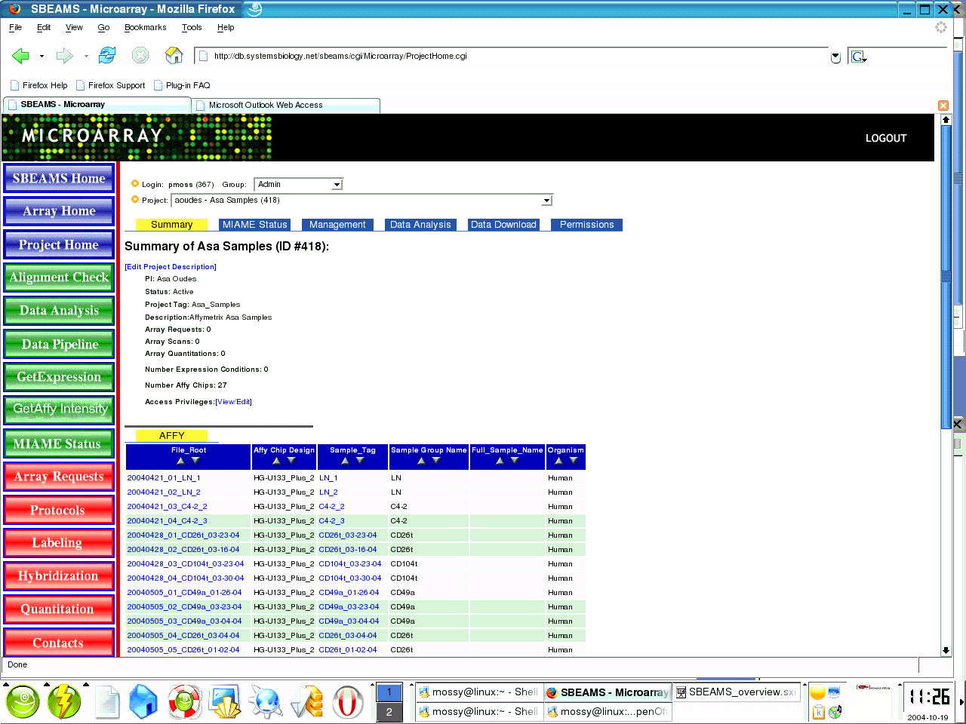
http://db.systemsbiology.net/sbeams/cgi/Microarray/ProjectHome.cgi
1) Choose Project
Project info
Select detailed array info
Select detailed sample info

Slide 4
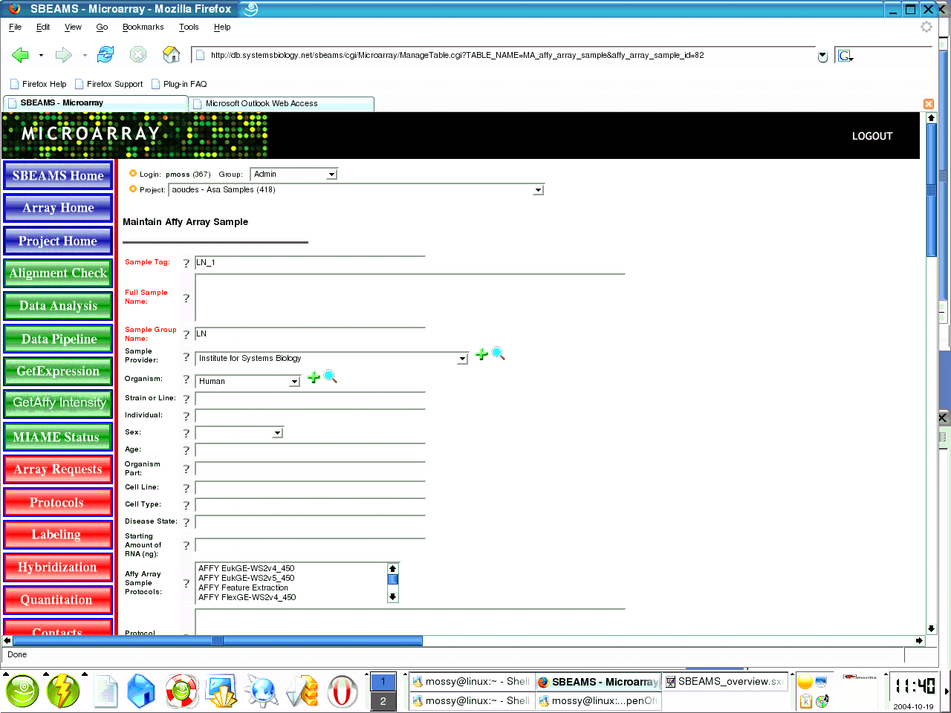
Add Sample information
  Sample Tag, Sample Group automatically filled in
  Users must fill in full sample tag before any additional information is submitted
  Data is not checked for MIAME compliance

Slide 5
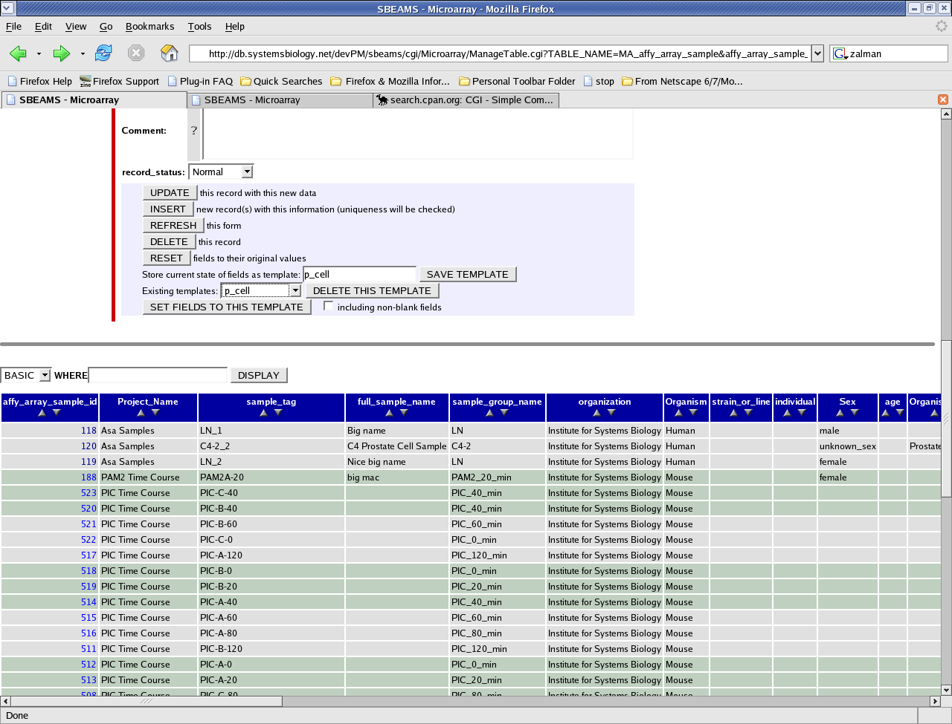
Use templates to speed data entry
Enter first sample
Type in a name in the save template and save template
Go back and choose the next sample to annotate.
Scroll to the bottom select the temple from the drop down
Click the button “Set fields to this template”
Make any additional edits and Click “Update”

Slide 6
File Down Load Info
All checked files will be bundled together into a single zip archive
Files that are viewable from the browser have a hyper link
File types available
  CEL.
    Binary Affymetrix file. The CEL file stores the results of the intensity calculations on the pixel values of the DAT file
  CHP.
    Binary Affymetrix file. CHP files contain probe set analysis results generated from Affymetrix software
  XML.
    MAGE XML Affymetrix file. Contains information from Affymetrix GCOS Software collected during sample preparation, hybridization, washing and scanning.
  RPT.
    Text report. Contains information about the CHP file, used for basic quality control

Slide 7
Files continued
  R_CHP.
    Text File. Contains Probe set intensity values, calculated by using R/Bioconductor or affy mas5.0 algorithms
  JPEG.
    Jpeg image of the Affy Chip generated by R using the image method within the affy library
  EGRAM_PF.jpg.
    Electrophoregram image of the Pre-fragmented cRNA
  EGRAM_T.jpg.
    Electrophoregram image of the total RNA
  EGRAM_F.jpg.
    Electrophoregram image of the fragmented cRNA

Slide 8
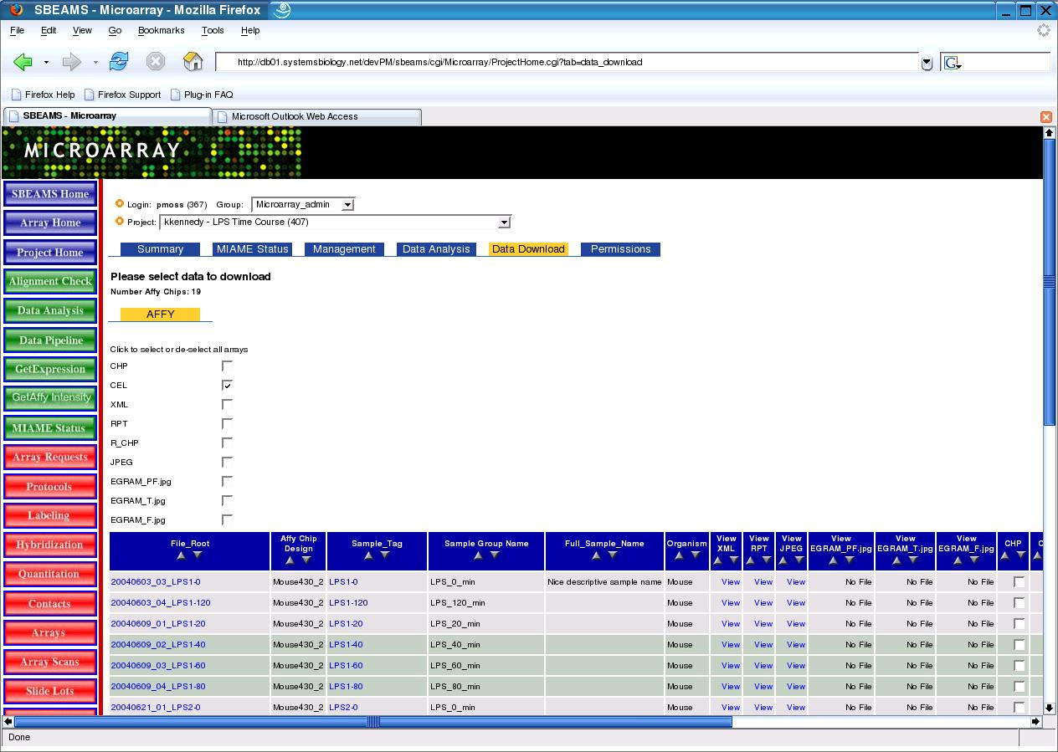
Data down load page
Many files can be directly viewed or downloaded from the Data Download Tab of the Microarray Project Home page
Select or de-select all files to download
Files that can be downloaded
Files types to view

Slide 9
Viewing Affy Expression Data
Currently two web pages are available to query the expression values derived from R_CHP data
What is an R_CHP file?
  It's a text file, containing probe set intensity values, calculated using R/Bioconductor affy mas5.0 algorithms
  http://affy/isb_help.php?help_page=Make_R_CHP_file.xml
Is the data any good?
  Tests by Bruz and other groups show a very good correlation between Affymetrix GCOS Mas 5.0 values and R-Mas5 values
  See the help pages for more info
  http://affy/isb_help.php?help_page=R_GCOS_comparison.xml

Slide 10
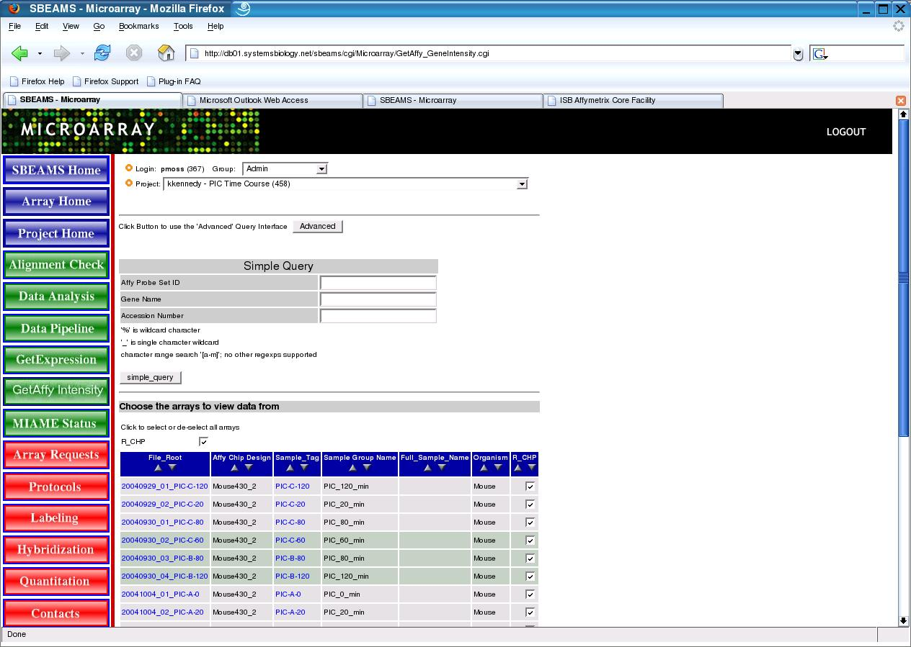
Simple Query
1) Choose your project
Enter a query term
Start run
Select Samples to display

Slide 11
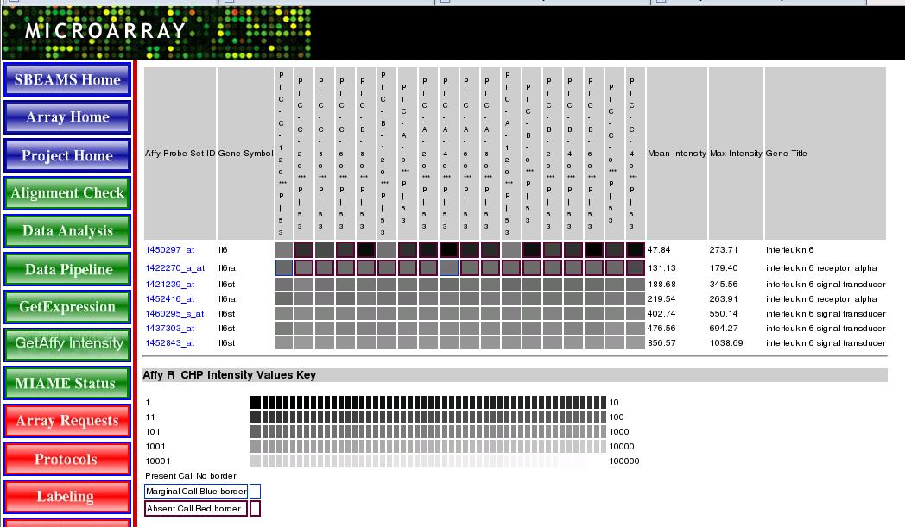
Simple Query Results
All expression values are converted to log10 values
Converted values are mapped to 256 shades of gray
Genes are sorted by mean intensity
Marginal/Absent calls are shown
Links to internal Affy annotation provided too

Slide 12
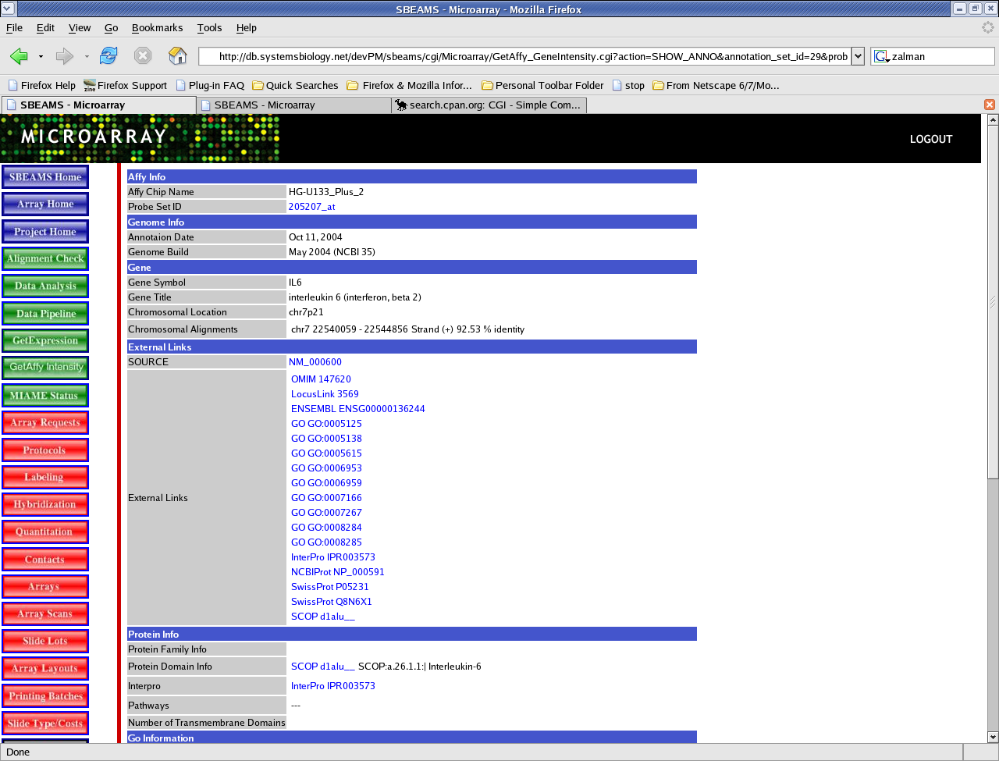
Internal Affy Annotation Page

Slide 13
Advanced Query Page
Affymetrix provides annotation files for all their arrays
  For the arrays ISB uses the annotation files are parsed and loaded into Sbeams on a quarterly basis
The Advanced Query page can be searched with a variety of terms
Arrays from different projects can be grouped together and searched
Data can be pivoted to display each array sample as a column
Data can be displayed with or without Gene Ontology annotation

Slide 14
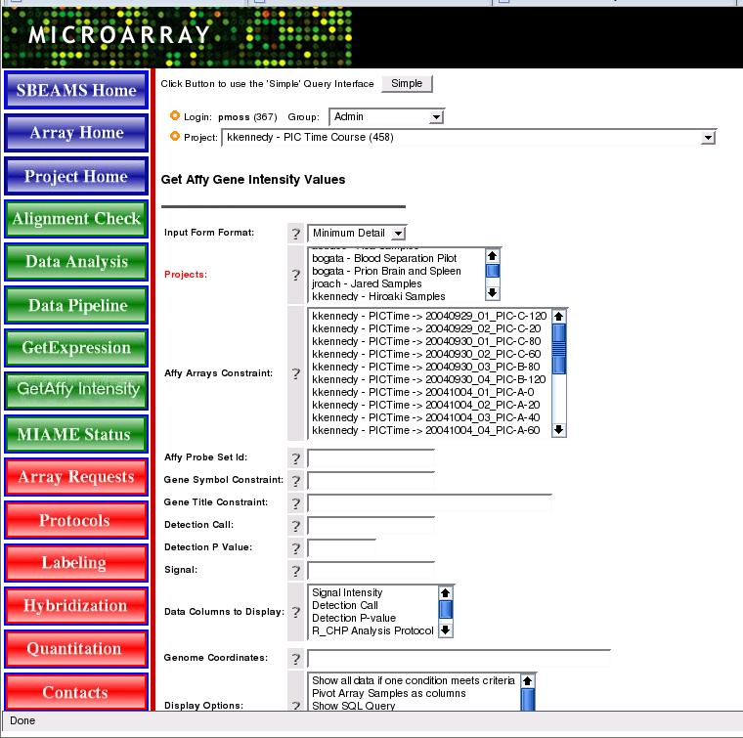
Advanced Query Page
Select one or more
projects with Affy data
Select arrays of interest
(defaults to all arrays from selected projects)
Enter Query terms
All Sbeams wild cards terms are
supported
Pivot Data or add
GO annotation

Slide 15
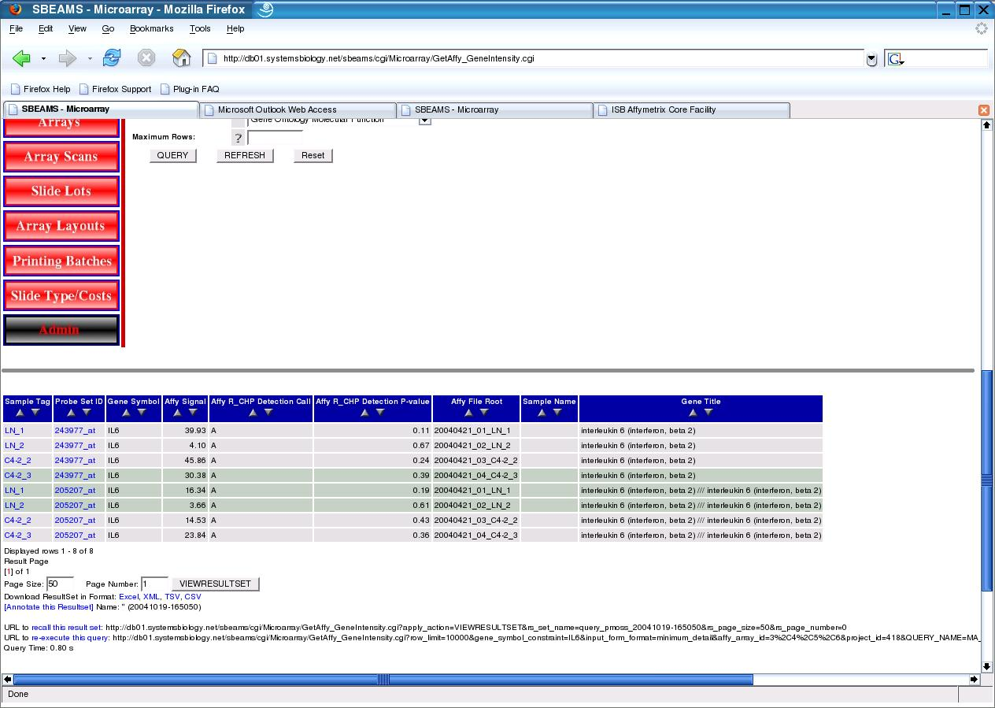
Advance query Results
Data can be displayed in a html table, tsv,csv,excel or xml formats
Any of the columns my be sorted
Link to Affy annotation page is provided

Slide 16
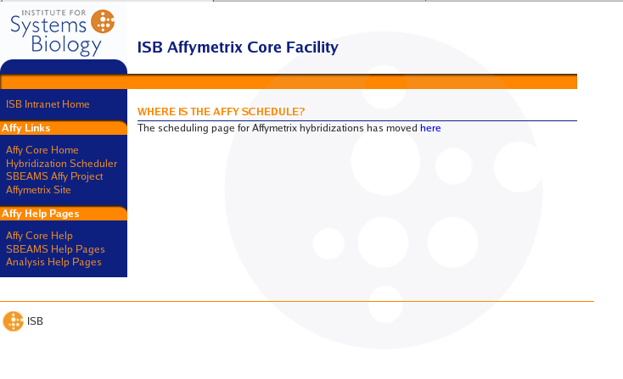
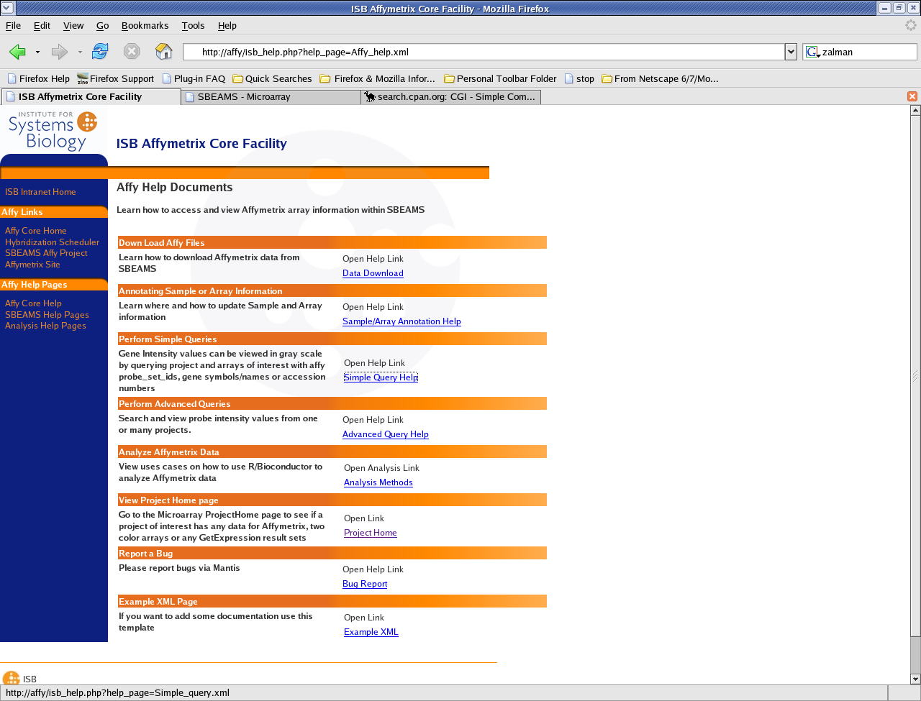
Affy Help Pages
View the Affy help pages to learn more about most of the things talked about today
http://affy/
Link to the Affymetrix hybridization scheduling page can be found here too.

Slide 17
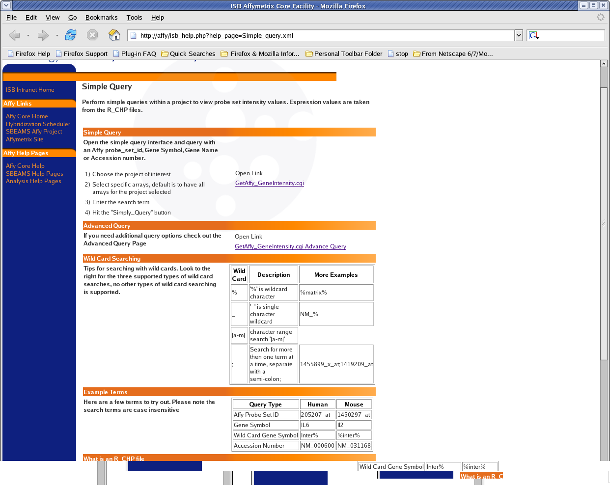
Example Affy Help Page
Simple Query

Slide 18
Affy Analysis Pipeline
Currently working to setup an analysis pipeline to help facilitate data pre-processing, differential expression detection, data integration and visualization
Discussion Points for setting up pipeline
  What programs and/or algorithms are currently being used for data pre-processing?
  What programs are being used for data analysis and visualization?
  What is the expression information being used for?
    What is the starting data format for the program(s)?
    What is the ending data format?
    Should or Could these steps be automated?
  Cytoscape integration
    What data should be loaded into Condition and GeneExpression tables

Slide 19
Initial pipeline work
Integrate Bioconductor analysis web pages into Sbeams.
  All open source software
  Will be relatively easy to setup
  Convenient platform to export data for use in different programs
  Simplifies using R command line to process data
Export data from Bioconductor in (MultiExperiment Viewer) MeV
  Open source software from TIGR, allows visualization and analysis of expression data sets

Slide 20
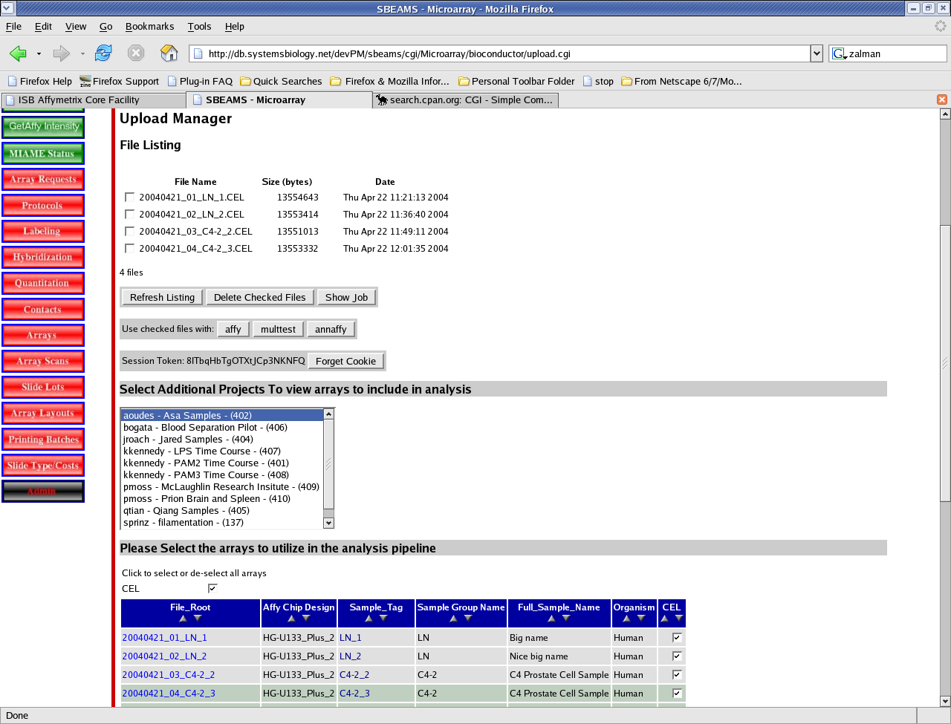
Entering data into Bioconductor
(Work in development)

Slide 21
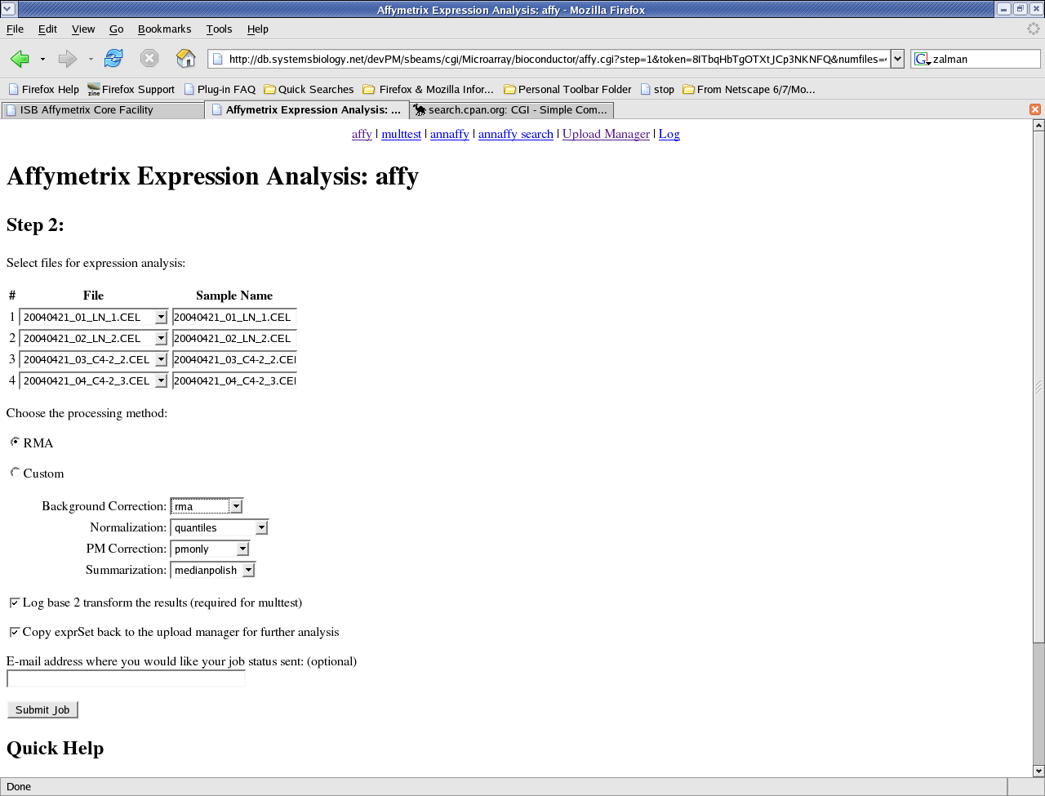
Pre Processing form
rma
rma2
mas
gcrma-eb
gcrma-mle
quantiles
quantiles.robust
loess
contrasts
constant
invariantset
qspline
vsn
mas
pmonly
subtractmm
avgdiff
liwong
mas
medianpolish
playerout
rlm

Slide 22
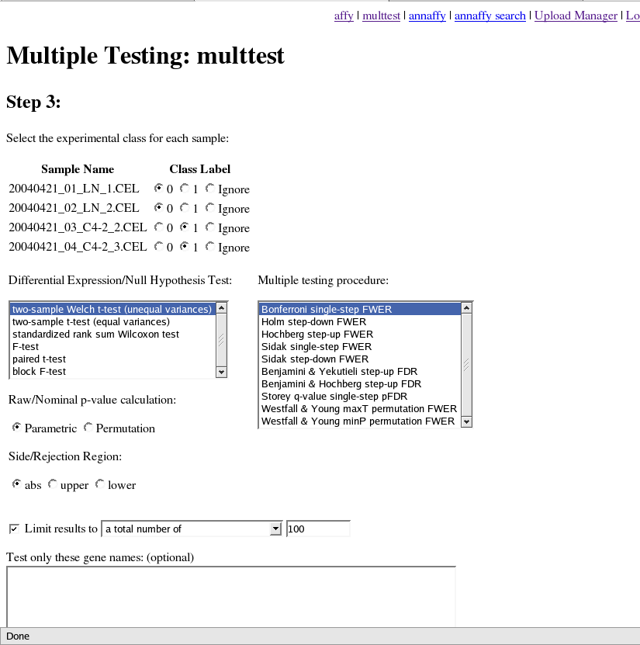
Analysis Start

Slide 23
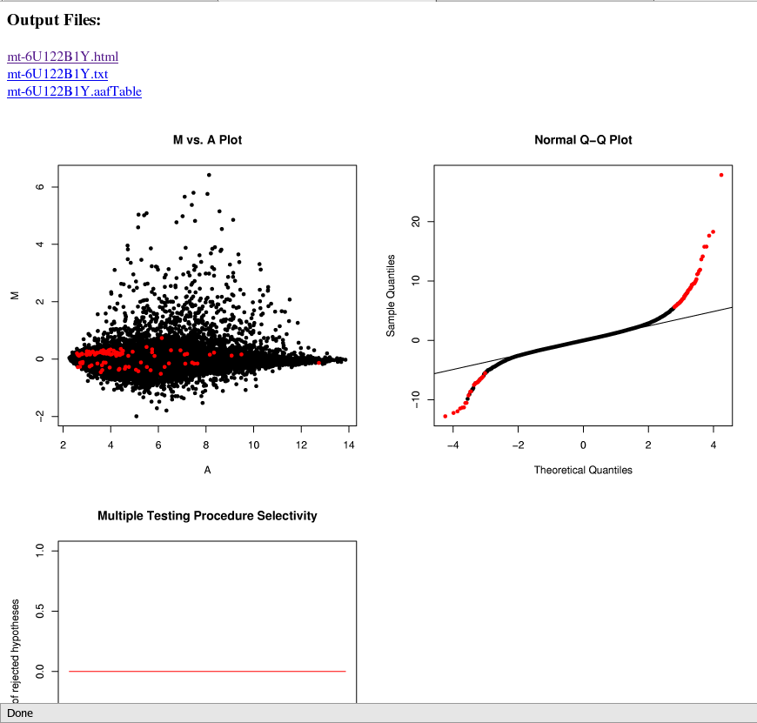
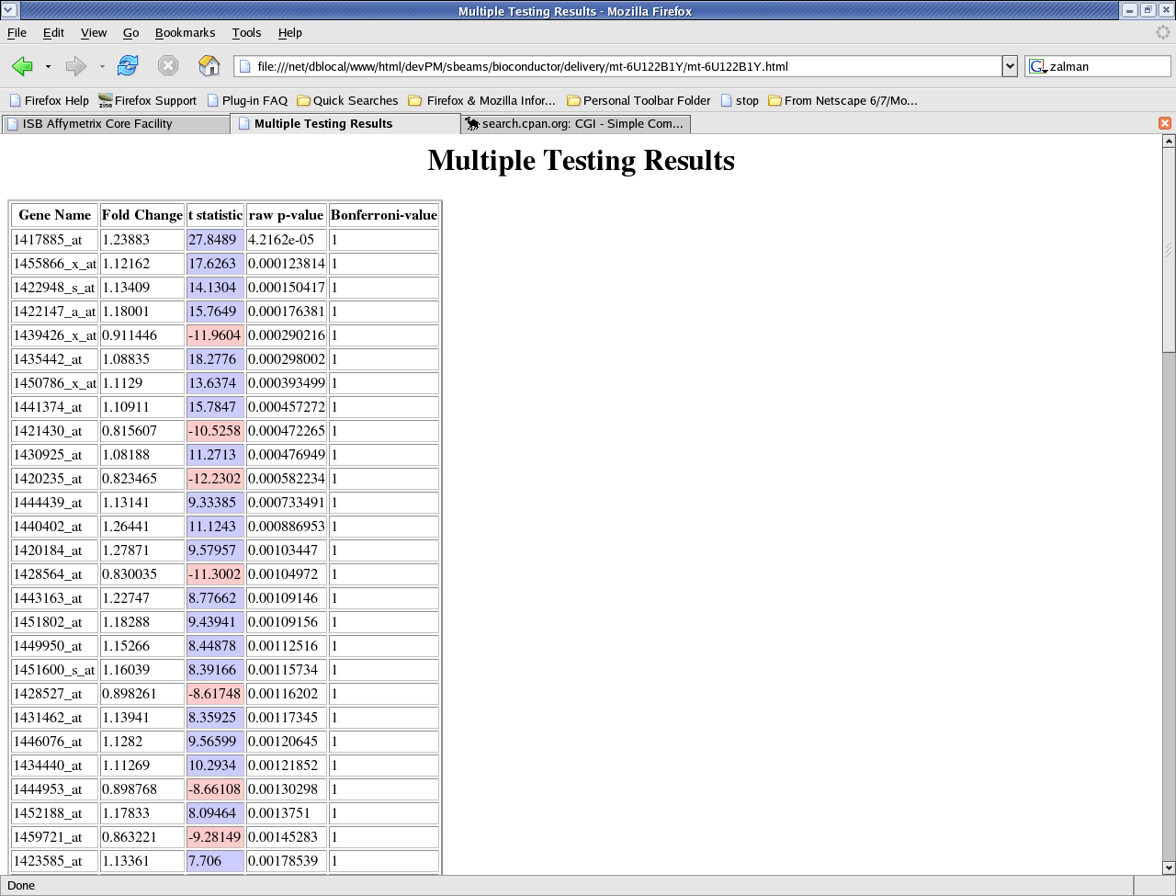
Results from Bioconductor

Slide 24
Data Display
Use MeV to display and analyze expression data sets
Bruz has some very encouraging observations using R to pre-process a data set and importing the data into MeV.
Similar results could be done with GeneSpring or other data analysis packages...

Slide 25
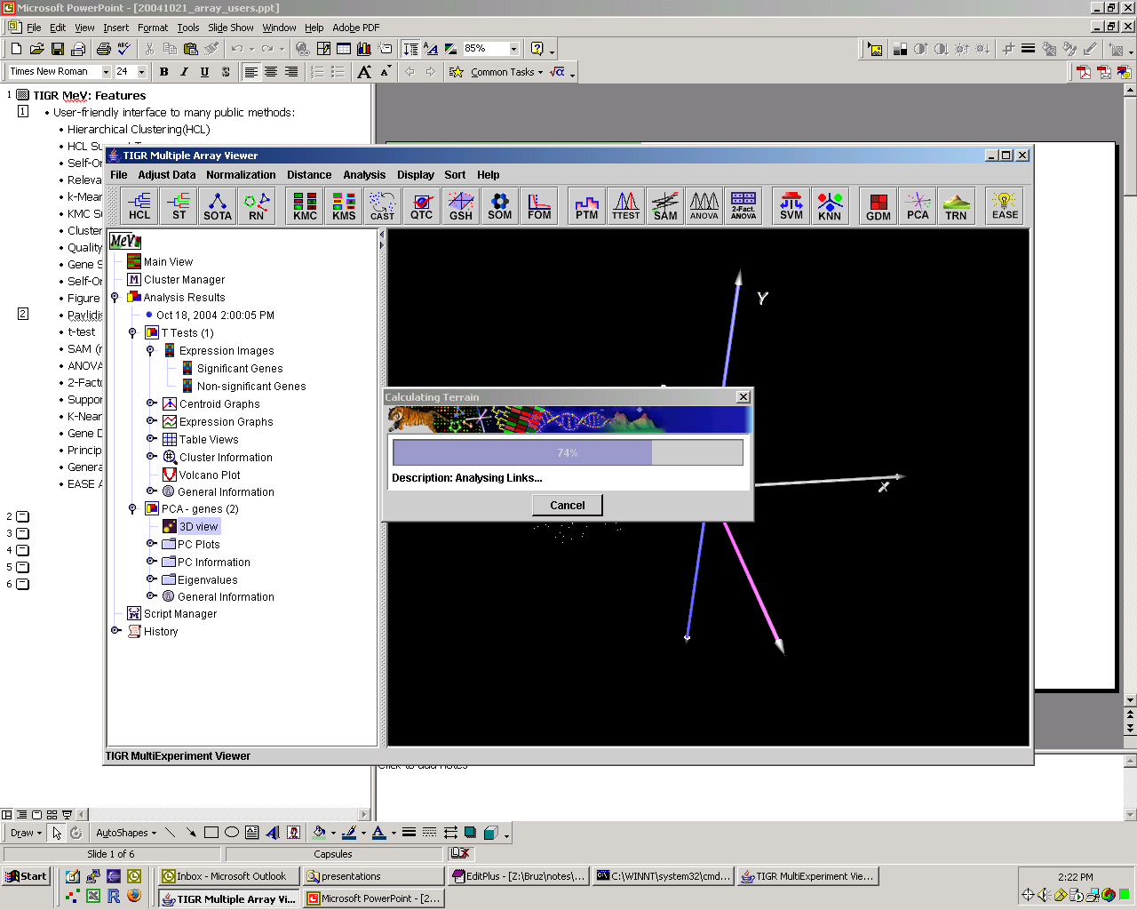
TIGR MeV: Features
= Clustering
User-friendly interface to many public methods:
  Hierarchical Clustering(HCL)
  HCL Support Trees
  Self-Organizing Tree Alorithm
  Relevance Networks
  k-Means Clustering (KMC)
  KMC Support
  Cluster Affinity Search Technique
  Quality Clustering
  Gene Shaving
  Self-Organizing Map
  Figure of Merit
= Statistics
= Classification
  Pavlidis Template Matching
  t-test
  SAM (not VERA/SAM)
  ANOVA
  2-Factor ANOVA
  Support Vector Machines
  K-Nearest Neighbors Classification
  Gene Distance Matrix
  Principal Component Analysis
  Generate Terrain
  EASE Annotation Analysis

Slide 26
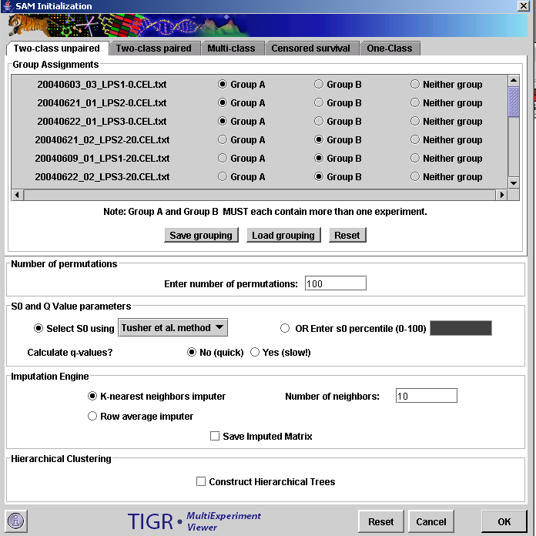
TIGR MeV: SAM
Modified t-test widely used with microarray data

Slide 27
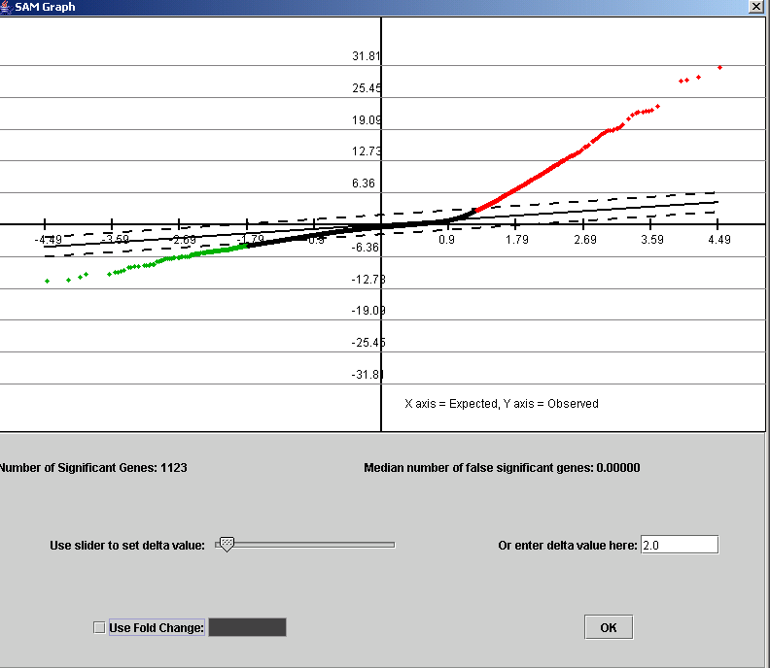
TIGR MeV: SAM
User selection of significance threshold based upon number of genes called significant and number of expected false positives

Slide 28
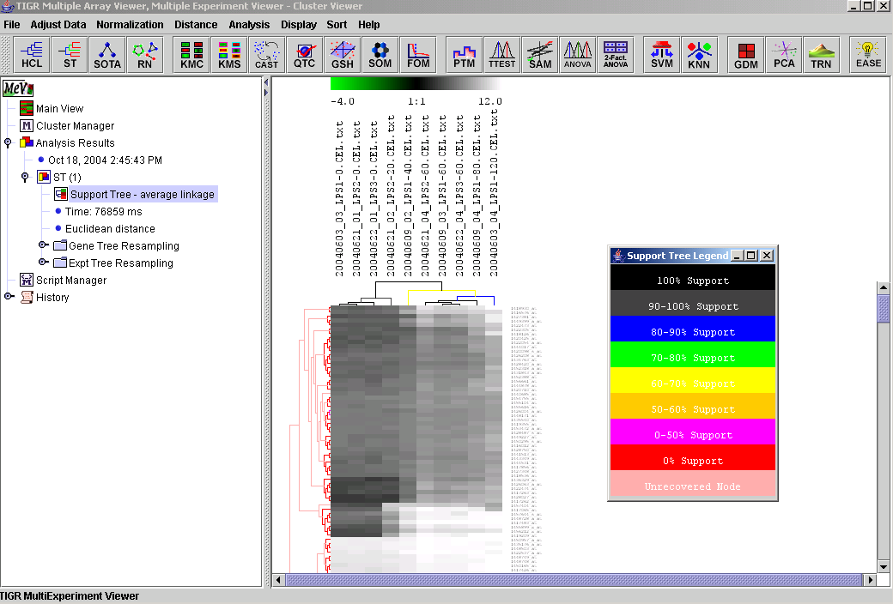
TIGR MeV: HCL Support Trees

Slide 29
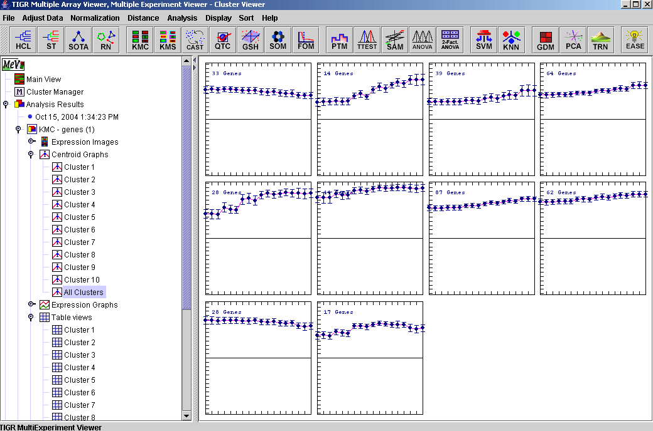
TIGR MeV: K-Means Clustering

Slide 30
Future Work
Complete the analysis pipeline
Start to check data for MIAME compliance
Make MAGE XML export possible
  Should simplify submitting results for publication

