Slide 1
Significance analysis of Microarrays (SAM)
Applied to the ionizing radiation response
Tusher, Tibshirani, Chu (2001)
Dafna Shahaf
Notes:
SAM is a method that tries to identify changes in gene expression between different biological conditions,
and determine the significance of these changes (while accounting for an enormous number of genes).

Slide 2
Outline
Problem at hand
Reminder: t-Test, multiple hypothesis testing
SAM in details
Test SAM’s validity
Other methods- comparison
Variants of SAM

Slide 3
Outline
Problem at hand
Reminder: t-Test, multiple hypothesis testing
SAM in details
Test SAM’s validity
Other methods- comparison
Variants of SAM

Slide 4
The Problem:
Identifying differentially expressed genes
Determine which changes are significant
Enormous number of genes
Notes:
Massive amounts of data are generated in a single hybridization experiment.
Also, there is a lot of noise.

Slide 5
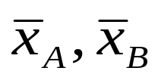
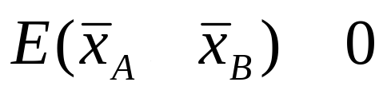
Reminder: t-Test
t-Test for a single gene:
We want to know if the expression level changed from condition A to condition B.
Null assumption: no change
Sample the expression level of the genes in two conditions, A and B.
Calculate
H0: The groups are not different,
Notes:
See http://mathworld.wolfram.com/Pairedt-Test.html for further details about t-Test.

Slide 6
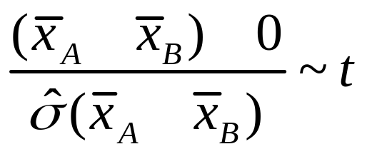
t-Test Cont’d
Under H0, and under the assumption that the data is normally distributed,
Use the distribution table to determine the significance of your results.
t-Statistic

Slide 7
Multiple Hypothesis Testing
Naïve solution: do t-test for each gene.
Multiplicity Problem: The probability of error increases.
We’ve seen ways to deal with it, that try to control the FWER or the FDR.
Today: SAM (estimates FDR)

Slide 8
Outline
Problem at hand
Reminder: t-Test, multiple hypothesis testing
SAM in details
Test SAM’s validity
Other methods- comparison
Variants of SAM

Slide 9

SAM- procedure overview
Sample genes
expression
scale
Define and calculate
a statistic, d(i)
Generate permutated
samples
Estimate attributes
of d(i)’s distribution
Identify potentially
Significant genes
Choose
Δ
Estimate FDR
Notes:
SAM assigns a score to each gene on the basis of change in gene expression relative to the standard deviation.
For genes with scores greater than an adjustable threshold, SAM uses permutations of the measurements to estimate the FDR.

Slide 10
SAM- procedure overview
Sample genes
expression
scale
Define and calculate
a statistic, d(i)
Generate permutated
samples
Estimate attributes
of d(i)’s distribution
Identify potentially
Significant genes
Choose
Δ
Estimate FDR

Slide 11
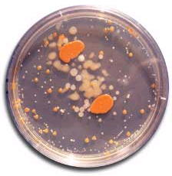
The Experiment
Two human lymphoblastoid cell lines:
I1A
I1
I1B
I2A
I2
I2B
1
2
U1A
U1
U1B
U2A
U2
U2B
Eight hybridizations were performed.

Slide 12
Scaling
Scale the data.
Use technique known as “linear normalization”
Twist- use cube root

Slide 13
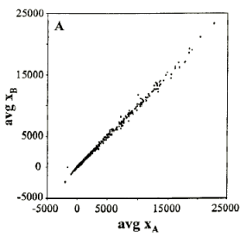
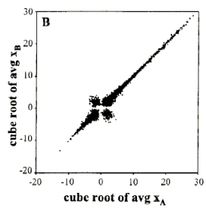
First glance at the data

Slide 14
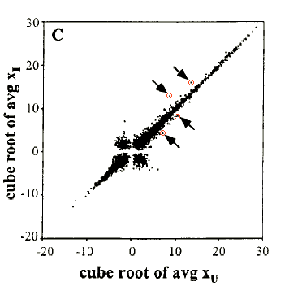
How to find the significant changes? Naïve method

Slide 15
SAM- procedure overview
Sample genes
expression
scale
Define and calculate
a statistic, d(i)
Generate permutated
samples
Estimate attributes
of d(i)’s distribution
Identify potentially
Significant genes
Choose
Δ
Estimate FDR

Slide 16
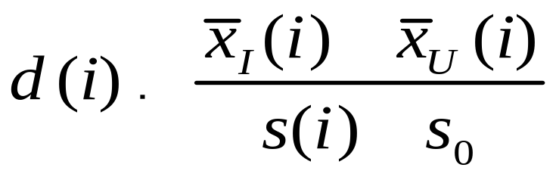
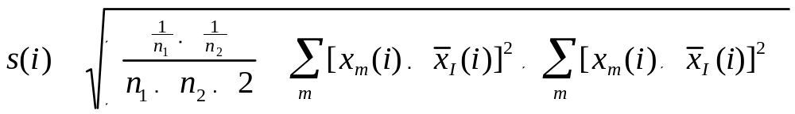
SAM’s statistic- Relative Difference
Define a statistic, based on the ratio of change in gene expression to standard deviation in the data for this gene.
Difference between the
means of the two conditions
Fudge Factor
Estimate of the standard
deviation of the numerator
Notes:
See http://davidmlane.com/hyperstat/B58842.html for further details about s(i).

Slide 17
Why s0 ?
At low expression levels, variance in d(i) can be high, due to small values of s(i).
To compare d(i) across all genes, the distribution of d(i) should be independent of the level of gene expression and of s(i).
Choose s0 to make the coefficient of variation of d(i) approximately constant as a function of s(i).

Slide 18
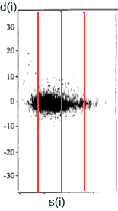
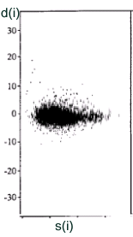
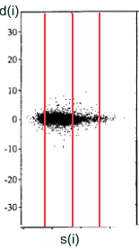
Choosing s0
* Figures for illustration only

Slide 19
Now what?
We gave each gene a score.
At what threshold should we call a gene significant?
How many false positives can we expect?

Slide 20
SAM- procedure overview
Sample genes
expression
scale
Define and calculate
a statistic, d(i)
Generate permutated
samples
Estimate attributes
of d(i)’s distribution
Identify potentially
Significant genes
Choose
Δ
Estimate FDR

Slide 21
More data required
Experiments are expensive.
Instead, generate permutations of the data (mix the labels)
Can we use all possible permutations?

Slide 22
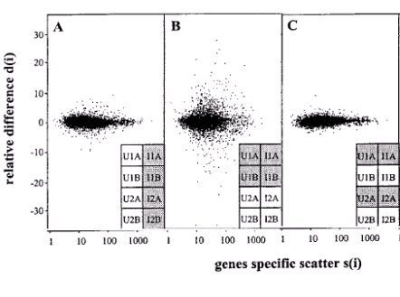

Slide 23
Balancing the Permutations
There are differences between the two cell lines.
Balanced permutations- to minimize the effects of these
differences
A permutation is balanced if each group of four
experiments contained two experiments from
line 1 and two from line 2.
There are 36 balanced permutations.

Slide 24
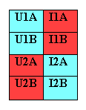
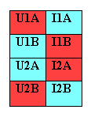
Balanced Permutations

Slide 25
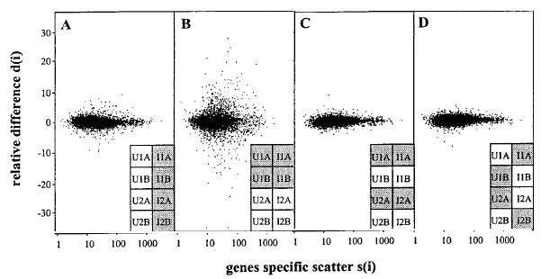

Slide 26
SAM- procedure overview
Sample genes
expression
scale
Define and calculate
a statistic, d(i)
Generate permutated
samples
Estimate attributes
of d(i)’s distribution
Identify potentially
Significant genes
Choose
Δ
Estimate FDR

Slide 27
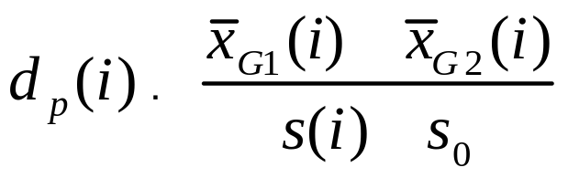
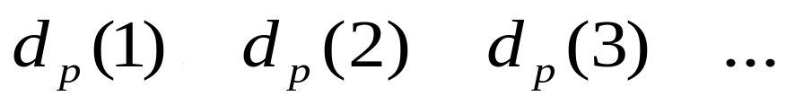
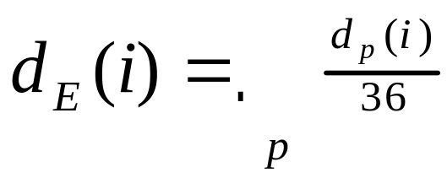
Estimating d(i)’s Order Statistics
For each permutation p, calculate dp(i).
Rank genes by magnitude:
Define:

Slide 28
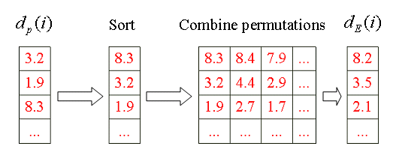
Example

Slide 29
SAM- procedure overview
Sample genes
expression
scale
Define and calculate
a statistic, d(i)
Generate permutated
samples
Estimate attributes
of d(i)’s distribution
Identify potentially
Significant genes
Choose
Δ
Estimate FDR

Slide 30
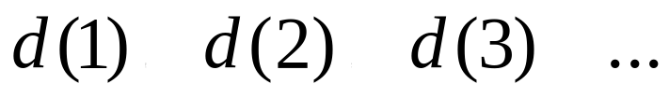
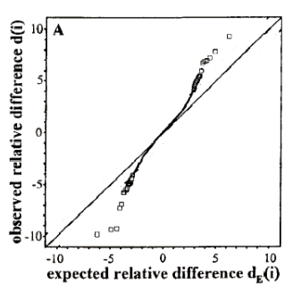
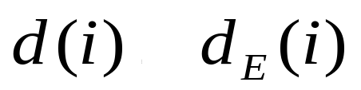
Identifying Significant Genes
Now Rank the original d(i)’s:
Plot d(i) vs. dE(i) :
For most of the genes,

Slide 31
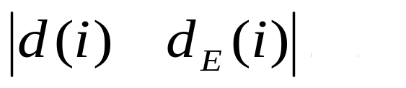
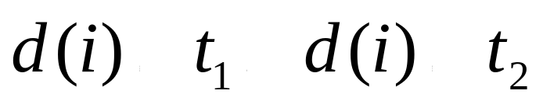
Identifying Significant Genes
Define a threshold, Δ.
Find the smallest positive d(i) such that
call it t1.
In a similar manner, find the largest negative d(i). Call it t2.
For each gene i, if,
call it potentially significant.

Slide 32
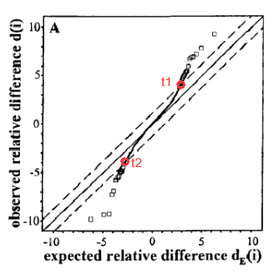

Slide 33
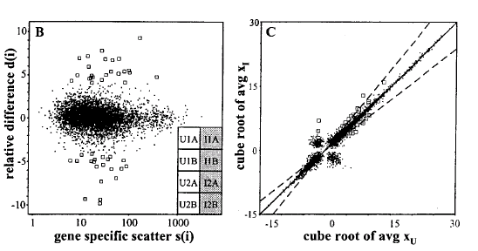
Where are these genes?

Slide 34
SAM- procedure overview
Sample genes
expression
scale
Define and calculate
a statistic, d(i)
Generate permutated
samples
Estimate attributes
of d(i)’s distribution
Identify potentially
Significant genes
Choose
Δ
Estimate FDR

Slide 35
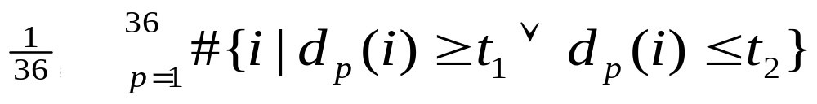
Estimate FDR
t1 and t2 will be used as cutoffs.
Calculate the average number of genes that exceed these values in the permutations.
Very similar to the Gap Estimation algorithm for clustering, shown in a previous lecture.
Estimate the number of falsely significant genes, under H0:
Divide by the number of genes called significant

Slide 36
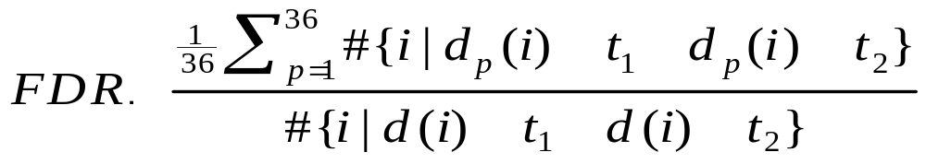
FDR cont’d
Note: Cutoffs are asymmetric

Slide 37
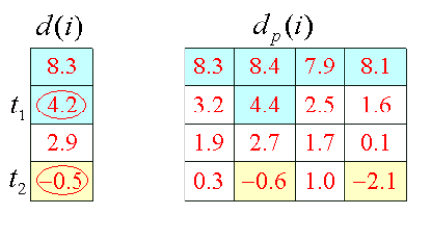
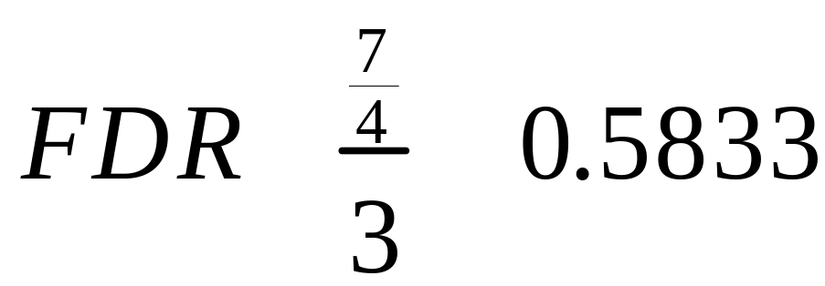
Example

Slide 38
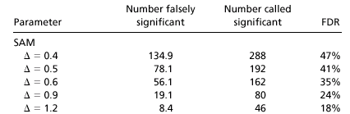
How to choose Δ?
Omitting s0 caused higher FDR.

Slide 39
Test SAM’s validity
10 out of 34 genes found have been reported in the literature as part of the response to IR
19 appear to be involved in the cell cycle
4 play role in DNA repair
Perform Northern Blot- strong correlation found
Artificial data sets- some genes induced, background noise

Slide 40
SAM- procedure overview
Sample genes
expression
scale
Define and calculate
a statistic, d(i)
Generate permutated
samples
Estimate attributes
of d(i)’s distribution
Identify potentially
Significant genes
Choose
Δ
Estimate FDR

Slide 41
Outline
Problem at hand
Reminder: t-Test, multiple hypothesis testing
SAM in details
Test SAM’s validity
Other methods- comparison
Variants of SAM

Slide 42
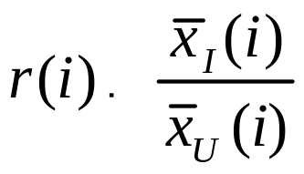
Other Methods- Comparison
R-fold Method:
Gene i is significant if r(i)>R or r(i)<1/R
FDR 73%-84% - Unacceptable.
Pairwise fold change: At least 12 out of 16 pairings satisfying the criteria. FDR 60%-71% - Unacceptable.
Why doesn’t it work?

Slide 43
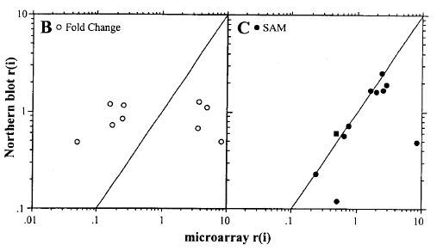
Fold-change, SAM- Validation

Slide 44
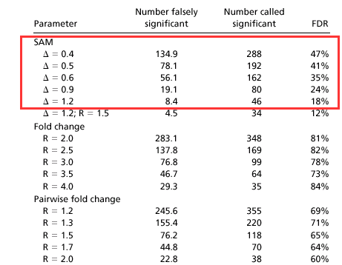

Slide 45
Multiple t-Tests
Trying to keep the FDR or FWER.
Why doesn’t it work?
FWER- too stringent (Bonferroni, Westfall and Young)
FDR- too granular (Benjamini and Hochberg)
SAM does not assume normal distribution of the data
SAM works effectively even with small sample size.

Slide 46
Clustering
Coherent patterns
Little information about statistical significance

Slide 47
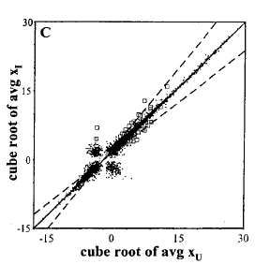
SAM Variants
SAM with R-fold

Slide 48
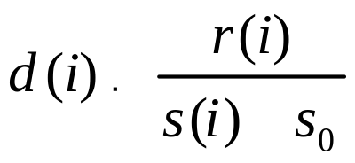
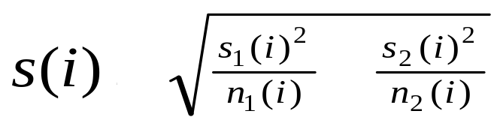
SAM Variants cont’d
Other variants- Statistic is still in form
definitions of r(i), s(i) change.
Welch-SAM (use Welch statistics instead of
t-statistics)
Notes:
Fisher’s linear discriminant- see the “Discrimination Methods” lecture

Slide 49
SAM Variants cont’d
SAM for n-state experiment (n>2)
define d(i) in terms of Fisher’s linear
discriminant.
(e.g., identify genes whose expression in
one type of tumor is different from the
expression in other kinds)

Slide 50
SAM Variants cont’d
Other types of experiments:
Gene expression correlates with a quantitative parameter (such as tumor stage)
Paired data
Survival time
Many others

Slide 51
Summary
SAM is a method for identifying genes on a microarray with statistically significant changes in expression.
Developed in a context of an actual biological experiment.
Assign a score to each gene, uses permutations to estimate the percentage of genes identified by chance.
Comparison to other methods.
Robust, can be adopted to a broad range of experimental situations.

Slide 52
Reference:
Significance analysis of microarrays applied to the ionizing radiation response \ Virginia Goss Tusher,Robert Tibshirani, and Gilbert Chu
Bibliography:
SAM Thresholding and False Discovery Rates for Detecting Differential Gene Expression in DNA Microarrays\ John D. Storey Robert Tibshirani
Statistical methods for ranking differentially expressed genes\ Per Broberg 2003
Assessment of differential gene expression in human peripheral nerve injury\ Yuanyuan Xiao, Mark R Segal, Douglas Rabert, Andrew H Ahn, Praveen Anand, Lakshmi Sangameswaran, Donglei Hu and C Anthony Hunt 2002
SAM “Significance Analysis of Microarrays” Users guide and technical document\ Gil Chu, Balasubramanian Narasimhan, Robert Tibshirani, Virginia Tusher
SAM\ Cristopher Benner
Statistical Design and analysis of experiments\ Mason, Gunst, Hess
http://www-stat-class.stanford.edu/SAM/servlet/SAMServlet

Slide 53
Thank You.

