Slide 1
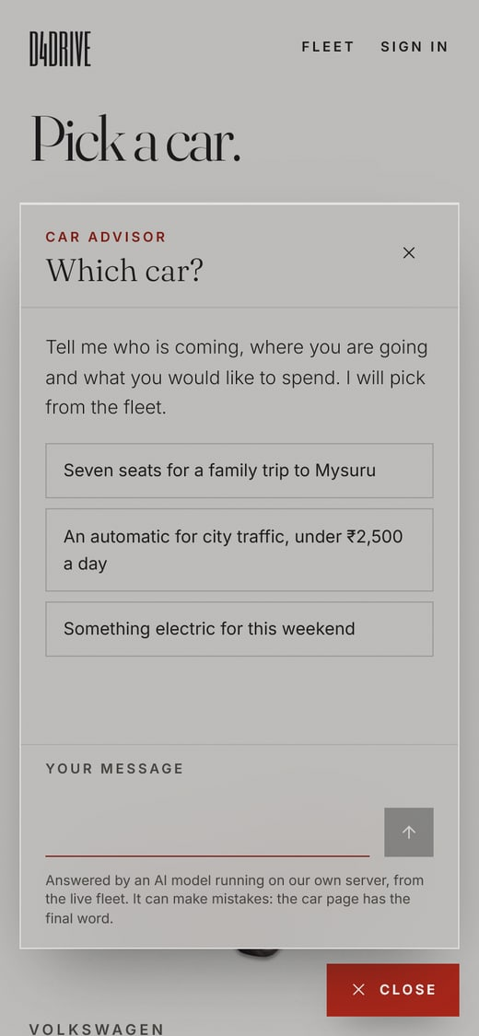
AI FEATURE INTEGRATION
Which car? An AI advisor for D4Drive
A small floating chatbot that helps a visitor choose a car from the live fleet: a language model running locally in Ollama, calling tools over the project’s MySQL database.
Rohit | D4Drive DBMS project | October 2026
Notes:
D4Drive is our car rental and doorstep delivery site for Bengaluru. For the AI feature I added a car advisor: a chat button on every public page. You describe your trip in plain words and it recommends cars from our real fleet, with real prices. The AI is an open model, qwen2.5:3b, running on this machine through Ollama, and it gets its facts from two tools that query our MySQL database.

Slide 2

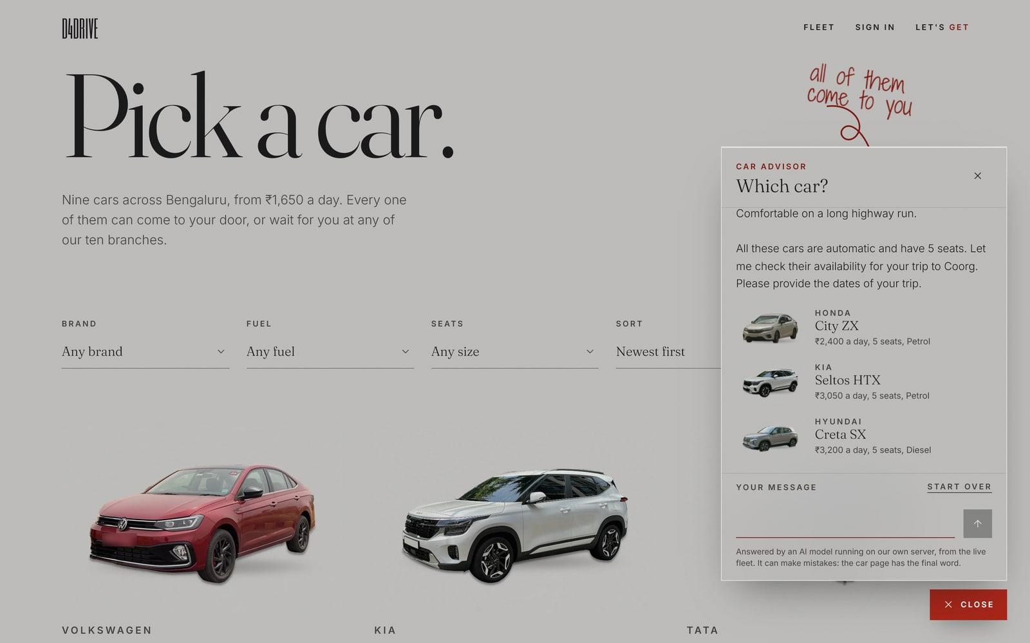



The feature at a glance
Ask in plain words
Type “Five adults to Coorg, automatic” instead of setting filters.
Answers from the live fleet
Every car, price and seat count comes from MySQL, never from the model’s memory.
One tap to the car
Up to three suggested cars, each linking to its page to reserve.
On every public page
A “Which car?” button at the bottom right; the chat stays open across pages.
The fleet page with the advisor open, on a laptop.
Notes:
What it does: the visitor types what they need, the advisor searches the fleet and answers in a few sentences with up to three cars. Each car card links to its page, where Reserve starts the normal booking. The widget lives in the root layout, so the conversation survives moving between pages.

Slide 3
How a question becomes an answer
Ollama, on this machine
qwen2.5:3b reads the prompt and our two tool definitions.
Chat widget
In the browser. Sends only the text of the chat to our own server.
POST /api/advisor
Next.js route on our server: rate limit, zod check, then runs the loop.
MySQL tools
search_fleet, check_availability: parameterised SELECTs and fn_car_available.
1
The visitor asks in plain words
2
The route checks the chat and the rate limit
3
The model answers with a tool call
4
The route runs that tool on MySQL
5
Rows go back; the server checks the draft
6
Only checked replies and real cars reach the page
Notes:
The browser only ever calls our own route. The route sends the conversation to Ollama on localhost with two tool definitions. The model does not touch the database: when it needs facts it replies with a tool call, our server runs that tool against MySQL and returns the rows, and the model writes the answer from them. Before a reply is shown, the server checks it: no cars or prices before a search, and every rupee amount must be one the tools returned. Nothing leaves our server.

Slide 4
Ollama and tool calling, explained
What Ollama is
lib/advisor/run.ts, simplified
A free program that runs open models on our own machine, behind a local REST API. We use qwen2.5:3b (1.9 GB). It needs no API key or quota, and no data leaves the server.
const res = await fetch(
`${OLLAMA_HOST}/api/chat`, {
method: 'POST',
body: JSON.stringify({
model: 'qwen2.5:3b',
messages, // system + the chat
tools: ADVISOR_TOOLS,
stream: false,
options: { temperature: 0.2 },
}),
});
const { message } = await res.json();
for (const call of message.tool_calls ?? [])
messages.push({ role: 'tool', content:
JSON.stringify(await runTool(call)) });
What tool calling adds
We describe two tools in JSON Schema. When the model needs facts it returns tool_calls (a name and arguments) instead of text. Our server runs the tool and sends back a tool message with the rows.
Why the server checks its answers
A 3B model will invent cars and prices if it can. The server sends back any draft that names a car before searching, or quotes a price no tool returned.
Notes:
Ollama downloads open models and serves them on localhost port 11434. A language model on its own only predicts text, so it could invent a car or a price, and our first test run did exactly that. Tool calling gives it a way to ask for facts: we declare search_fleet and check_availability, and when the model needs data it returns a structured call instead of prose. Our code runs it and hands back the result as a tool message. Because a small model still cuts corners, the server checks each draft before the visitor sees it and sends it back with a correction if it is not grounded.

Slide 5
The model never writes SQL
Real calls, run against the seeded MySQL database
search_fleet
Seats, fuel, gearbox, price and brand, each bound as a ? in one fixed query. Sort is an allowlisted key.
WHERE c.is_active = 1 AND c.seats >= ? ...
tool call search_fleet
{ "seats_min": 5, "transmission": "automatic",
"sort": "price_asc" }
tool result 5 rows, first two:
{ "id": 5, "model": "City ZX", "seats": 5,
"rupees_per_day": 2400,
"branch": "Jayanagar" }
{ "id": 3, "model": "Nexon EV Max", "seats": 5,
"rupees_per_day": 2950,
"branch": "Indiranagar" }
tool call check_availability
{ "car_name": "Honda City ZX",
"start_date": "2026-10-23",
"end_date": "2026-10-26" }
tool result
{ "available": true, "days": 3,
"rental_rupees": 7200 }
check_availability
Takes the car by id or by name, then the same overlap rule the booking procedure checks under its lock.
SELECT fn_car_available(?, ?, ?)
Every argument is checked by zod first. A bad call goes back to the model as an error it can correct, never to a query.
Notes:
The tools are where the AI feature meets the DBMS coursework: the model only chooses a function and its arguments. The server validates them with zod and binds them into fixed, parameterised SQL, exactly like the catalog page. check_availability reuses the stored function fn_car_available, which sp_create_booking also uses. The output on the left is real: I ran both tools against the seeded database. Five automatic cars with at least five seats, and the Honda City, named in words, is free for those three days at 7,200 rupees. A car can be named instead of numbered because the chat history keeps names, not ids; a guessed id is never trusted.

Slide 6
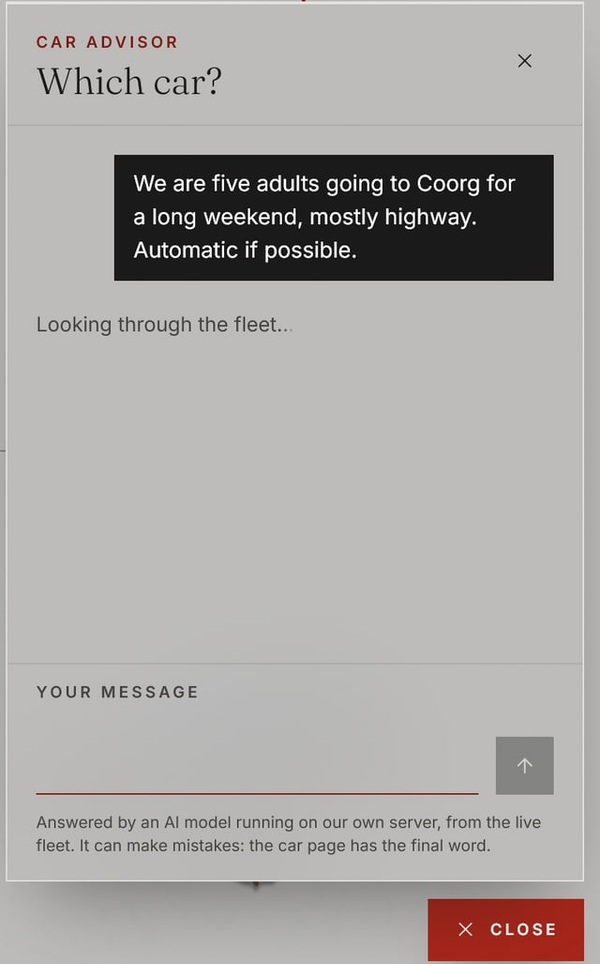
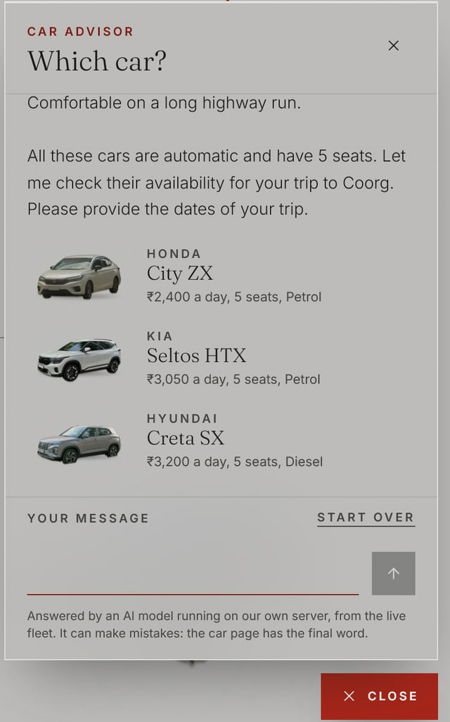
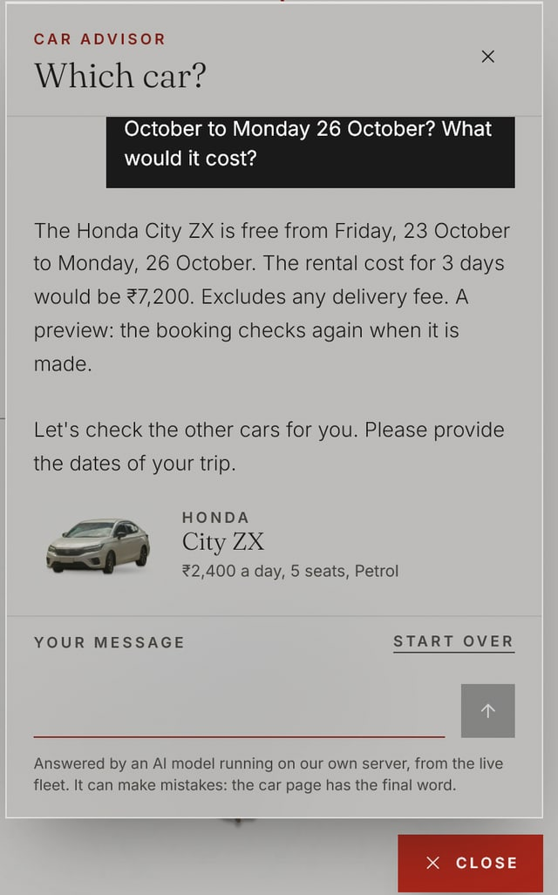
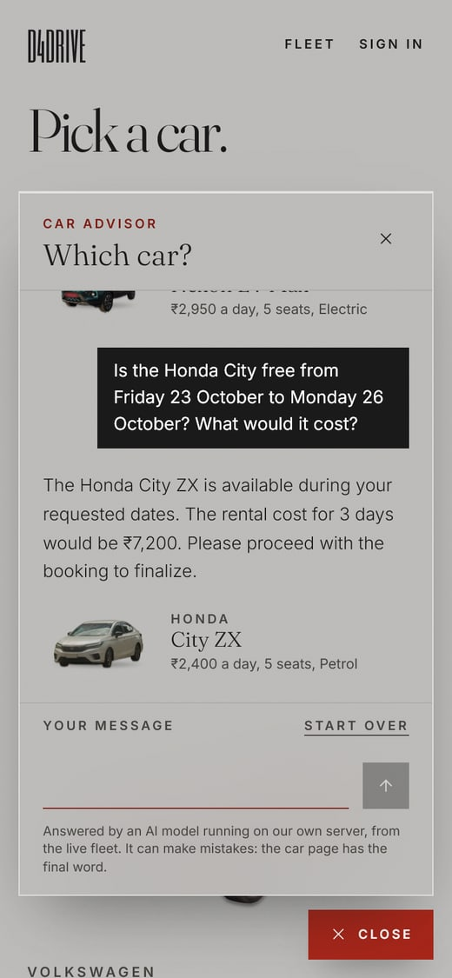
What the visitor sees
Real, unedited answers from qwen2.5:3b in Ollama on this laptop’s CPU, against the seeded fleet. Each reply took 10 to 27 seconds.
1 While it looks through the fleet
2 Three cars, real prices, linked
3 Dates checked and priced
4 On a phone
Notes:
These are real, unedited answers from the running site. The visitor asks for five seats and a highway trip. While the model works, the panel says it is looking through the fleet. The reply recommends the City ZX, Seltos HTX and Creta SX at their real daily rates, all automatic, and the cards link to the car pages. Asked about dates, it checks availability by name and prices the three days at 7,200 rupees, which matches the database.

Slide 7
Guardrails, tests and limits
The model runs on our server: no API key, no third party, and the page’s CSP still allows our own origin only
zod checks the chat (roles, turns, length) and every tool call
Read-only, parameterised SQL; the model never writes a query
No car or price before a search; every ₹ amount must be one a tool returned
Only cars a tool returned are linked; invented links are stripped
20 messages per visitor in 10 minutes, to spare the CPU
72
tests pass against MySQL, 8 of them for the advisor
69
browser checks, including a live answer with real links
Limits
A 3B model on a CPU is slow (10 to 27 s a reply) and can still misdescribe a car: once it called the manual Swift automatic. The server checks prices and searches, not every sentence. A larger model or a GPU would help.
Notes:
The model runs on our own server, every input is validated, the SQL is read-only and parameterised, and the server checks each draft before the visitor sees it. 72 tests pass against MySQL and the browser smoke test now includes a live answer. The limits: a 3 billion parameter model on a laptop CPU takes 10 to 27 seconds and can still get a description wrong, which is why the widget says the car page has the final word.

