Slide 1

Internship-2
Deep Learning and Reinforcement Learning
Vighnesh Reddy S
Gagan Bidaralli
Vedant V H

Slide 2





Project Objective
Our primary objective was to develop a Convolutional Autoencoder. This model aims to denoise images effectively.
Denoise Images
Develop a Convolutional Autoencoder to restore image clarity.
Clean Fashion-MNIST
Train the model to reconstruct clean images from noisy inputs.
Unsupervised Learning
Apply and understand core concepts in Unsupervised Learning.
Evaluate Autoencoders
Assess their effectiveness for practical noise reduction tasks.

Slide 3





Methodology and Workflow
Our project followed a structured methodology. We focused on data preparation, model architecture, and training.
Data Preparation
Load Fashion-MNIST dataset.
Add Gaussian noise to images.
Model Architecture
Convolutional Encoder-Decoder structure.
ReLU activations and Batch Normalization.
Training Strategy
Mean Squared Error (MSE) loss.
Adam optimizer for efficiency.
Early Stopping to prevent overfitting.
Visualization
Compare original, noisy, denoised outputs.

Slide 4

Key Assumptions
Our model relies on specific assumptions about the noise and data. These guide its design and expected performance.
Noise Type: Gaussian
Gaussian noise (mean=0, std=0.3) mimics real-world sensor artifacts.
Fashion-MNIST Representativeness
Fashion-MNIST images represent general structured data well.
Generalization Across Classes
Model generalizes effectively across all fashion item categories.
Fixed Input Size
Input images are consistently 28x28 grayscale, simplifying processing.

Slide 5
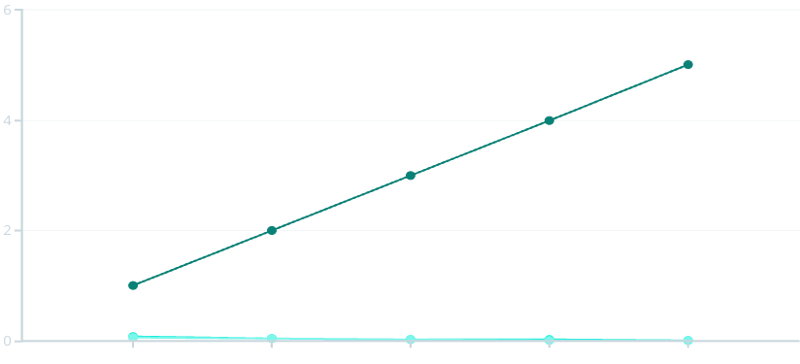
Model Evaluation and Analysis
Our evaluation focused on quantitative metrics and visual quality. The results demonstrate successful noise reduction.
Training Accuracy
Denoised images closely resembled original, clean inputs.
Validation Loss
Validation loss consistently decreased, showing stable learning.
Visual Results
Epoch
Training Loss
Validation Loss
Clear reconstruction of fine edges and patterns observed.
Latent Space
Graph: Training vs Validation Loss over Epochs
Compressed representations effectively captured essential features.

Slide 6





Project Summary and Outcomes
Our project successfully demonstrated the application of deep learning for image denoising. Key outcomes include:
Implemented Autoencoder
Successfully built a functional Denoising Autoencoder.
Unsupervised Learning Power
Demonstrated unsupervised learning for feature extraction.
Effective Noise Removal
Model effectively removed noise from unseen test data.
Deep Network Insights
Gained insights into deep network design and training.

Slide 7
Future Improvements and Extensions
Several avenues exist for further enhancing this project. These improvements can expand its capabilities.
Diverse Noise Types
Experiment with salt-and-pepper or motion blur noise.
Variational Autoencoders
Explore VAEs for generative denoising capabilities.
Skip Connections
Integrate U-Net style skip connections for detail preservation.
Real-World Applications
Apply the model to coloured or complex real-world images.

Slide 8








Reflections and Learning Outcomes
This project provided invaluable learning experiences. We developed a deeper understanding of autoencoders and deep learning practices.
Visual Quality Focus
Evaluated models beyond simple accuracy metrics.
TensorFlow/Keras Skills
Enhanced proficiency in deep learning frameworks.
Dataset Preparation
Mastered creating noisy datasets and result visualization.
Autoencoder Concepts
Understood architecture, bottleneck, and latent space.

Slide 9



