Slide 1
Quality Business Analytic Decision Support System for Realty Management
By:
(Cyberbullying Detection Using SVM Algorithm Team)
Faith Ballesteros
Paulo Miguel Capuz
Jason Juarez
Samantha Mallari
Eva Samillano

Slide 2
Introduction
Business Analytic Decision Support System for Realty Management is an application that help the company Promax Realty Corporation (PRC) to automate paper-based system in their organization to avoid data loss, data redundancy, inconsistencies in their company workflow.

Slide 3
The system objective are:
Able to manage the database record
Calculate data
Produce reports and graphs
To produce reliable information to help decision maker
To analyze data for future use.

Slide 4
Purpose
Identify the project information about the system that should be tested
To test the feasibility and performance of the system
List the recommendation and describe the testing strategies to improving the system
Show the result of the test activities
To ensure the Functional and Design Requirements are well implemented and met the demand of the client
To enhance the performance and interface of the system for user need purposes

Slide 5
Scope
Test Plan is only for Business Analytic Decision Support System for Realty Management Group
Testing are only focused on the Use Cases available in Test link (User Management, Contract Management and Property Management)

Slide 6
References
Business Analytic (DSS) for Realty Management Documents (Software Requirement Specification, Statement of Work and Final Paper Submitted on Software Development)
Knowledge of the Team Members to their project

Slide 7
Test Area and Specification
UC No. | UC Name | Test Type | Build No.
USER MANAGEMENT
UC 01 | User Authentication | Functional, GUI, Performance | 001, 002
UC 02 | Creating new user account | Functional, GUI, Performance | 001, 002
UC 03 | Creating user types | Functional, GUI, Performance | 001, 002
UC 04 | Update user account | Functional, GUI, Performance | 001, 002
UC 05 | Change user password | Functional, GUI, Performance | 001, 002

Slide 8
PROPERTY MANAGEMENT
UC 06 | Creating unit types | Functional, GUI, Performance | 001, 002
UC 07 | Change Access rights | Functional, GUI, Performance | 001, 002
UC 08 | Edit company | Functional, GUI, Performance | 001, 002
UC 09 | Update user type | Functional, GUI, Performance | 001, 002
UC 10 | Create reservation contract | Functional, GUI, Performance | 001, 002
CU 11 | Create units | Functional, GUI, Performance | 001, 002
UC 12 | Create tenant | Functional, GUI, Performance | 001, 002
UC 13 | Create Property | Functional, GUI, Performance | 001, 002

Slide 9
CONTRACT MANAGEMENT
UC 14 | Create reservation contract | Functional, GUI, Performance | 001, 002
UC 15 | Generate invoice | Functional, GUI, Performance | 001, 002
UC 16 | Create invoice for Miscellaneous payment | Functional, GUI, Performance | 001, 002
UC 17 | Apply payment for Miscellaneous payment | Functional, GUI, Performance | 001, 002

Slide 10
Milestone
Milestone Task | Date Start | Date End
System Test Planning (Use Cases for our System) | February 27, 2017 | March 01, 2017
System Test Development – Iteration 1 (Test Cases for other group System) | March 06, 2017 | March 09, 2017
System Test Execution – Iteration 1 | March 10, 2017 | March 31, 2017
System Test Evaluation – Iteration 1 | March 31, 2017 | March 31, 2017
System Test Development – Iteration 2 (Test Cases for other group System) | March 31, 2017 | April 01, 2017
System Test Execution – Iteration 2 | April 01, 2017 | April 01, 2017
System Test Evaluation – Iteration 2 | April 01, 2017 | April 01, 2017
Review of the Test Cases | April 01, 2017 | April 02, 2017
Create Test Plan | February 27, 2017 | April 02, 2017

Slide 11
Deliverables
Deliverable | Date Start | Date End
Create Use Cases (will be tested by other group) | February 27, 2017 | March 01, 2017
Develop Test Plan | February 27, 2017 | April 02, 2017
Update and Review Test Plan | March 03, 2017 | April 02, 2017
BUILD 001
Test Cases(Iteration1) | March 06, 2017 | March 09, 2017
Execute TC – Build 001 | March 10, 2017 | March 31, 2017
Test Log/Reports | March 31, 2017 | March 31, 2017
BUILD 002
Test Cases(Iteration2)
Execute TC – Build 002 | March 31, 2017 | April 01, 2017
Test Log/Reports | April 01, 2017 | April 01, 2017
Review/Update all the Test Cases | April 01, 2017 | April 02, 2017

Slide 12
Participants
Name | Role | Note
Samantha Mallari | Project Manager | Property Management 58-84 test cases
Faith Ballesteros | Technical Writer/UI/UX Designer | User Management and Property Management 36-57 test cases
Eva Samillano | Software Analyst/Programmer | User Management 1-35 test cases
Paulo Capuz | Programmer | Contract Management 115-129 test cases
Jason Juarez | Software Quality Assurance Engineer/Software Tester | Property Management 85-114 test cases

Slide 13
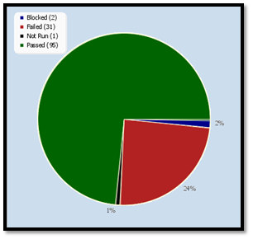
Test Reports
Figure1: Pie Chart for Iteration1 & Iteration2 consisting of 129 Test Cases

Slide 14
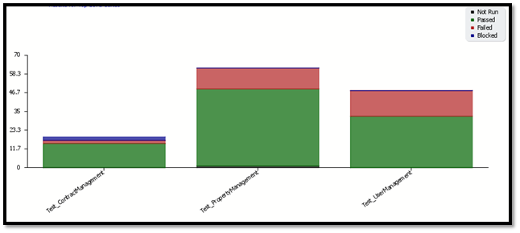
Figure2: Test Result per Use Cases

Slide 15

Figure3: Overall Build Status per Iteration
Figure4: Test Result by top level Test Suites

Slide 16
Summary Test Result:
Passed Result – 92/129 Test Cases
Failed Result – 34/129 Test Cases
Blocked Result – 2/129 Test Cases
Not Run Result – 1/129 Test Cases

Slide 17
Environmental Needs
Hardware & Software
Resource | Configuration | Installed OS, Software
Test Server |  | Windows 10 – Operating System (64 bit)
 |  | Laravel Framework
 | Apache Web Server, MySQL Database | XAMPP
Client Server | (Standard) +RAM: 2GB | Windows7 (64 bit) Chrome and Mozilla Firefox

Slide 18
Productivity and Support Tools
Tool’s Purpose | Tool Name | Vendor or in-house | Version
Bug Tracking Management | TestLink | Open Source | 1.9.2
Test Management | TestLink | Open Source | 1.9.2
Documentation | MS Word, MS excel | Microsoft Office | 2016
Revision Control System | Planner (Office 365), GitHub | Microsoft Tom-Preston Werner | GitHub Enterprise2.9

Slide 19
Test Environment Configuration
Configuration Name | Description | Implemented in Physical Configuration
Test Server | Install test server at system admin test server | Open any device where Application are installed
Testlink | Open Source Software Application | Log-in
GitHub | Open Source Software Application | Log-in

Slide 20
Planning risks and contingencies
Risks | Mitigation | Contingency (risks is realized) | Probability | Impact
SCHEDULE Testing schedule is tight. If the start of the testing is delayed due to design tasks, the test cannot be extended beyond the UAT schedule start date. | Testing team should control the preparation tasks (in advance) Make an early communication to the people involved in testing. | Optimize the test schedule and define overtime strategy at the beginning | High | High
DEFECTS Defects are found at a late stage of the cycle, those are changes that discovered late due to unclear specifications. | Management plan is in place to ensure prompt communication and fixing of issues. | Document defects found Report found defects to the programmer Apply all changes made by the programmer Document possible result | Medium | High

Slide 21
SCOPE Scope are not completely defined | Scope in their paper is well defined but the changes in the functionality are not yet done so might there will be added or deleted process. | Revised document after correction has been made Execute TC after correcting and defining the document | Medium | Medium
Lack of resources for testing Non-availability of Independent Test environment and accessibility | Prepare other computer for testing environment Send application Codes into GitHub for testing Install software into tester computer/laptop for testing | Testing time is based on the availability of the computer/Laptop Implementing Static Testing/Verbal Testing | Medium | High

