Slide 1
A SELF LEARNING BOT
PIP2001 Capstone Project
Final Review (viva-voce)
Batch Number: 19
Roll Number | Student Name
20211CST0015 | T MOUNIKA
20211CST0022 | K YUVA SAHITHYA PREETHI
20211CST0090 | NISBA KOUSAR
20211CST0078 | V R SHUSHMA REDDY
Under the Supervision of,
Dr. Saira Banu Atham
School of Computer Science and Engineering
Presidency University
Name of the Program: COMPUTER SCIENCE AND TECHNOLOGY (AI-ML)
Name of the HoD: DR. SAIRA BHANU ATHAM
Name of the Program Project Coordinator: DR . MANJULA H M
Name of the School Project Coordinators: Dr. Sampath A K / Dr. Abdul Khadar A / Mr. Md Ziaur Rahman

Slide 2
Introduction
Chatbots are conversational tools that perform routine tasks efficiently. People like them because they help them get through those tasks quickly so they can focus their attention on high-level, strategic, and engaging activities that require human capabilities that cannot be replicated by machines.
A self-learning chatbot, also known as an AI or intelligent chatbot, is a type that uses machine learning algorithms to enhance its performance over time continuously.
This indicates that the chatbot can acquire knowledge from user interactions and modify its responses accordingly.
In contrast to conventional chatbots designed to reply to particular keywords or phrases, self-learning chatbots benefit from natural language processing (NLP) and machine learning to understand the intent behind a user’s message. As a result, they can deliver individualized and context-appropriate replies.

Slide 3
Literature Review
The first time a Bot was created was in , 1966 by an MIT professor names JOSEPH WEIZENBAUM and named it as ELIZA. It was casted in the role of psychotherapist.
After Eliza , PARRY was one of the 1st chatbot to gain significant popularity. Which was developed by KENNETH COLBY in the early 1970s.
ALICE(Artificial Linguistic Internet Computer Entity) was the next chatbot in the early 2000s , developed by Richard Wallace. It was used to engage in human like conversations on a wide range of topics.
SmarterChild is another type of chatbot that gained its popularity around the same time , it was developed by Verbot it had the capability to complete tasks such as searching web etc.

Slide 4
Research Gaps Identified
1. Lack of advanced natural language understanding and contextual reasoning in early bots.
2. Limited scalability and adaptability to diverse user needs and queries.
3. Absence of emotional intelligence and ability to handle nuanced human emotions.
4. Dependence on predefined scripts and rules, restricting flexibility and learning.
5. Minimal focus on ethical considerations and data privacy during interactions.

Slide 5
Proposed Methodology
The methodology will be used for developing such a self-learning bot that improves the interaction of its users and efficiently categorizes questions. The bot will incorporate AI techniques to handle challenges such as the classification of questions in real time, user feedback, adapting to user needs, among others.
Understanding the User Needs
Data Collection and Preparation
Model Development
User-Friendly Interface Design
Feedback Mechanism
Scalability and Future Enhancements
Privacy and Security

Slide 6
Objectives
Categorize Feedback
Classify Feedback in Real Time
Permit Continuous Learning and Improvement
Retrain Model with New Feedback and Corrective Inputs
Persistent Model and Dataset
Classification of Feedback for Different Use Cases
Model on Testing Before Interacting with Users
Support Easy Integration into Real-Time Applications

Slide 7
System Design & Implementation
The system design and implementation of SELF LEARNING BOT elaborates on the architectural framework, core components, development methodology, and implementation strategies.
Overview of the System - The Self-Learning Bot is designed to interact with users in a natural, conversational manner and continuously improve its performance through learning from user interactions
User Interface (UI): The interface through which users interact with the bot. This can be a chatbot interface on a website, mobile app, or even a voice assistant interface (e.g., integration with Alexa or Google Assistant). It handles user input and displays the bot’s output.
Core Logic : The central processing unit of the bot, responsible for understanding user inputs, generating responses, and applying the learning algorithms.

Slide 8
Data Layer : The backend storage for holding user data, interaction logs, and knowledge base.
External Services/Integrations: If the bot integrates with external APIs (e.g., for retrieving weather information, accessing a recommendation engine, etc.), these external services interact with the bot’s core logic.
3. Functional Components
Data Collection: The bot needs data to learn from
Data Preprocessing : Before feeding data into the system, preprocessing is crucial for ensuring high-quality input:

Slide 9
Learning Mechanism : The bot uses decision trees, neural networks, or other models to choose the best response. This could involve multi-step reasoning, taking into account user history, preferences, and context.
Natural Language Processing (NLP): If the bot is conversational, it explain the processes human language.
Feedback Mechanism: The system should collect user feedback on the bot. The bot can use this feedback to improve its responses, update its knowledge base, or refine its models.
Response Generation:This component decides how the bot will respond.
Decision-Making Mechanism: The bot uses decision trees, neural networks, or other models to choose the best response.

Slide 10
4. Implementation Details
Programming Languages & Frameworks: Python, TensorFlow , PyTorch, NLTK, spaCy
API Integrations: The bot integrates with APIs for weather data, news feeds, and other external services.
Database : A relational database (e.g.Postgre SQL) is used to store user data, model parameters, and system logs.
5. System Workflow
User Input
Input Processing

Slide 11
Decision-making
Response Generation
Response Delivery
6. Challenges & Solutions
Technical Challenges
Solutions
7. Testing and Evaluation
Testing Methodology
Evaluation Metrics
Performance

Slide 12
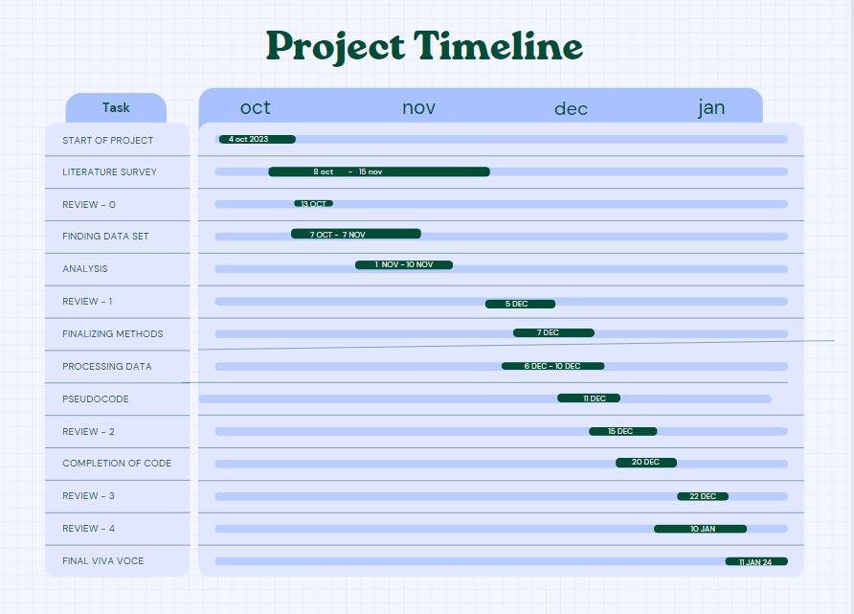
Timeline of Project

Slide 13
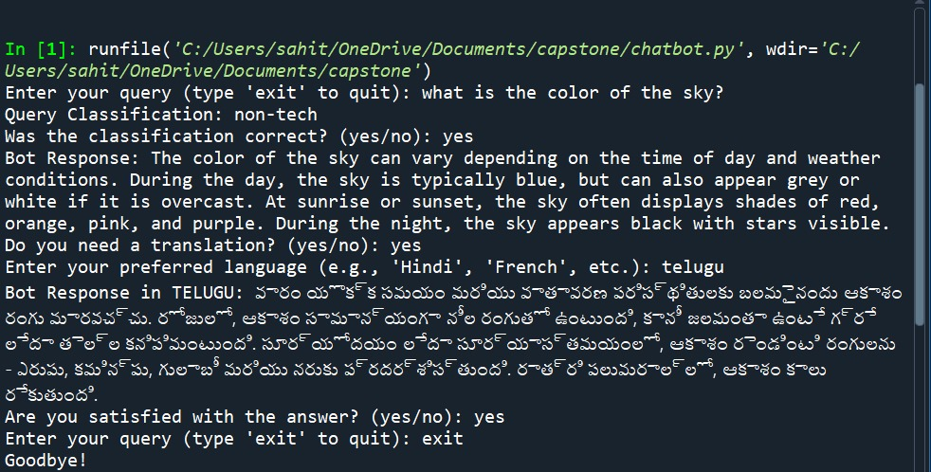
Expected Outcomes

Slide 14
Conclusion
Self-learning chatbots represent a major breakthrough in technology, enabling more natural and engaging conversations with users. Their ability to understand and respond to human language significantly enhances the overall user experience.
By leveraging Natural Language Processing (NLP) and advanced algorithms, these chatbots can continuously learn from interactions and adapt to changing user needs. This adaptability makes them powerful tools for businesses looking to improve customer service and support.
As technology continues to evolve, self-learning chatbots will play an increasingly important role in various industries. Their capacity to provide personalized assistance and efficient solutions will transform how organizations connect with their customers.

Slide 15
Reference
[1] Thosani, Parth, Manas Sinkar, Jaydeep Vaghasiya, and Radha Shankarmani. "A self
learning chat-bot from user interactions and preference” IEEE, 2020.
[2] G. Chandrasekar, S. A. Lenin, S. Rahul, C. Sanjay and R. Reshma, "Self Balancing
Robot 1, December 2021.
[3] Joshi, Aravind J. “Natural Language Processing.” Science 253, 1991
[4] Yildiz, Sibel. "Artificial intelligence based e-commerce types and consumer
behaviours." Master's thesis, Sosyal Bilimler Enstitüsü, 2017.
[5] Lokman, Abbas Saliimi, and Mohamed Ariff Ameedeen. "Modern chatbot systems: A
technical review” 2019.

Slide 16
Publication Details
Title: A Self-Learning Bot Authors: V R Shushma Reddy, T Mounika, K Yuva Sahithya Preethi, Nisba Kousar. Journal International Journal of Research Publication and Reviews (IJRPR 2025) Volume/Issue: Volume 6 Issue 1 ISSN 2582-7421 Date of Publication: January 2025 Pages: 5

Slide 17
Thank You

