Slide 1
Free Assembly Languages for developing real-time operating system for embedded devices
Veselin Stanchev
Technical University of Sofia – Plovdiv Branch

Slide 2
Introduction
Usage of assembly languages is most natural way to program embedded devices. There are several types of instruction-set architectures. x86, RISC, CISC and RISC-V instruction-set architectures are the most known. There are different free assembly languages for different devices. For x86 based devices Netwide assembler or Yarn assembler can be used. For devices based on RISC based devices there are GNU assembler, AVR assembler. For RISC-V based devices can be used RISC-V assembler. This paper describes process of finding best assembler to design real-time operating system.

Slide 3
Materials and Methods
AVR assembler is used for range of AVR RISC devices. Binutils package contains linker ld and GNU assembler. GNU assembler can be used for RISC-based single board computers, such as Raspberry Pi 3, 4 or for latest Raspberry Pi 5. Attiny85 microcontroller and PIC10F320 will be compared. Assembler languages will be analyzed.

Slide 4
Target microcontroller modules
Attiny 85 is 8-bit RISC based microcontroller. AVR assembly language can be used for it. PIC10F320 is 8-bit PIC based microcontroller. PIC assembly language can be used for it. Attiny 85 has more instructions available than PIC10F320
Attiny85 PIC10F320 Datasheet, (2023).

Slide 5
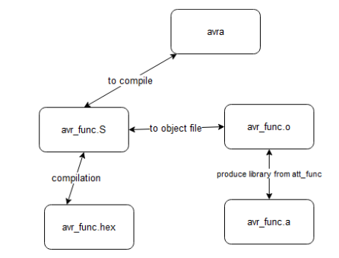
AVR Assembler compilation
Stanchev, Msc Thesis (2023).

Slide 6
Results
→ Free assembly languages for different instruction sets are compared.
→ AVR assembly compilation is shown.
→ Microcontrollers for AVR / PIC assemblers are analysed.

Slide 7
Conclusions and future work
According to Free assembly languages overview that can be used and AVR PIC instruction analys the conclusion of the paper:
AVR assembly language and RISC-V assembly languages will be best choice to design real-time operating system
Contact me on:
GitHub: vrstanchev
Twitter:vrstanchev
Mail: vrstanchev@gmail.com
PhD thesis theme -> Methods and Tools to develop a assembly-based operating system for embedded devices

Slide 8
References
1. GNU Binutils Reference Manual, 2023
2. Atmel,ATTiny85 Datasheet,2018
3. Microchip, PIC10F320 Datasheet,2023
4. Linux Manual Pages
5. Design microcontroller module to use AVR/PIC assembler (Master Degree Thesis), 2023

