Slide 1
Overview of Real-time Operating Systems for embedded devices
Veselin Stanchev
Technical University of Sofia – Plovdiv Branch

Slide 2
Introduction
Real-time operating systems can be used for embedded devices management,smart home automation, for civil or military aviation – for optical devices and weapon controls management. Real-time operating system manages devices with that has:
→ limited resources
→ limited time to complete task
→ sensors for communication
Target of the paper is to explore and describe features of well-known RTOS such as: FreeRTOS, Zephyr and Armbian GNU/Linux. Paper performs the Overview task of PhD thesis.

Slide 3
Materials and Methods
Programming languages for real-time os development are C or Assembly language. Usage of assembly language gives more control of current task execution. For every RTOS will be analyzed:
→ Short description
→ Supported virtualizators
→ Supported Instruction set architectures
→ Embedded device whitch is supported by the os

Slide 4
FreeRTOS
Short Description | Supported Virtualizators | Supported ISA | Supported microcontroller modules
Written in C,modular libraries, supports AWS | QEMU,Virtualbox | X86,ARM-RISC,PIC | PIC24-RISC based, SIFive board-RISCV based
FreeRTOS Docs (2023).

Slide 5
Zephyr OS
Short Description | Supported Virtualizators | Supported ISA | Supported microcontroller modules
Written in C,multi-thread OS | QEMU | ARM64,x86 | NEORV32-RISCV based Adafruit KB2040- RISC based
Zephyr Docs (2023).

Slide 6
Armbian
Short Description | Supported Virtualizators | Supported ISA | Supported microcontroller modules
Debian – ported OS for microcontroller modules; SD card can be used for storage | QEMU | X86_64, RISC | OrangePi,BananaPi
Armbian Docs (2023).

Slide 7
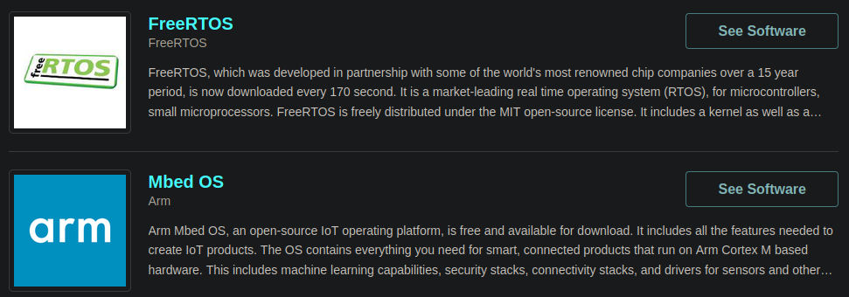
Best RTOS 2023

Slide 8
Results
→ FreeRTOS, Zephyr and Armbian OS are analyzed and compared.
→ Virtualizators for x86 simulation are shown.
→ For every OS is shown supported device

Slide 9
Conclusions and future work
Analyzed operating systems are written in C and they support RISC-V architecture because of C. But when requirements for the RTOS are OS to be much faster and more useful for RISC-V projects then exists need to develop truly RISC-V assembly-based OS. That is main target of my PhD thesis.
Contact me on:
GitHub: vrstanchev
Twitter:vrstanchev
Mail: vrstanchev@gmail.com
PhD thesis theme -> Methods and Tools to develop a assembly-based operating system for embedded devices

Slide 10
References
1. A practical introduction to real-time systems for undergraduate engineering
2. FreeRTOS Documentation, 2023
3. Zephyr Documentation,2023
4. Armbian Documentation,2023

