Slide 1
Data & Web Science
MANAGING AND MINING COMPLEX NETWORKS
Exact and Approximate triangle counting Αlgorithms
158 - Χρήστος Κούρος
166 - Στυλιανός Βέρρος

Slide 2
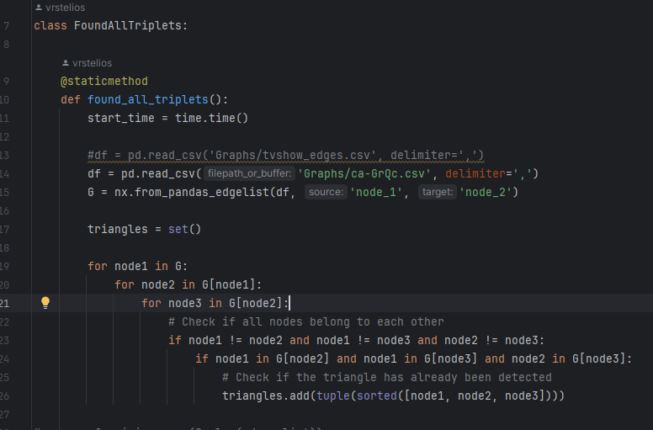

The algorithm “all triplets” is brute force.
The program will check if all nodes belong to each other and form a triangle.
It will also check if the triangle has already been detected.
Algorithm All Triplets

Slide 3
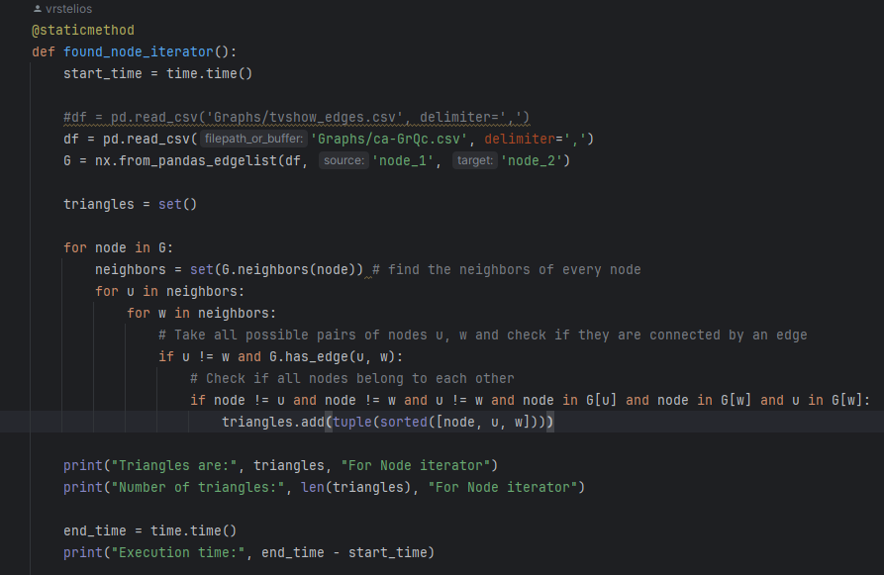

Another approach is to check for each node in G whether it forms any triangles with its neighbors. This algorithm iterates over all nodes in the graph.
For each neighbor, it considers all possible pairs of nodes (u, w) and checks if they are connected by an edge.
It also verifies if the triangle has already been detected.
Algorithm Node Iterator

Slide 4
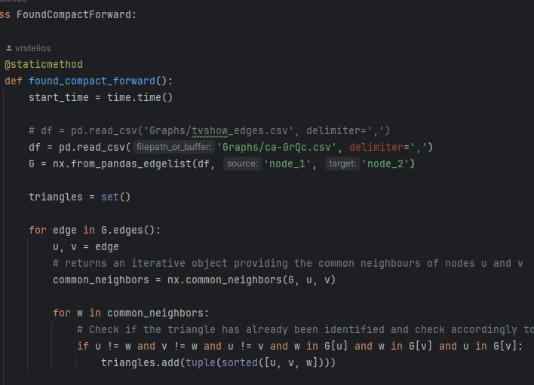

For each edge in the graph, it checks the common neighbors of the two nodes of the edge.
For each common neighbor, it checks if there is a triangle formed by the three nodes (u, v, w). It verifies that the nodes are distinct from each other and that there are edges connecting the nodes to each other
Compact Forward Algorithm

Slide 5
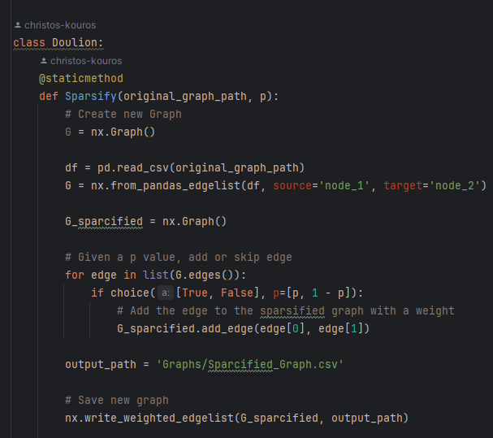
The Doulion Algorithm is used to sparsify a graph
It iterates through each edge of the original graph and based on a specified probability ‘p’ we decide if we want to keep an edge
The resulting sparsified graph which now contains a subset of the original edges is now saved in a new CSV file
Complexity: O(E)
Doulion Algorithm

Slide 6
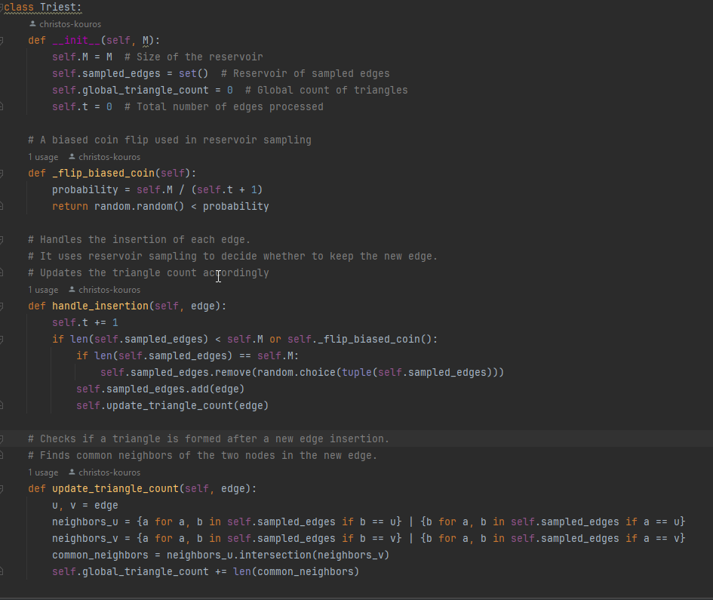
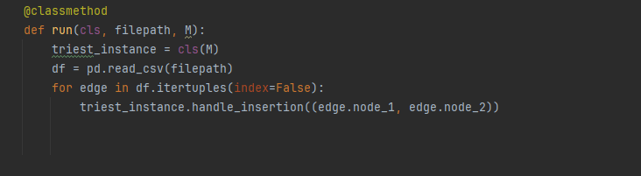
Triest is a streaming algorithm
Iterates the graph and based on a coin flip, It decides whether a new edge should be included in the reservoir.
Handles insertions of each new edges
Updates the count of triangles after inserting a new edge
Complexity: O(M)
This parameter controls the trade-off between accuracy and memory usage. A larger M allows for greater accuracy but requires more memory.
Triest Algorithm

Slide 7
Graphs from Snap & NetworkX Graphs
Name | Type | Nodes | Edges | Description
GR-QC | Undirected | 5242 | 14.496 | Collaboration network of Arxiv General Relativity category
New Sites | Undirected | 27,917 | 206.259 | Facebook data from February 13 2018
Artist | Undirected | 50,515 | 819.306 | Facebook data from February 13 2018

Slide 8
Graphs from Snap & NetworkX Graphs
Αλγόριθμος | GR-QC |  |  | New Sites |  | Artist
 | Run time |  | N-triangles | Run time | N-triangles | Run time | N-triangles
All Triplets | 2.059 | 48.260 |  | 68.656 | 387.444 | 846.823 | 2.273.700
Node Iterator | 1.609 | 48.260 |  | 18.451 | 387.444 | 151.738 | 2.273.700
Compact Forward | 1.288 | 48.260 |  | 29.882 | 387.444 | 328.705 | 2.273.700
Doulion | 0.760 | 24.523 |  | 6.565 | 197.650 | 36.157 | 1.165.588
Triest | 4.480 | 8.451 |  | 15.807 | 139.157 | 29.325 | 630.000

Slide 9
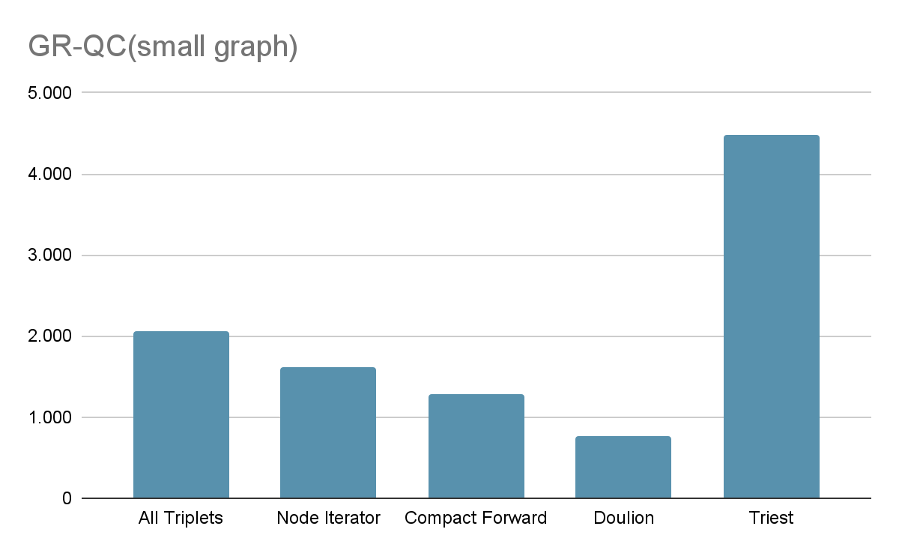
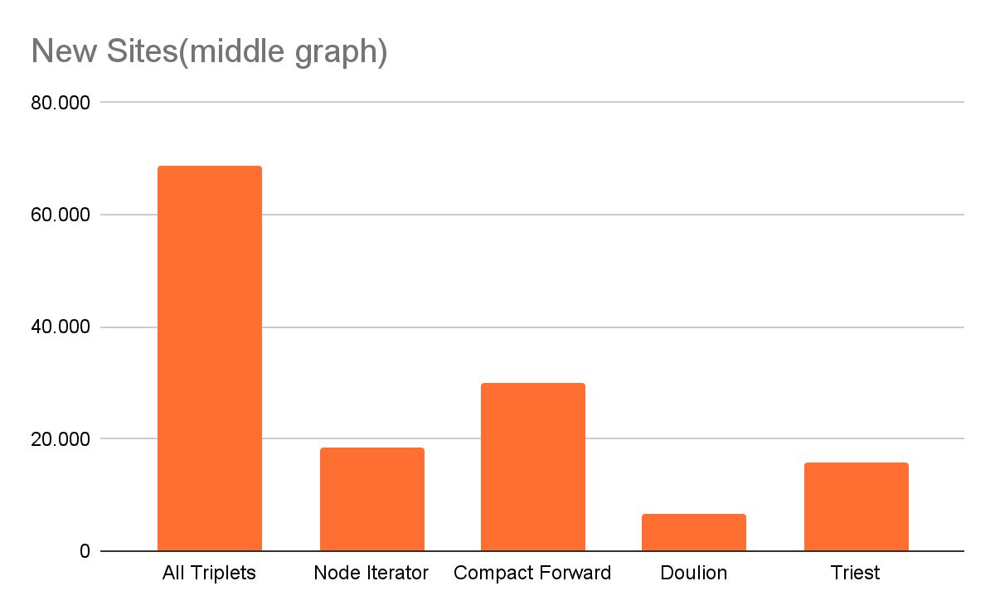
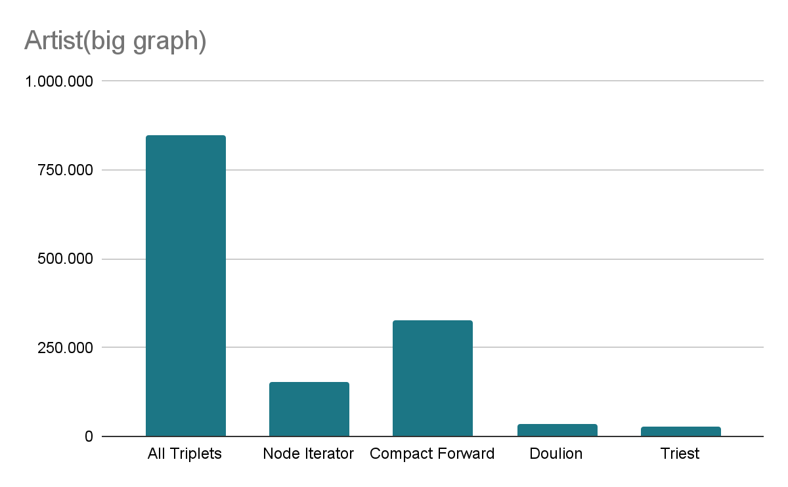
Results & Comments

Slide 10
Thanks you!!
Any Question ?
sverr@csd.auth.gr
ckouros@csd.auth.gr

