Slide 1
Supervised ML Approach

Slide 2
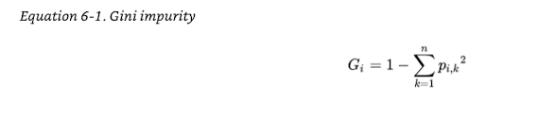
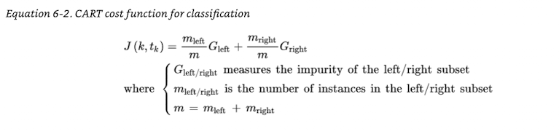
Constructing a Decision Tree
Perform EDA
Determine splits
Misclassification loss
Entropy loss
Gini Impurity
Courtesy: Géron, Aurélien. Hands-On Machine Learning with Scikit-Learn, Keras, and TensorFlow (p. 333). (Function). Kindle Edition.

Slide 3
Find the min CART function
Train the model using Decision Tree classifier
Measure performance using cross validation score
Train the model using Dummy classifier
Is the accuracy of Decision Tree classifier better than Dummy classifier
Use Cross validation Predictor to predict against training data
Use Decision Tree model to predict against test data
Calculate Precision, Accuracy, Recall scores
Plot the ROC curve
Use Grid Search to find best params and best estimators

Slide 4
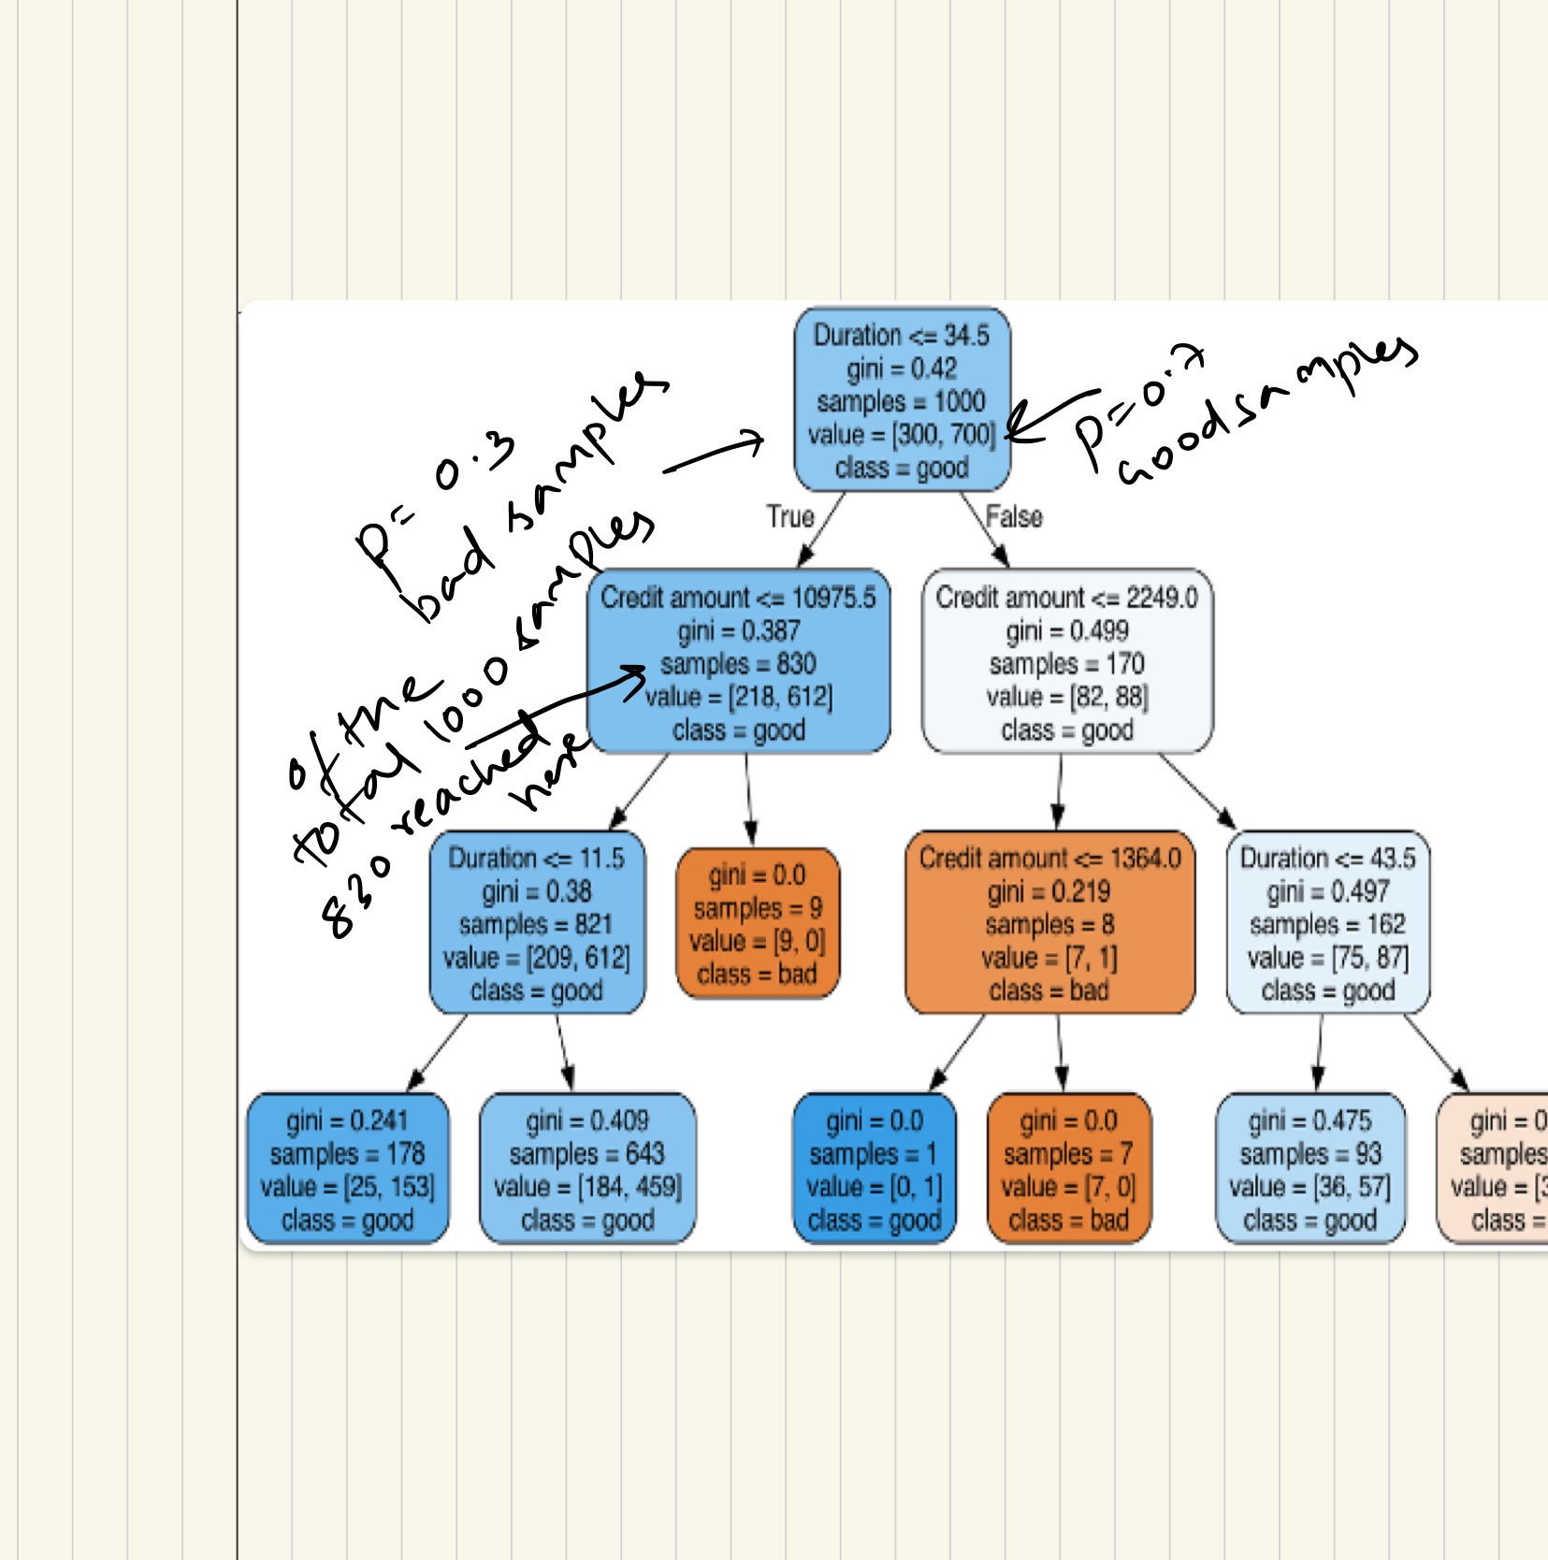
Decision Tree Model

Slide 5
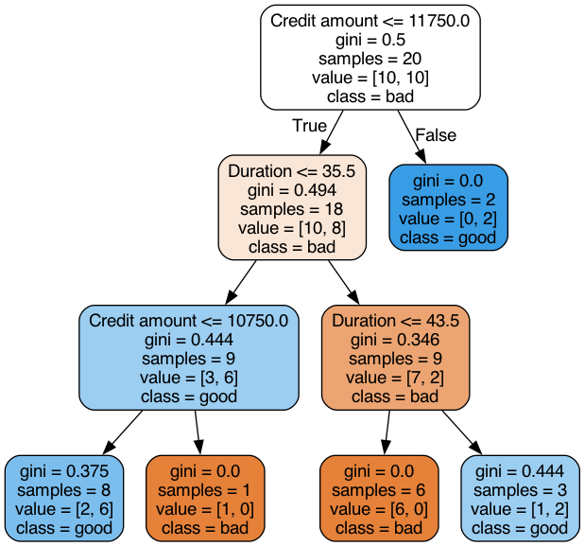
Decision Tree Model Modified

Slide 6
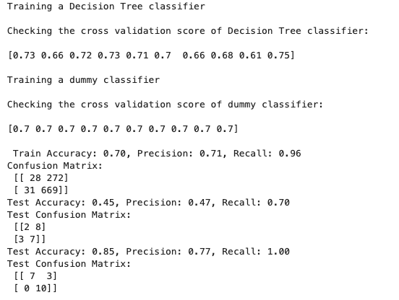
Performance measures

Slide 7
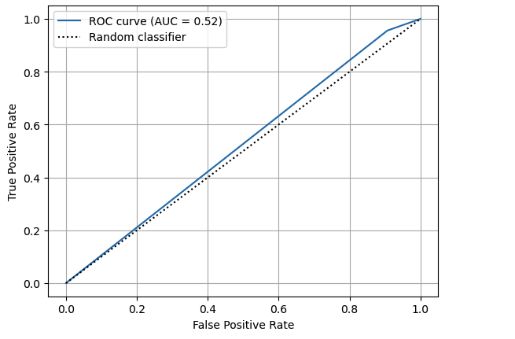
ROC Curve of training model

Slide 8
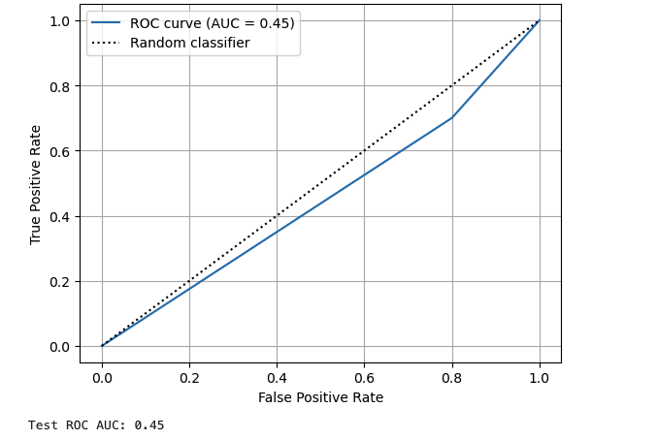
ROC Curve of test model

Slide 9
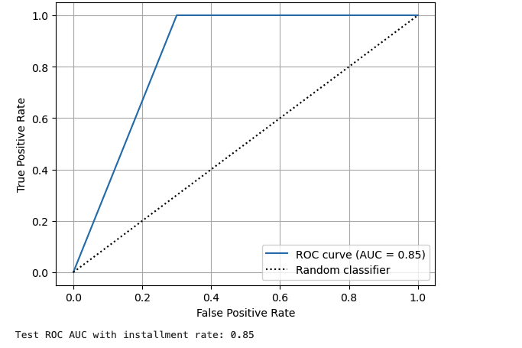
ROC Curve of Modified test model

Slide 10
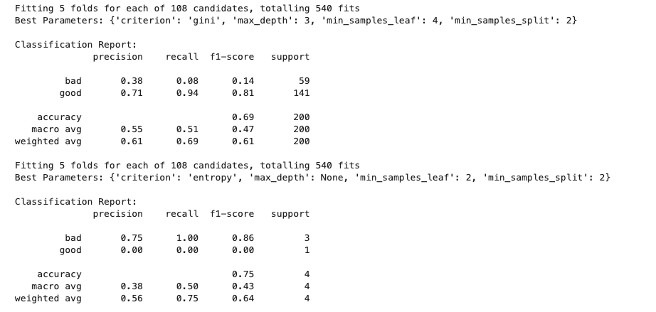
Grid Search for best params

Slide 11
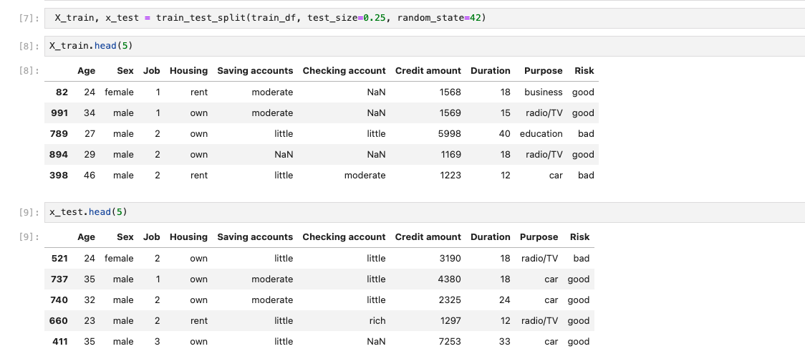
Train and Test split

Slide 12
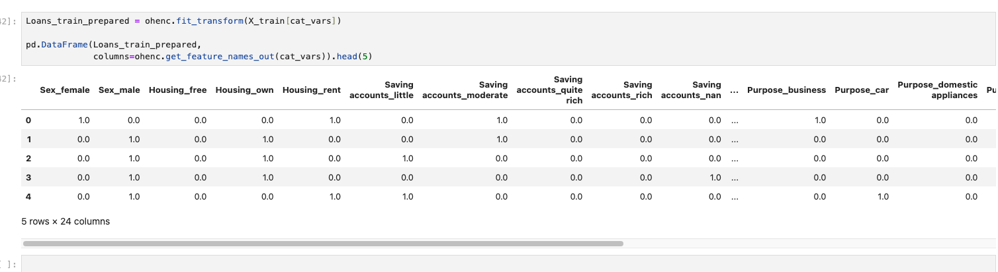
One Hot Encoding
One hot encoding binarizes the categorical classes
House Free | 1 | 0 | 0
House Rent | 0 | 1 | 0
House Own | 0 | 0 | 1

