Slide 1
Artificial Intelligence Approach in Retail Market Analysis & Growth
CECS 551: Advanced Artificial Intelligence
Group 03:
Mudra Chaudhary
Anthony Martinez
Santosh Vanteddu
Jeremy Keener
Vruddhi Mehta
Misha Chodavadiya
Supervisor(s):
Professor Mahshid Fardadi
Dr. Allen Bolourich

Slide 2
Report outline
Introduction: International Retail Business
Understanding dataset(s), data cleaning/preprocessing
Phase(s) of work
Investigation and Recommendations
Conclusion

Slide 3
Problem Statement
Background:
Historical sales and inventory data of an international retail business for over 30 stores is given along with economic, weather and promotional sales data in order to build descriptive models along with predictive ML model/s.
Goal:
Improve sales and run a more robust inventory chain in the face of changing economic and environmental challenges using Artificial Intelligence.

Slide 4
Proposed Workflow
Phase 1: Data Visualization, Feature Engineering/Selection & Sales Analysis
Phase 2: Machine Learning Model(s)
Phase 3: Model Deployment

Slide 5
Phase 1: Data Visualization
Analyze Dataset 01 & 02
Addressing the feedback

Slide 6
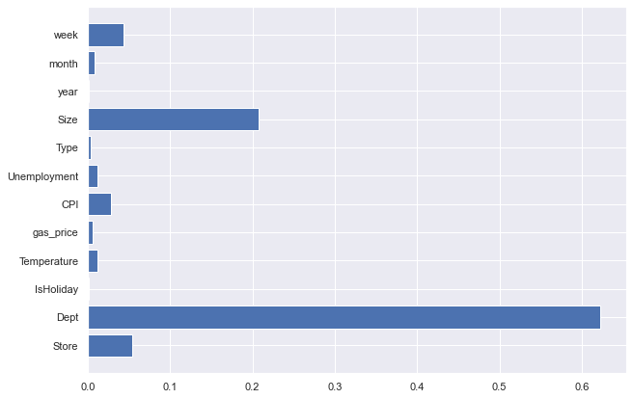
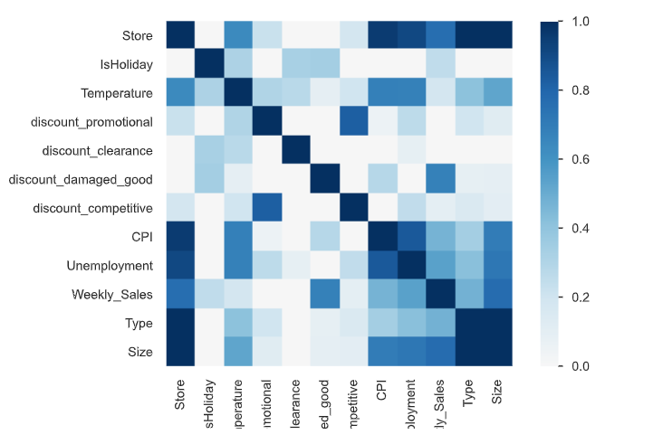
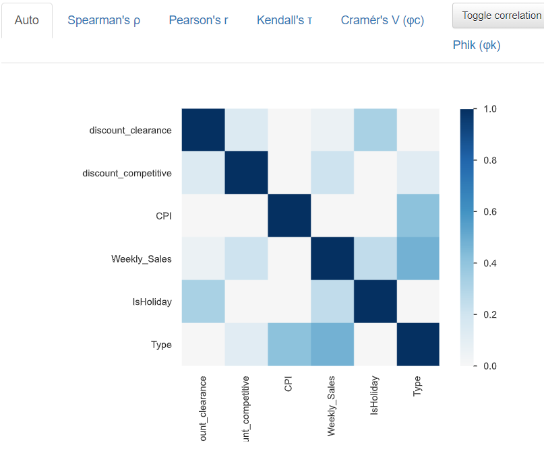
Dataset 01 - Data Visualization: Identifying key variables, Feature Selection
Shap plot
Correlation matrix
Correlation matrix
After dropping features

Slide 7
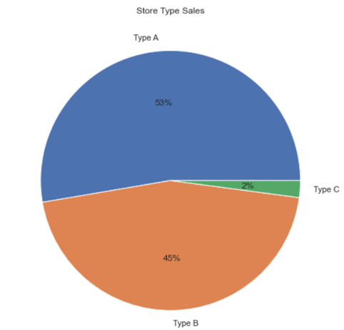
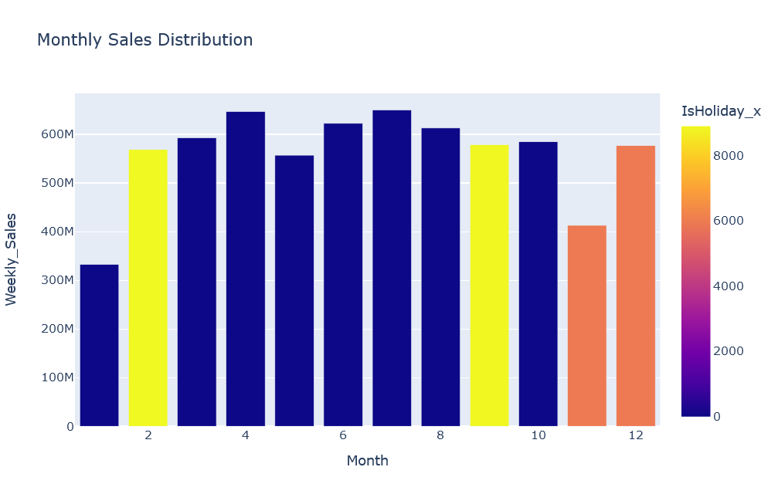
Dataset 01 - Data Visualization: Store sales
The Sales are maximum in the month of April, July, September , October which are not Holiday Months.
Division highlight that store A and B represent 98% of the dataset

Slide 8
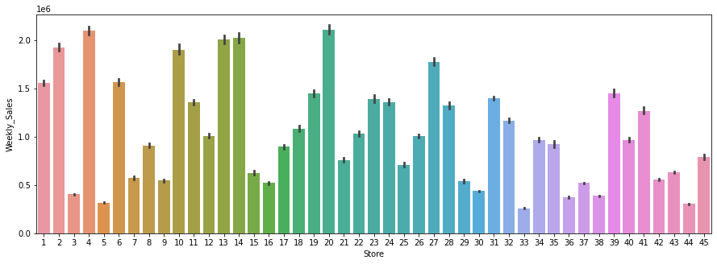
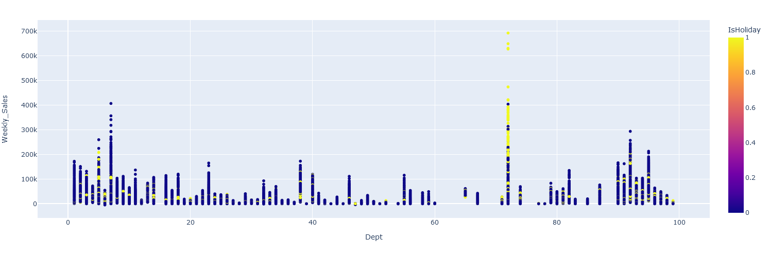
Dataset 01 - Data Visualization: Store Sales
Store 20 and 4 are the biggest stores in Weekly_sales
Dept with the highest sales for one week is the Dept 72. It has the highest sales and it is mainly during holidays.
Weekly_sales for each store
Weekly_sales for each dept with holiday parameter

Slide 9
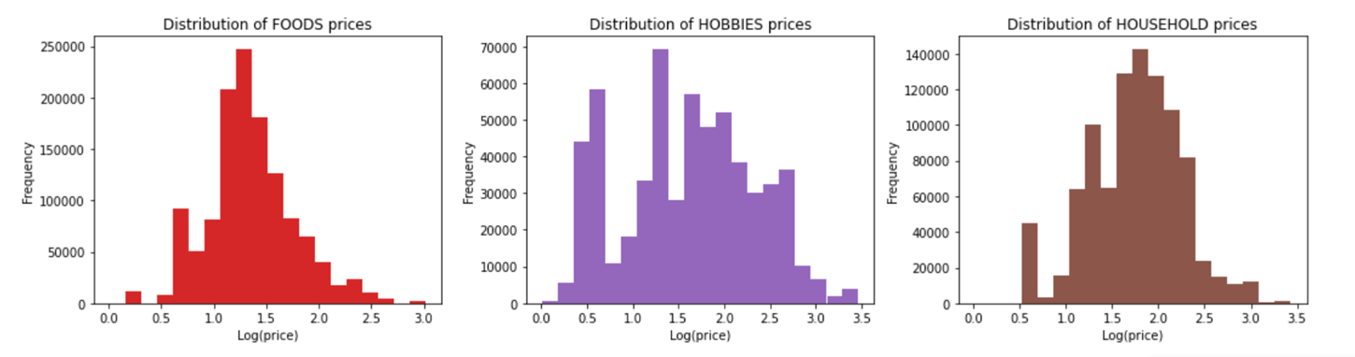
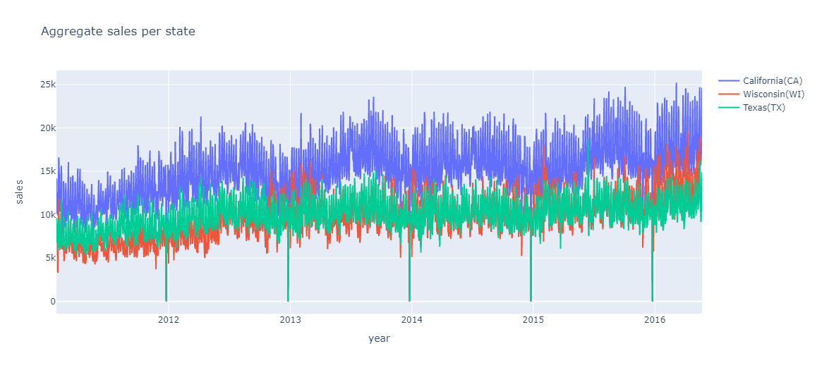
Dataset 02 - Data Visualization/Distribution

Slide 10
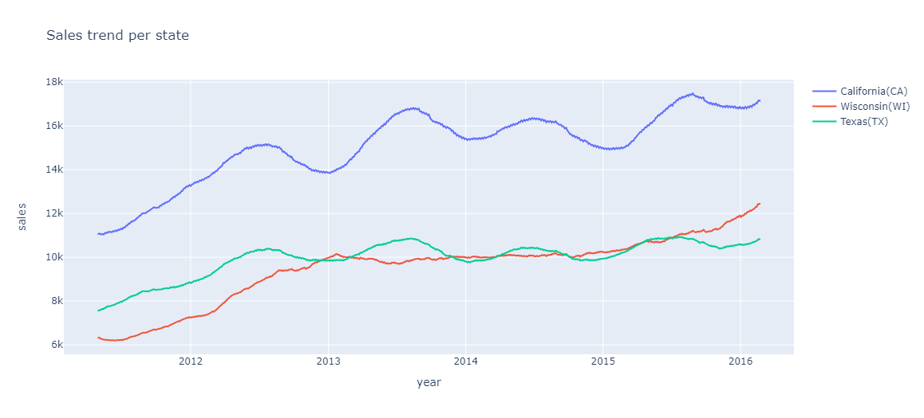
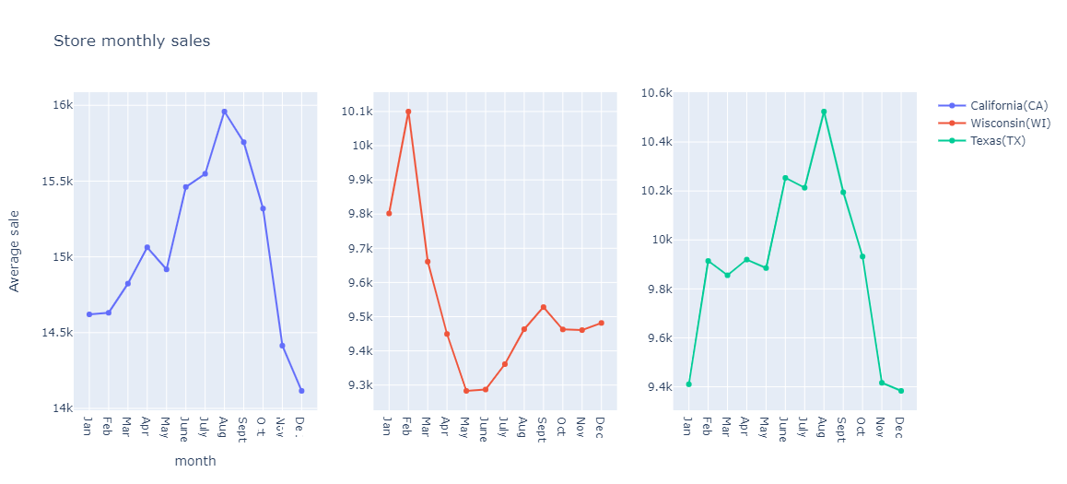
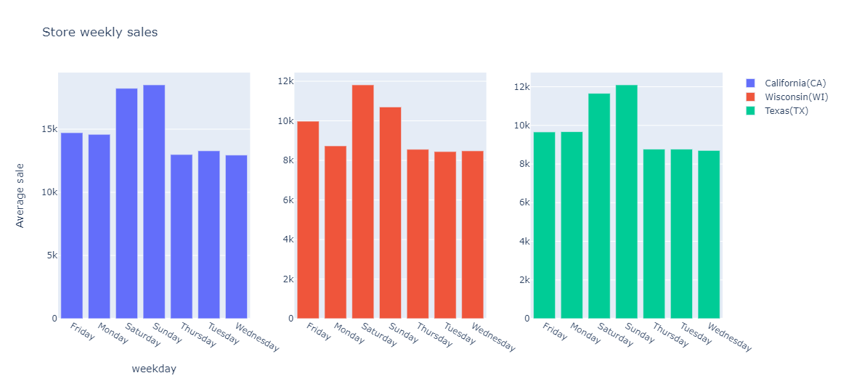
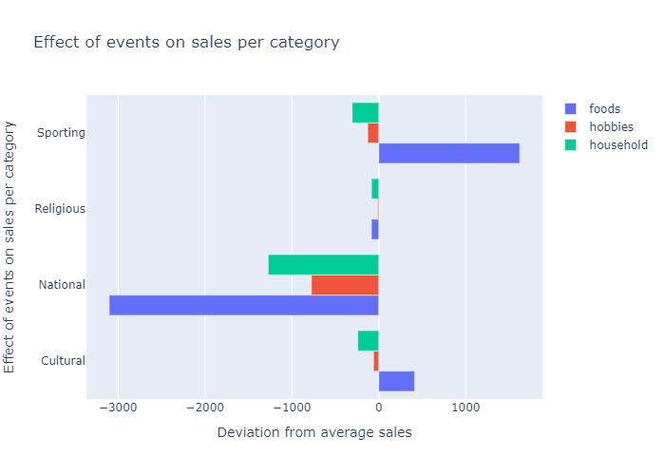
Dataset 02 - Store Sales & Trend per State

Slide 11
Phase 2: Machine Learning Model(s)

Slide 12
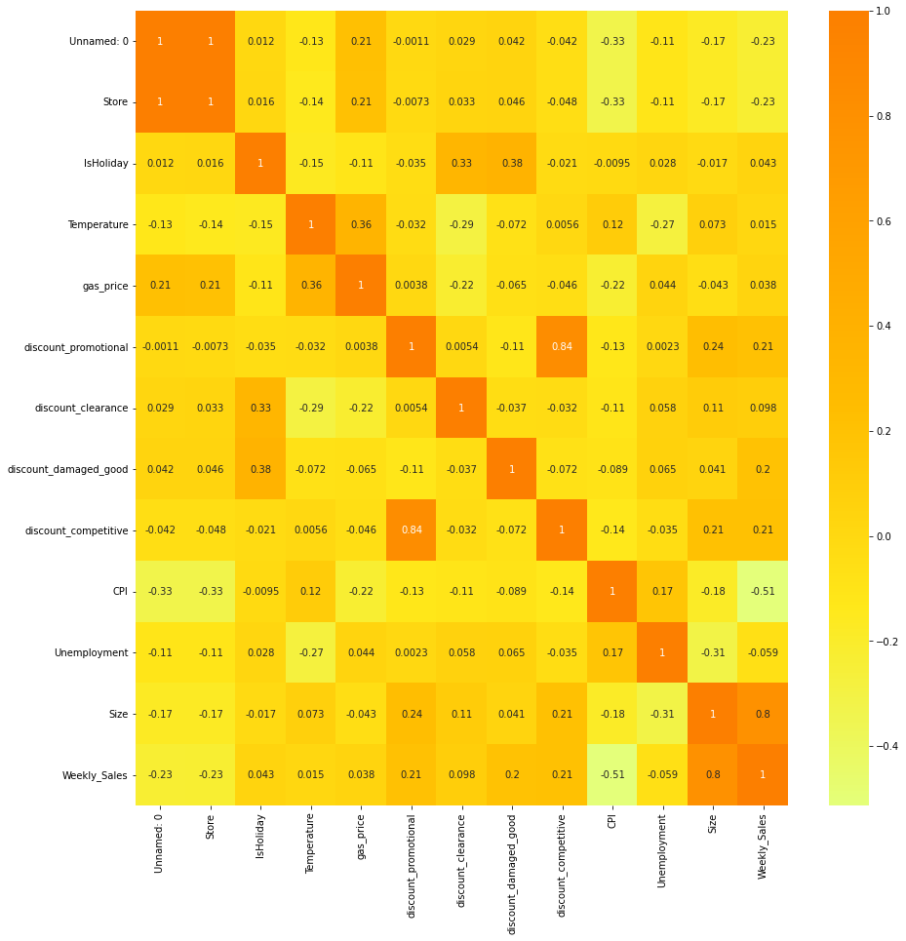
Dataset 01 - Algorithms
Linear Regression
Ridge Regression
Decision Tree
XGBoost
Ridge Regression & XGBoost reported the best accuracies among all the models performed
Regression Tech. | First 10 stores (Combined data) | store_11_35
Decision Tree | R2 score : 0.355 MSE score : 422976542.97 RMSE: 20566.39 | R2 score : 0.378 MSE score : 311824352.21 RMSE: 17658.54
XGBoost | R2 score : 0.969 MSE score : 20270114.90 RMSE: 4502.23 | R2 score : 0.955 MSE score : 22513453.94 RMSE: 4744.83
Ridge | R2 score : 0.951 MSE score : 20410114.90 RMSE: 4279.75 | R2 score : 0.962 MSE score : 21124520.92 RMSE: 4429.16

Slide 13
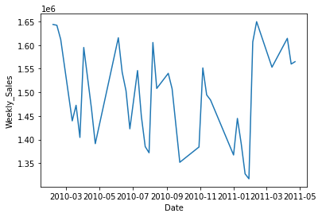
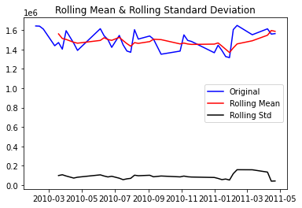
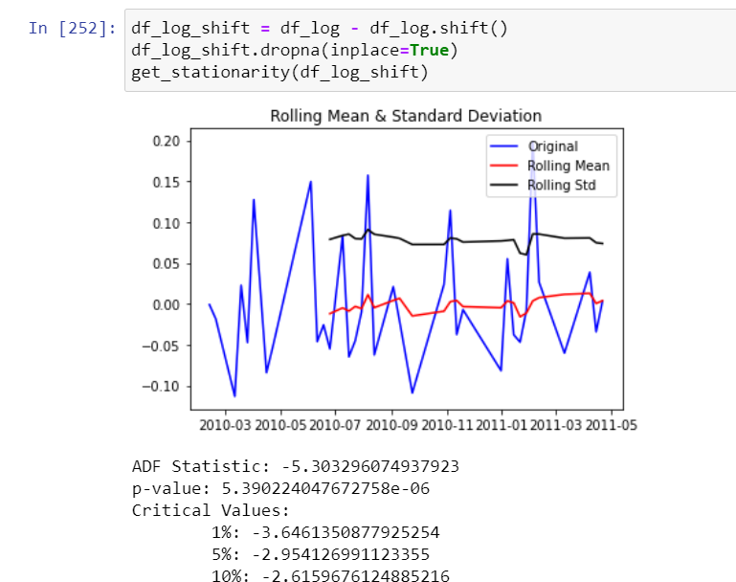
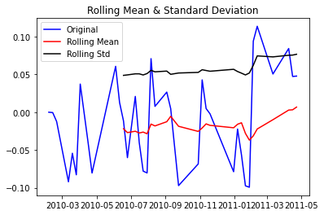
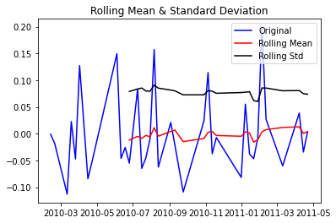
Dataset 01 - Algorithms (Cont’d) - ARIMA

Slide 14
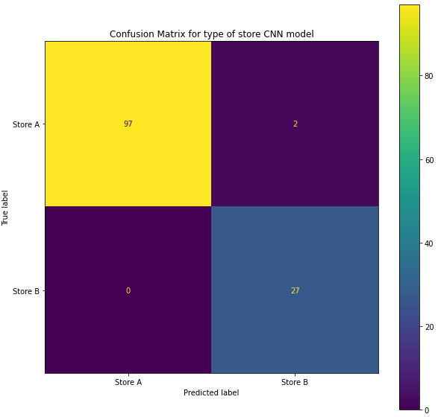
Dataset 01 - Multilabel Classification - Ensemble, RNN, CNN
Ensemble model performed well with a 99% chance to classify/predict the type of a store.
100% to predict store A
99% to predict store B
For the Recurrent Neural Network (RNN) model, used the features that are really correlated with the Type of store to classify using the optimizer Adam and attained an accuracy of 96%
Convolutional Neural Network (CNN), known for having a better score, with the same parameters and the Adam model, achieved an accuracy of 98%.

Slide 15
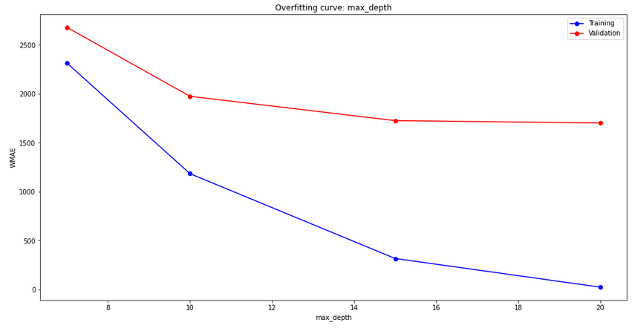
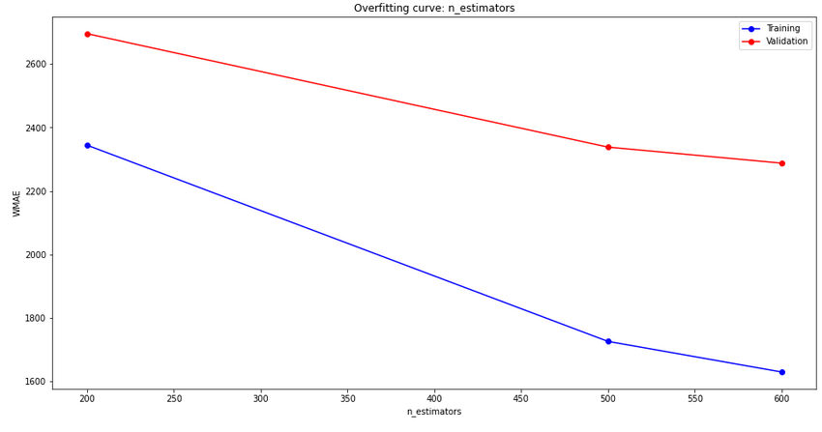
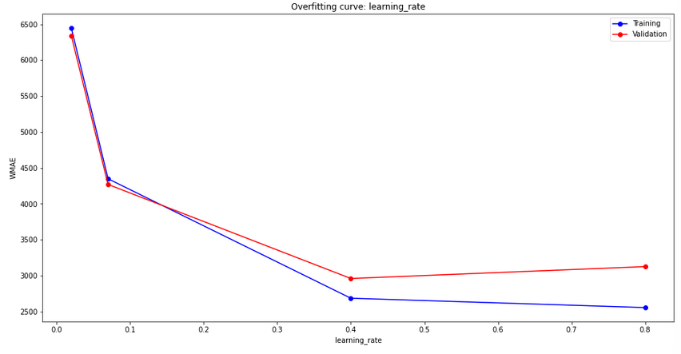
HyperParameter tuning
With XGBoostRegressor (random forest is taking too long)
Results :
Estimator:500
Max_depth:15
Learning_rate:0.4 (above 0.4 there is overfitting)

Slide 16
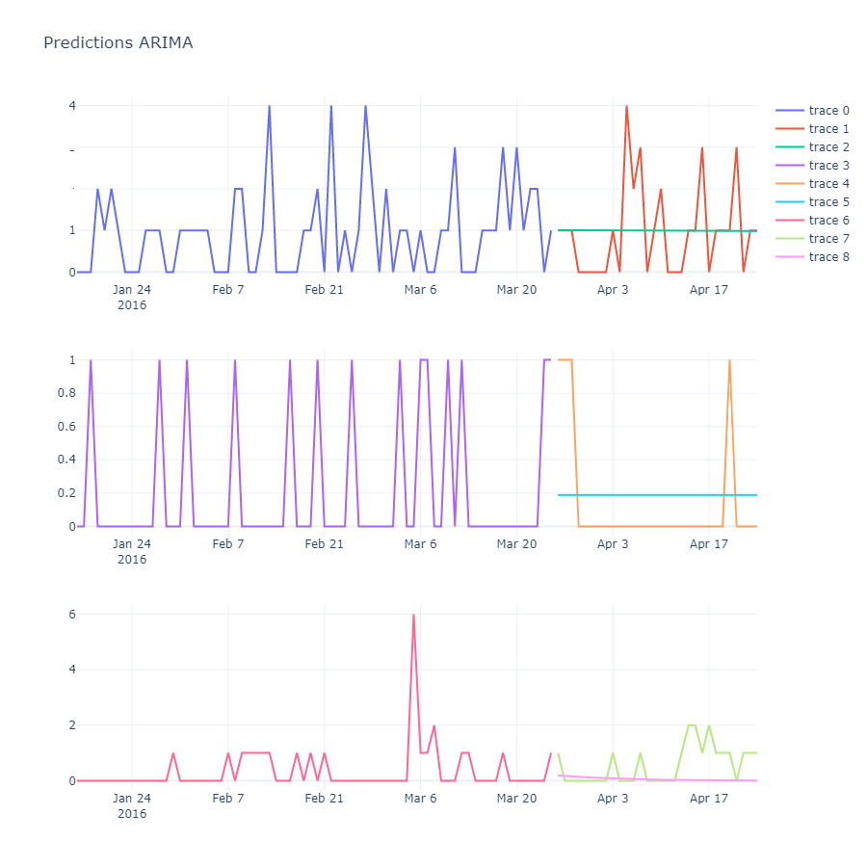
Dataset 02 - ARIMA

Slide 17
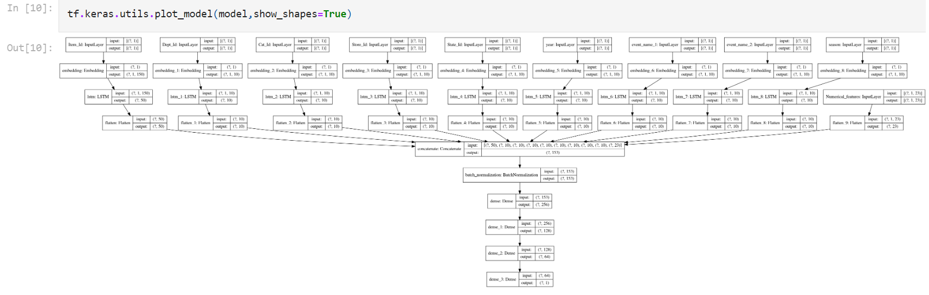
Dataset 02 - Long Short Term Memory (LSTM)

Slide 18
Dataset 02 - Performance
Model | MAE | RSME | Accuracy
ARIMA | 1887 | 5684 | 96.42
LSTM | 2291 | 5205 | 97.23

Slide 19
Phase 3: Model Deployment & Business Recommendation

Slide 20
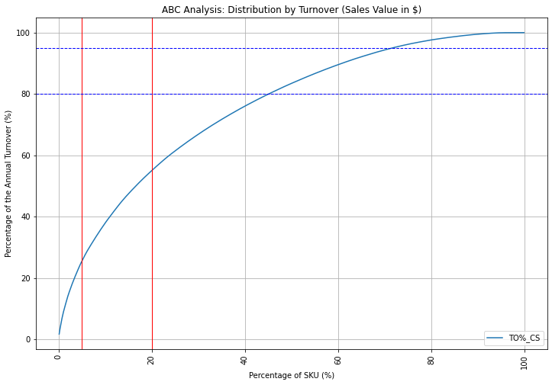
Dataset 02
From the graph we can clearly observe the following –
Class A: the top 5% - Turnover (%): 25%
Class B: the following 15% - Turnover (%): 31%
Class C: the 80% slow movers - Turnover (%): 43%
We can see that 80% of our portfolio makes less than 50% of the sales.

Slide 21
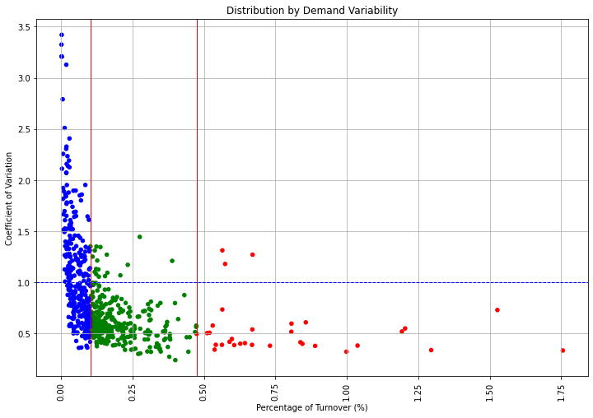
Dataset 02
From the graph, we can make the following conclusions –
Most of the A SKUs have a quite stable demand so they won’t create any problem.
The majority of B SKUs are in the stable area but there are few references with a high CV on which we will have to spend effort for optimal planning.
Most of the C SKUs have high value of CV. They will bring the most planning and distribution challenges.

Slide 22
Recommendation(s)
Inventory Optimization
Supplier Relations
Customer Service
Strategic Pricing
Better Resource Allocation
Trend: Improved sales during weekends/holidays.
Implication : Increasing stocks during weekends/holidays in a legit mode, eases customer demand and increase revenue.

Slide 23
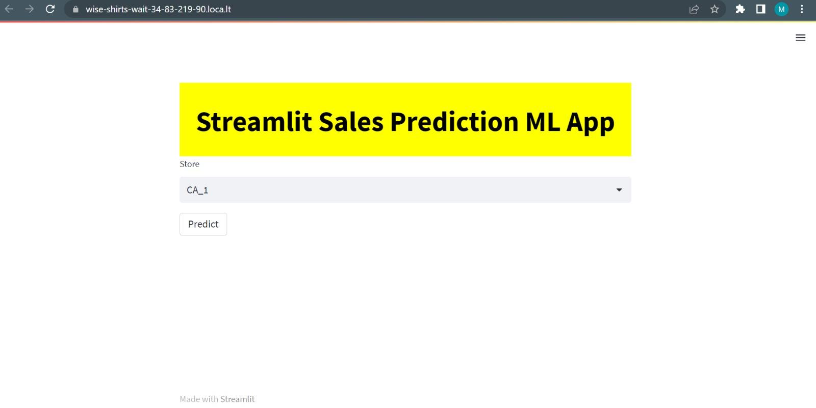
Deployment

Slide 24
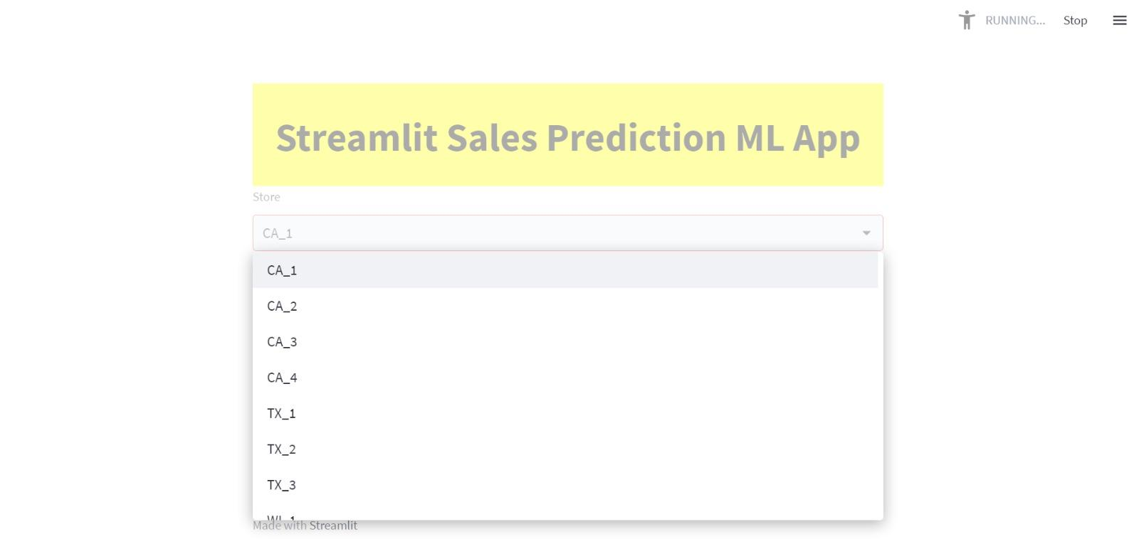
Deployment

Slide 25

Deployment

Slide 26
Conclusion

Slide 27
Our team worked on two datasets pertaining to Stores & features to identify the most important Retail store sales information. Our work includes analyzing the datasets for any anomalies, studying/understanding the graphs by creating different visualizations, build the neural network models, and lastly making public dashboards using Tableau. We were able to calculate sales weekly, monthly & also identify the top performing stores & products.
Next, we deployed various machine learning algorithms to predict sales for the stores and generate analysis based on weather, seasons, income of the people, etc.
Lastly, we created ABC analysis for the dataset and provided some recommendations for the same and deployed our model on to Streamlit. Also, not to mention, there is a huge scope for improvement with the accuracy of the models.

