Slide 1
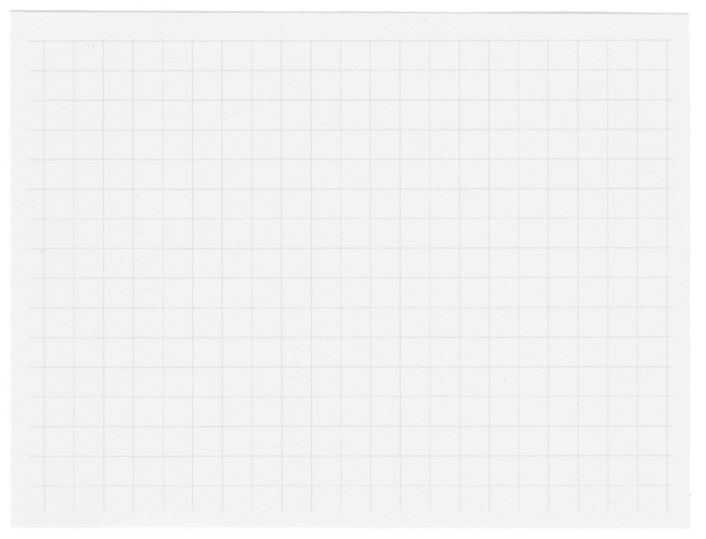














INNOFUSION
2024
DEEP MANGO
A Mango defect identifier
Presented by Team ITU

Slide 2

Problem Statement:
Defect identification, classification in mangoes, and the percentage of defects

Slide 3

Introduction
Human inspectors can be susceptible to
fatigue, distraction, and individual biases,
leading to inconsistencies in defect
identification. A deep learning model is
objective and consistent, minimizing
human error.
Manual inspection is time-consuming and
labor-intensive, especially for large
volumes of mangoes. Deep learning models
can analyze numerous mangoes rapidly,
boosting efficiency and throughput
significantly.

Slide 4
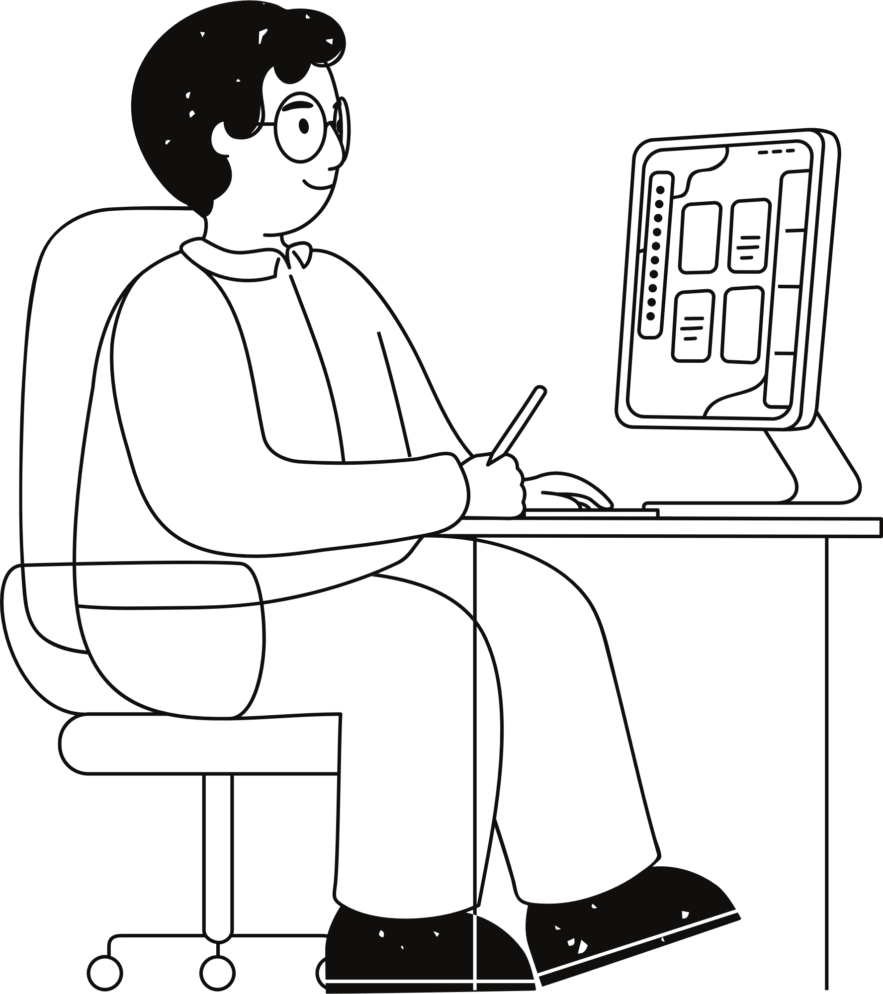
Problem Identified
We have collected the dataset for the Mango defect identification. And we found out there are 4 categories of the mangoes in the images like fresh, rot defect, bruise and black spot.
Now we can build a CNN model and apply suitable convolutions on the images to categorize the mangoes by detecting the type of defect present in the mangoes.

Slide 5
Methodology
01
02
03
04
05
DATA ACQUISITION
IMAGE PREPROCESSING
DATA TRANSFORMATION
TRAINING
MODEL
BUILDING APPLICATION INTERFACE

Slide 6
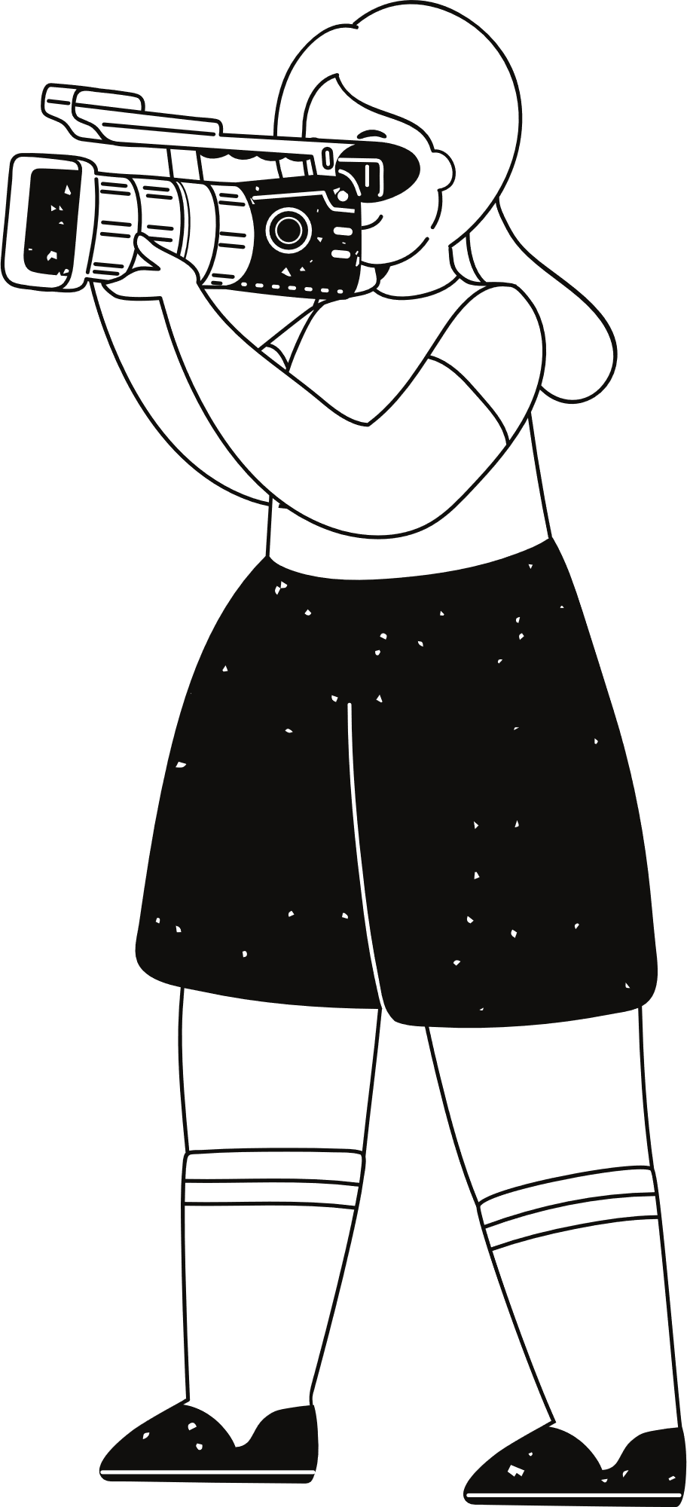
Proposed Architecture
InceptionV3 Model Architecture
InceptionV3 is a convolutional neural network (CNN) architecture known for its efficiency and high performance in image classification.
1. Stem Block:
This initial block processes the input image using several convolutional layers and pooling operations to extract low-level features.
2. Inception Modules:
The core of the architecture consists of multiple Inception modules, each containing different convolutional layers and pooling operations arranged in parallel branches.
These branches capture different sizes and orientations of features, allowing the network to learn a wider range of information.

Slide 7
There are several types of Inception modules used throughout the network, each with slightly different configurations.
3. Reduction Blocks:
These blocks are inserted periodically to reduce the spatial dimensions of the feature maps while increasing the number of channels.
This helps control the network's size and complexity while maintaining its ability to learn complex features.
4. Auxiliary Classifier:
An additional classifier is added after one of the reduction blocks.
This helps propagate information from earlier layers to the final classification layer, improving overall performance.
5. Global Average Pooling and Classification:
The final layers consist of global average pooling, which reduces the feature maps to a single vector per class.
This vector is then fed into a fully connected layer for final classification.

Slide 8
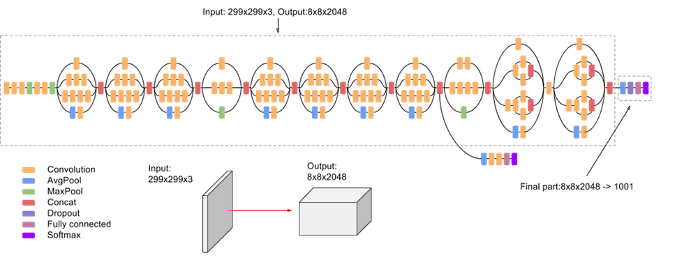

Slide 9
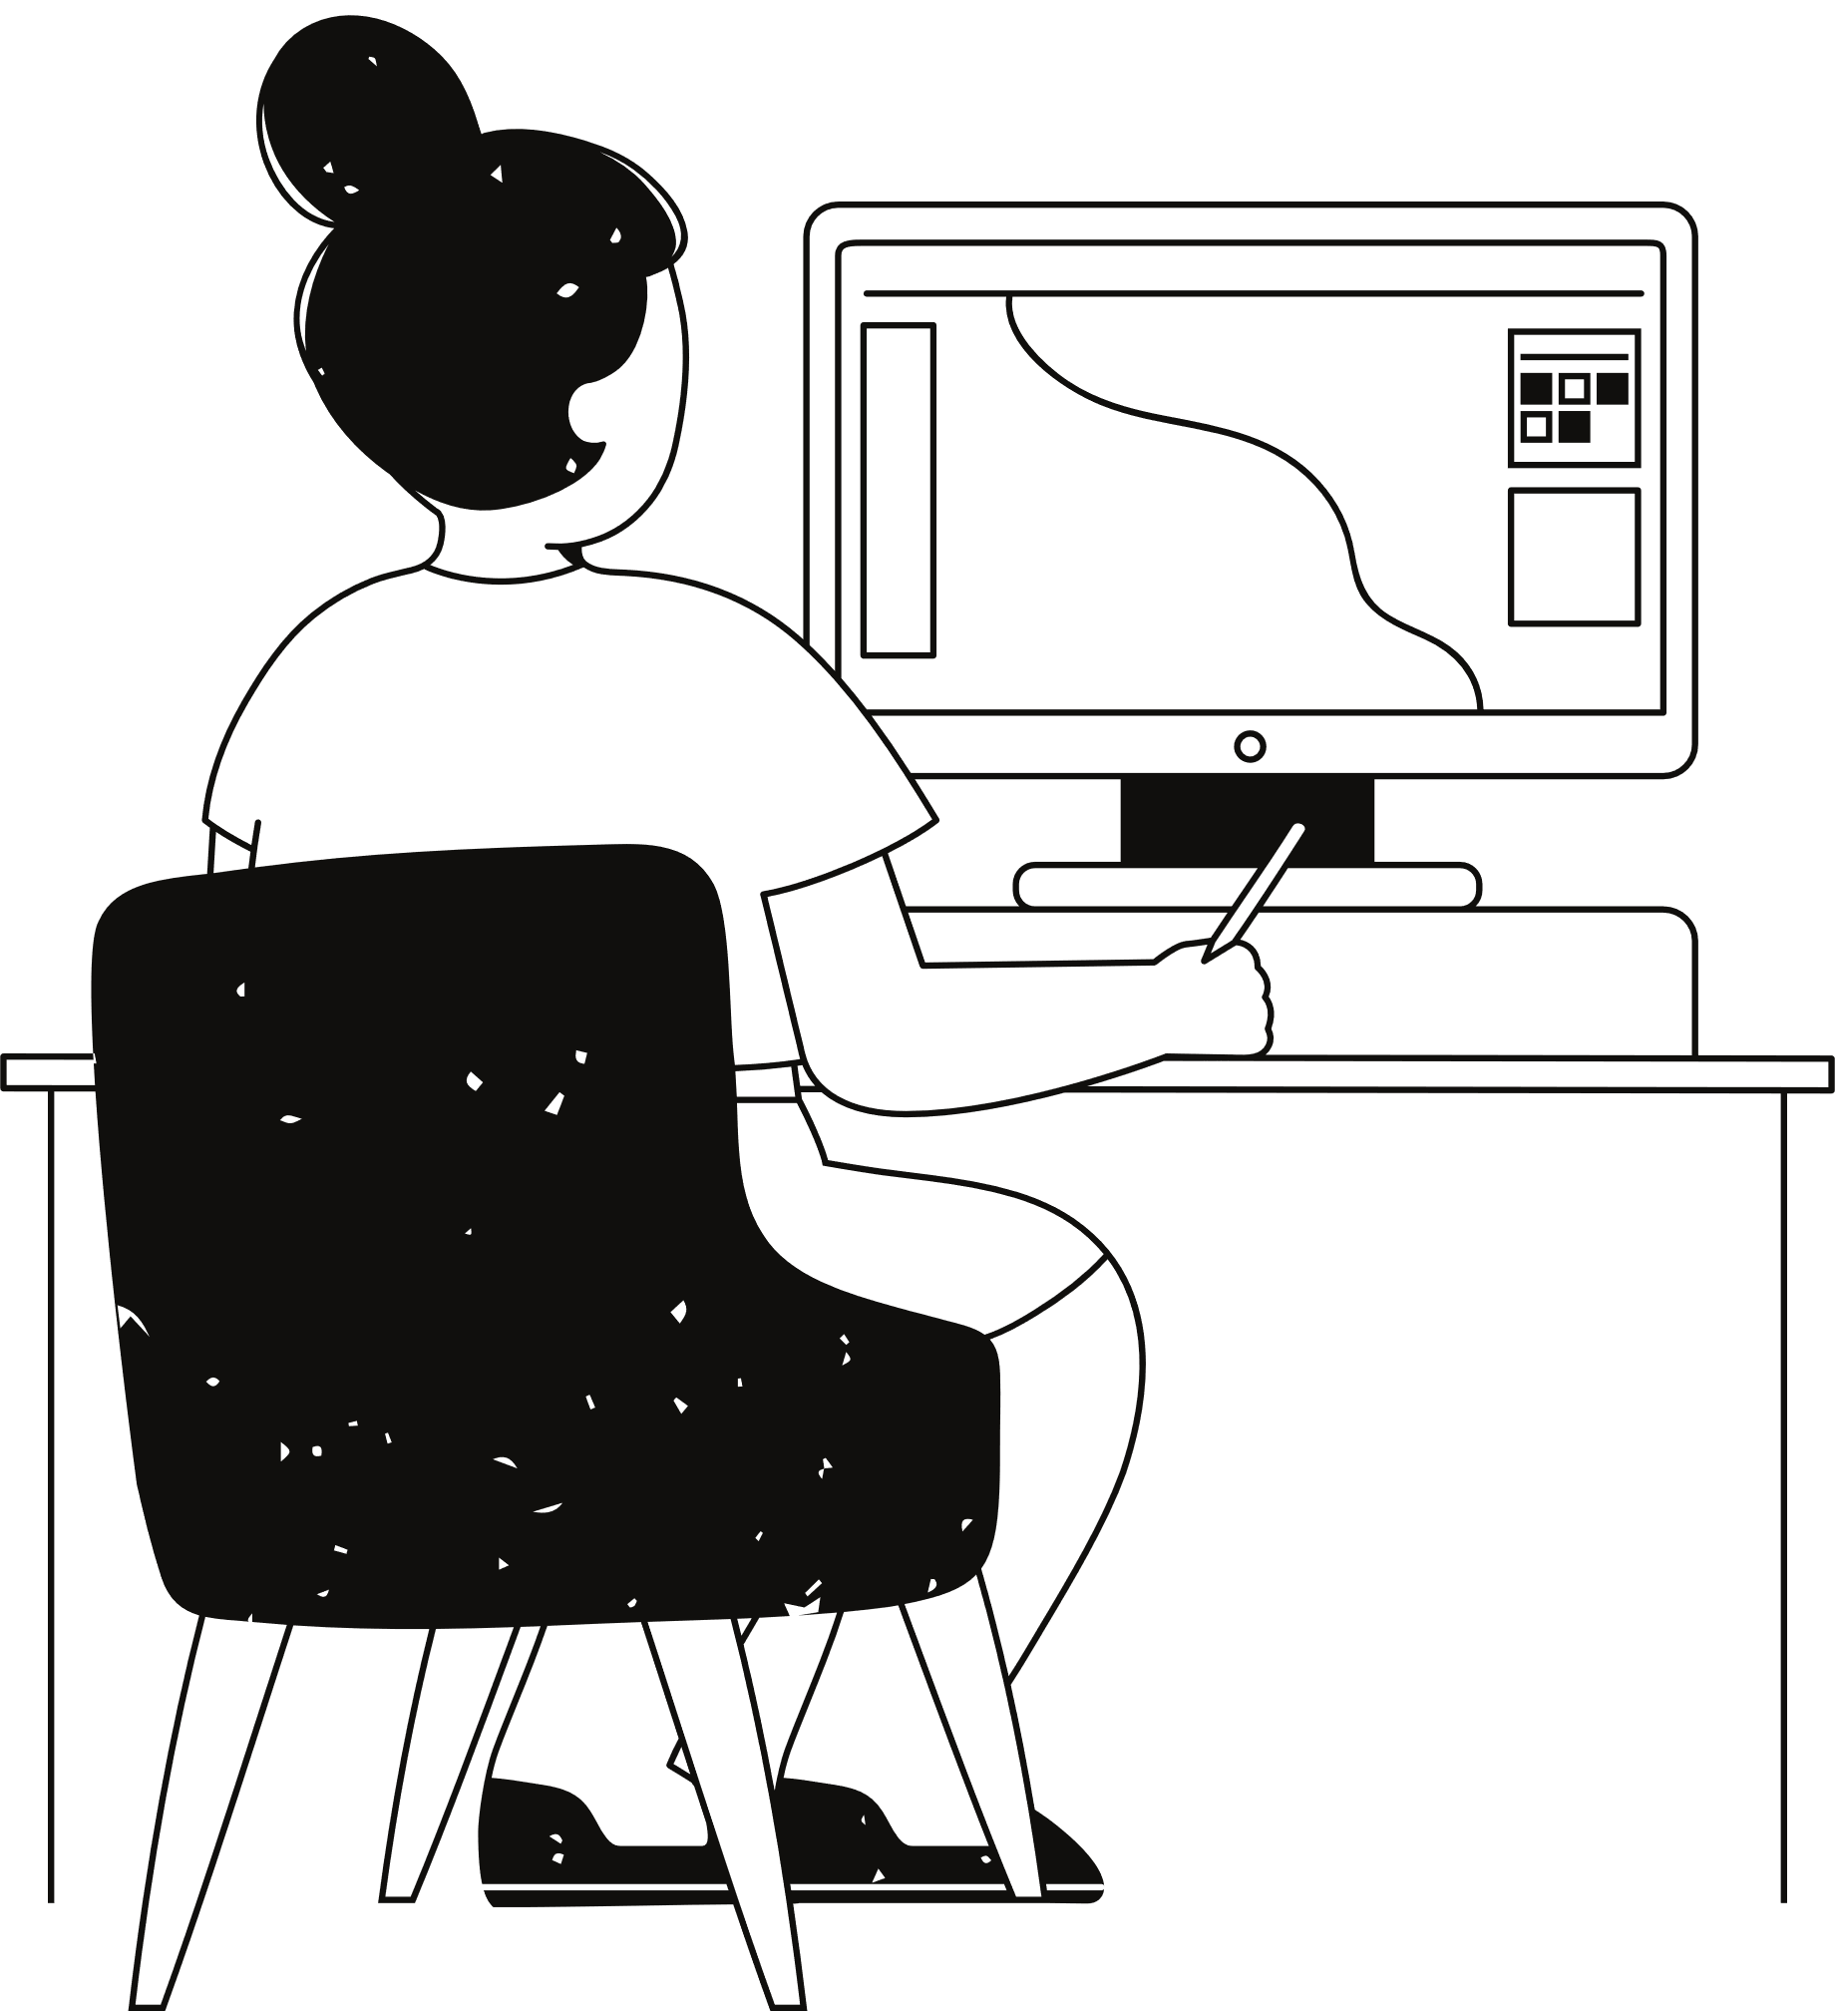
Innovation
We have incorporated the Deep learning approach into the daily life’s real time application. And integrated the Machine learning model with development tool flask rather than commonly used javascript which acts as server side of the code

Slide 10
Proof of Concept

Slide 11
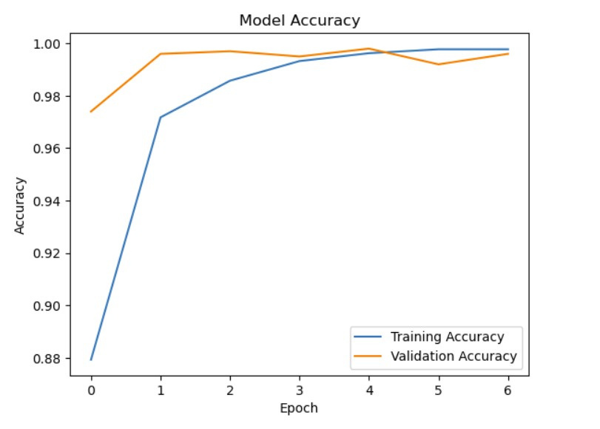

Slide 12
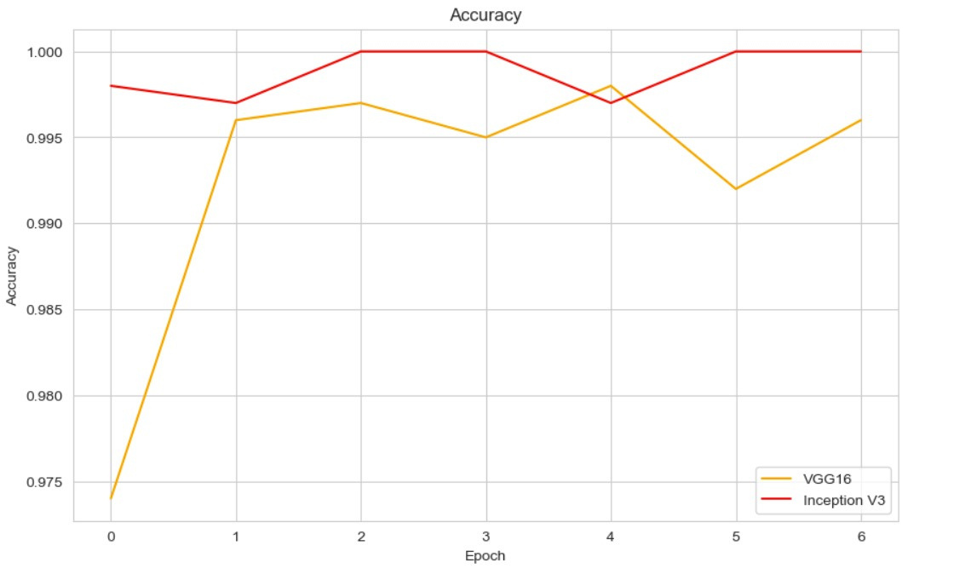

Slide 13
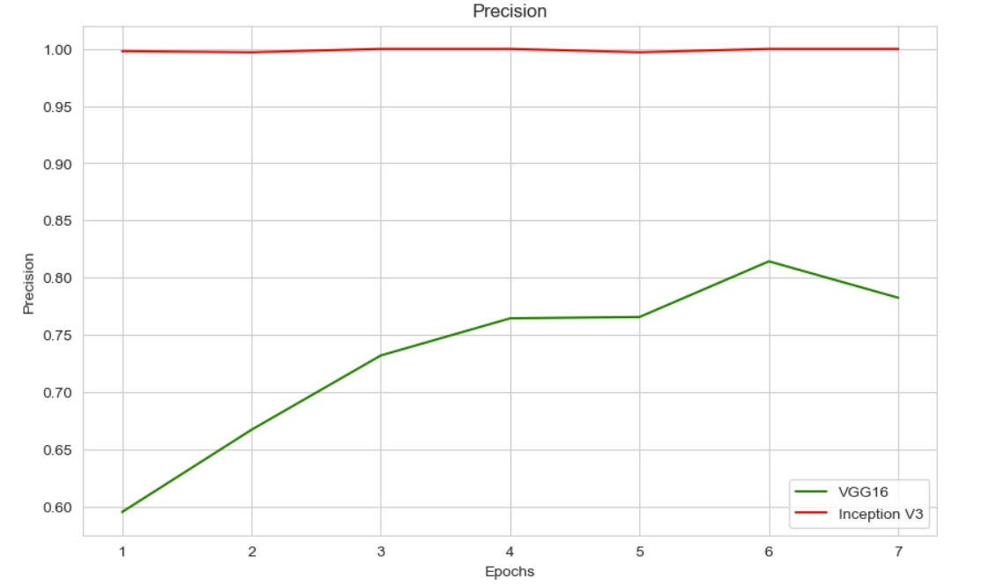

Slide 14
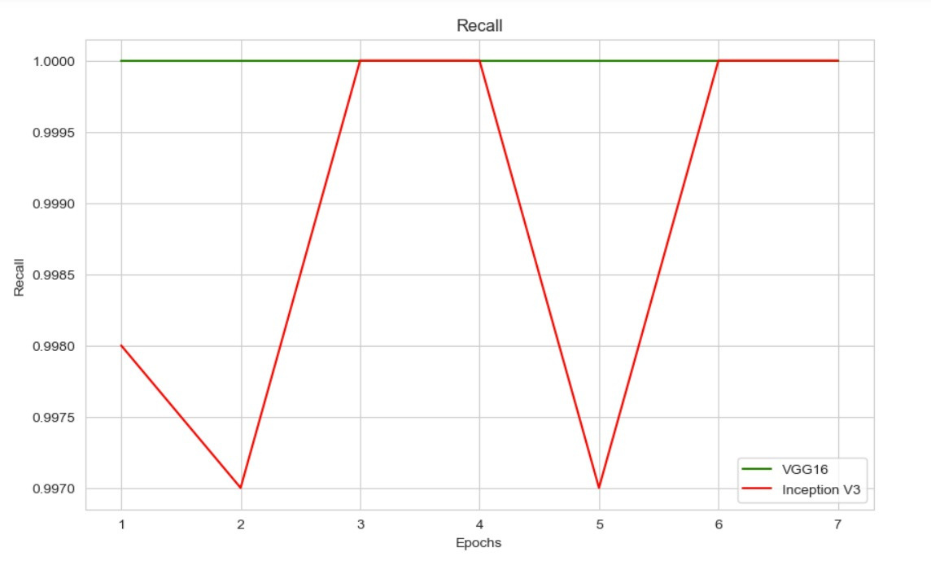

Slide 15

Conclusion
At last, by following the described methodology and architecture a CNN model that predicts the category of the mango and gives the percentage of possibility of the defect in the mango is developed.

Slide 16
Thank you very much!
TEAM ITU

