Slide 1
IBM University Engagement
Project Submission
"Exploring Farmer-First AI for Cotton & Groundnut Markets"
AgriConnect Gujarat — AI-Powered Cotton & Groundnut Market Linkage Platform
A Farmer-Facing Web App for Mandi Prices, Price Forecasting, Buyer Matching & Income Tracking

Slide 2

Project Details
Field
Detail
Project Title
AgriConnect Gujarat — AI-Powered Cotton & Groundnut Market Linkage Platform
Domain
Agriculture / Market Intelligence / Financial Empowerment
Crops Covered
Cotton & Groundnut
Target Users
Farmers across Gujarat (Rajkot, Junagadh, Ahmedabad, Bhavnagar, Amreli, Gondal)
Platform
Web App (HTML, CSS, JavaScript) — mobile-first, no app install required
Data Source
Agmarknet / data.gov.in (live mandi price feed)
Storage
localStorage (client-side; no backend or database)
Student Name | Recent Passport Photo | Email ID | Mobile Number (WhatsApp)
Pandya Vrunda P. |  | vrundapandya10@gmail.com | 9016605254
2

Slide 3
Problem Statement
Cotton & Groundnut farmers in Gujarat lack market transparency and fair price access
The Challenge
The Objective
🌾 Farmers sell cotton & groundnut without knowing live mandi prices or weekly trends
🌾 Farmers sell cotton & groundnut without knowing live mandi prices or weekly trends
✅ Show live mandi prices for Cotton & Groundnut across 6 Gujarat mandis
🏪 Middlemen buy at depressed prices — farmers lose 10–30% of their potential income
✅ Provide a 7-day price forecast using linear regression on historical data
🏪 Middlemen buy at depressed prices — farmers lose 10–30% of their potential income
✅ Help farmers find and compare direct buyers vs mandi rates
📊 No easy tool exists to compare mandi prices across 6 Gujarat mandis in one place
📊 No easy tool exists to compare mandi prices across 6 Gujarat mandis in one place
✅ Give AI-based Sell or Store recommendations based on price trends
📉 Price swings are unpredictable — farmers cannot decide when to sell vs store
📉 Price swings are unpredictable — farmers cannot decide when to sell vs store
✅ Simulate AI quality grading (Grade A/B/C) with estimated price impact
🔍 No simple way to estimate crop quality grade and its impact on price
🔍 No simple way to estimate crop quality grade and its impact on price
✅ Track income vs mandi averages in a personal dashboard
💸 No dashboard to track income vs mandi averages over the season
💸 No dashboard to track income vs mandi averages over the season
✅ Support both English and Gujarati language for all farmers
Who is it for? Cotton and groundnut farmers across Gujarat — especially in Rajkot, Junagadh, Ahmedabad, Bhavnagar, Amreli, and Gondal mandis — who sell through APMC or want direct buyer access.
3

Slide 4
Proposed Solution
AgriConnect Gujarat: a farmer-first web app for market intelligence
AgriConnect Gujarat is a single-page web application built for cotton and groundnut farmers in Gujarat. It runs entirely in the browser — no installation, no login, no backend server. It pulls live mandi price data from Agmarknet / data.gov.in, runs a 7-day price forecast using client-side linear regression, and helps farmers make better decisions about when to sell, who to sell to, and how much their crop is worth.
📈
🤝
🏪
🔍
💰
1. Mandi Price Forecast
2. Buyer Matching
3. Sell or Store Advisor
4. Quality Grading (AI Simulated)
5. Income Dashboard
Live Cotton & Groundnut prices from Agmarknet across Rajkot, Junagadh, Ahmedabad, Bhavnagar, Amreli & Gondal. Includes 7-day AI forecast via linear regression. Price history chart powered by Chart.js.
Farmers enter crop, location, quantity and grade to find and compare illustrative direct buyer offers vs live mandi rates. Shows estimated savings vs middlemen (−10% estimate).
AI recommendation (Sell Now / Wait / Store) based on live price trend + 7-day forecast slope. Shows break-even storage period, estimated extra income if waiting, and storage cost vs gain.
Farmer uploads/takes a crop photo. The app simulates AI quality analysis to assign Grade A, B, or C with a confidence score. Translates grade to estimated price per quintal.
Personal sale log saved in localStorage. Tracks total income, quantity sold, average price/qtl, and savings vs mandi average. Bar + line combo chart via Chart.js.
💻 The app works in English and Gujarati. All data is stored locally in the browser (localStorage). No backend, database, or authentication is used.
4

Slide 5
Technology Used
HTML5, CSS3
JavaScript (Vanilla)
Single-file web app with responsive mobile-first layout. CSS custom properties for theming. Sticky header, bottom navigation for mobile, side navigation for desktop.
All logic in-browser — no frameworks, no npm, no build step. Handles data fetching, forecast calculation, chart rendering, localStorage, and language toggle.
Chart.js 4.4
Agmarknet / data.gov.in
Renders the mandi price history chart (line), AI forecast overlay (dotted), and the income bar + line combo chart. Loaded from CDN.
Live mandi price feed for Cotton and Groundnut across Gujarat mandis. The app fetches this API; on failure it falls back to 4-hour cached data stored in localStorage.
localStorage
Linear Regression (client-side)
Stores mandi price cache (4-hour TTL), farmer's personal sale records for the income dashboard, and any user preferences. No backend database.
7-day price forecast computed in JavaScript on historical price arrays. Slope and intercept calculated from recent data points. Labeled clearly as AI Forecast — not official mandi data.
Current status: AgriConnect Gujarat is a fully working frontend prototype. All features are functional in the browser. Live Agmarknet API is integrated; on API failure the app uses cached prices.
5

Slide 6
App Components Used
Key frontend modules and data flow in AgriConnect Gujarat
1
Agmarknet API Connector
2
Price Forecast Engine
3
Buyer Matching Module
Fetches live Cotton & Groundnut mandi prices from data.gov.in for 6 Gujarat mandis. Falls back to localStorage cache (4-hour TTL) on network failure.
JavaScript linear regression on recent price array. Calculates slope + intercept, projects 7-day forward price, and labels it clearly as AI Forecast.
Takes crop, location, quantity, grade as inputs. Generates illustrative buyer offers with price comparison vs live mandi. Shows mandi price, middleman-adjusted price, and best buyer offer.
4
Storage Advisor Logic
5
Quality Grader (AI Simulated)
6
Income Dashboard + Chart
Computes sell/store/wait recommendation using live price + forecast slope. Calculates break-even storage period and estimated extra income. Labeled as AI advice.
Accepts photo upload or camera. Simulates AI grading with a random-seeded confidence score. Assigns Grade A/B/C with tips and estimated price per quintal at that grade.
localStorage-backed sale log. Calculates total income, quantity, average price, and savings vs mandi average. Renders bar + line combo chart via Chart.js.
6

Slide 7
Working Project — Home Screen
Live view of the AgriConnect Gujarat dashboard
🌱 AgriConnect Gujarat | AI-Powered Market Linkage
ગુ / EN
AgriConnect Gujarat 🌾
Real-time mandi prices, AI forecasts, and direct buyer connections for cotton & groundnut farmers across Gujarat.
🌿 Cotton & Groundnut
📍 6 Gujarat Mandis
🤖 AI Forecast
📊 Live Agmarknet
6,230
5,480
6
Today
Cotton (Rajkot) ₹/qtl
Groundnut (Junagadh) ₹/qtl
Mandis Tracked
Last Updated
📈
Price Forecasting
🤝
Find Buyers
🏪
Sell or Store?
Live mandi prices + 7-day AI forecast
Compare mandi vs direct buyer offers
AI timing advisor based on price trend
🔍
Quality Grading
💰
Income Dashboard
📞
Kisan Helpline
Upload photo — AI grades A/B/C
Track sales vs mandi average
1800-180-1551 (Free) 6am–10pm
Screenshot representation of the working AgriConnect Gujarat home screen — live Cotton & Groundnut prices, quick navigation to all 5 modules, and bilingual support.
7

Slide 8
Working Project — Mandi Price Forecast
Live prices from Agmarknet + 7-day AI forecast via linear regression (Chart.js)
📈 Mandi Price Forecast
Today's Mandi Prices
LIVE
Crop: Cotton
Mandi: Rajkot
Period: 14 days
Source: Agmarknet / data.gov.in
Mandi
Modal ₹
Min
Max
vs Yesterday
7d Forecast
₹6,600
Rajkot
6,230
6,100
6,420
▲ +80
▲ ₹6,575
₹6,400
Junagadh
6,150
6,020
6,350
▼ −30
▲ ₹6,490
₹6,200
Ahmedabad
6,380
6,230
6,550
▲ +120
▲ ₹6,680
₹6,000
Bhavnagar
6,080
5,960
6,250
▲ +50
▲ ₹6,400
₹5,800
Amreli
6,190
6,060
6,380
▼ −20
▲ ₹6,520
14 Jun
13 Jun
12 Jun
11 Jun
10 Jun
9 Jun
8 Jun
+1d
+2d
+3d
+4d
+5d
+6d
+7d
Gondal
6,120
5,990
6,300
▲ +90
▲ ₹6,450
Live Mandi Price
7-day AI Forecast
🤖 AI Forecast Cotton/Rajkot: Expected to rise ~₹345 (+5.5%) over 7 days based on 14-day linear trend. Forecast — not an official mandi price.
8

Slide 9
Working Project — Buyer Matching & Storage Advisor
Direct buyer comparison and AI sell/store/wait recommendation based on live price trend
🤝 Find Direct Buyers
🏪 Storage & Timing Advisor
ILLUSTRATIVE
LIVE + AI
Crop: Cotton
Crop: Cotton
Location: Rajkot
Mandi: Rajkot
Quantity: 50 qtl
Quantity: 100 qtl
Grade: B — Standard
Storage cost: ₹80/qtl/month
🔍 Match Buyers
Current Modal Price
₹6,230/qtl
⏳
Live Mandi Price
₹6,230/qtl
7-day Forecast Direction
▲ Rising (+₹345 est.)
After Middleman (−10%)
₹5,607/qtl
Break-even Store Period
12 days
Best Direct Buyer Offer
₹6,450/qtl
Est. Extra Income (if wait)
₹34,500 on 100 qtl
WAIT
💚 Direct sale saves ≈ ₹11,150 on 50 qtl vs middlemen route
Forecast shows upward trend.
Wait 10–14 days for higher prices.
Anand Ginning Mill
₹6,450/qtl
Rajkot Traders Co-op
₹6,380/qtl
9

Slide 10
Working Project — Quality Grading & Income Dashboard
AI-simulated crop quality assessment and personal sale income tracker (localStorage-backed)
🔍 Quality Grading (AI Simulated)
💰 My Income Dashboard
Select Crop: Cotton
₹3,42,000
55 qtl
Photo/Upload Area: [📷 Upload or Take Photo]
Total Income
Total Sold
Quality Parameters: Fibre length, moisture, contamination
₹6,218
₹18,700
🔬 Analyse Quality
Avg Price/qtl
Saved vs Middlemen
Your Price ₹/qtl vs Mandi Avg ₹/qtl (Live) — Chart.js Bar+Line Combo
A
Grade A
03 Jun C
08 Jun G
12 Jun C
18 Jun C
Your Price
Mandi Avg (Live)
Confidence: 87%
Date
Crop
Qty
Your ₹
Mandi ₹
vs Avg
✅ Good fibre length & uniformity
03 Jun
Cotton
10
6,100
6,050
+50
✅ Low moisture content
08 Jun
Grndnt
20
5,600
5,550
+50
✅ Minimal contamination
💡 Eligible for export grades
At Grade A, Cotton estimated at ~₹6,230/qtl (Rajkot live price) | AI Estimate
18 Jun
Cotton
25
6,480
6,230
+250
10

Slide 11
Role of Frontend AI in the Solution
What "AI" means in AgriConnect Gujarat — client-side, transparent, and labeled
AgriConnect Gujarat does not use a cloud AI API or a trained ML model. Instead, it implements lightweight, transparent AI algorithms directly in JavaScript in the browser. Each AI feature is clearly labeled so farmers know what is a live price and what is an estimate.
Linear Regression Forecast
Quality Grade Simulation
AgriConnect
Gujarat
A 7-day price forecast is computed in JavaScript by fitting a linear regression line to the last 14 days of mandi price data. Slope and intercept give the trend direction and magnitude.
The quality grader uses a seeded pseudo-random function combined with user-selected parameters (moisture, fibre, contamination) to assign Grade A/B/C with a confidence score. Results include grade-adjusted price estimates.
Sell or Store Logic
Buyer Offer Estimation
The advisor compares the live price against the 7-day forecast slope. If the slope indicates rising prices and extra gain exceeds storage cost, it recommends "Wait" or "Store"; otherwise "Sell Now".
Direct buyer offers are computed as illustrative percentage premiums over the live mandi price (e.g. +3.5% for Grade A direct buyers). Clearly labeled as ILLUSTRATIVE — not real buyer data.
📌 Every AI-generated output is labeled LIVE, AI Forecast, AI Estimate, or ILLUSTRATIVE — farmers always know the source
📌 No backend, no cloud API calls for AI — all logic runs client-side in the browser for privacy and offline resilience
📌 Forecast is clearly distinguished from official Agmarknet mandi prices in all UI labels
📌 localStorage caches price data for 4 hours — ensuring the app works even when Agmarknet API is temporarily unavailable
11

Slide 12
Novelty and Uniqueness
What makes AgriConnect Gujarat different from a standard price-check app
📈 Live Price + Forecast in One View
🌐 Bilingual by Design
🔒 No Login, No Backend
Most price apps show today's price only. AgriConnect shows 14-day history, today's cross-mandi table, AND a 7-day linear regression forecast — all on one screen.
Full English and Gujarati toggle built into every label, heading, and button. Designed from the ground up for rural Gujarat farmers, not as an afterthought translation.
Runs entirely in the browser with no account, no server, and no data sent anywhere. Income records stay private in the farmer's own device (localStorage).
🤝 Mandi vs Buyer Comparison
📦 Sell or Store Decision Tool
📊 Personal Income Tracker
The Buyer Matching module shows live mandi price, middleman-adjusted price, and direct buyer offers side-by-side — making the cost of using a middleman visible and concrete.
Combines live price trend and forecast to give a concrete Sell Now / Wait / Store recommendation with break-even period and estimated extra income — not just raw data.
Farmers log each sale and the dashboard automatically compares their achieved price to the live mandi average, showing cumulative savings vs the middlemen route over the season.
12

Slide 13
GitHub Link
Repository URL:
https://github.com/vrundapandya-dev/AI-Powered-Cotton-Groundnut-Market-Linkage-Platform
13

Slide 14
Future Scope
1. Live Agmarknet API Integration with Real Backend
Replace the current CORS-proxy approach with a proper backend proxy server (Node.js/Python) to reliably stream live Agmarknet mandi prices across all Gujarat mandis in real time, eliminating the need for cached fallback data.
2. Real Buyer CRM / Directory
Replace illustrative buyer offers with a real verified-buyer directory. Ginning mills, co-operatives, and exporters could list live bids. Farmers could submit their crop details and receive actual offers via WhatsApp or SMS.
3. Voice Assistant in Gujarati & Hindi
Add a voice-enabled interface so low-literacy farmers can speak their questions (e.g., "Rajkot ma kapas no bhav shu che?") and hear the answer. Web Speech API or a lightweight on-device model could power this.
4. ML-Based Price Forecast (ARIMA / LSTM)
Replace the current linear regression with a time-series ML model (ARIMA or LSTM) trained on 3–5 years of Agmarknet history, giving better seasonal pattern recognition and more accurate forecasts.
5. Real AI Quality Grading (Computer Vision)
Replace the simulated quality grader with an actual image classification model (TensorFlow.js or a cloud CV API) trained on cotton and groundnut crop images to give real Grade A/B/C output from a photo.
14

Slide 15
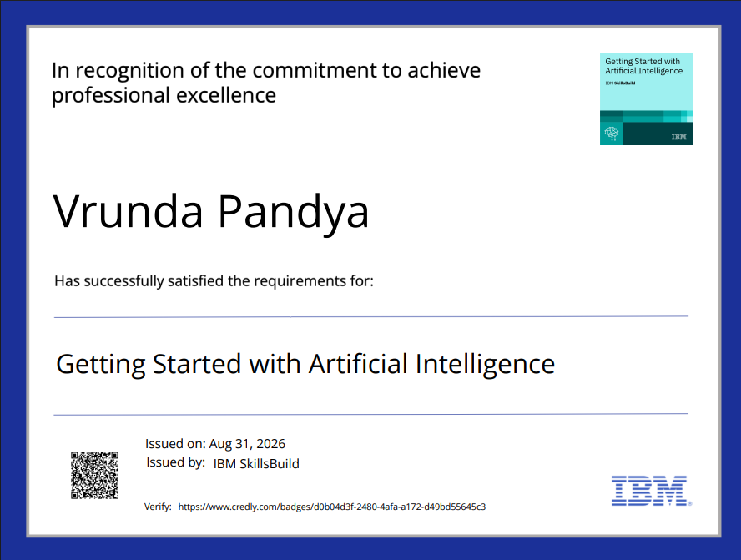
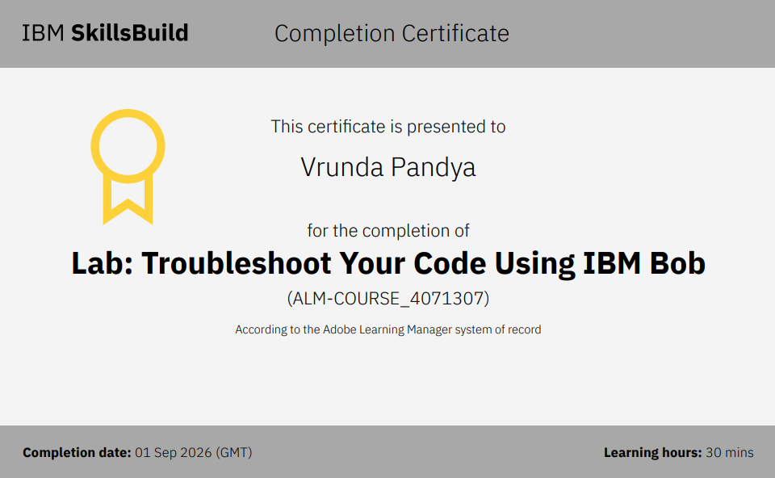
Certificates Earned
First certificate here
Second Certificate here
Credly Certificate
IBM SkillsBuild Certificate
15

Slide 16
Thank You!
Thank you for your time and interest in AgriConnect Gujarat.
🌾 AI-Powered Cotton & Groundnut Market Linkage for Gujarat Farmers

