Slide 1


SMART INDIA HACKATHON 2025
Introduction
Problem Statement ID : SIH25013
Problem Statement Title : Real-Time Public Transport Tracking for Small Cities
Theme : Transportation & Logistics
PS Category : Software
Team Name : The Helios

Slide 2
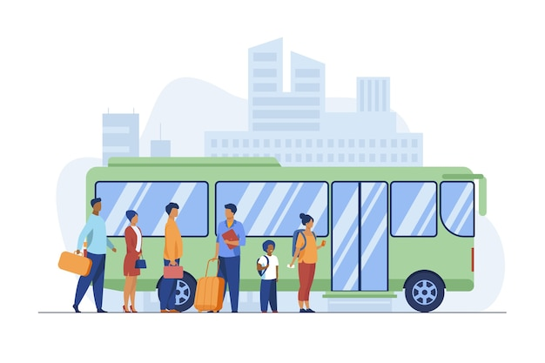
Problem Statement Explained
THE HELIOS
Traveling in a city using public transit is often a hassle with scattered maps, delays, and no unified system. Our solution is a mobile app that simplifies the transit experience by bringing everything into one platform.
Proposed Solution:
Our app builds a live network by integrating official route and stop data with real-time GPS from the driver's phone, offering a trip planner, traffic-aware ETAs, and smart disruption alerts for smoother travel.
It reduces users waiting times, improves reliability, and generates data to support better transport planning while enhancing last-mile connectivity and commuter trust.
Unique to India, it offers multilingual support, future UPI integration, Tier-2/3 focus, and gamified eco-friendly rewards through crowdsourcing.

Slide 3
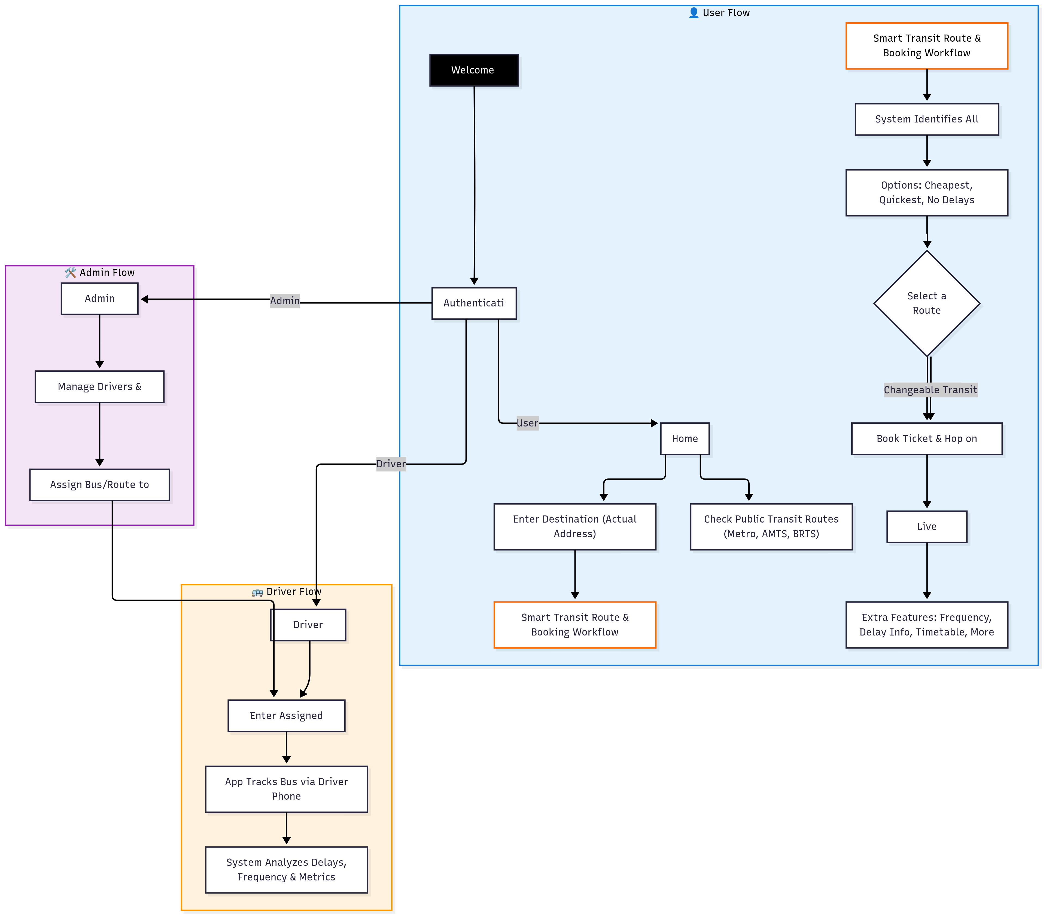
THE HELIOS
Technical Approach
We will use a modern tech stack to build an app that enhances the public transit experience and remains scalable for future growth.
Tech Stack:
UI/UX : Figma
Frontend : React Native (Expo) , Native Wind
Backend & Database : Firebase, Python, PostgreSQL + PostGIS
Data Sources : AMTS, BRTS and GMRC official sites of Ahmedabad
@The Helios – SIH2025
3
@The Helios – SIH2025
3

Slide 4
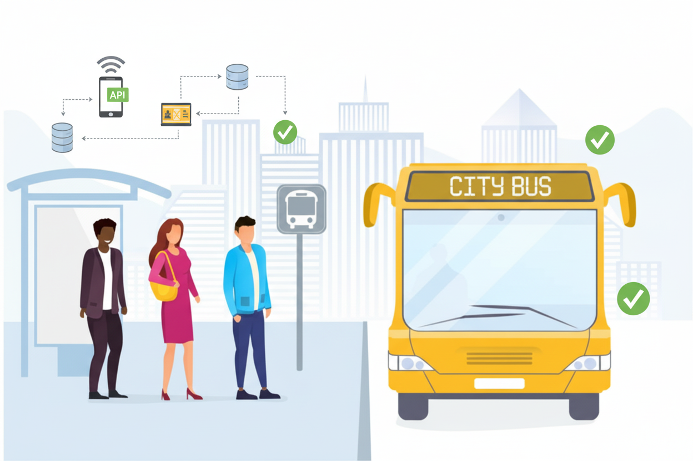

THE HELIOS
Feasibility and Viability
FEASIBILITY
Zero-Hardware Approach: Leverages driver's smartphone GPS.
Tier-2/3 City Focus: Designed for evolving digital infrastructure.
Gamified Crowdsourcing: Rewards for user-reported data like crowd levels.
CHALLENGES & RISKS
Fragmented ticketing systems across agencies.
No reliable and accurate opensource data available
User adoption hurdles in Tier-2/3 cities.
STRATEGIES TO OVERCOME
To Track bus live location through Drivers Phone
Use gamification & rewards to drive crowdsourcing participation.

Slide 5
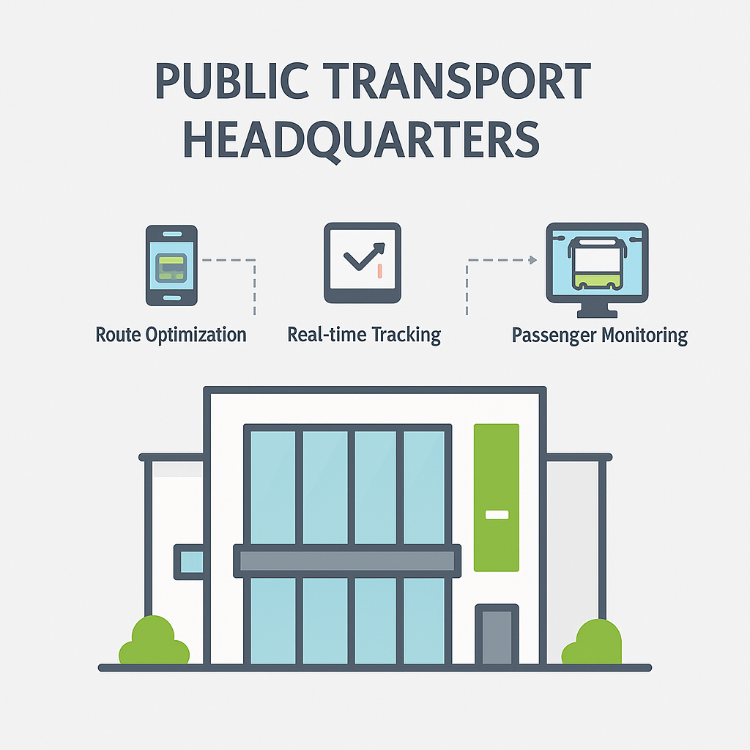
THE HELIOS
Impact and Benefits
Impact
Commuters: Reliable schedules, live tracking, less waiting.
Operators: Analytics on punctuality, crowding, demand.
Govt: Operational Data for planning & policy.
Overall: Builds trust, boosts ridership.
Benefits
Social: Safer, accessible, inclusive travel.
Economic: Time saved, productivity up, more revenue.
Environmental: Less congestion, lower emissions.
Governance: Data-driven policies & planning.

Slide 6
THE HELIOS
Research and References
• NCMC (National Common Mobility Card) → Govt of India’s “One Nation, One Card” initiative. • Moovit & City Mapper → Global multimodal transit apps (routing, live tracking). • Gamification Research → Studies show rewards improve crowdsourced reporting participation.(Optional) • OpenStreetMap & Mapbox APIs → Open data & routing frameworks for maps/navigation.
• Mappls : 🔗 Mappls • Ahmedabad Janmarg (BRTS) → Official portal for real-time tracking, route information, and services. 🔗 BRTS • AMTS (Ahmedabad Municipal Transport Service) → Official site for schedules and city bus information. 🔗 AMTS
• Ahmedabad Metro (GMRC) → Official PDF with detailed metro route information, stations, and timings. 🔗 GMRC

