Slide 1


SMART INDIA HACKATHON 2025
Introduction
Problem Statement ID : SIH25100
Problem Statement Title : Accelerating High-Fidelity Road Network Modeling for Indian Traffic Simulations.
Theme : Transportation & Logistics
PS Category : Software
Team ID : 54318
Team Name : The Helios

Slide 2

Problem Statement Explained
THE HELIOS
The Urban Data Gap: Why We Are Planning Blind
The Core Problem: To build smart infrastructure, cities need detailed digital road models. The current manual process of creating them is too slow, expensive, and cannot scale for India's rapidly growing cities.
The Gap in India: Existing tools are inadequate for high-fidelity simulation.
Navigation Maps: Lack the engineering-grade detail (lanes, signal data, road quality) required for accurate planning.
Official Datasets: Are often incomplete, outdated, or entirely missing for the Tier-2/3 cities that need them most.
This data gap forces our cities to make critical infrastructure decisions without a complete picture, leading to inefficient planning and traffic congestion.

Slide 3
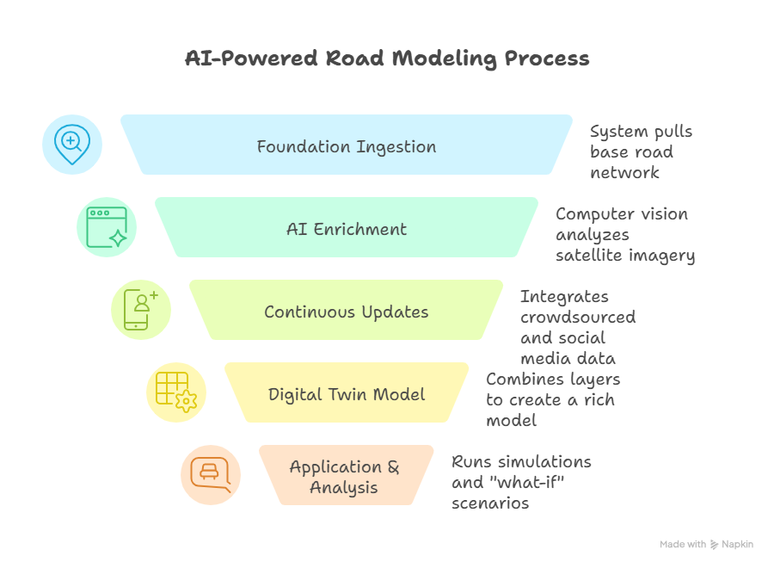
THE HELIOS
Technical Approach
URBaNS is a software platform that automates and accelerates the creation of high-fidelity road models.
Tech Stack:
Desktop Framework : Electron + React or Qt + Python
Core Simulation & Logic: Python, Node.js
Framework: FastAPI
Visualization & UI: React / Qt Designer, Tailwind CSS, Matplotlib / Plotly
Simulation Integration: SUMO
Database & Storage: PostgreSQL + PostGIS
@The Helios – SIH2025
3
@The Helios – SIH2025
3

Slide 4
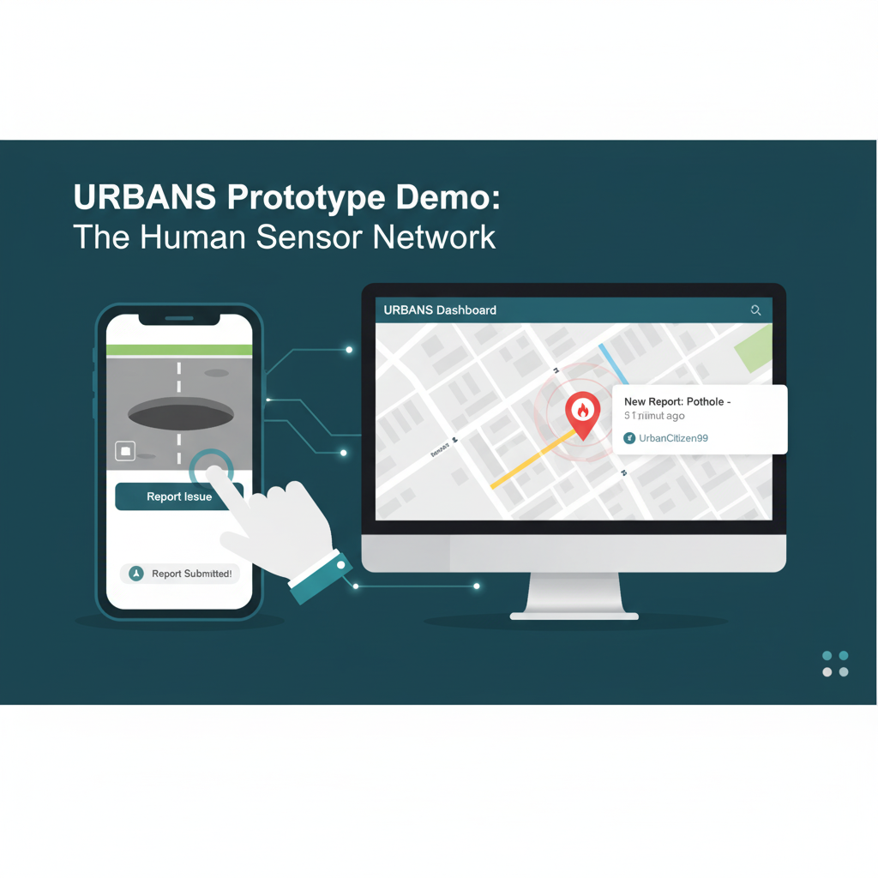
THE HELIOS
Feasibility and Viability
FEASIBILITY
software-only approach is built entirely on free, open-source technologies, eliminating hardware dependencies and high costs.
The "Human Sensor" network (our crowdsourcing app) is a fast, low-cost method to overcome the challenge of fragmented official data.
A demo of our prototype processing real-time citizen reports.
Viability (It will succeed):
We focus on Tier-2/3 cities, an underserved market with a massive need for better planning tools.
We propose a subscription (SaaS) model for Municipal Corporations and Urban Development Authorities

Slide 5
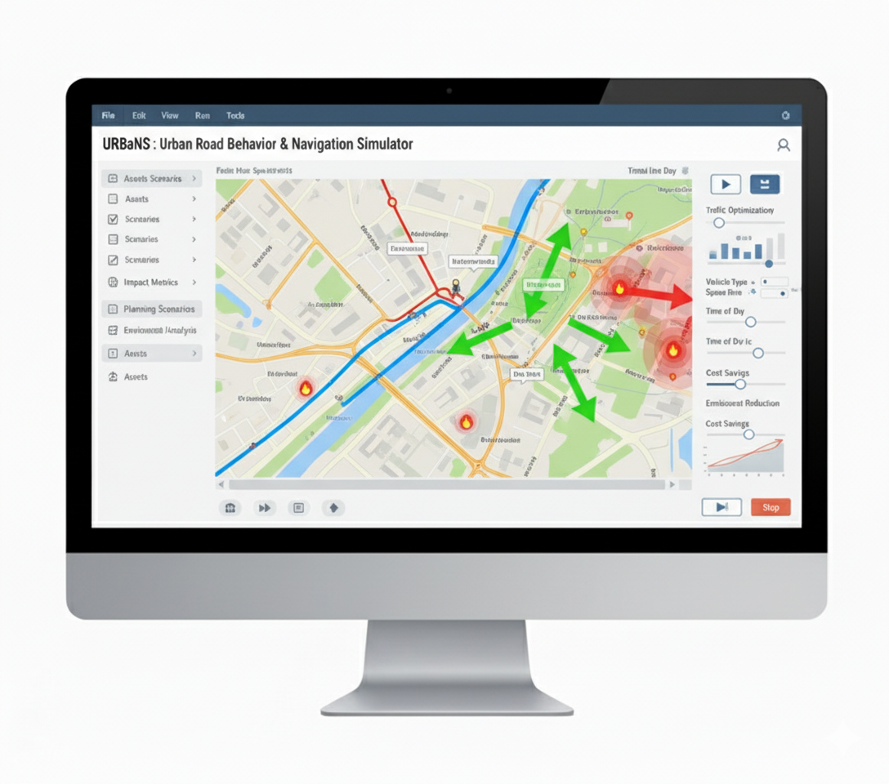
THE HELIOS
Impact and Benefits
Impact and Benefits
De-risk Major Projects: Planners can accurately simulate the impact of new flyovers or metro routes before construction, saving crores and ensuring effectiveness.
Improve Traffic Management: Predict congestion hotspots and optimize traffic flow with data-driven insights.
Economic & Environmental: Less congestion leads to fuel savings, lower emissions, and increased productivity.
Better Governance: Empowers city officials to move from guesswork to data-backed policy and planning

Slide 6
THE HELIOS
Research and References
Indian Traffic & Route Data: Official data from city transport authorities of Tier-2/3 cities.
Mapping Frameworks: OpenStreetMap, Mapbox
Primary Data Sources: ISRO's Bhuvan Satellite Imagery, Citizen-Generated Data (via URBaNS App), Real-time Social Media Feeds.
Simulation Integration: Our models are exported in standard formats compatible with open-source engines like SUMO, ensuring wide usability.
Scenario Data: Historical traffic disruptions, road modifications, and urban planning case studies.

