Slide 1


SMART INDIA HACKATHON 2025
Introduction
Problem Statement ID : SIH25100
Problem Statement Title : Accelerating High-Fidelity Road Network Modeling for Indian Traffic Simulations.
Theme : Transportation & Logistics
PS Category : Software
Team ID : 54318
Team Name : The Helios

Slide 2

Problem Statement Explained
THE HELIOS
Understanding and managing urban road behavior is often challenging due to scattered traffic data, unpredictable navigation, and lack of a unified system. URBaNS is a software that brings these elements together, simplifying traffic simulation and planning.
Proposed Solution:
URBaNS creates a smart simulation by combining real-world traffic patterns, Indian road conditions, and navigation logic. It offers feature to modify existing road and test traffic simulation on it
It reduces traffic uncertainties, improves planning reliability, and generates data to support better urban mobility in Indian cities.
Designed for India, URBaNS offers scalable simulations for Tier-2/3 cities, multilingual support, and potential AI-driven behavior analysis.

Slide 3
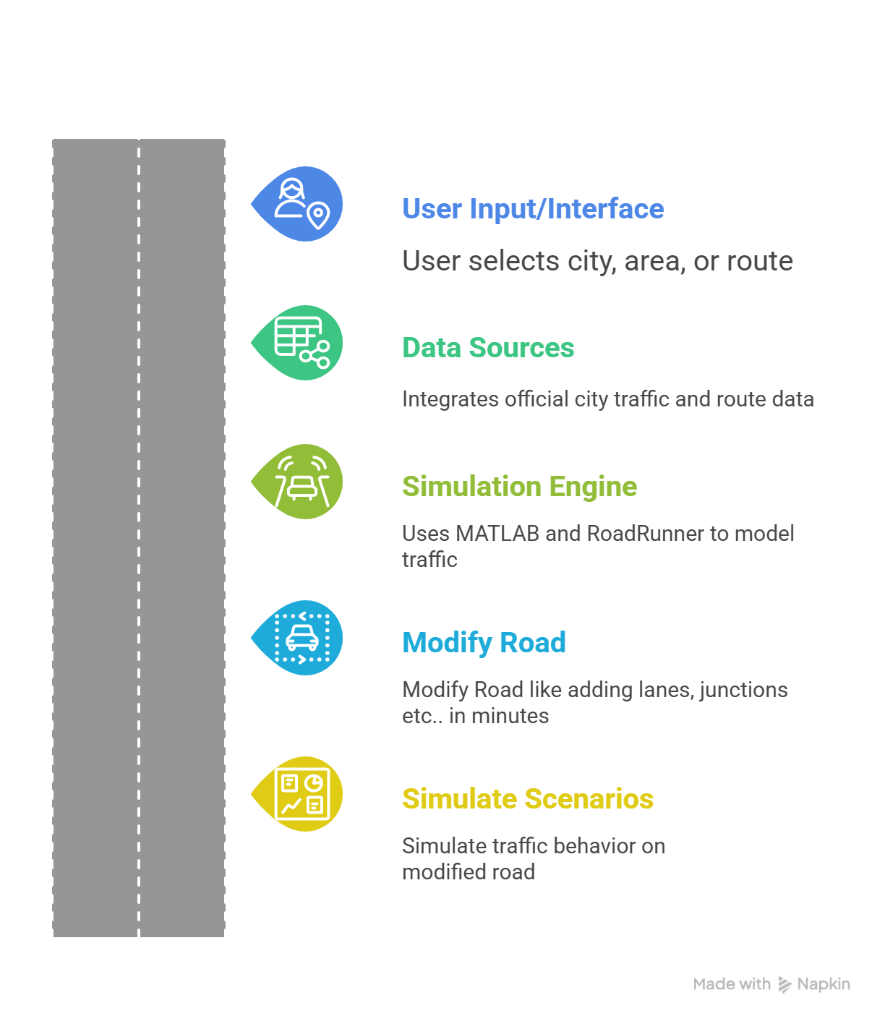
THE HELIOS
Technical Approach
We will use a modern tech stack to build a software which is optimized for running heavy simulations and handing smooth user experience.
Tech Stack:
Desktop Framework : Electron + React or Qt + Python
Core Simulation & Logic: Python, Node.js
Visualization & UI: React / Qt Designer, Tailwind CSS, Matplotlib / Plotly
Simulation Integration: MATLAB / RoadRunner for advanced traffic modeling
Database & Storage: PostgreSQL + PostGIS
@The Helios – SIH2025
3
@The Helios – SIH2025
3

Slide 4

THE HELIOS
Feasibility and Viability
FEASIBILITY
Simulation-First: Uses MATLAB/RoadRunner, no physical hardware needed.
Tier-2/3 Focus: Designed for Indian cities with evolving infrastructure.
Scenario-Based: Models traffic, driver behavior, and road modifications.
CHALLENGES & RISKS
Incomplete or fragmented official traffic data.
Lack of standardized datasets for smaller cities.
Ensuring realistic traffic and driver behavior modeling.
STRATEGIES TO OVERCOME
Integrate official traffic and route data for accuracy.
Use MATLAB/RoadRunner for flexible scenario testing.

Slide 5
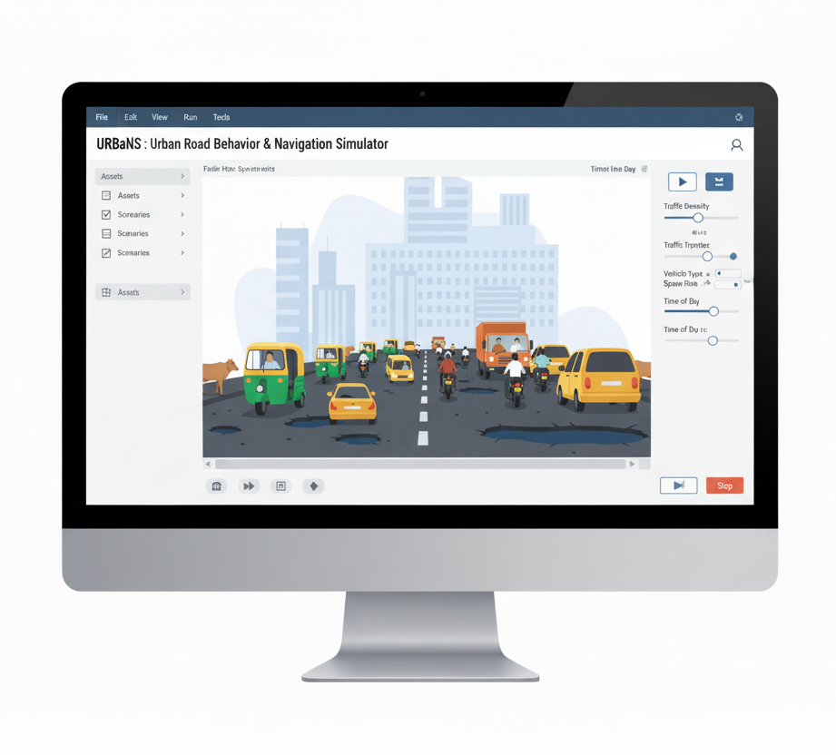
THE HELIOS
Impact and Benefits
Impact
Traffic Management: Improved congestion prediction and road usage insights.
Planning & Operations: Analytics for infrastructure efficiency and maintenance.
Policy Support: Data-driven decisions for urban mobility planning.
Benefits
Efficiency: Faster planning and optimized resource allocation.
Economic: Time saved, productivity up, more revenue.
Environmental: Less congestion, lower emissions.
Governance: Data-driven policies & planning.

Slide 6
THE HELIOS
Research and References
Indian Traffic & Route Data: Official data from city transport authorities of Tier-2/3 cities.
Road Network & Infrastructure: Maps, road layouts, signal locations, and lane information.
Vehicle Flow & Driver Behavior: Observed traffic patterns, average speeds, and congestion points.
Simulation & Modeling References: Studies, algorithms, and models from MATLAB/RoadRunner research.
Mapping Frameworks: OpenStreetMap, Mapbox, and Mappls for visualization and routing.
Scenario Data: Historical traffic disruptions, road modifications, and urban planning case studies.

