Slide 1
INTRODUCTION
Name: Vrushal Bhegade Project: Facial Emotion Recognition Batch: PG44 Date: 25-01-2024

Slide 2
SYNOPSIS
Facial expressions play an important role in recognition of emotion. Marketing research has proven that predicting sentiments correctly can be a huge source of growth for businesses
This module has ability to detect the location of face in any input image or frame and it will classify the emotion on the face as happy, angry, sad, neutral, surprise, disgust or fear
The idea is to replicate the human thought process based on training data in the form of images and videos of humans and try to capture the emotions present in this data.
We will be working with OpenCV and CNN model, using various parameters & Methods to tune the model which are part of deep learning to understand emotion.

Slide 3
Flow-Chart
Neural Network
ANN
RNN
CNN
Reg. Model/Prediction
Images & Videos
Text & Time Series

Slide 4
Types Of Layers Used
CNN
Convolutional Layer
Pooling Layer
Fully Connected Layer

Slide 5
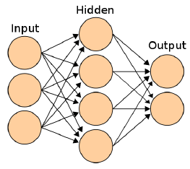
Diagram
Flatten Data As Input
Hyper-Parameter/
Hidden Layer Neurons
Output

Slide 6
Analysis and Design
Dataset
Pre-processing
Extraction
Building Model
Training Set
CNN Training
Prediction
Testing
Trained Model

Slide 7
ALGORITHMS/METHODS USED
CNN (Convolutional Neural Network)
tensorflow
keras
pandas
numpy
Jupyter/Vs Code
tqdm
opencv-contrib-python
scikit-learn
Flask

Slide 8
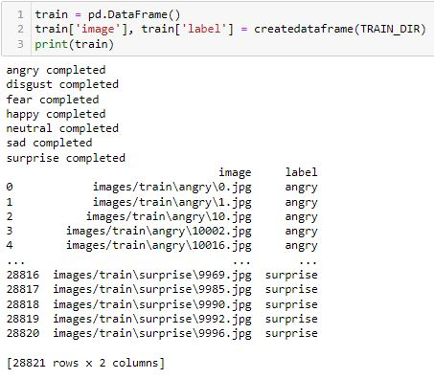
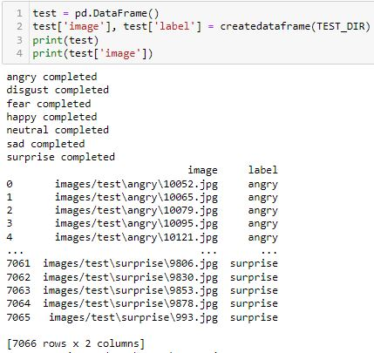
As We Can See We Have Created A Data Frame Consisting Of Image & Label Column, Whereas Each Record Is Labeled Under Any 7 Category .

Slide 9
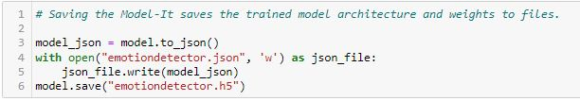
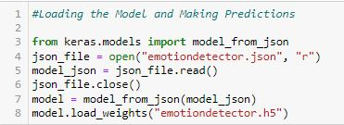
A Snippet Of Saving The Trained Model
We Trained For Further Prediction & Analysis
A Snippet Of Pickle/Loaded Trained Model
For Prediction & Analysis

Slide 10
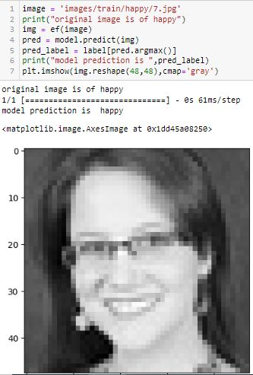
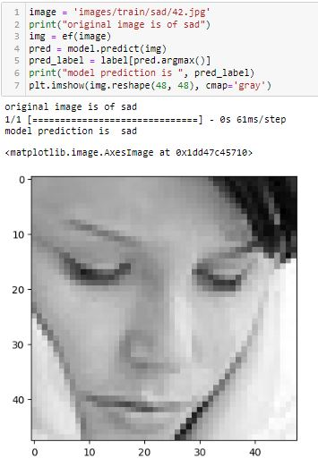
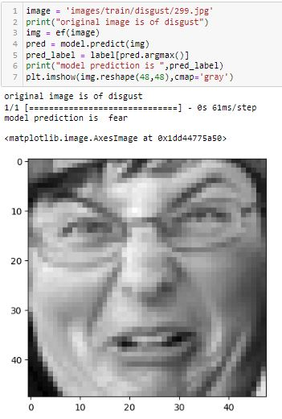
Output Of Actual Image Emotions
Vs
Predicted Emotions

Slide 11
Drawbacks and Limitations
● Need Webcam to detect and analyses of facial expressions
Future Enhancement & Conclusion
Accuracy will become better and better, just need to train data again and again.
We can predict exact facial expression using statistical model to finding maximum facial expressions occur.
After getting maximum facial expression we don’t need to accept any input expression from user it will automatically give video/music therapy depending on maximum facial expressions.

Slide 12
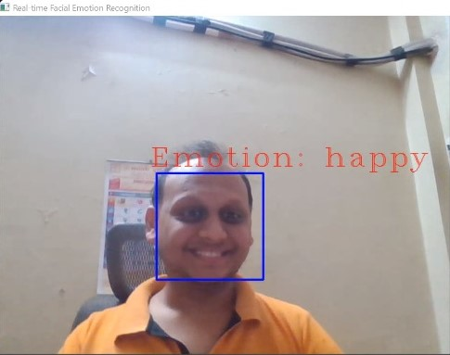
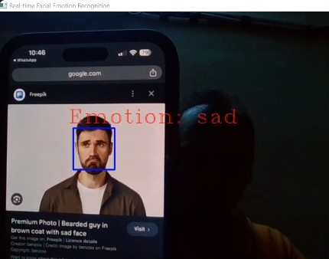
Using Real-Time Live Camera We Can Recognize Facial Expression

Slide 13
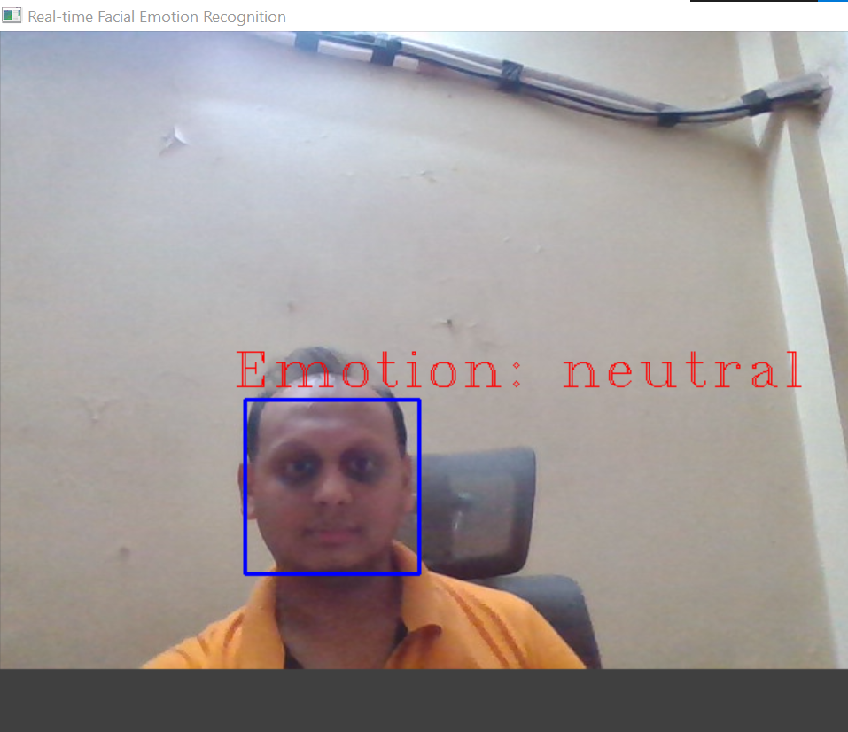
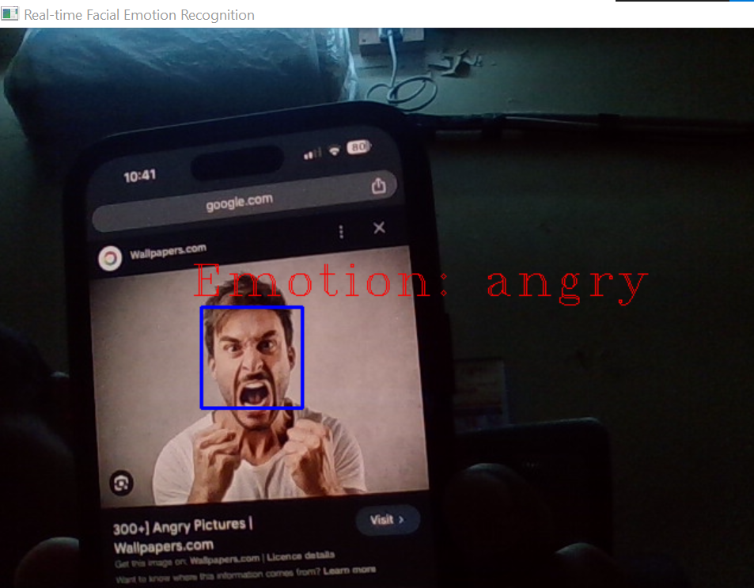
Using Real-Time Live Camera We Can Recognize Facial Expression

Slide 14
INTERPRETATION FOR BUSINESS
This module can be used by psychologists to detect the emotion of their patient and help them accordingly.
This module can be used for the criminals’ sentiment analysis.
There are companies that use AI with emotion recognition API capabilities as HR assistants. The system is helpful in determining whether the candidate is honest and truly interested in the position by evaluating intonations, facial expressions, keywords, and creating a report for the human recruiters for final assessment.
This module can also help customer care service providers to help understand their customer’s behavior and help them.
There is a project using a system in Google Glass smart glasses that aims to help autistic children interpret the feelings of people around them. When a child interacts with other people, clues about the other person’s emotions are provided using graphics and sound.
Companies are also using emotion recognition to determine their business outcomes in terms of the audience’s emotional responses. Apple also released a new feature in their iPhones where an emoji is designed to mimic a person’s facial expressions, called Animoji

Slide 15
Conclusion
The face detection and emotion recognition are very challenging problems. They require a heavy effort for enhancing the performance measure of face detection and emotion recognition. This area of emotion recognition is gaining attention owing to its applications in various domains such as gaming, software engineering, and education.

Slide 16
THANK YOU

