Slide 1
INTRODUCTION
Name: Vrushal Bhegade Project: Diabetes Prediction Batch: PG44 Date: 24-12-2023

Slide 2
SYNOPSIS
The objective of the dataset is to diagnostically predict whether or not a patient has diabetes, based on certain diagnostic measurements included in the dataset.
Steps Followed:
1] Data Analysis: Performed various operations to get more information about the data
2] Data Cleaning: Performed data cleaning to treat outliers, missing values, null values etc
3] Feature Selection: Performed forward and backward stepwise feature selection methods
4] Machine Learning: Developed various machine learning models and obtained accuracy of 83.83%

Slide 3
Types Of Modeling
Supervised
Target Variable
Random Sampling
Unsupervised
No Target Variable/Random Sampling

Slide 4
ALGORITHMS/METHODS USED
Logistic Regression which is supervised learning
Crosstab Reading
Accuracy Formula To Find Performance
Tpr: Used To Find Performance Only For Class 1
Fpr: Finds Amount Of Errors Only For Class 0
Precision: Higher Precision, Better The Model
AUROC: Higher The AREA UNDER THE CURVE, Better The Model

Slide 5
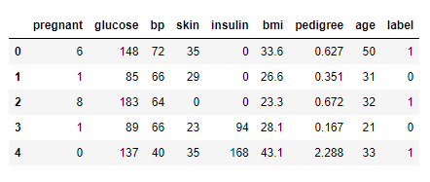
This Is Just A Snippet Of Our Dataset Just To Get Idea How It Looks Like.

Slide 6
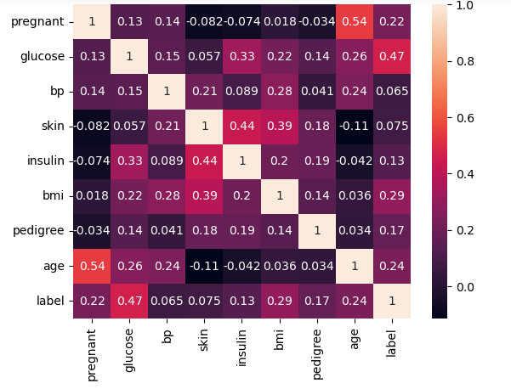
Heat Map

Slide 7
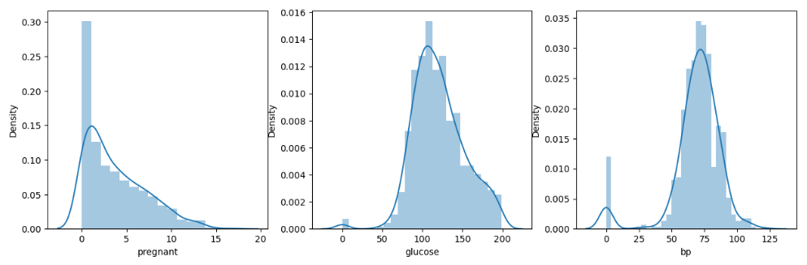
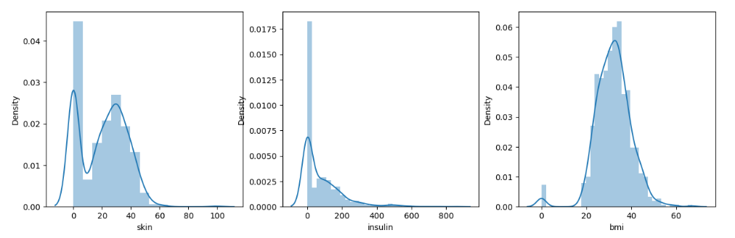
Normal Distribution

Slide 8
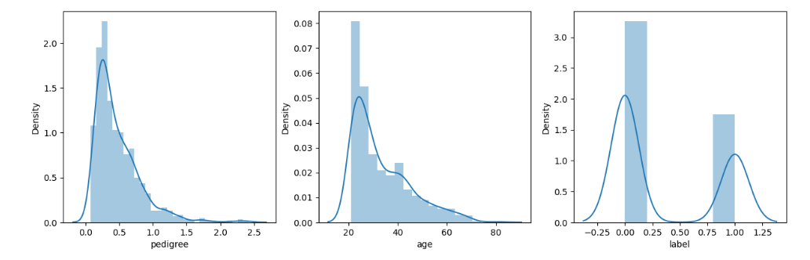
As We Can See The Column Glucose & BMI Seems To Be Normally Distributed,
Where As Pregnant,Insulin,Age and Pedigree Columns Seems To Be Right Skewed

Slide 9
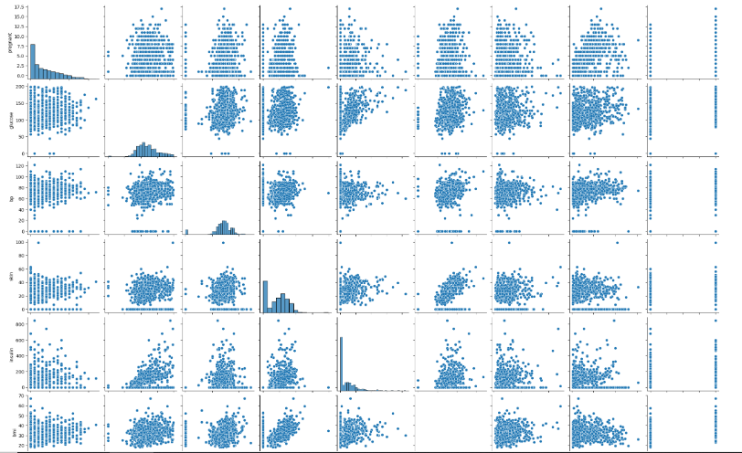
PAIR PLOT
Pairplot Allows Us To Plot Pairwise Relationships Between Variables Within Given Dataset.

Slide 10

CROSS TAB
Predicted
0
1
0
TN
FP
Actual
1
FN
TP
Final Outcome Will Always Be Based On Prediction

Slide 11
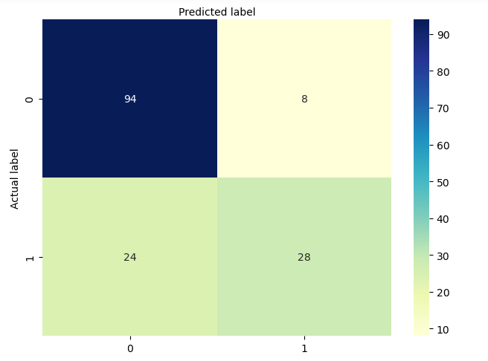
CONFUSION MATRIX

Slide 12
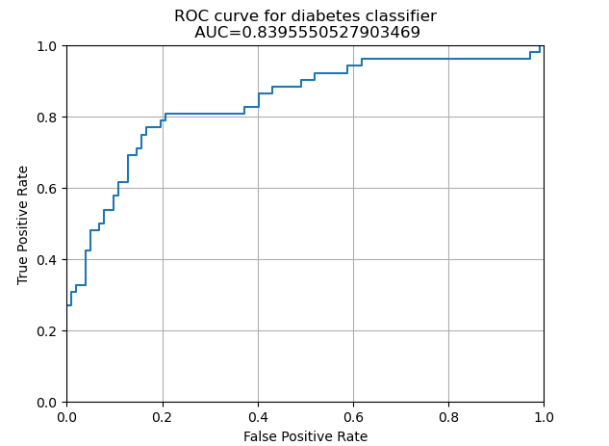
AUROC Curve

Slide 13
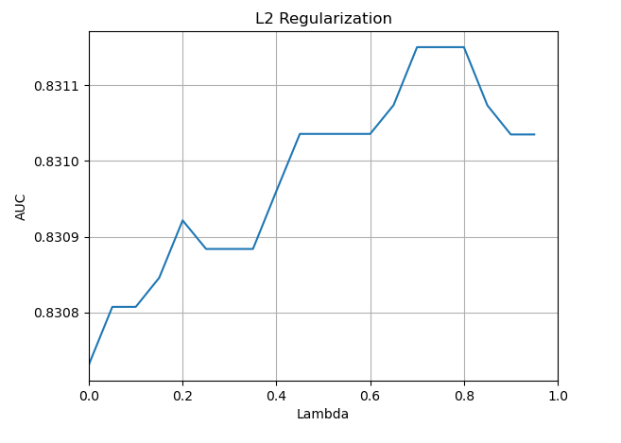
Graph After Tuning The Parameters

Slide 14
INTERPRETATION FOR BUSINESS
Early detection and prevention of individuals at risk allows for earlier cure and reduces healthcare cost.
The model can help healthcare providers to prioritize resources for people at risk individuals & optimizing resource utilization
Model can be used to personalize prevention and treatment plans based on individual risk profiles.
Identifying early intervention and risk management can lead to better health outcomes for individuals with diabetes

Slide 15
THANK YOU

