Slide 1
Agentic RAG Chatbot with MCP
A Retrieval-Augmented Generation (RAG) system enhanced with agent-based design using Model Context Protocol (MCP) for document-based QA.
Key Components:
IngestionAgent: Parses PDFs, DOCX, CSV, TXT, PPTX
RetrieverAgent: Searches document chunks using FAISS
LLMResponseAgent: Generates answers based on retrieved context
MCP: Enables structured message passing between agents.

Slide 2
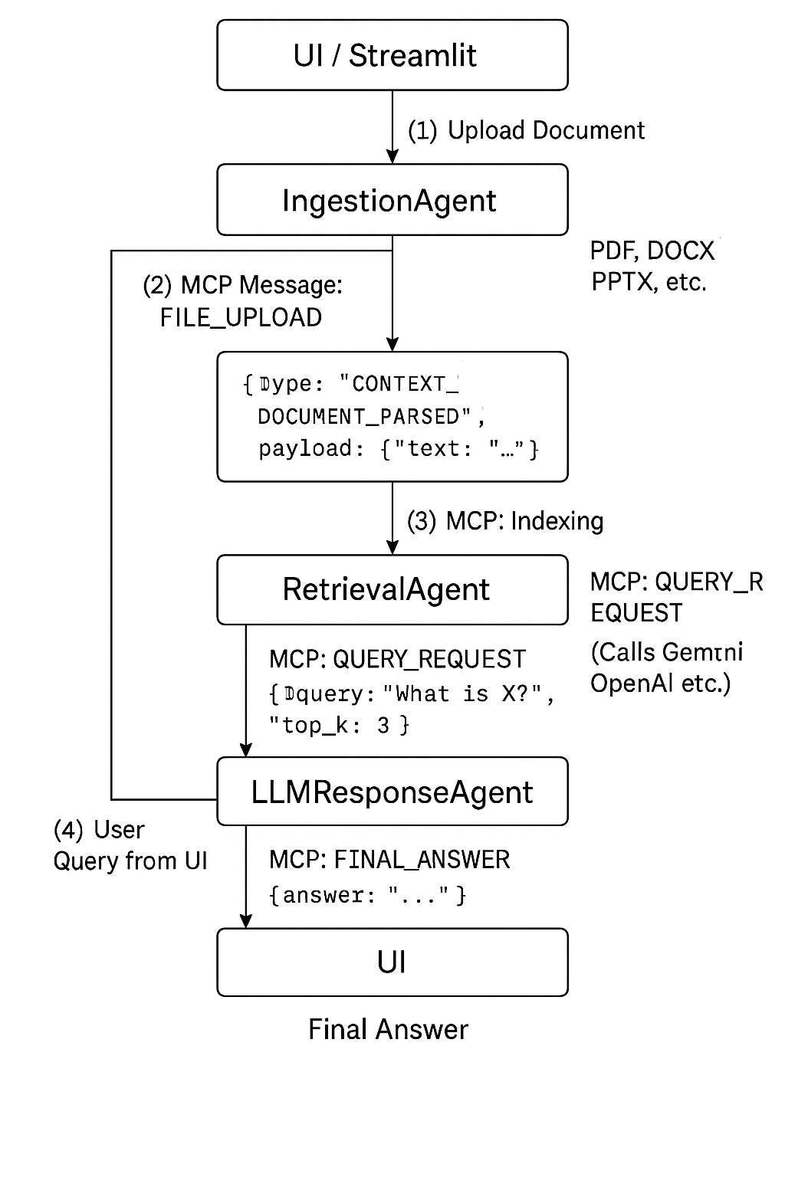
System Workflow

Slide 3
Technology Stack Used
Frontend/UI: Streamlit for interactive document upload and chatbot interface
LLM API: Gemini 1.5 via Google Generative AI SDK | Vector Store | FAISS |
Vector Store: FAISS for fast similarity search over embedded document chunks
Message Protocol: MCP for structured message passing
Document Parsing: PyMuPDF, python-docx, python-pptx, pandas, and plain text I/O

Slide 4
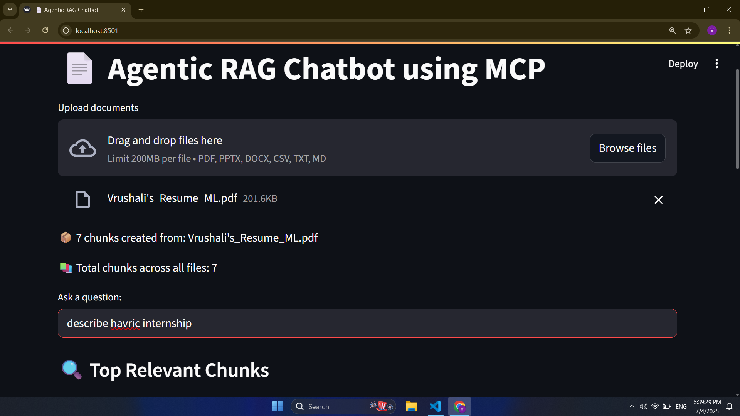
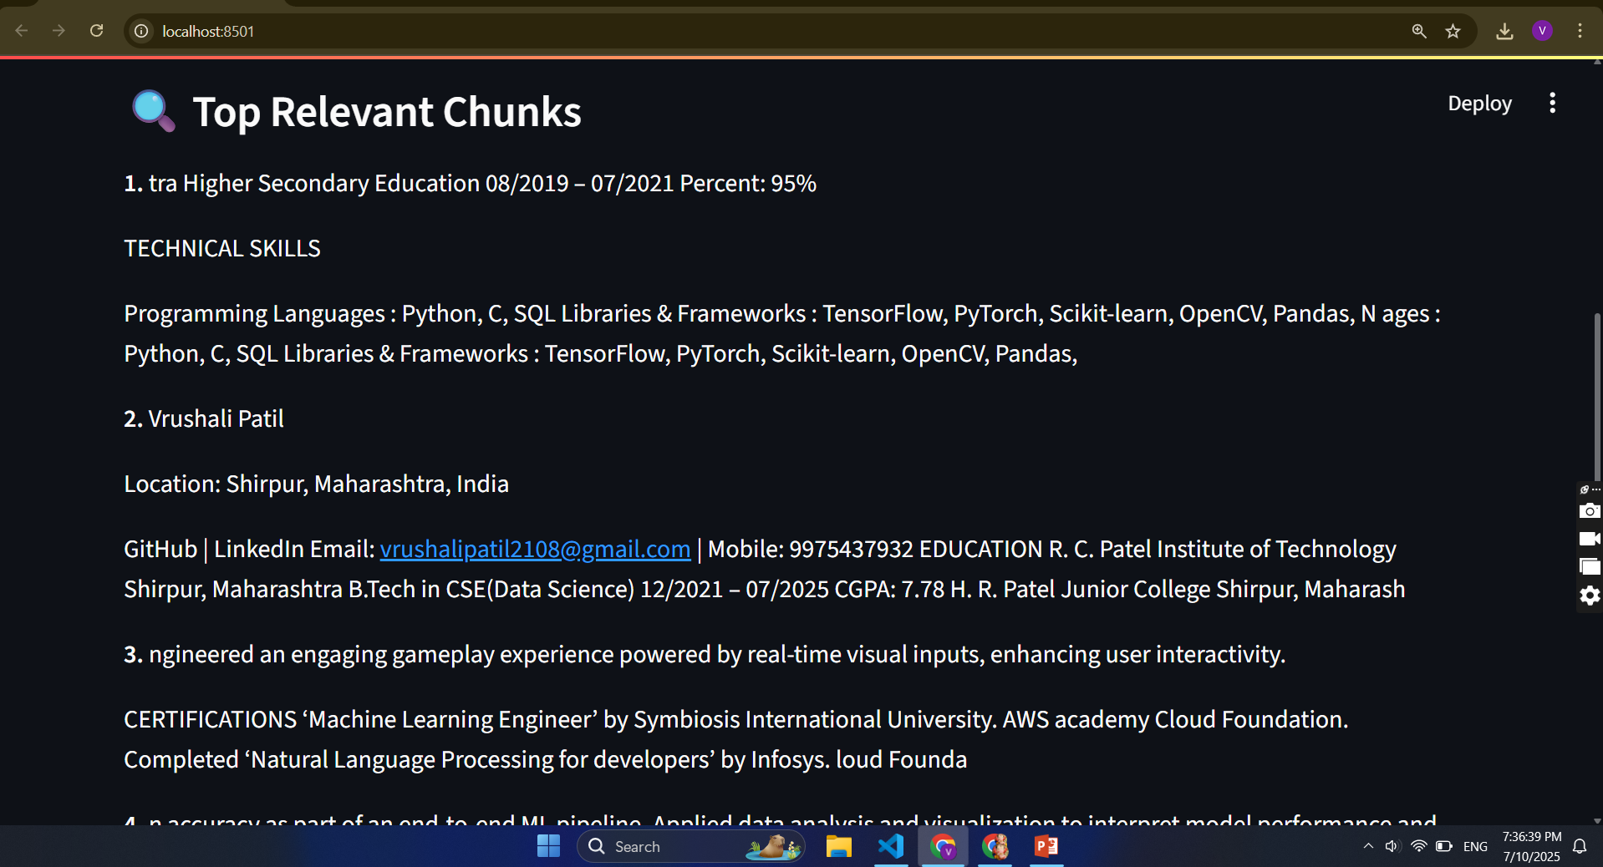
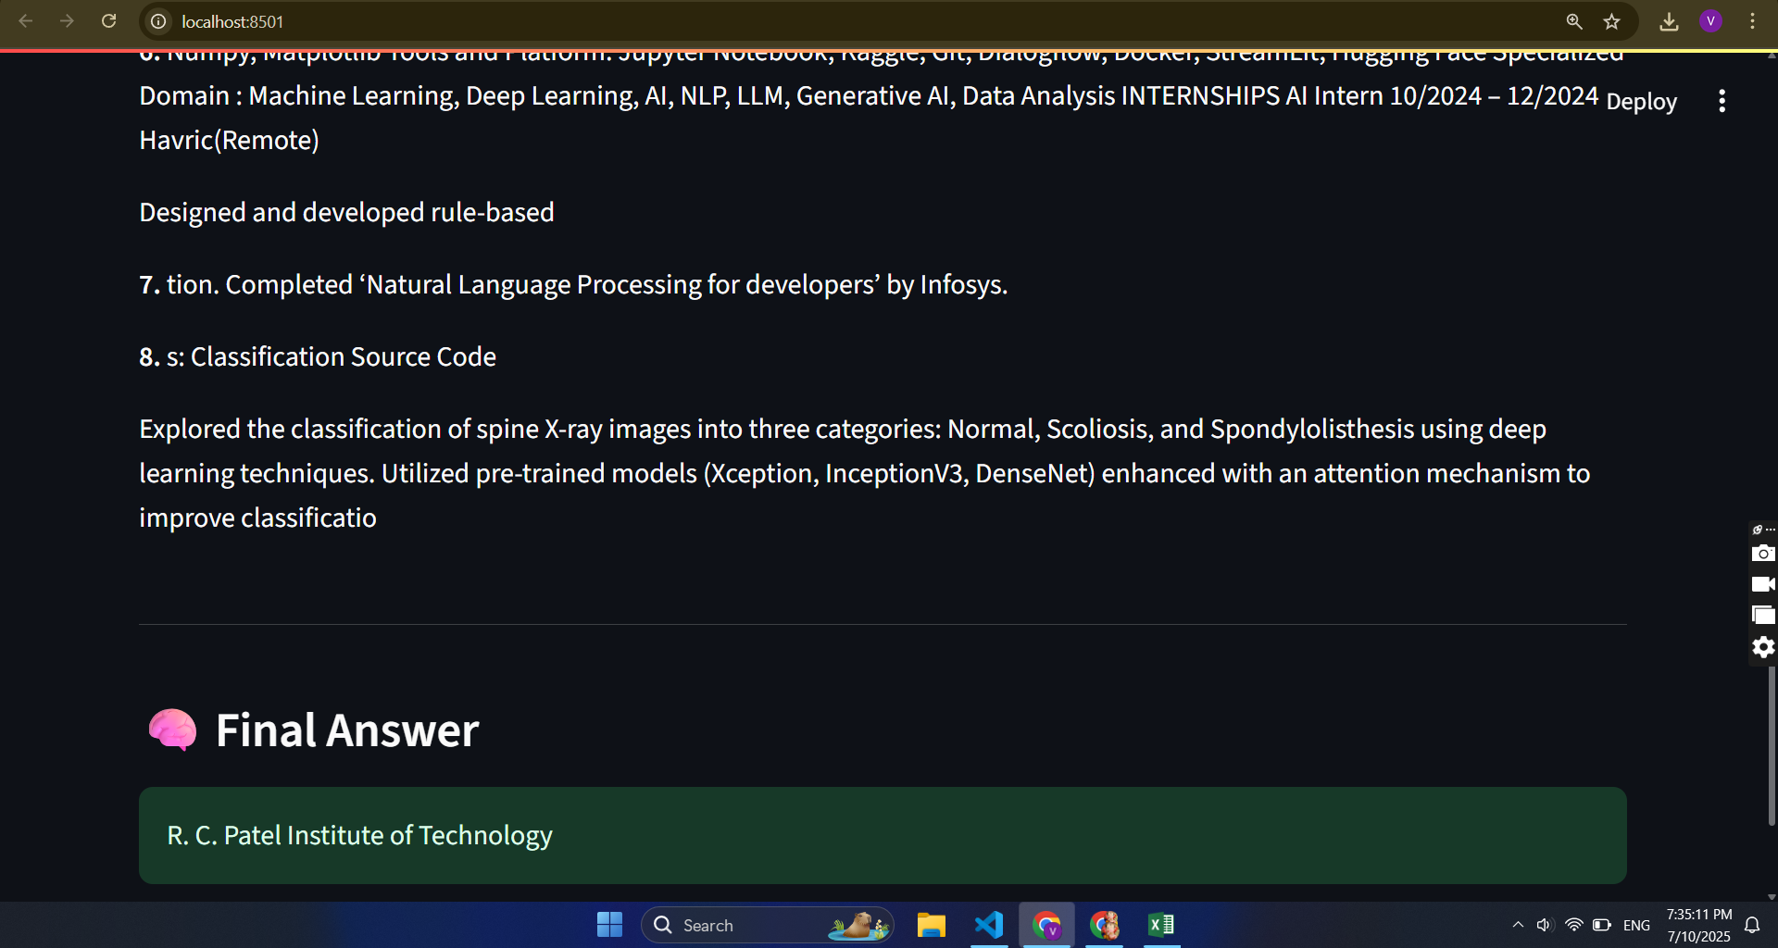
UI Screenshots

Slide 5
Challenges Faced
- Parsing multi-format documents robustly
- Designing effective chunking strategies
- Managing token costs with LLMs
- Designing MCP message schemas
- Ensuring low latency and user-friendly UX

Slide 6
Future Scope
- Integrate open-source models (e.g., Mistral 7B via Ollama)
- Add metadata filtering during retrieval
- Improve UI with chat history
- Introduce feedback and evaluation loops
- Support multi-user sessions

