Slide 1
India’s Crop Production Data Analysis
Vrushali Kulkarni
07/07/2023
Notes:
Good Afternoon, Today I am presenting my analysis on India’s Crop Production. India is an agricultural country. Approx 60% of the population work in this industry directly or indirectly. Which helps to contribute about 18% of total GDP. While doing this analysis the first question in mind my was is India producing enough to feed its population?

Slide 2
Data Collection
Crop Production = India’s Government website
Population = Web scraping
Rainfall = Kaggle
Notes:
I have collected crop produce dataset from Gov website and to add more features, I have also included rainfall and population dataset.

Slide 3
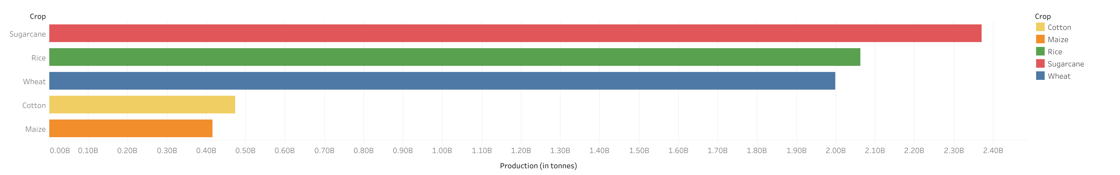
Highest crop producing states (1997 - 2019)
Notes:
This graph represents crops highly produced from 1997-2019. Sugarcane, Rice, Wheat cotton and maize are the most produced ones. Among these crops wheat is grown in winter and others are grown in monsoon. Until 2019 crops like rice and wheat were produced about more than 1.9B tonnes.

Slide 4
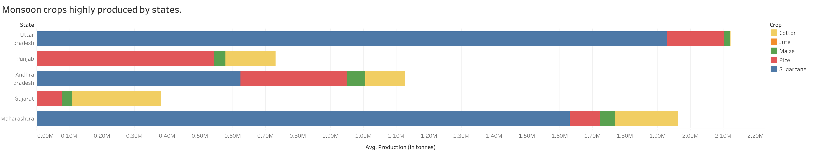
Notes:
In monsoon apart from rice and sugarcane, maize, jute and cotton are also highly produced. Generally Northen and western states produce sugarcane and southern states produce rice in larger quantities during monsoon. Because these crops require lots of water and depending upon the geographic location, the monsoon crops are grown.

Slide 5
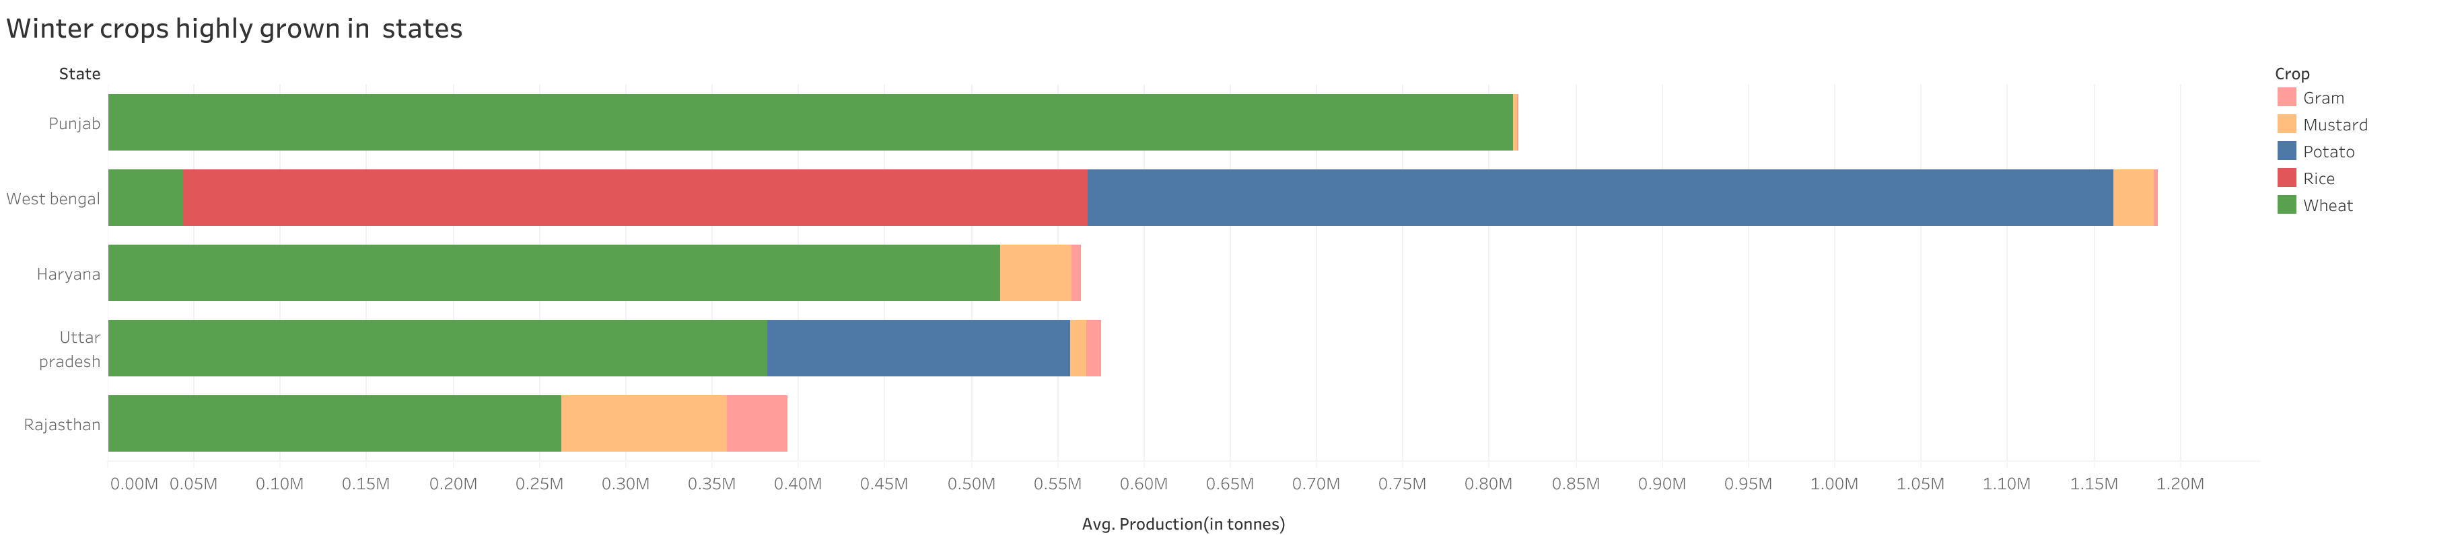
Notes:
In winter, wheat and potatoes are grown largely. Apart from them lentils, gram, mustard and also rice in grown in some parts. Now the northern states like Punjab, Rajasthan and uttar pradesh. Produce wheat…and the weather conditions are perfect for it. Here we can see that these states in total had produced about 2 M tonnes of wheat. These are just top 5 states, there are also other states that contribute to it.
The eastern and southern states still produce rice and sometimes for whole year. The primary reason for it because they are located at the coastal line.

Slide 6
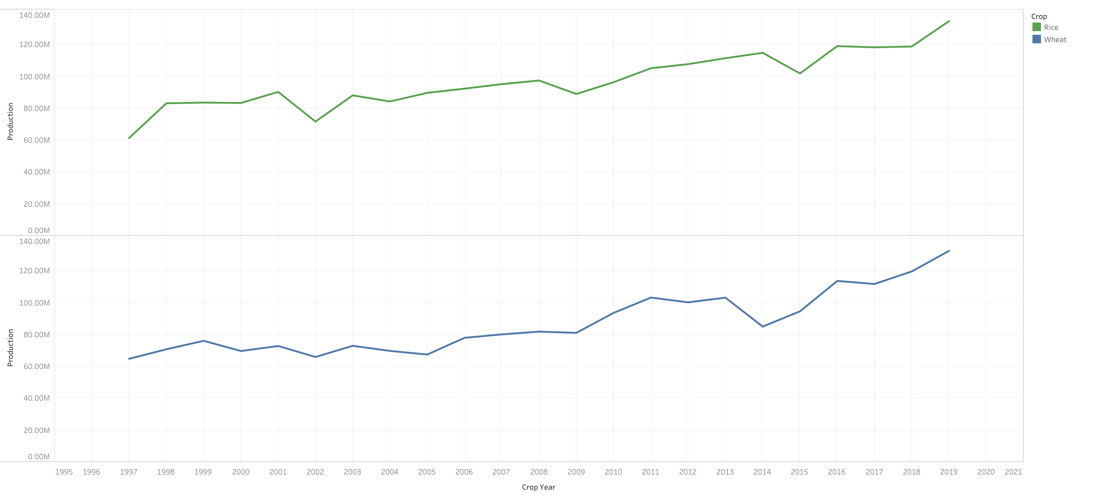
Wheat and Rice statistics
Notes:
This graph show the wheat and the rice produce over the years. We can see that over years the produce has increased gradullay.
In 2019, all the states in total had produced more that 120 M tones of wheat and rice. Some time back, I read news that in 2021 India had exported about 7 M tonnes of wheat and 22 m tonnes of rice. Looking at the numbers India can afford to export.
The graph also shows dips of production for some years like 2002, 2014. The major reason behind it is the rainfall, if there is unexpected or may be more rainfall then it hampers the produce.

Slide 7
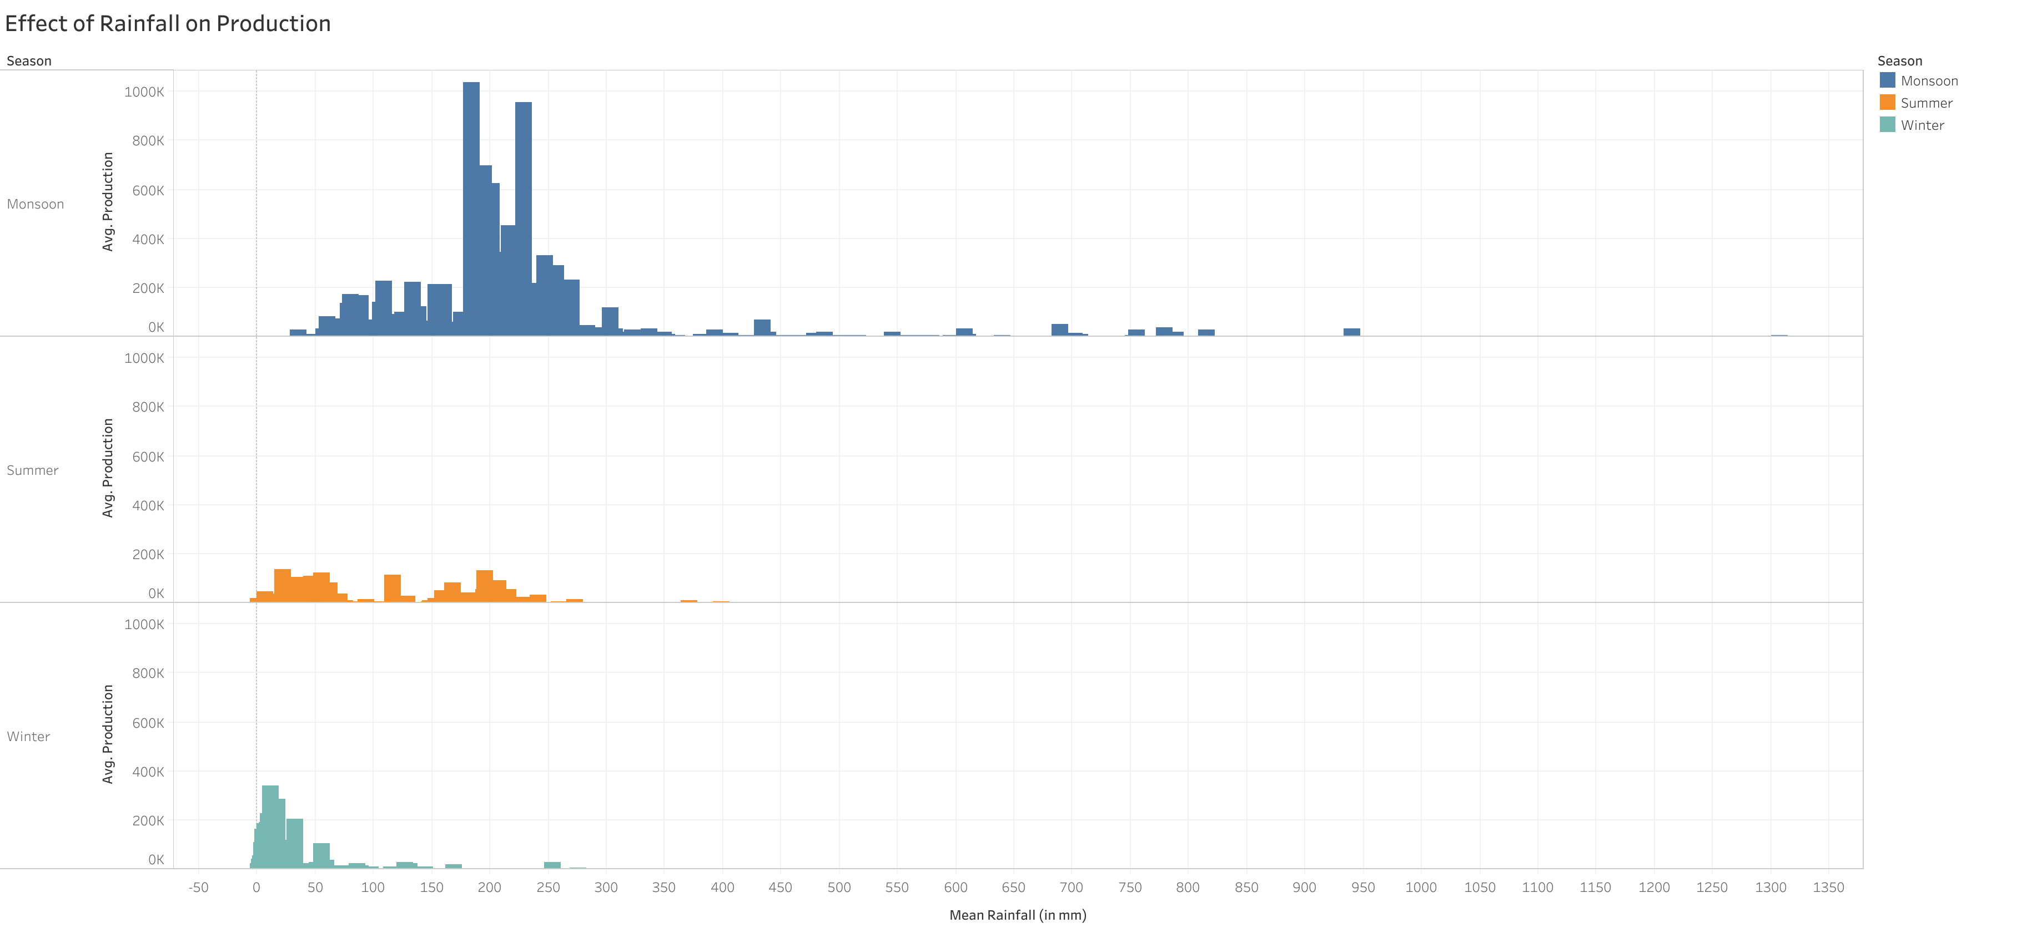
Notes:
Lets understand how rainfall affects produce. In monsoon if rainfall is between 150- 300 mm then the produce flourishes. If not then if certainly affects the crops.
Before doing the analysis, My hypothesis was that rainfall in Summers and Winter destroys the crops. But this is not entire true.
We can see some spikes of production in Summer where there was rainfall between 100-200 mm. as well in winter there is produce when rainfall was about 50 mm.

Slide 8
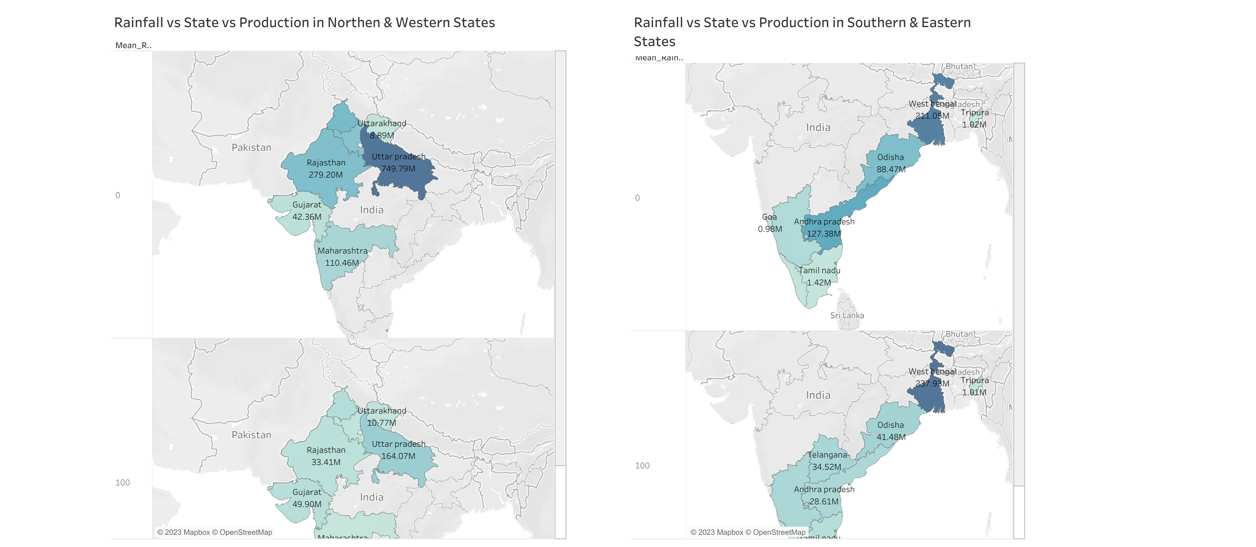
Effect of rainfall on Crop Production in Winter
Notes:
This map represents effect of rainfall in Winter.
In first section of Northern and Western states, the produce was more when there is no rainfall. I come from state Maharastra, where millet and barley are grown in winter…and these crop don’t require rainfall. And if there is it affects the crop production. But in state like Gujrat, the produce increases because they grow diff crop. So it completely depends on crops.
Where some states like west Bengal and Tamil nadu benefit from rain wheares some not.

Slide 9
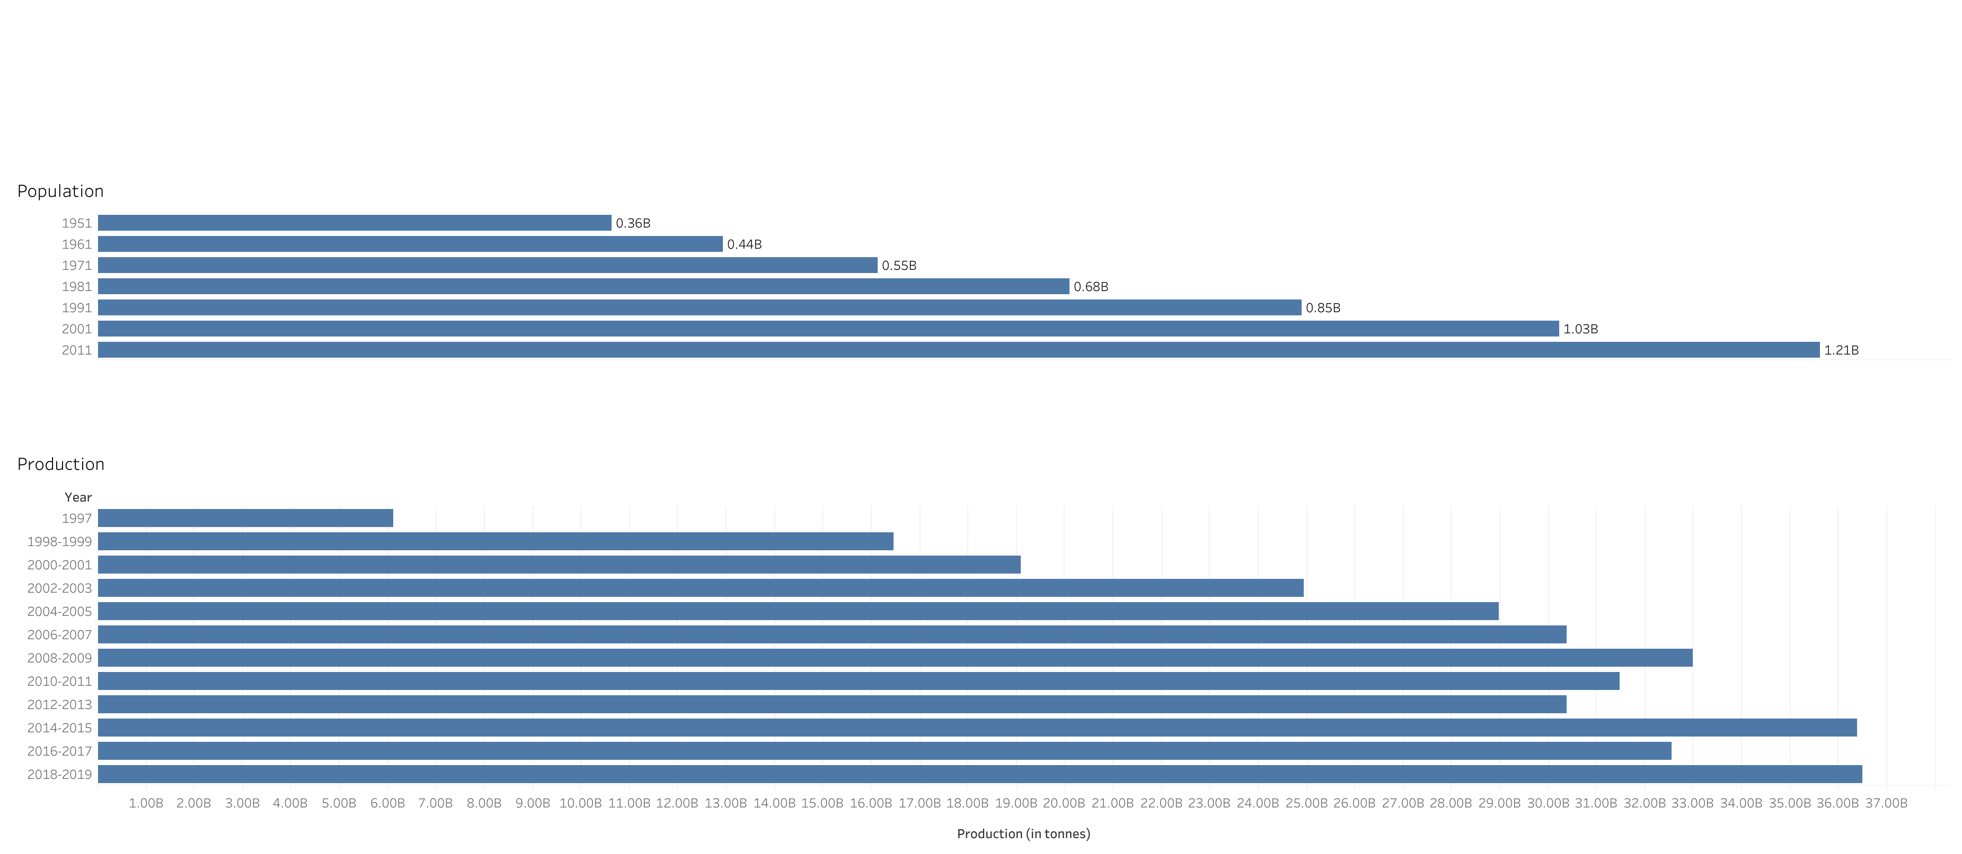
Growth of population and production
Notes:
Still the question lies is India producing enough for it population?
Here is the graph of population and crop produce. Over the years both have increased. The agriculture picked up in 2002- 2003, because of gov policies, pesticides, fertilizers, modern agriculture techniques and tools. Also the workforce was increased.
In 2019, there was gross production of 36 billion tonnes. So it looks like India can feed its population. But still we hear news of hunger, malnutrition. It can be because of inflation, distribution problem, policies for poor people. This dataset doesn’t cover these factors.
Thank you for your time and attention.

Slide 10
Thank you

