Slide 1
SMS Spam CLASSIFICATION
Group 14​

Slide 2
AGENDA
Business Problem​
Dataset Walkthrough
Data Cleaning and Preprocessing
Visualization of Data
​Algorithms & Conclusion​

Slide 3
Business Problem
Short Message Service (SMS) is one of the best and fast ways to communicate.
A lot of bogus messages are being sent for both personal and professional reasons, which is contributing to the problem of SMS spam.
Scammers create fraudulent text messages to deceive you into giving them your personal information, such as your password, account number, or Social Security number.

Slide 4
DataSet WALKTHrough
5573 SMS collected Messages Collected from Kaggle website
Label
Text
Two labels used for each text messages are:
Ham – Legitimate messages
Spam – Fraudulent messages
Provides the exact text message received by the user
Example – Spam: Thanks for your subscription to Ringtone UK your mobile will be charged å£5/month Please confirm by replying YES or NO. If you reply NO you will not be charged
Example – Ham: Oops, I'll let you know when my roommate's done

Slide 5
Data Cleaning
Removed not required columns using drop function
Renamed the two relevant columns as label and text using rename function

Slide 6
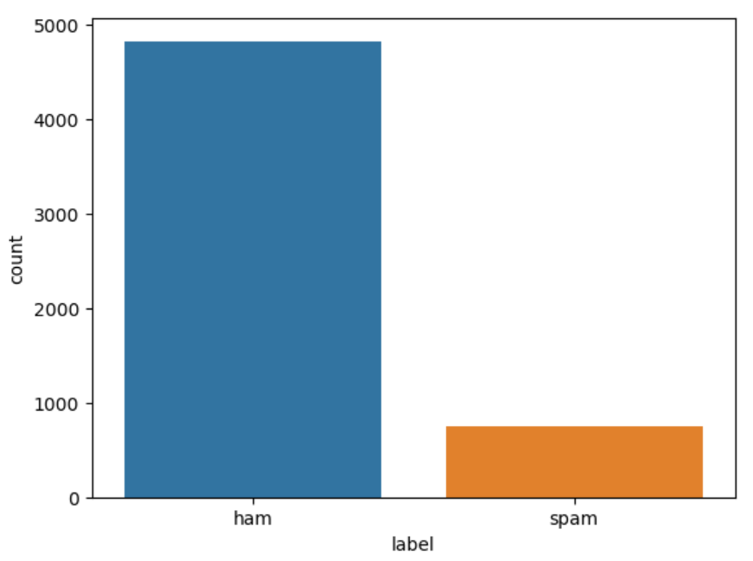
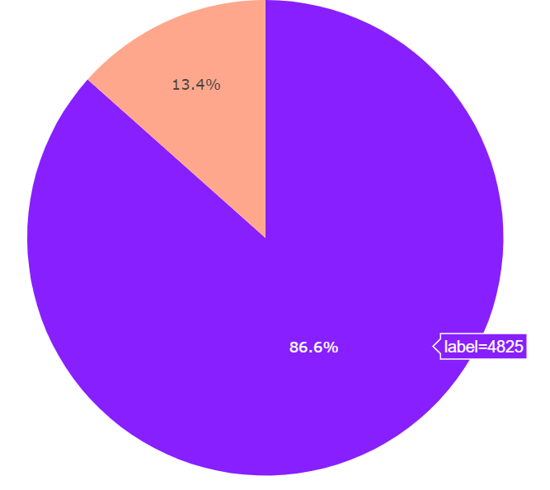
Pre-Processing
Derived the count of spam and ham messages from the entire dataset using seaborn library

Slide 7
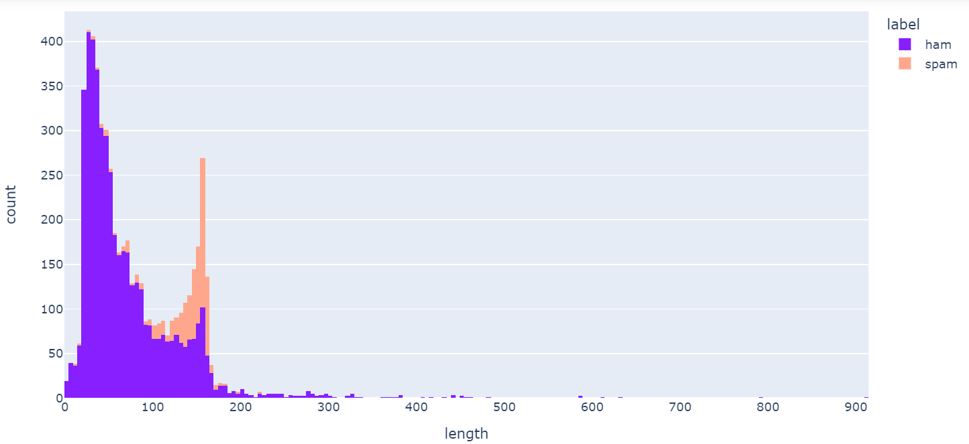
Visualization
Analyzed the length of ham and spam messages

Slide 8
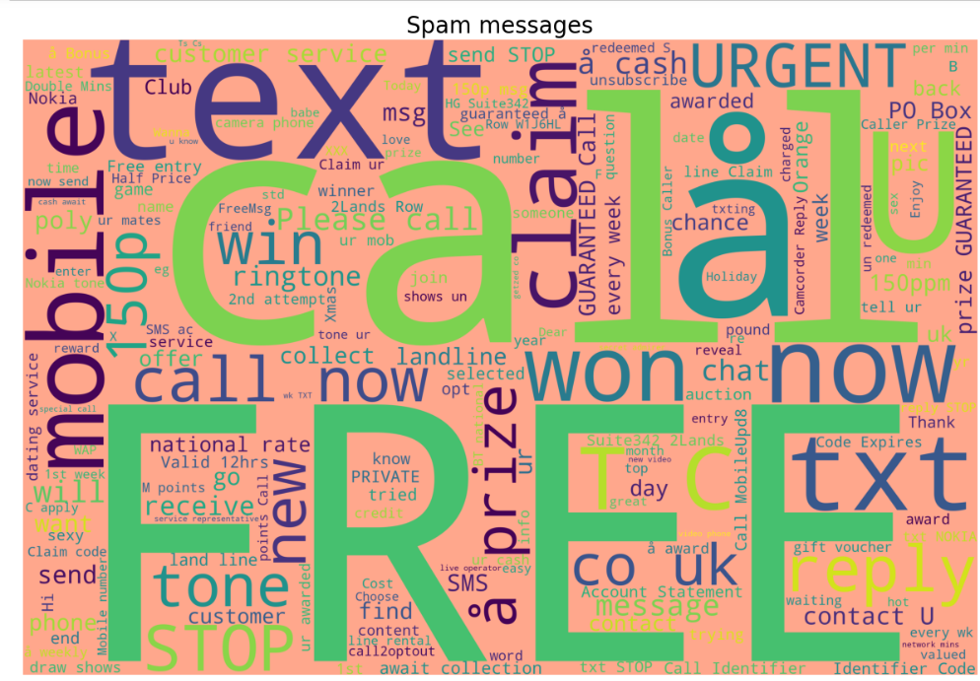
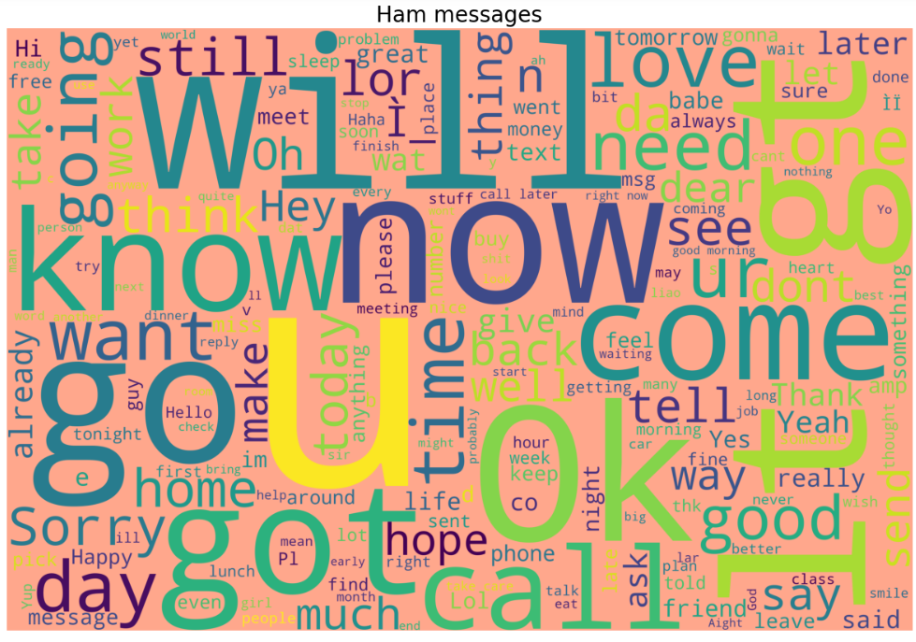
Visualization
Word cloud for spam and ham messages
Categorized ham messages as 0 and spam messages as 1
Removed all special characters from the dataset
Removed stop words

Slide 9
ML ALGORITHMS
Logistic Regression
Naïve Bayes'
K Nearest Neighbors
Support Vector Machines

Slide 10
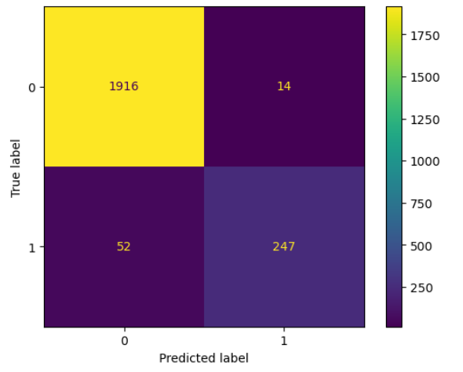
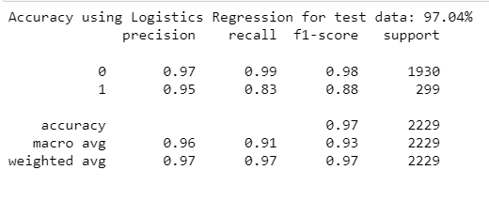
Logistic REGRESSION RESULTS

Slide 11
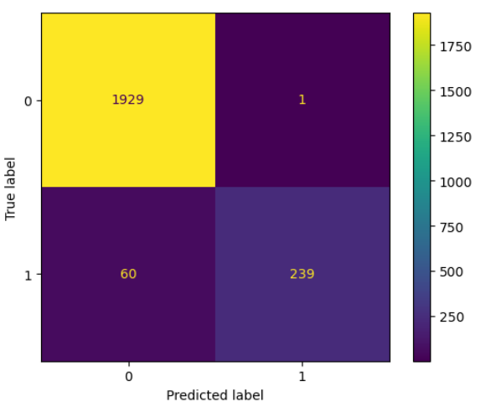
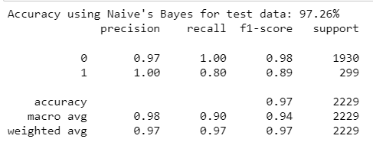
Naïve Bayes’ RESULTS

Slide 12
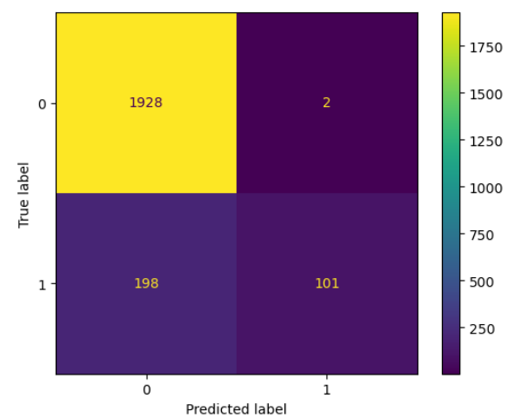
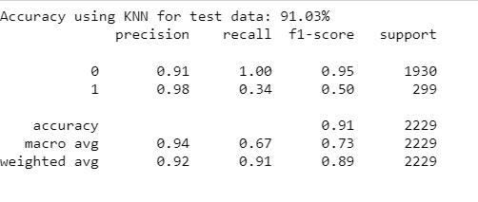
K Nearest Neighbours RESULTS

Slide 13
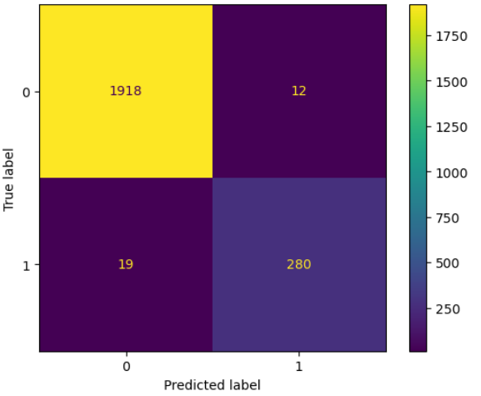
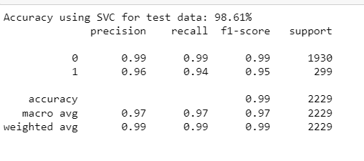
Support VECTOR MACHINES RESULTS

Slide 14
Models and Comparison
 | Naïve Baye’s | Linear Regression | KNN | SVC
Accuracy | 97.26 | 97.04 | 91.3 | 98.61
F1-Score | 0.99 0.94 | 0.99 0.91 | 0.96 0.64 | 0.99 0.95
Precision | 0.98 1.00 | 0.98 0.97 | 0.92 1.00 | 0.99 0.96
Recall | 1.00 0.89 | 1.00 0.85 | 1.00 0.47 | 0.99 0.93

Slide 15
THANK YOU

