Slide 1


Slide 2

Online Book Store
By
Vrushali Kadam (Batch-6522)
Under the Guidance of
Chittaranjan Ghosh

Slide 3
INTRODUCITON
The main purpose of the project is to create an online book store that allows users to search and purchase a book based on title, author and subject. The selected books are displayed in a tabular format and the user can order their books online through credit card payment. The Book saler will have additional functionalities when compared to the common user.

Slide 4
Modules:
Book Saler Module:
Customer Module:
Book Types Module:

Slide 5
Software Requirements:
Front end : Core Java
Back end: MySQL workbench 8.0 CE.
Output section: result on Console Application
Operating System: Windows 10

Slide 6
Data Dictionary

Slide 7
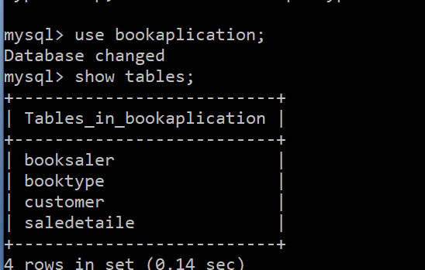
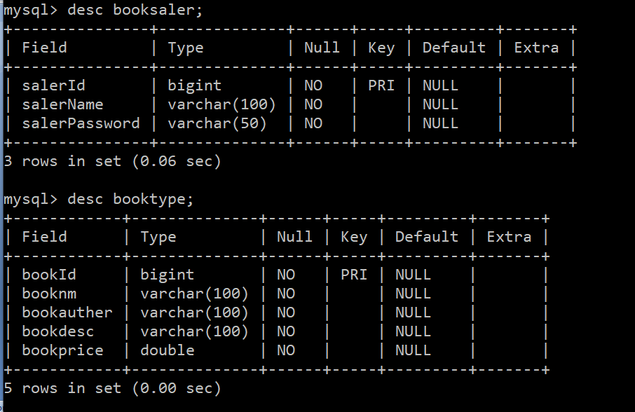
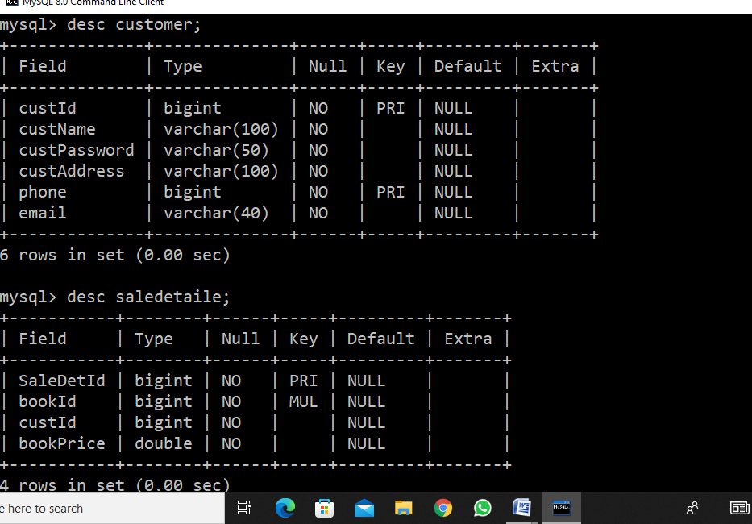

Slide 8
Output Section

Slide 9
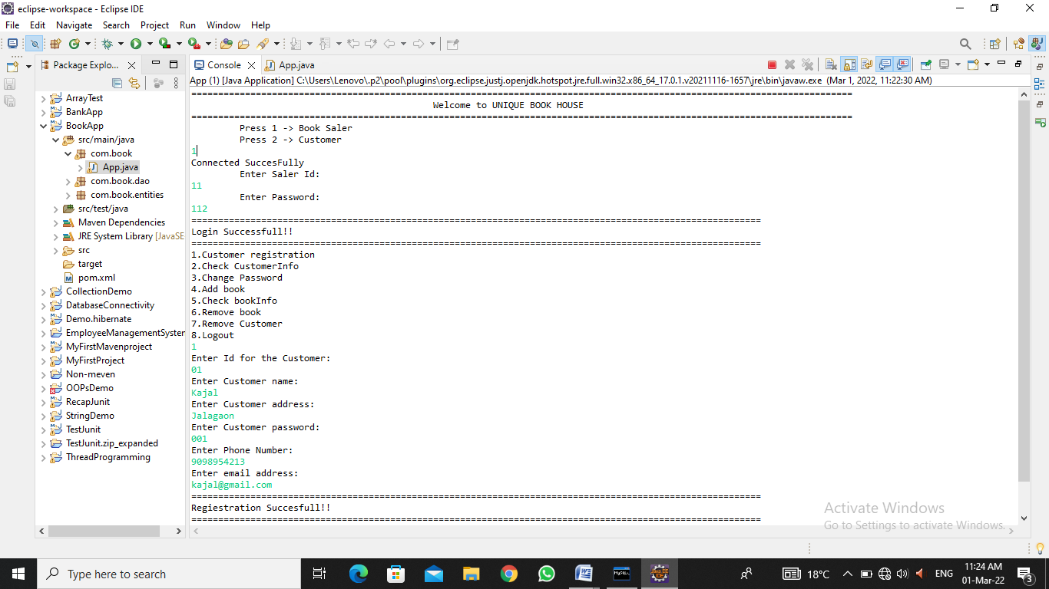

Slide 10
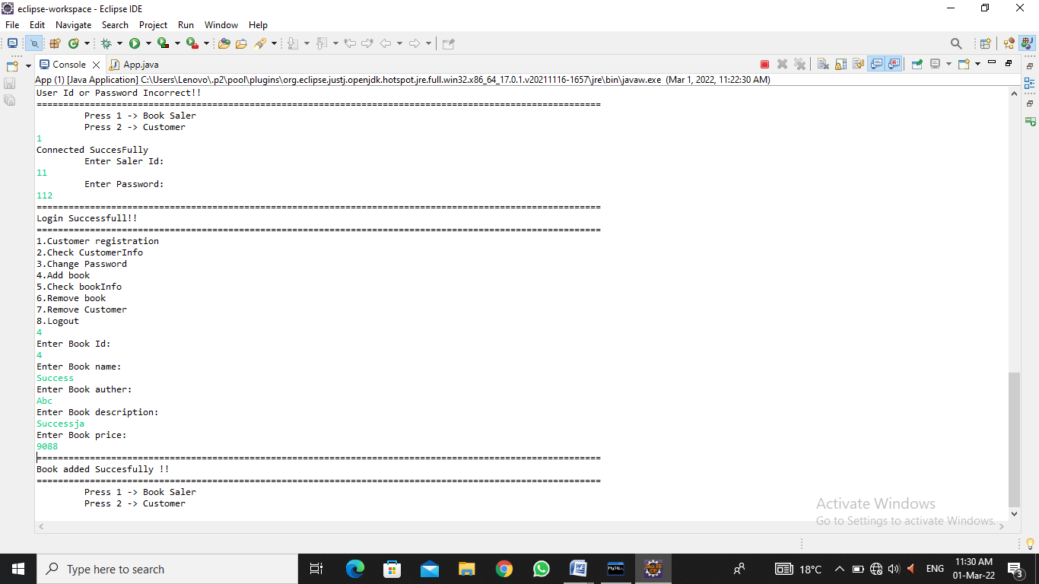

Slide 11
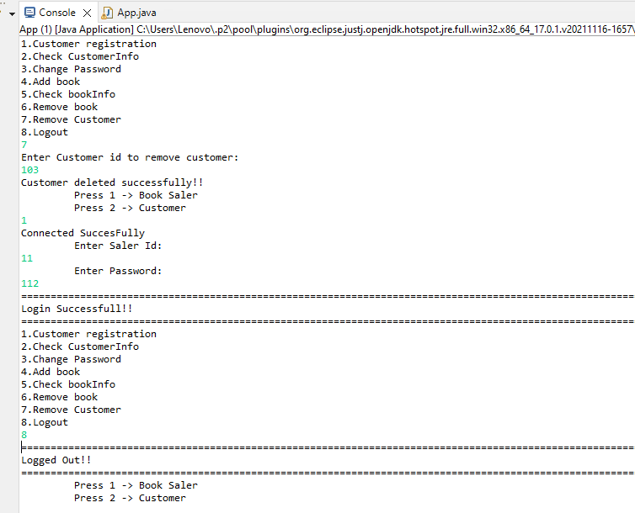

Slide 12
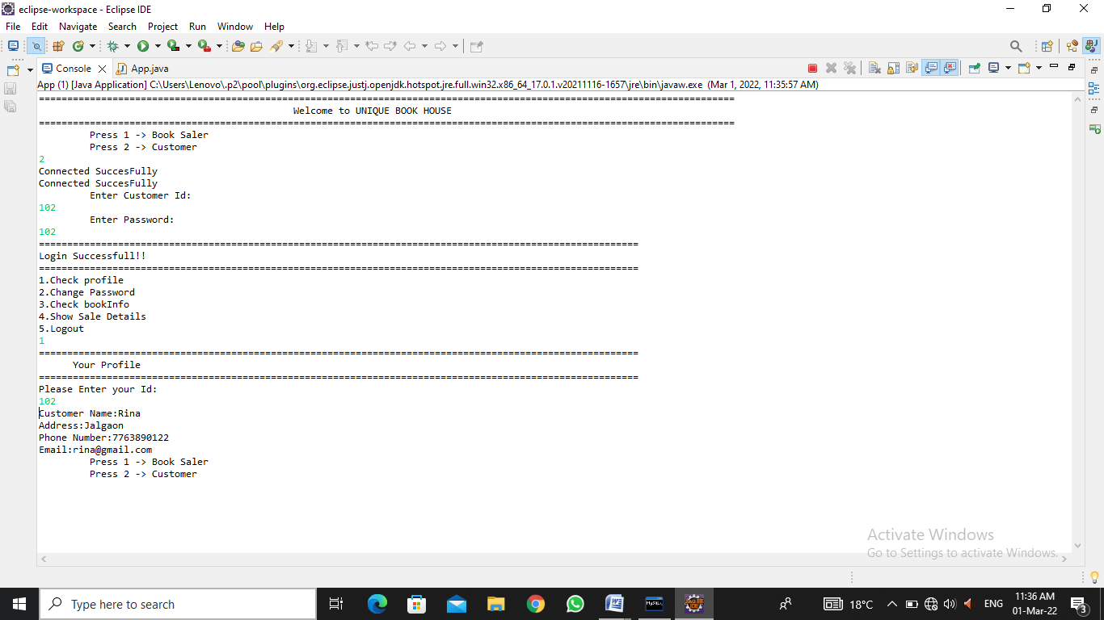

Slide 13
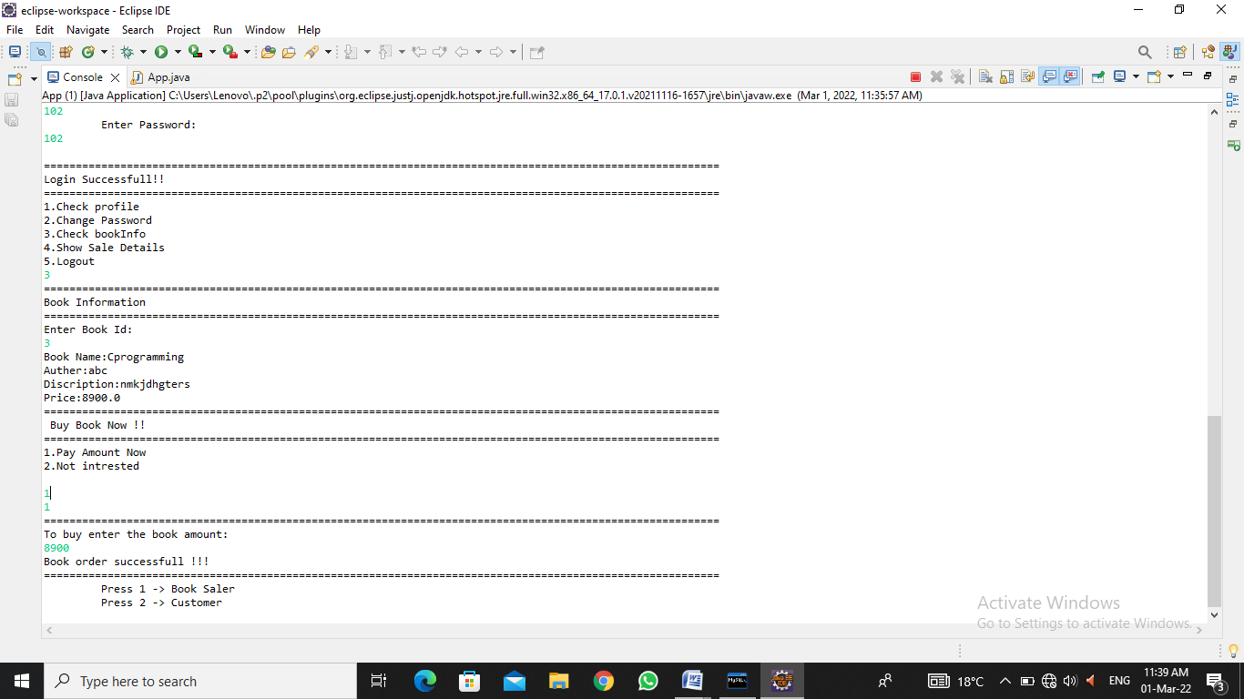

Slide 14
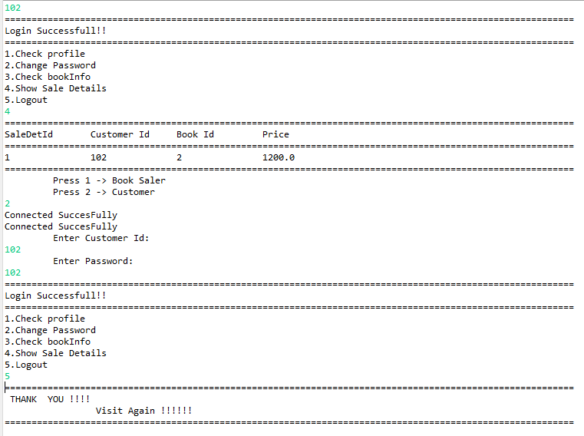

Slide 15


