Slide 1

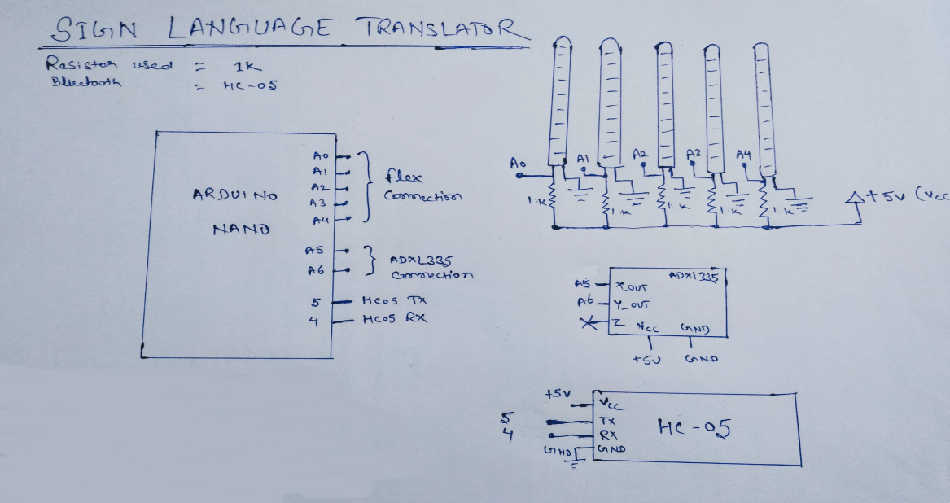
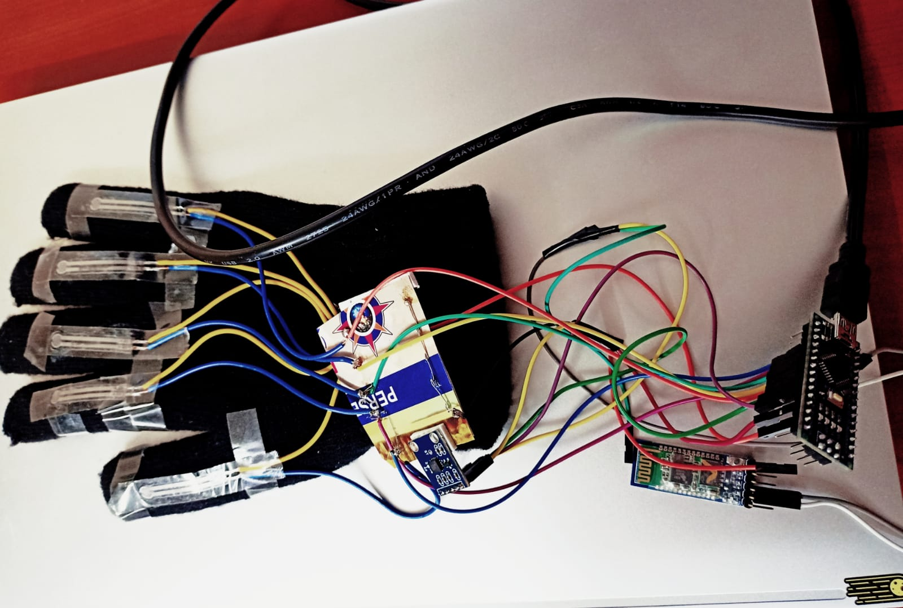




A Glove That Translates Sign Language Into Text and Speech
The glove uses various sensors like
Flex sensors to detect the angles of the fingers,
Accelerometer to detect direction of hand, and converts corresponding combinations of directions and angles of the fingers to text.
Bluetooth to send the responses to the mobile.
It makes use of Arduino NANO as a electronic platform
Y Srinivas
PES1UG20CS517
Venkata Sathvik Adepalli
PES1UG20CS493
Vrushank G
PES1UG20CS516
HB Mahesh

