Slide 1
Project Documentation for M605 Advanced Databases Group Final Project
Submitted by: Vrushita Ketankumar Malani
Student ID : GH1038408
Course: M605 Advanced Databases | Winter 2025
GitHub Repository: https://github.com/vrushitamalani/advancedatabase
Video Demonstration: https://go.screenpal.com/watch/cTetFYniAJn

Slide 2
1. Introduction
Domain: E-commerce Platform Modern e-commerce systems require handling structured data (e.g., user accounts, transactions) and unstructured/semi-structured data (e.g., product reviews, logs).
Objectives:
Design a hybrid database system using PostgreSQL (SQL) and MongoDB (NoSQL).
Implement CRUD operations, optimize performance, and ensure seamless integration.
Demonstrate practical use cases for structured and unstructured data storage.
Significance:
Hybrid systems balance ACID compliance (SQL) with scalability for dynamic data (NoSQL).
Enhances flexibility in managing diverse data types common in e-commerce.

Slide 3
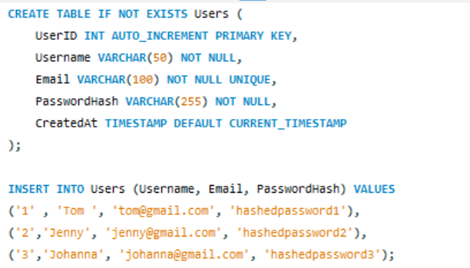
3. Implementation

Slide 4

Functional Queries:
SQL Join Query:
2.NoSQL Aggregation:

Slide 5
4. Challenges and Solutions
Challenge | Solution
Data consistency between SQL and NoSQL | Used eventual consistency for reviews; scheduled sync jobs.
Query performance in NoSQL | Created indexes on product_id and user_id.
Schema design conflicts | Separated transactional data (SQL) from dynamic data (NoSQL).

Slide 6
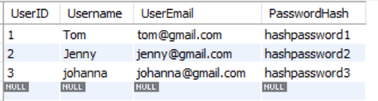
5. Results
SQL Query Output:
NoSQL Aggregation Result:

Slide 7
Screenshots:
PostgreSQL Table Structure:

Slide 8
6. Conclusion and Future Work
Outcomes:
Successfully integrated SQL and NoSQL databases for an e-commerce platform.
Achieved ACID compliance for transactions and flexible data handling for reviews.
Future Work:
Implement real-time data synchronization using Apache Kafka.
Add caching (Redis) to improve read performance.

Slide 9
7. Contributions
Team Member | Responsibilities
Vrushita Malani | SQL database design, query implementation
 | NoSQL setup, integration, video demonstration

Slide 10
8. References
PostgreSQL Documentation. (2025). PostgreSQL.org. https://www.postgresql.org
2.MongoDB Inc. (2025). MongoDB Manual. https://docs.mongodb.com

