Slide 1
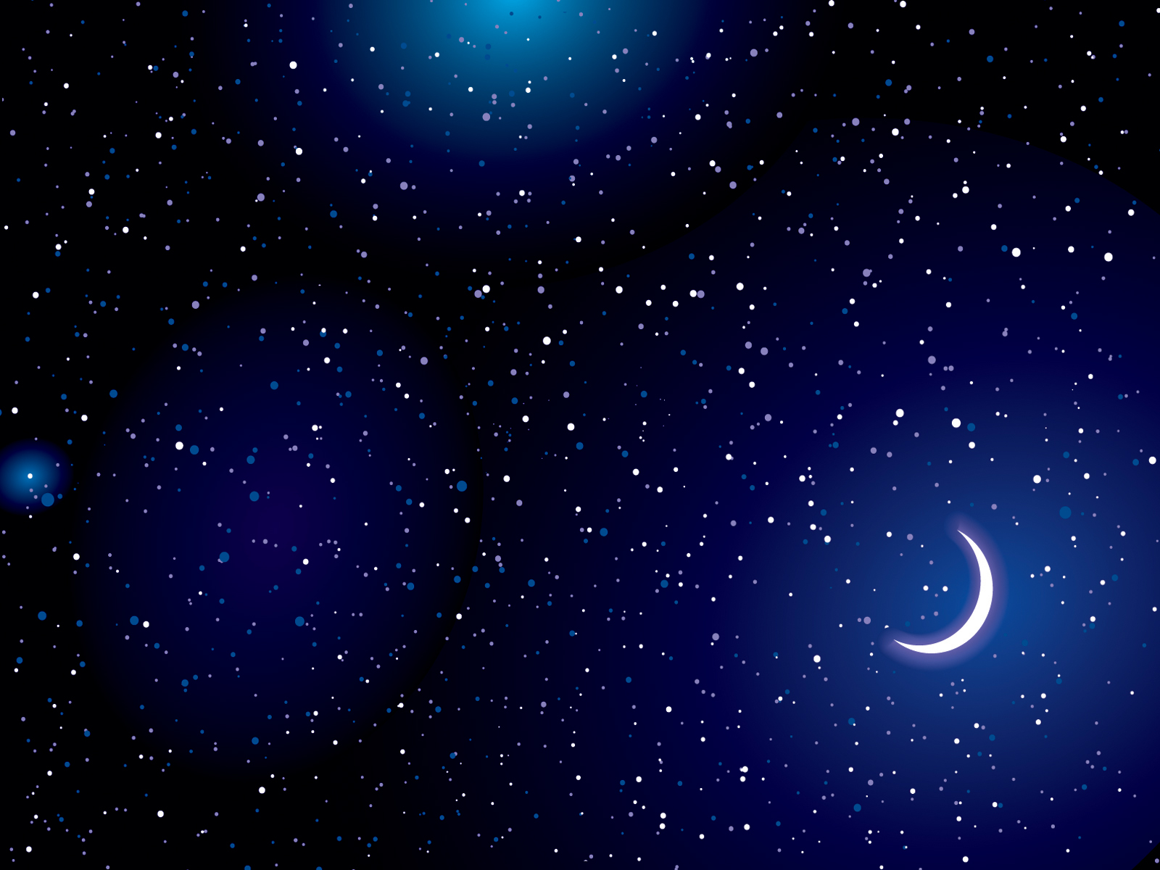
God The Creator
“In the Beginning, God created the Heavens and the Earth.”
Genesis 1:1

Slide 2
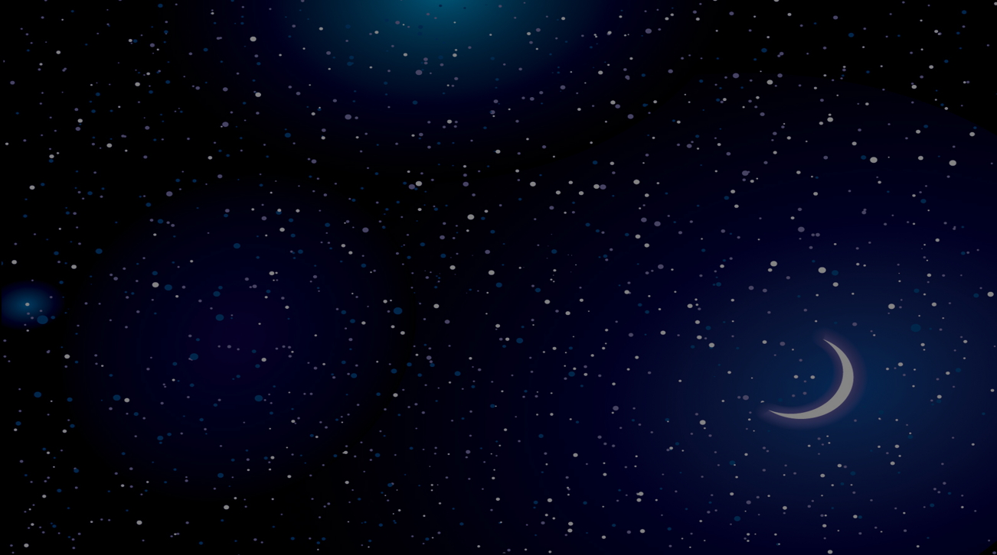
God Spoke All of Creation into Existence
“Let all the earth fear the LORD; let all the inhabitants of the world stand in awe of him! For he spoke, and it came to be; he commanded, and it stood firm.”
Psalm 33:9

Slide 3
All Things Are Upheld by the Power of His Word
“For by him all things were created, in heaven and earth – all things were created through him and for him. And he is before all things, and in him all things hold together.”
Colossians 1:17

Slide 4
The Host of Heaven Worships Him as The Creator
“Worthy are you, our Lord and God, to receive glory and honor and power, for you created all things, and by your will they existed and were created.”
Revelation 4:11

Slide 5
The Glory of God’s Creation Speaks of Him as Creator
“For his invisible attributes, namely, his eternal power and divine nature, have been clearly perceived, ever since the creation of the world, in the things that have been made.”
Romans 1:20

Slide 6
God’s Creation is to Worship and Praise Him as Creator
“But the hour is coming, and is now here, when the true worshipers will worship the Father in spirit and truth, for the Father is seeking such people to worship him.”
John 4:23

Slide 7

Let Us Begin Our Worship Of Praise To God Our Creator!
“Oh come, let us worship and bow down; Let us kneel before the LORD our Maker. For He is our God, and we are the people of His pasture.”
Psalm 96:6-7

