Slide 1
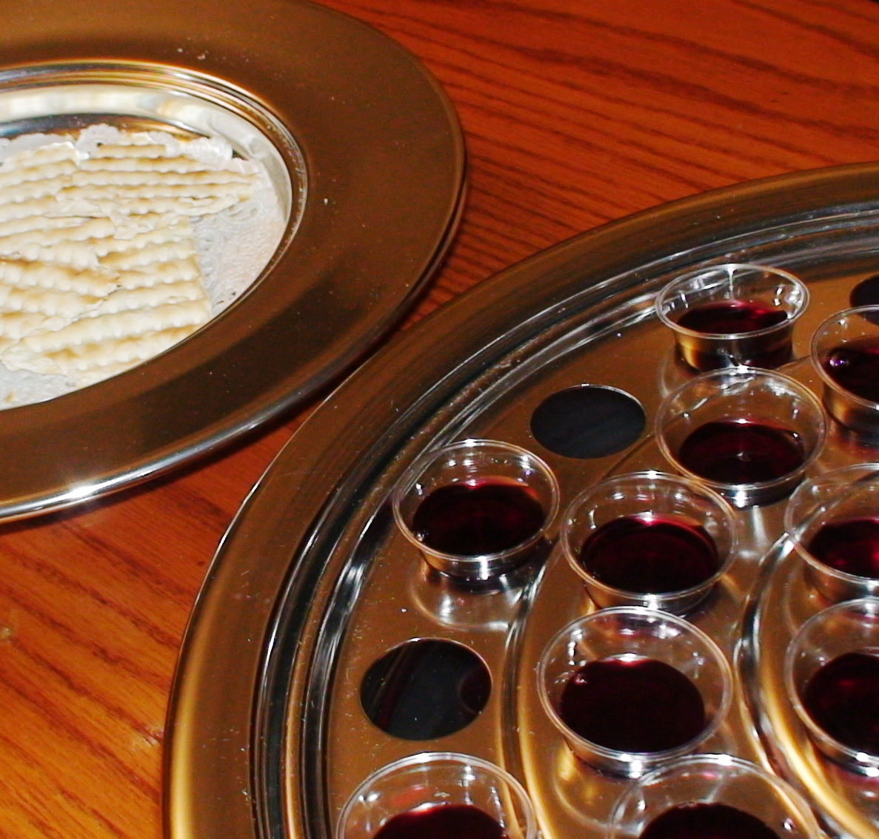
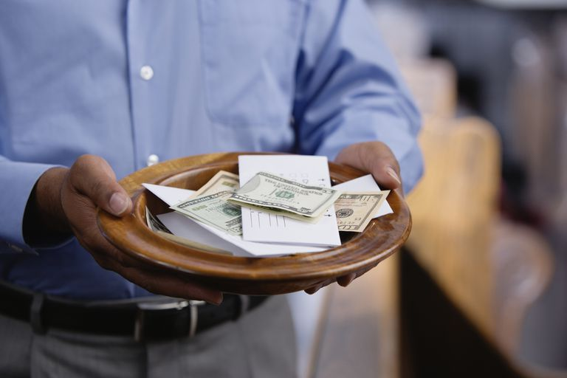
Contrasting Bible Doctrine with Denominational Practices:
The Lord’s Supper and Church Treasuries

Slide 2

The Lord’s Supper: With Many Denominations
Most are scriptural in the elements & purpose (Mt. 26:26-29; 1 Cor. 11:23-26)
Most are UNSCRIPTURAL in the day & frequency (Cf. Acts 20:7; Exod. 20:8-11)

Slide 3
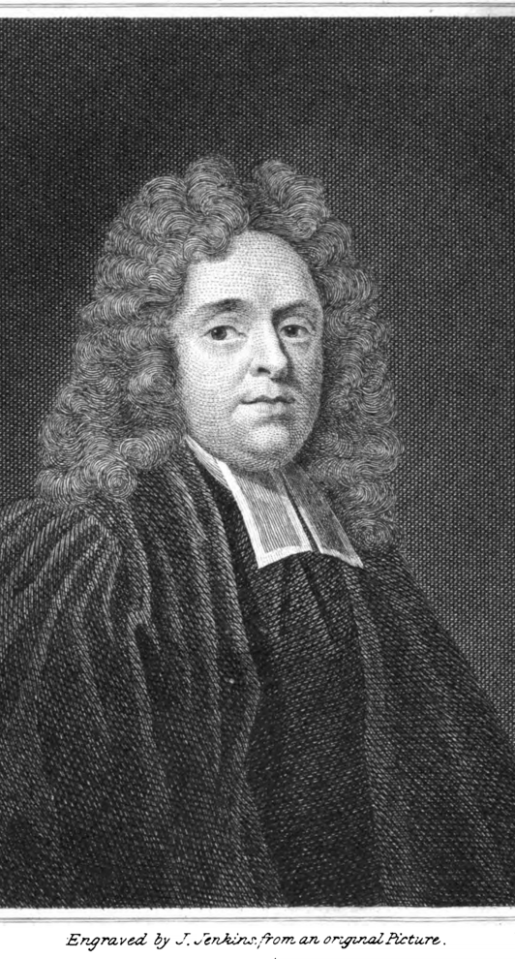
Matthew Henry’s Concise Commentary
“Though the disciples read, and meditated, and prayed, and sung apart, and thereby kept up communion with God, yet they came together to worship God, and so kept up their communion with one another. They came together on the first day of the week, the Lord's day. It is to be religiously observed by all disciples of Christ. In the breaking of the bread, not only the breaking of Christ's body for us, to be a sacrifice for our sins, is remembered, but the breaking of Christ's body to us, to be food and a feast for our souls, is signified. In the early times it was the custom to receive the Lord's supper every Lord's day, thus celebrating the memorial of Christ's death.”

Slide 4
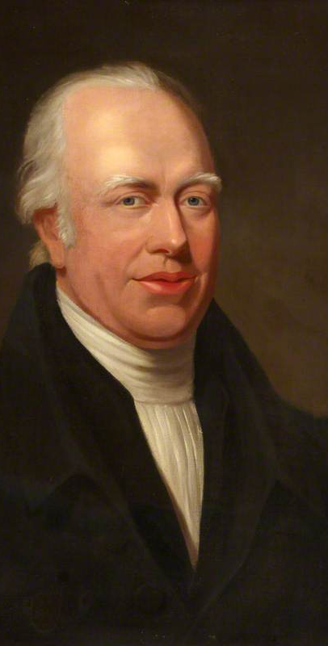
Adam Clarke’s Commentary
“Upon the first day of the week—What was called κυριακη, the Lord's day, the Christian Sabbath, in which they commemorated the resurrection of our Lord; and which, among all Christians, afterwards took the place of the Jewish Sabbath. To break bread—To break eucaristia, the eucharist, as the Syriac has it; intimating, by this, that they were accustomed to receive the holy sacrament on each Lord's day.”

Slide 5
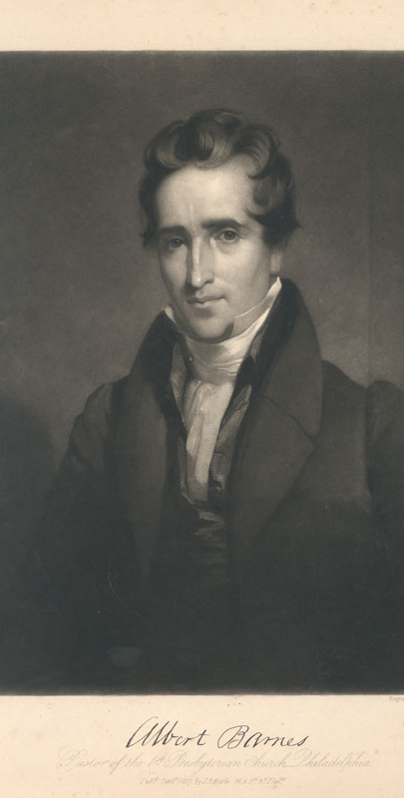
Albert Barnes:
“And upon the first day of the week - Showing thus that this day was then observed by Christians as holy time. Compare 1 Corinthians 16:2; Revelation 1:10. To break bread - Evidently to celebrate the Lord‘s Supper. Compare Acts 2:46. So the Syriac understands it, by translating it, “to break the eucharist”; that is, the eucharistic bread. It is probable that the apostles and early Christians celebrated the Lord‘s Supper on every Lord‘s day.”

Slide 6
Church Treasuries: With Many Denominations
NT congregations raised their funds by contributions on the first day of the week (1 Cor. 16:1-2; Cf. 2 Cor. 9:6-7)
Most denominations raise funds in addition to the pattern revealed in the NT

Slide 7
Coffee shop
Landscaping
Bookstore
Brewery
Restaurant
Hotel and Bed-and-Breakfast
Media Productions
Recording Studio
T-shirt company
Conference
Design Firm
Real Estate
Magazines and Newspapers
Software Repair
Retail
Clothing Line

Slide 8
        “Having a business creates a source of revenue that is entirely independent from tithes and offerings. This additional income gives pastors freedom to do what God has called them to do, without having to worry about lack of resources or numbers of members.” https://outreachmagazine.com/resources/ministry-consulting/44105-should-your-church-start-a-business.html
Coffee shop
Landscaping
Bookstore
Brewery
Restaurant
Hotel and Bed-and-Breakfast
Media Productions
Recording Studio
T-shirt company
Conference
Design Firm
Real Estate
Magazines and Newspapers
Software Repair
Retail
Clothing Line

Slide 9
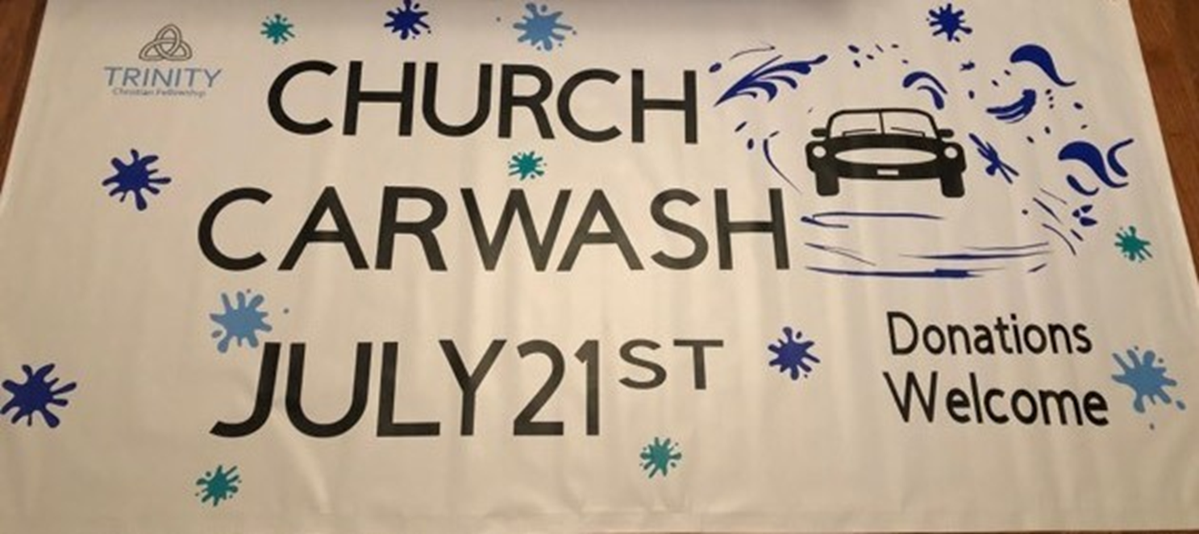


2 John 9-11
“Whoever transgresses and does not abide in the doctrine of Christ does not have God. He who abides in the doctrine of Christ has both the Father and the Son. ¹⁰ If anyone comes to you and does not bring this doctrine, do not receive him into your house nor greet him; ¹¹ for he who greets him shares in his evil deeds.” (NKJV)

Slide 10
Matthew 28:18-20
¹⁸ And Jesus came and spoke to them, saying, "All authority has been given to Me in heaven and on earth. ¹⁹ Go therefore and make disciples of all the nations, baptizing them in the name of the Father and of the Son and of the Holy Spirit, ²⁰ teaching them to observe all things that I have commanded you; and lo, I am with you always, even to the end of the age."
(NKJV)

