Slide 1
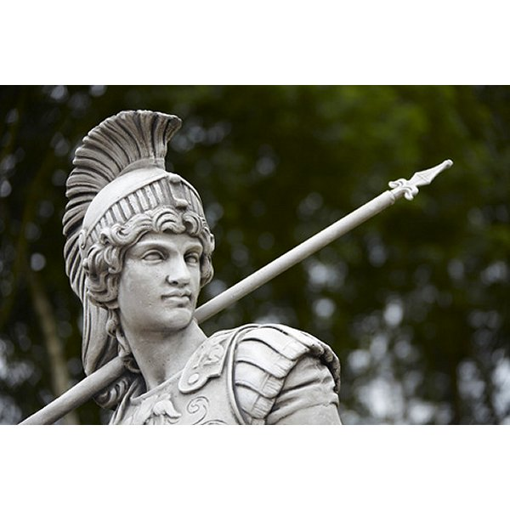

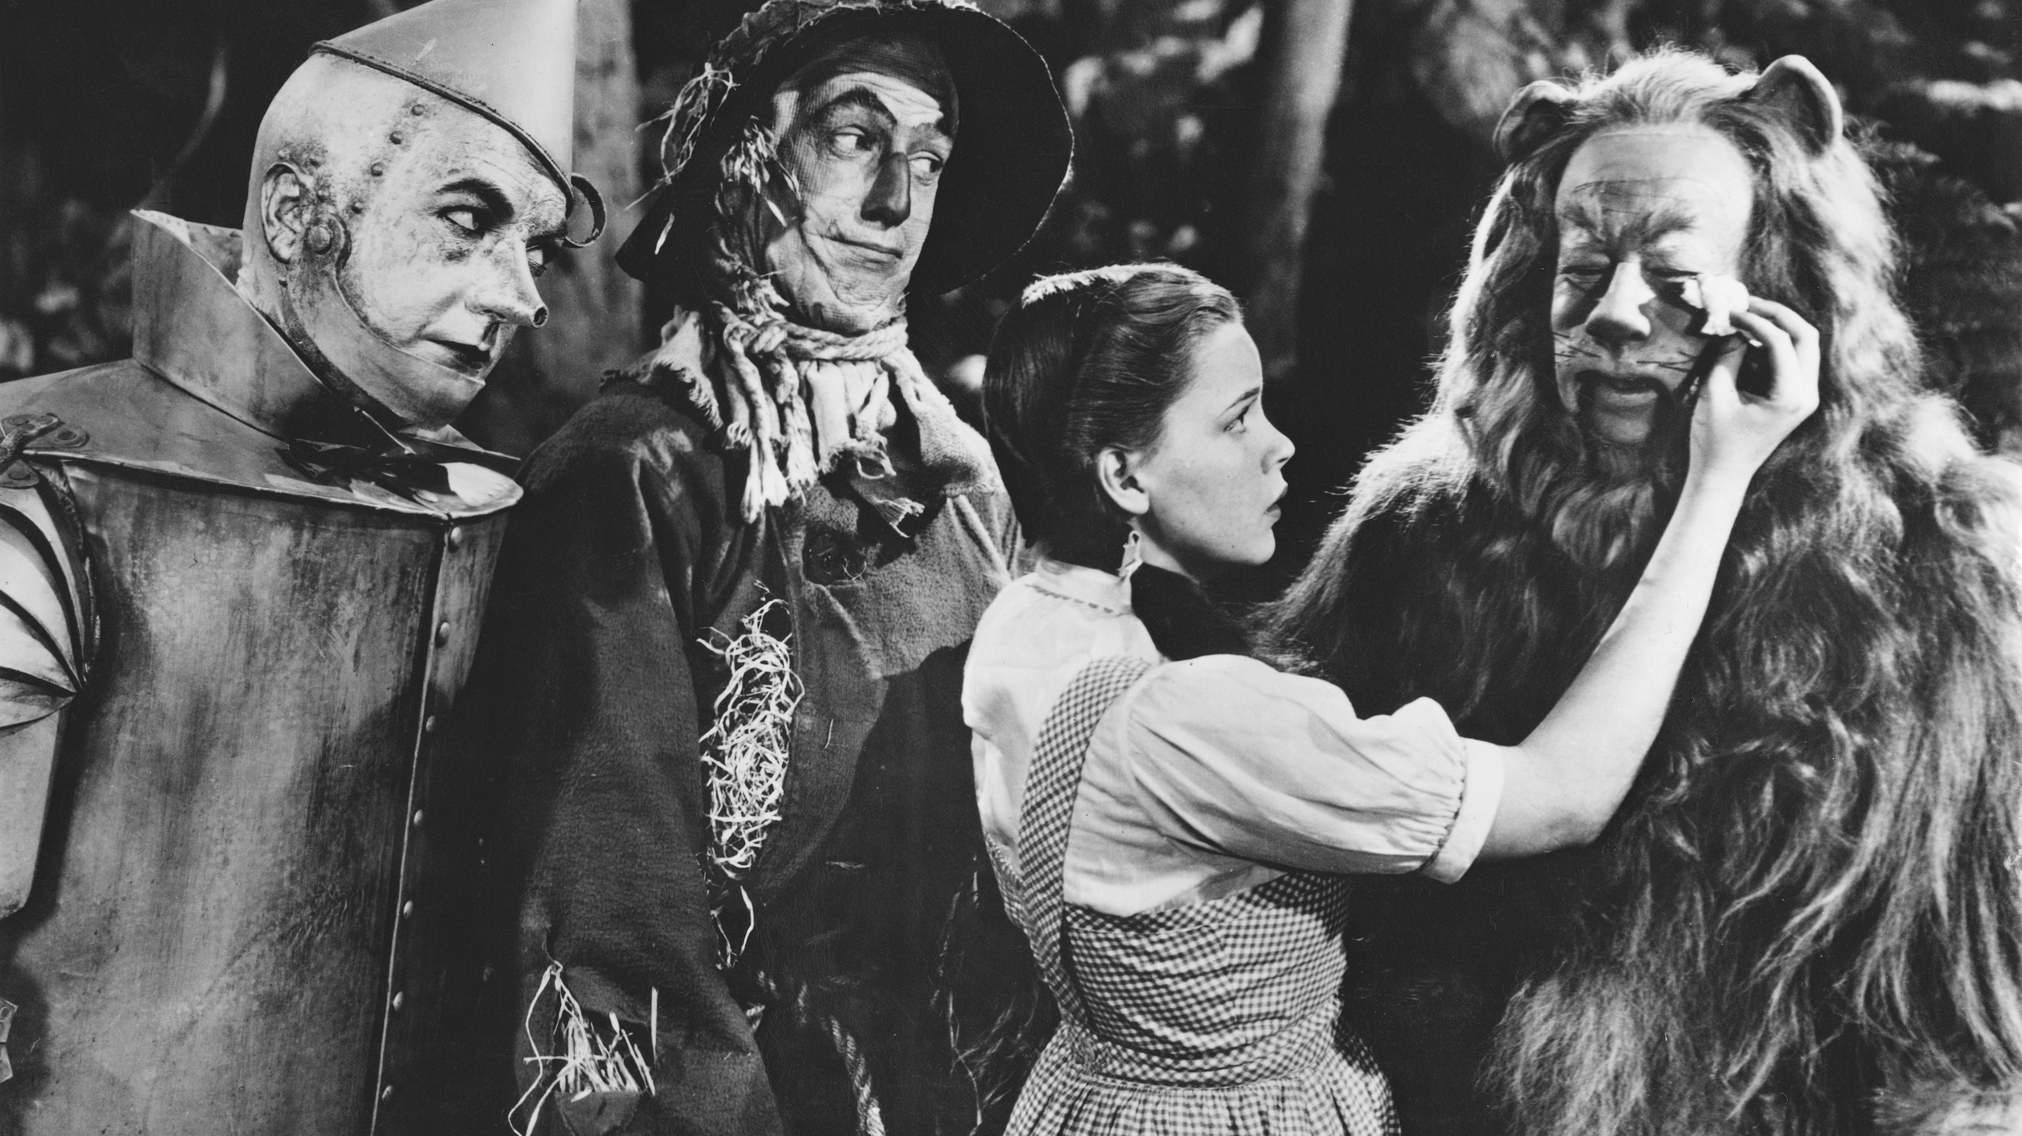
Courage to Stand Up for
The Lord & His Ways
Revelation 21:1-8

Slide 2
Cowardly Vs. Brave
John 7:1-13
John 18:19-21
Acts 5:27-28
Acts 16:19-20
Acts 17:4-6
Cf. Acts 4:19-20; 5:29-33, 40-42; Mt. 10:27; 2 Tim. 1:7-8

Slide 3
Cowardly Vs. Brave
John 9:18-23
John 12:42-43
Acts 18:6-8
Cf. Lk. 9:23-26; 12:8-9; 1 Pet. 3:15

Slide 4
Courage to Stand Up for
The Lord & His Ways
Revelation 21:1-8

