Slide 1
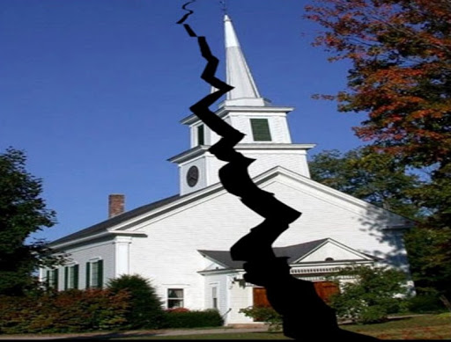
Greatest Threats Facing the Local Church
Revelation 2-3

Slide 2
Threats Facing the Local Church
Losing Motive (Rev. 2:4-5)
Tolerating False Doctrine (Rev. 2:13-16)
Tolerating Evil (Rev. 2:20-25)
Emphasizing the Superficial; Spiritual Atrophy (Rev. 3:1-3)
Getting Complacent (Rev. 3:15-19)

Slide 3
Commendations of Jesus
There will be some necessary enduring and overcoming of hardships (Rev. 2:7, 11, 17, 26; 3:5, 12, 21).
True strength comes when we keep the Lord’s word. Remember Who is in control (Rev. 1:1-20)!
The lessons of God’s word apply to all (Rev. 2:7a, 11a, 17a, 29a; 3:6a, 13a, 22a).

Slide 4

John 3:3-5
³ Jesus answered and said to him, "Most assuredly, I say to you, unless one is born again, he cannot see the kingdom of God." ⁴ Nicodemus said to Him, "How can a man be born when he is old? Can he enter a second time into his mother's womb and be born?" ⁵ Jesus answered, "Most assuredly, I say to you, unless one is born of water and the Spirit, he cannot enter the kingdom of God.”
(NKJV)

