Slide 1
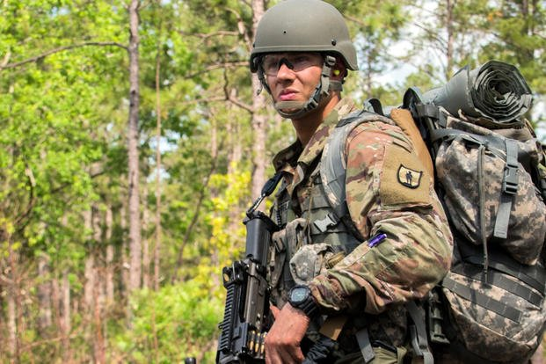

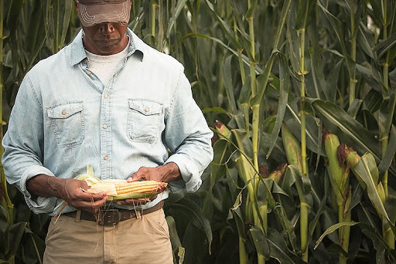
Hold Fast the Pattern of Sound Words
~ 2 Timothy 1:13; 2:1-13

Slide 2
You therefore must endure hardship as a good soldier of Jesus Christ. ⁴ No one engaged in warfare entangles himself with the affairs of this life, that he may please him who enlisted him as a soldier. ⁵ And also if anyone competes in athletics, he is not crowned unless he competes according to the rules. ⁶ The hard-working farmer must be first to partake of the crops.
~ 2 Tim 2:3-6 (NKJV)

Slide 3
You therefore must endure hardship as a good soldier of Jesus Christ. ⁴ No one engaged in warfare entangles himself with the affairs of this life, that he may please him who enlisted him as a soldier. ⁵ And also if anyone competes in athletics, he is not crowned unless he competes according to the rules. ⁶ The hard-working farmer must be first to partake of the crops.
~ 2 Tim 2:3-6 (NKJV)

Slide 4
You therefore must endure hardship as a good soldier of Jesus Christ. ⁴ No one engaged in warfare entangles himself with the affairs of this life, that he may please him who enlisted him as a soldier. ⁵ And also if anyone competes in athletics, he is not crowned unless he competes according to the rules. ⁶ The hard-working farmer must be first to partake of the crops.
~ 2 Tim 2:3-6 (NKJV)

Slide 5
You therefore must endure hardship as a good soldier of Jesus Christ. ⁴ No one engaged in warfare entangles himself with the affairs of this life, that he may please him who enlisted him as a soldier. ⁵ And also if anyone competes in athletics, he is not crowned unless he competes according to the rules. ⁶ The hard-working farmer must be first to partake of the crops.
~ 2 Tim 2:3-6 (NKJV)

Slide 6
2 Timothy 2:7-13 (NKJV)
Consider what I say, and may the Lord give you understanding in all things. ⁸ Remember that Jesus Christ, of the seed of David, was raised from the dead according to my gospel, ⁹ for which I suffer trouble as an evildoer, even to the point of chains; but the word of God is not chained. ¹⁰ Therefore I endure all things for the sake of the elect, that they also may obtain the salvation which is in Christ Jesus with eternal glory. ¹¹ This is a faithful saying: For if we died with Him, We shall also live with Him. ¹² If we endure, We shall also reign with Him. If we deny Him, He also will deny us. ¹³ If we are faithless, He remains faithful; He cannot deny Himself.

Slide 7
2 Timothy 2:7-13 (NKJV)
Consider what I say, and may the Lord give you understanding in all things. ⁸ Remember that Jesus Christ, of the seed of David, was raised from the dead according to my gospel, ⁹ for which I suffer trouble as an evildoer, even to the point of chains; but the word of God is not chained. ¹⁰ Therefore I endure all things for the sake of the elect, that they also may obtain the salvation which is in Christ Jesus with eternal glory. ¹¹ This is a faithful saying: For if we died with Him, We shall also live with Him. ¹² If we endure, We shall also reign with Him. If we deny Him, He also will deny us. ¹³ If we are faithless, He remains faithful; He cannot deny Himself.

Slide 8
2 Timothy 2:7-13 (NKJV)
Consider what I say, and may the Lord give you understanding in all things. ⁸ Remember that Jesus Christ, of the seed of David, was raised from the dead according to my gospel, ⁹ for which I suffer trouble as an evildoer, even to the point of chains; but the word of God is not chained. ¹⁰ Therefore I endure all things for the sake of the elect, that they also may obtain the salvation which is in Christ Jesus with eternal glory. ¹¹ This is a faithful saying: For if we died with Him, We shall also live with Him. ¹² If we endure, We shall also reign with Him. If we deny Him, He also will deny us. ¹³ If we are faithless, He remains faithful; He cannot deny Himself.

Slide 9
2 Timothy 2:7-13 (NKJV)
Consider what I say, and may the Lord give you understanding in all things. ⁸ Remember that Jesus Christ, of the seed of David, was raised from the dead according to my gospel, ⁹ for which I suffer trouble as an evildoer, even to the point of chains; but the word of God is not chained. ¹⁰ Therefore I endure all things for the sake of the elect, that they also may obtain the salvation which is in Christ Jesus with eternal glory. ¹¹ This is a faithful saying: For if we died with Him, We shall also live with Him. ¹² If we endure, We shall also reign with Him. If we deny Him, He also will deny us. ¹³ If we are faithless, He remains faithful; He cannot deny Himself.

Slide 10
2 Timothy 2:7-13 (NKJV)
Consider what I say, and may the Lord give you understanding in all things. ⁸ Remember that Jesus Christ, of the seed of David, was raised from the dead according to my gospel, ⁹ for which I suffer trouble as an evildoer, even to the point of chains; but the word of God is not chained. ¹⁰ Therefore I endure all things for the sake of the elect, that they also may obtain the salvation which is in Christ Jesus with eternal glory. ¹¹ This is a faithful saying: For if we died with Him, We shall also live with Him. ¹² If we endure, We shall also reign with Him. If we deny Him, He also will deny us. ¹³ If we are faithless, He remains faithful; He cannot deny Himself.

Slide 11
2 Timothy 2:7-13 (NKJV)
Consider what I say, and may the Lord give you understanding in all things. ⁸ Remember that Jesus Christ, of the seed of David, was raised from the dead according to my gospel, ⁹ for which I suffer trouble as an evildoer, even to the point of chains; but the word of God is not chained. ¹⁰ Therefore I endure all things for the sake of the elect, that they also may obtain the salvation which is in Christ Jesus with eternal glory. ¹¹ This is a faithful saying: For if we died with Him, We shall also live with Him. ¹² If we endure, We shall also reign with Him. If we deny Him, He also will deny us. ¹³ If we are faithless, He remains faithful; He cannot deny Himself.

Slide 12

Galatians 3:26-29
~ For you are all sons of God through faith in Christ Jesus. ²⁷ For as many of you as were baptized into Christ have put on Christ. ²⁸ There is neither Jew nor Greek, there is neither slave nor free, there is neither male nor female; for you are all one in Christ Jesus. ²⁹ And if you are Christ's, then you are Abraham's seed, and heirs according to the promise.

Slide 13
Galatians 3:26-29
~ For you are all sons of God through faith in Christ Jesus. ²⁷ For as many of you as were baptized into Christ have put on Christ. ²⁸ There is neither Jew nor Greek, there is neither slave nor free, there is neither male nor female; for you are all one in Christ Jesus. ²⁹ And if you are Christ's, then you are Abraham's seed, and heirs according to the promise.

Slide 14
Galatians 3:26-29
~ For you are all sons of God through faith in Christ Jesus. ²⁷ For as many of you as were baptized into Christ have put on Christ. ²⁸ There is neither Jew nor Greek, there is neither slave nor free, there is neither male nor female; for you are all one in Christ Jesus. ²⁹ And if you are Christ's, then you are Abraham's seed, and heirs according to the promise.

