Slide 1

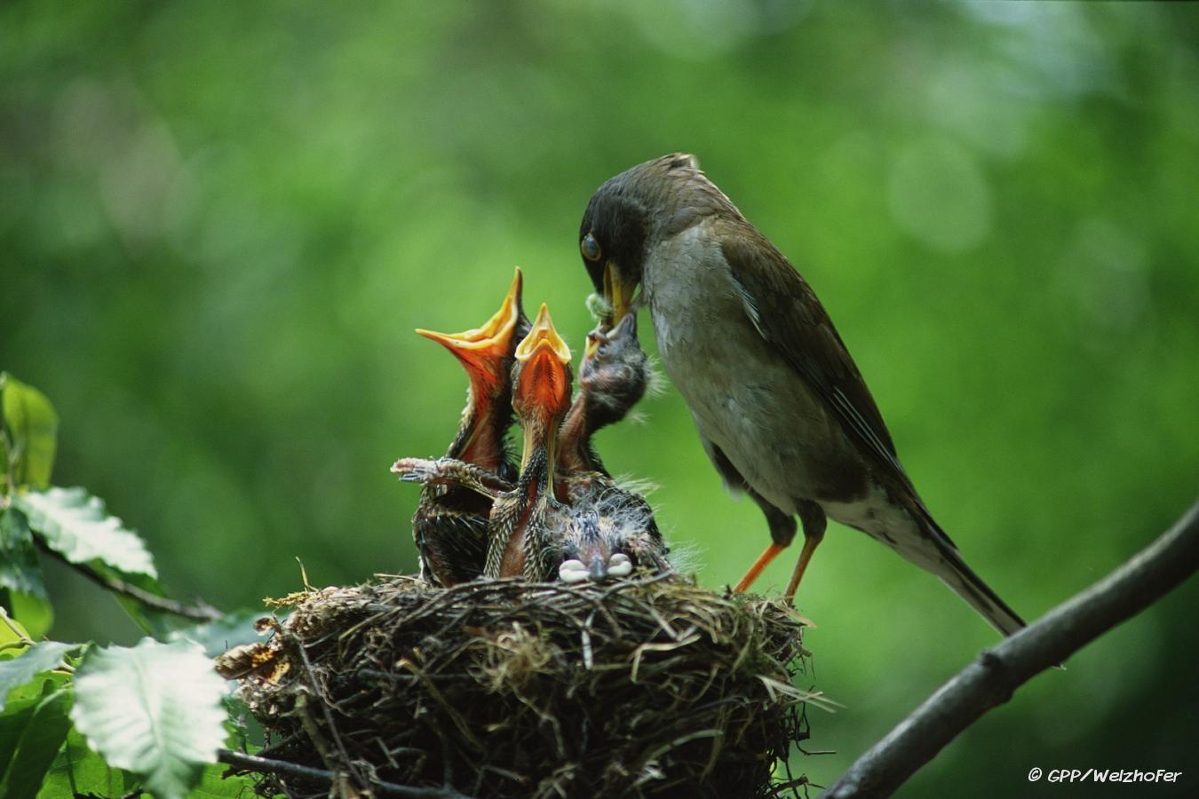
Jesus and Material Things
Luke 9:58

Slide 2



Jesus had none of this world’s goods
It did not depress Him (Mt. 6:33; Jn. 4:34)
It did not make Him feel sorry for Himself (Lk. 12:15, 21; Ps. 2:8; Heb. 12:1-2)
It did not embitter Him (Mt. 19:16-30; 6:19-20)
His happiness & satisfaction did not depend upon material things (Mt. 6:24-34; Jn. 17:4-5)

Slide 3
Jesus and Material Things
We can learn a great deal about material things from Jesus.
  We should avoid the connection of our feeling of self-worth to our possessions.
  Instead of feeling sorry for ourselves, we should be grateful to God for what we do have.
  We should not be bitter when we have problems with material things, and we need to learn to find our happiness & satisfaction in our hope of heaven and in what we are able to accomplish in this life.

Slide 4

Only Those who obey God will receive salvation from sin (Mt. 7:21; Heb. 5:9).
You must hear/read the gospel of Jesus Christ (Rom. 10:14,17).
You must believe in Jesus Christ (Acts 16:30-33).
You must repent of all your past sins (Acts 17:30-31).
You must confess your faith in Jesus Christ (Acts 8:35-37).
You must be baptized (immersed in water) into Jesus Christ (Acts 8:38; 22:16).
After becoming saved, you must live a faithful/righteous life to remain saved (1 Tim. 4:16; 1 Jn. 1:7).
Eternal life in heaven awaits only those who are faithful/righteous (1 Pet. 1:3-5; Mt. 25:34).

Slide 5
Jesus and Material Things
Luke 9:58

