Slide 1



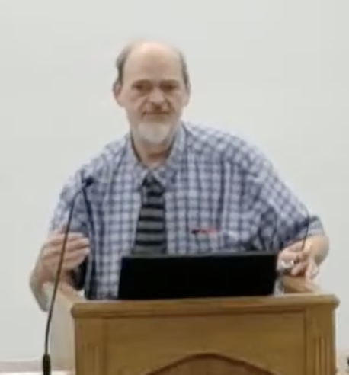
“Church of Christ MEETING @ 100 CORNERSTONE, Alexander AR. 72002”
TODAY’S LESSON
Sunday Morning Stream
10:00 AM ^{CT} November 8, 2026
https://www.youtube.com/user/donmcclain11/live / WWW.ALEXANDERCHURCHOFCHRIST.COM

Slide 2
PERFECT HEART
VS.
PERFECT PERFORMANCE
1 SAMUEL 16:7

Slide 3
David, a Man After God’s Own Heart
Saul was first king of Israel 1 Samuel 8-10
Started well (humble, faithful) 1 Sm 11-12
Started living with foolish fear 1 Sm 13-14
Rejected God’s word, God Himself 1 Sm 15
The LORD rejected Saul as king
The LORD selected a man after His own heart 1 Sm 16
God looks at the heart, not physical details

Slide 4
Contrast Between David and Saul
Saul rejected the Lord, so the Spirit of the Lord departed from Saul 1 Sm 16:14
The Spirit of the Lord was now with David 1 Sm 16:13 when anointed (see Jesus in John 1:29-34; see Acts 10:38)
Saul now has a distressing spirit
David, with the Spirit, plays music and drives away the distressing spirit (see Jesus in Matthew 15:21-28)

Slide 5
Contrast Between David and Saul
Battle at Valley of Elah 1 Sm 17
Giant Goliath taunted Israel v.8-11
Taunted Israel (the LORD’s people) for 40 days; all fled 2x daily (morning and evening v.16)
David obediently took food for the unit where his oldest three brothers were part v.12-22
Then Goliath taunted Israel for the 81st time

Slide 6
Contrast Between David and Saul
David can’t believe that Israel is letting this heathen defy God’s people (army) v.23
And Israelites are running away! v.24
They informed David of the reward for whoever defeats Goliath v.25
David is intrigued and asks others v.26-27
David gets resistance from his oldest brother v.28 (like Jesus in John 7:1-8)
Word reaches Saul! Somebody willing! v.31

Slide 7
Contrast Between David and Saul
Saul seemed to be disappointed v.33
David told Saul,“Let no man’s heart fail because of him.” (Goliath) “I will fight against him.”
Saul said, “Go, and the LORD be with you.”
Saul then put his armor on David (Saul’s helmet of bronze and coat of mail); he tried them but refused to use them v.38-39
David came as a shepherd with faith, staff and sling; picked up 5 smooth stones v.40

Slide 8
Contrast Between David and Saul
Compare how Goliath was equipped v.4-7
Bronze helmet (like the one David tried)
Coat of mail (NASB “scale mail armor”) = 5000 shekels (125 lbs.) of bronze Ezekiel 29:4 dragon’s scales
Bronze bracers on his legs
Bronze javelin on his back
Spear handle as thick as a weaver’s beam with an iron spearhead that weighed 600 shekels (15 lbs.)

Slide 9
Serpent and Bronze in Hebrew
SERPENT
BRONZE
נָחָשׁ
נְחֹשֶׁת
nāḥāsh
neḥoshet
Genesis 3:1
1 Samuel 17:5,38
Both words from the same root of consonants נָחָשׁ (nun, ḥet, shin).
Notes:
Base dictionary forms are shown, without cantillation marks. Genesis 3:1 has וְהַנָּחָשׁ, “and the serpent.” The words share the consonants nun, het, shin. They are distinct words, and shared letters alone do not establish a theological connection. Brass/bronze also occurs in 1 Samuel 17:38, not 17:28. Sources: https://biblehub.com/hebrew/strongs_5175.htm ; https://biblehub.com/hebrew/strongs_5178.htm ; https://bam.sites.uiowa.edu/RTL/nahash ; https://biblehub.com/interlinear/1_samuel/17-28.htm

Slide 10
Contrast Between David and Saul
This is a picture of Genesis 3:15 that was fulfilled by Jesus against Satan John 12:27-34; Revelation 12:7-11.
David is the ancestor of Jesus Christ.
Goliath had a coat of mail (Hebrew word QASQESETH, literally “scales” in every other place in the Old Testament Leviticus 11 fish scales, Ezekiel 29:3-4 dragon scales, etc.) Rev. 12:1-11

Slide 11
Contrast Between David and Saul
Goliath viewed David contemptuously v.42-45 felt insulted
David responded with glory to God: “You come with javelin, spear, and sword, but I come to you in the name of the LORD.” Psalm 118:26 all about Jesus
Everyone here (winners and losers) will know that the battle is the LORD’s

Slide 12
Contrast Between David and Saul
David killed Goliath with one stone to the head
Goliath fell face down dead (ate dust; on his belly) Genesis 3:15 indeed foreshadowed the serpent’s defeat John 12:23-33; Rev. 12:7-11
David cut his head off as he said
Then the Philistines fled
Then the Israelites pursued the Philistines

Slide 13
Do you see in David What God Saw?
Living in bold faith
Desire to praise Him Deuteronomy 10:27
Love for God Psalm 101:1
Love for His will Psalm 101:2
Hatred for sin Psalm 101:3
Hatred for God’s enemies Psalm 101:4-5
Love for God’s people Psalm 101:6
True trust in God Psalm 37:1-11

Slide 14
We Are Who We Are Because of Who God Is
Titus 3:1-8
Saved for a purpose Titus 2:11-15; 1 Peter 2:9-10
God is looking for our hearts
His commands are for our benefit
His commands are for His glory
Obey the gospel Mark 16:16; Acts 2:38
Repent and pray if your heart is not right before God Acts 8:24

Slide 15
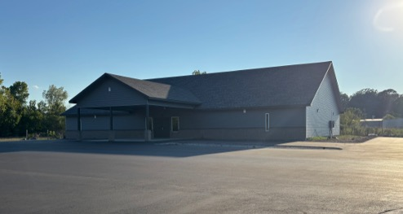

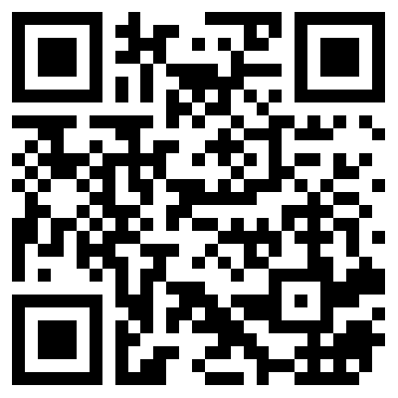
100 CORNERSTONE ALEXANDER AR, 72002
You Are Welcome At Any And All of Our Services!
Meeting Times:
Sunday A.M. Bible Study: 9:00
Sunday A.M. Assembly: 10:00
Sunday P.M. Assembly: 4:00
Wed. P.M. Bible Study: 7:00
ALEXANDERCHURCHOFCHRIST.COM

